Slide 1
Article Text Categorization

Slide 2
Introduction
Data Preprocessing
Unsupervised Model
NLP Text Categorization
Model Training
Supervised Model
Evaluation

Slide 3
Dataset
The dataset which we have used is BBC news dataset
Public dataset from the BBC comprised of 2225 articles, each labeled under one of 5 categories: business, entertainment, politics, sport or tech. The dataset is broken into 1490 records for training and 735 for testing.
Split ratio: Training 60, test 40

Slide 4
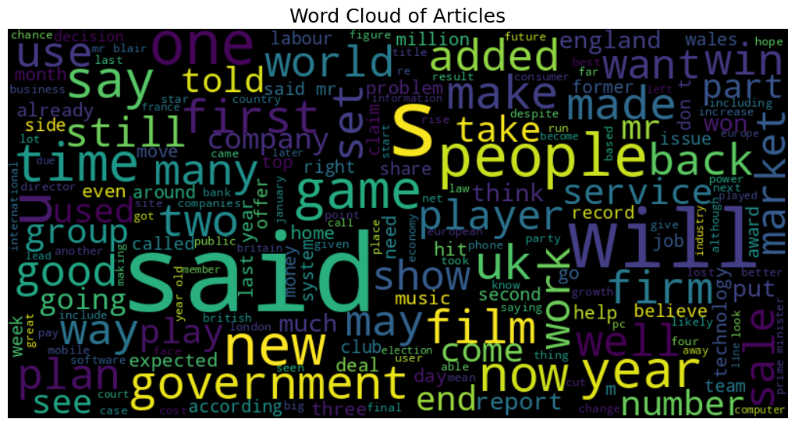

Slide 5
Data Preprocessing
Remove duplicates
Convert to lower case
Data Preprocessing
TF IDF
Remove punctuation
Text Preprocessing
Remove stopwords
Stemming

Slide 6
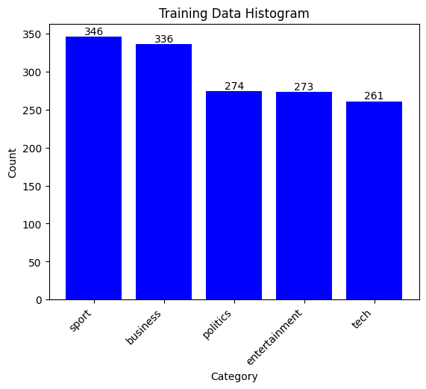
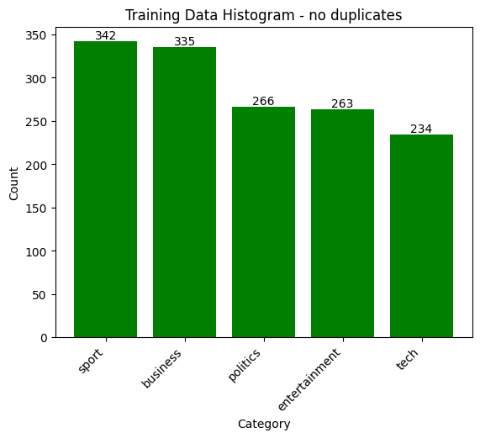
Data pre-processing
Removing repeated articles
Tokenization
Document length
Stemming
n grams
stop words
maximum and minimum document frequency
lower cases
Punctuations
numbers

Slide 7
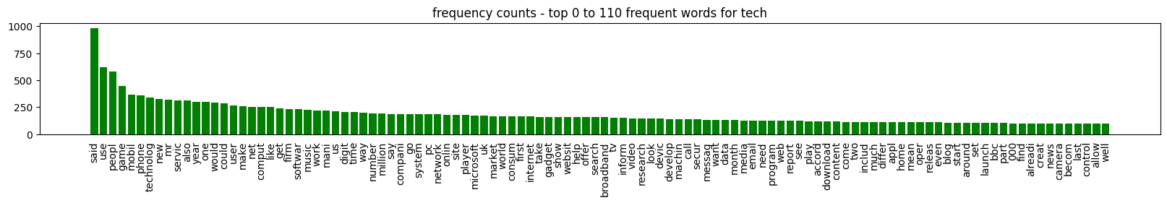
Top 110 frequent words in each category after some word pre-processing

Slide 8
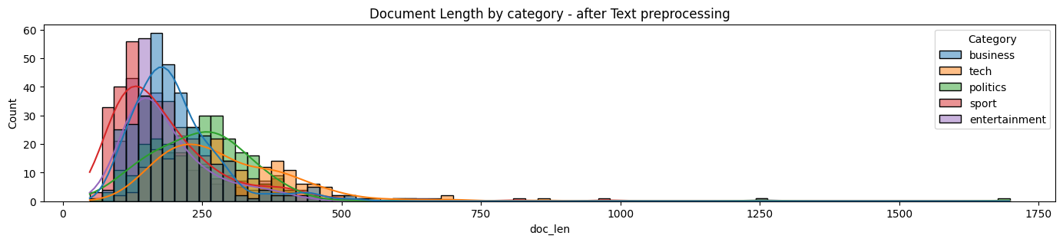
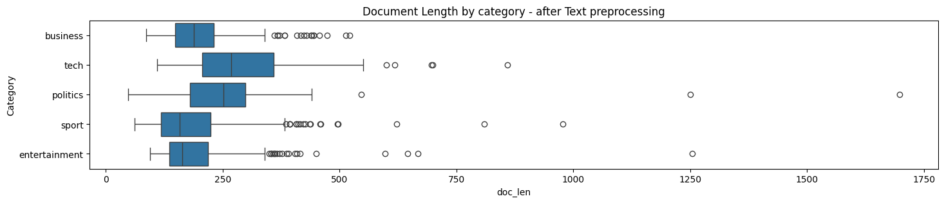
Data pre-processing
Removing repeated articles
Tokenization
Document length
Stemming
n grams
stop words
maximum and minimum document frequency
lower cases
Punctuations
numbers

Slide 9
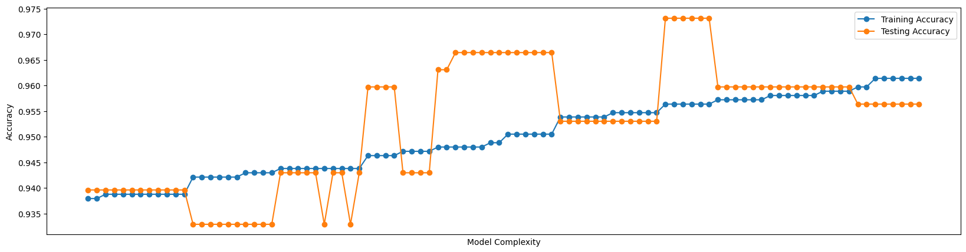
Unsupervised Model Training and Testing Accuracies

Slide 10
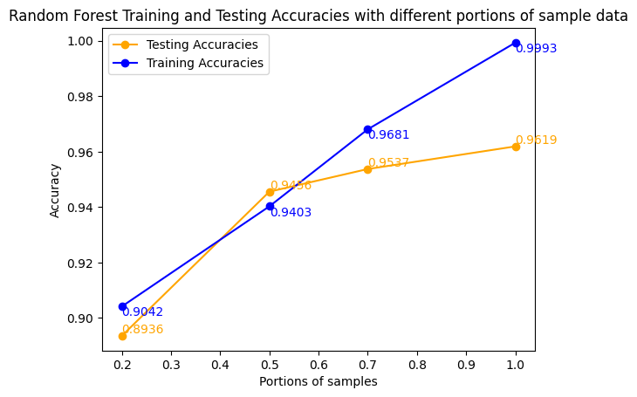
Supervised Model Training and Testing Accuracies

Slide 11
Conclusion
The training accuracy of random forest with grid search training is 100%. The testing accuracy is 0.9619.
The training accuracy of my best NMF with tunning is 95%. The testing accuracy is 0.967315.
The goal is to choose the best model to predict unseen data, so NMF performs better (on testing data).
For training data, random forest is clearly more overfitting since it has higher (than NMF) training accuracy but lower (than NMF) testing accuracy than the NMF model.
In conclusion, NMF outperforms random forest in test accuracy, avoid overfitting, and efficient use of labeled data

Slide 12
Thank You

