Slide 1
IoT · EDGE AI · BIOMETRICS
Iris Biometric
Access Control System
A production-grade edge-to-cloud security platform — on-device iris matching, anomaly detection, and an AI agent alert loop across ESP32, Firebase & AWS.
ESP32-CAM
Edge inference
TinyML
Ambient risk
AWS Bedrock
AI alert agent
Firebase
Realtime sync

Slide 2
SYSTEM OVERVIEW
01
Three layers, one secure access loop
EDGE
CLOUD
FRONTEND
ESP32-CAM Firmware
Firebase + AWS
Web Dashboard
› Captures iris → 64-element descriptor
› On-device matching vs SPIFFS templates
› Sliding-window anomaly scorer
› Relay / LED actuation + TinyML monitor
› Firebase RTDB: state, sign-ins, users
› AWS IoT Core routes alerts via Rules
› Lambda → Bedrock Agent → SNS
› ACK published back to device
› Live sign-in logs & enrolled users
› Security alerts + ambient charts
› Enrollment command panel
› Manual relay override (5-min expiry)

Slide 3
WHY IRIS?
02
What you actually get out of it
Privacy by design
Your iris template never leaves the device. There's no central face database in the cloud to be breached, sold, or subpoenaed.
You're never locked out
Recognition fails? Fall back to a PIN on the keypad, then a one-time QR code emailed to an authorised person's phone.
It sees attacks, not just logins
Spoof attempts and brute-force are flagged in real time with an anomaly score — a replayed photo lights up at 100%.
AI triages the noise
A Bedrock agent decides which anomalies are worth a human's attention and notifies you — instead of 50 raw alerts a day.
Cheap, off-the-shelf hardware
Built on a ~$10 ESP32-CAM and common modules — not a proprietary $500 reader locked to one vendor.
Every attempt is on the record
Full audit trail: who, when, match score, deny reason, and anomaly % — exportable and searchable from the dashboard.

Slide 4
WHO IT'S FOR
03
One door, three ways in — no one gets stranded
1
2
3
Look at the camera
Iris is matched on-device in under a second. Score below 0.30 → door unlocks, logged as ✓ Granted.
Lighting bad? Use your PIN
Press * on the keypad and enter a 4-digit code to unlock the access panel — a built-in second factor.
Visitor or emergency? QR code
Generate a one-time QR code, emailed to an authorised recipient. They show it on their phone; the camera scans it.
BUILT FOR
Offices & co-working
Front-door access without badges to lose
Labs & server rooms
High-security zones with full audit trails
Small business / home
Affordable smart-lock with attack detection
Multi-site fleets
Same hardware, central dashboard, auto-discovery

Slide 5
ARCHITECTURE
04
Edge-to-cloud data flow
Firebase RTDB
devices · signins · users · alerts
TOPICS
iot/{thing}/biometric/signin
iot/{thing}/biometric/alert
iot/{thing}/ai/alerts
ESP32-CAM Node
Iris capture · matching · anomaly · TinyML
HTTPS / MQTT-TLS
AWS IoT Core
Rules → Lambda → Bedrock Agent
SNS
User Notification
+ ACK back to device
Web Dashboard
logs · alerts · charts · controls

Slide 6
BIOMETRIC PIPELINE
05
From photons to a pass / fail decision
1
Capture
OV2640 grayscale frame, 160×120, JPEG-decoded
WHY 8×8 ZONAL?
Zero external dependencies
Fits on-chip SRAM
No segmentation needed
Production path: Gabor wavelets or a CNN embedding (AWS Rekognition).
2
Extract
8×8 zonal grid → mean intensity → float[64]
3
Match
Normalised RMS distance vs ≤5 templates/user
4
Decide
score < 0.30 → PASS · else REJECTED

Slide 7
ANOMALY DETECTION
06
Catching brute-force & spoofing in real time
score = 0.40 × failure_rate + 0.35 × score_proximity + 0.25 × frequency_spike
0.40
failure_rate
Fraction of failed attempts in the 20-event window
0.35
score_proximity
A match just below threshold ⇒ likely partial replay
0.25
frequency_spike
> 5 events in 60 s → 1.0
Exceed anomalyScoreThreshold (0.60) → AlertManager fires to AWS IoT + Firebase, with 30 s duplicate suppression.

Slide 8
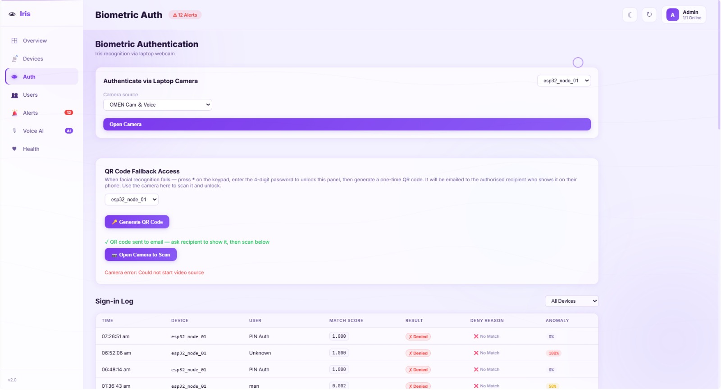
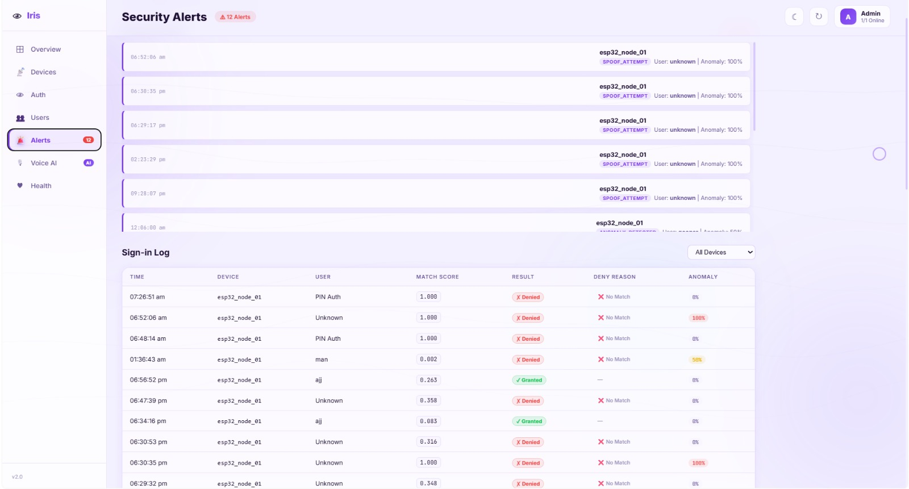
THE DASHBOARD
07
See every sign-in and threat, live
Auth & QR fallback — authenticate, or issue a one-time code
Security alerts — spoof attempts flagged at 100% anomaly
Spoof attempts, brute-force and granted/denied results stream in real time — each row carries match score, deny reason and an anomaly percentage.

Slide 9
FIRMWARE STATE MACHINE
08
Ten states, one legal transition table
INIT
CONNECTING
READY
MONITORING
ENROLLING
AUTHENTICATING
AUTHENTICATED
REJECTED
ALERT
ERROR
AUTHENTICATED → relay ON, LED solid. REJECTED → 3 fast flashes. ALERT → relay ON + fast blink. ERROR → SOS, then restart.

Slide 10
TINYML — AMBIENT MONITOR
09
A second pair of eyes on the environment
MODEL
Input(3) → Dense(16) → Dense(8) → Softmax(3)
~700 parameters
~4.2 KB TFLite model
~8 KB tensor arena on ESP32
Inputs: temperature · humidity · light
Output: normal / warning / critical
TRAINING PIPELINE
mock_data_generator.py → 5000 samples
model_training.py → Keras → TFLite
model_converter.py → C hex array
firmware → GetModel() → Invoke()
riskScore ≥ mlRiskThreshold triggers an ALERT state — secondary to biometrics, runs in the background loop.

Slide 11
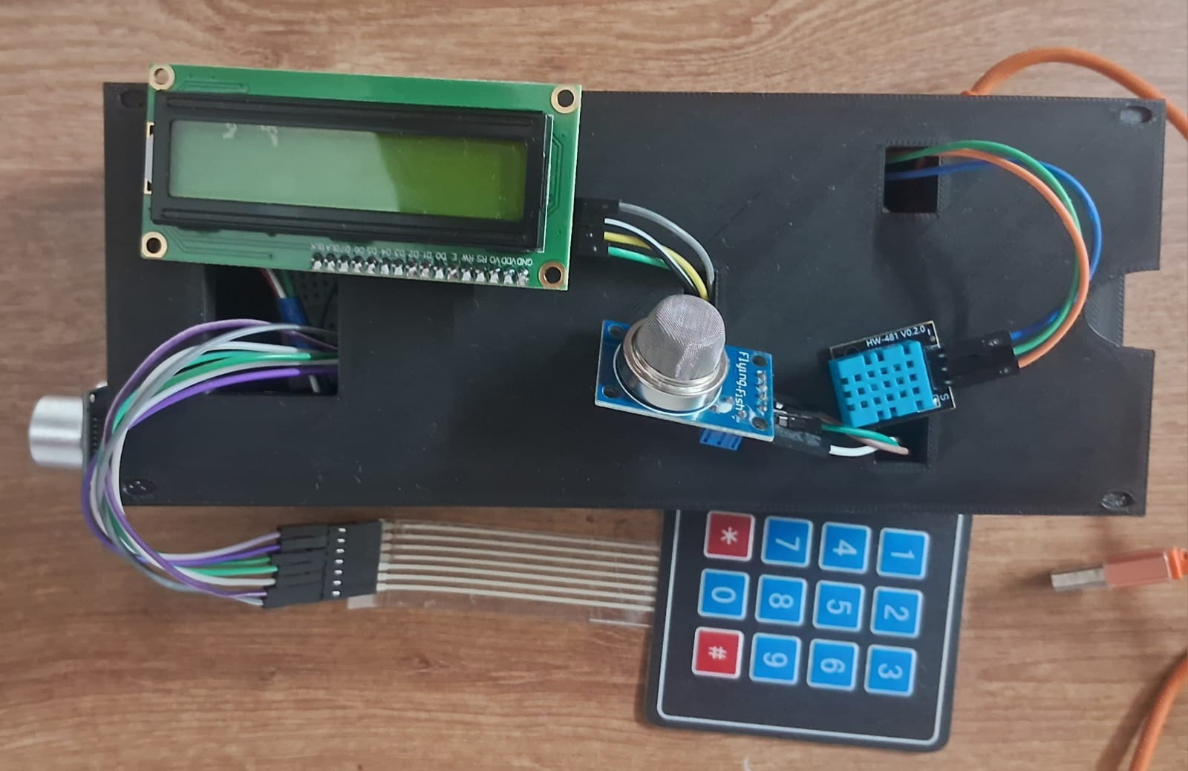
THE HARDWARE
10
Off-the-shelf parts, one custom enclosure
ESP32-CAM
Brains + iris camera, on-device matching
4×4 keypad
PIN entry & QR-panel unlock (press *)
16×2 LCD
Live status: state, prompts, results
DHT + gas sensor
Feeds the ambient TinyML risk model
Relay (door lock)
Driven by the auth result, 5-min override
Prototype node — keypad, LCD, gas & DHT sensors

Slide 12
SCALING STRATEGY
11
From 2 to 20+ devices — no schema changes
Single binary, per-device config
Flash the same firmware; only config.json in SPIFFS changes.
Auto-discovery
Dashboard's onValue('/devices') listener picks up new nodes instantly.
Read-cost control
Per-device listeners + .limitToLast(50) on sign-ins.
Template backup
Optional blob upload to Firebase Storage; restore after SPIFFS format.
OTA updates
ArduinoOTA via /devices/{id}/commands/otaUrl — templates survive.
Cloud Functions
Server-side aggregation offloads logic from devices.

Slide 13
ROADMAP
12
Where it goes next
Liveness detection
Blink challenge defeats photo replay
Thank you.
Iris Biometric Access Control
github.com/ajjajay/iot_EL
Daugman segmentation
Greatly improves FAR / FRR
CNN embeddings
Production-grade matching via Rekognition
Multi-factor (iris + PIN)
Higher security for sensitive areas

