Slide 1
Data Merging
Data Visualisation
Model Improvement
Oct 9
Oct 11
Data Cleaning
Model Building

Slide 2
Forecasting MoM sales for Walmart Retail Stores using empirical data
OBJECTIVE

Slide 3
Data Description
Macroeconomic
Weather
Holiday

Slide 4
1
Null Vaues
1
Treating Null Values

Slide 5
2
Combining Data
Holiday, Weather and Macroeconoic Data into a single Datase using Left Joun method.t
1
2
Spliting Data
Spliting Data based on product category.

Slide 6
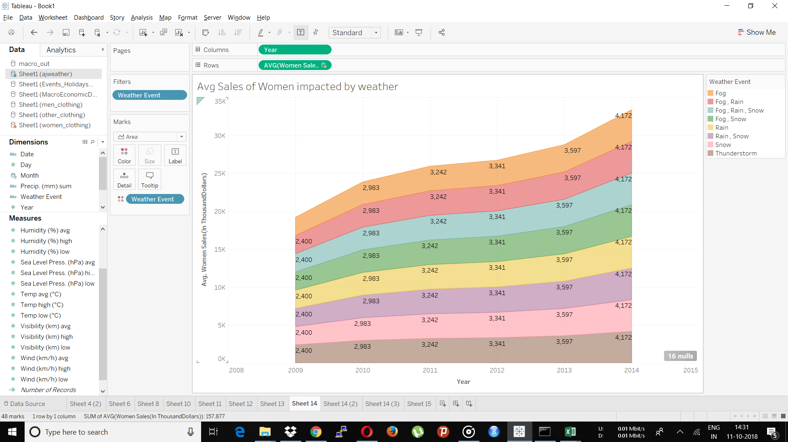

Slide 7
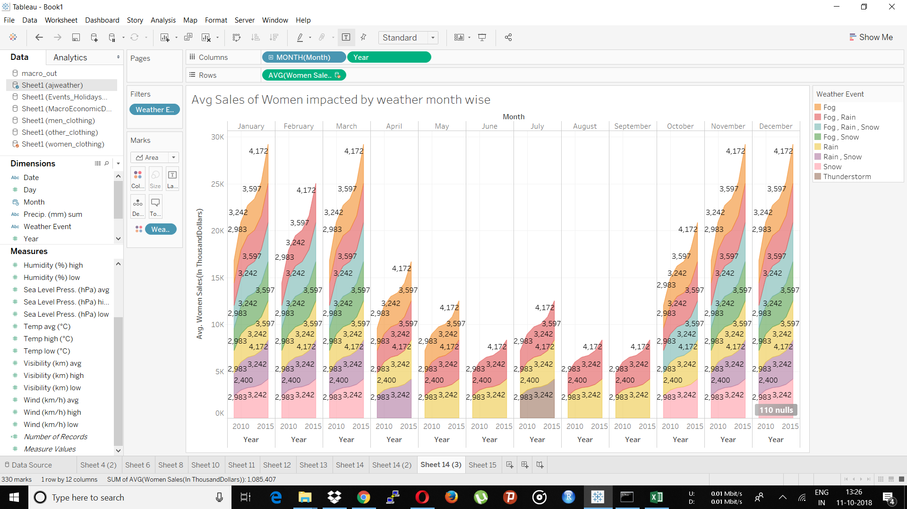
Influence of Weather on monthly Sales

Slide 8
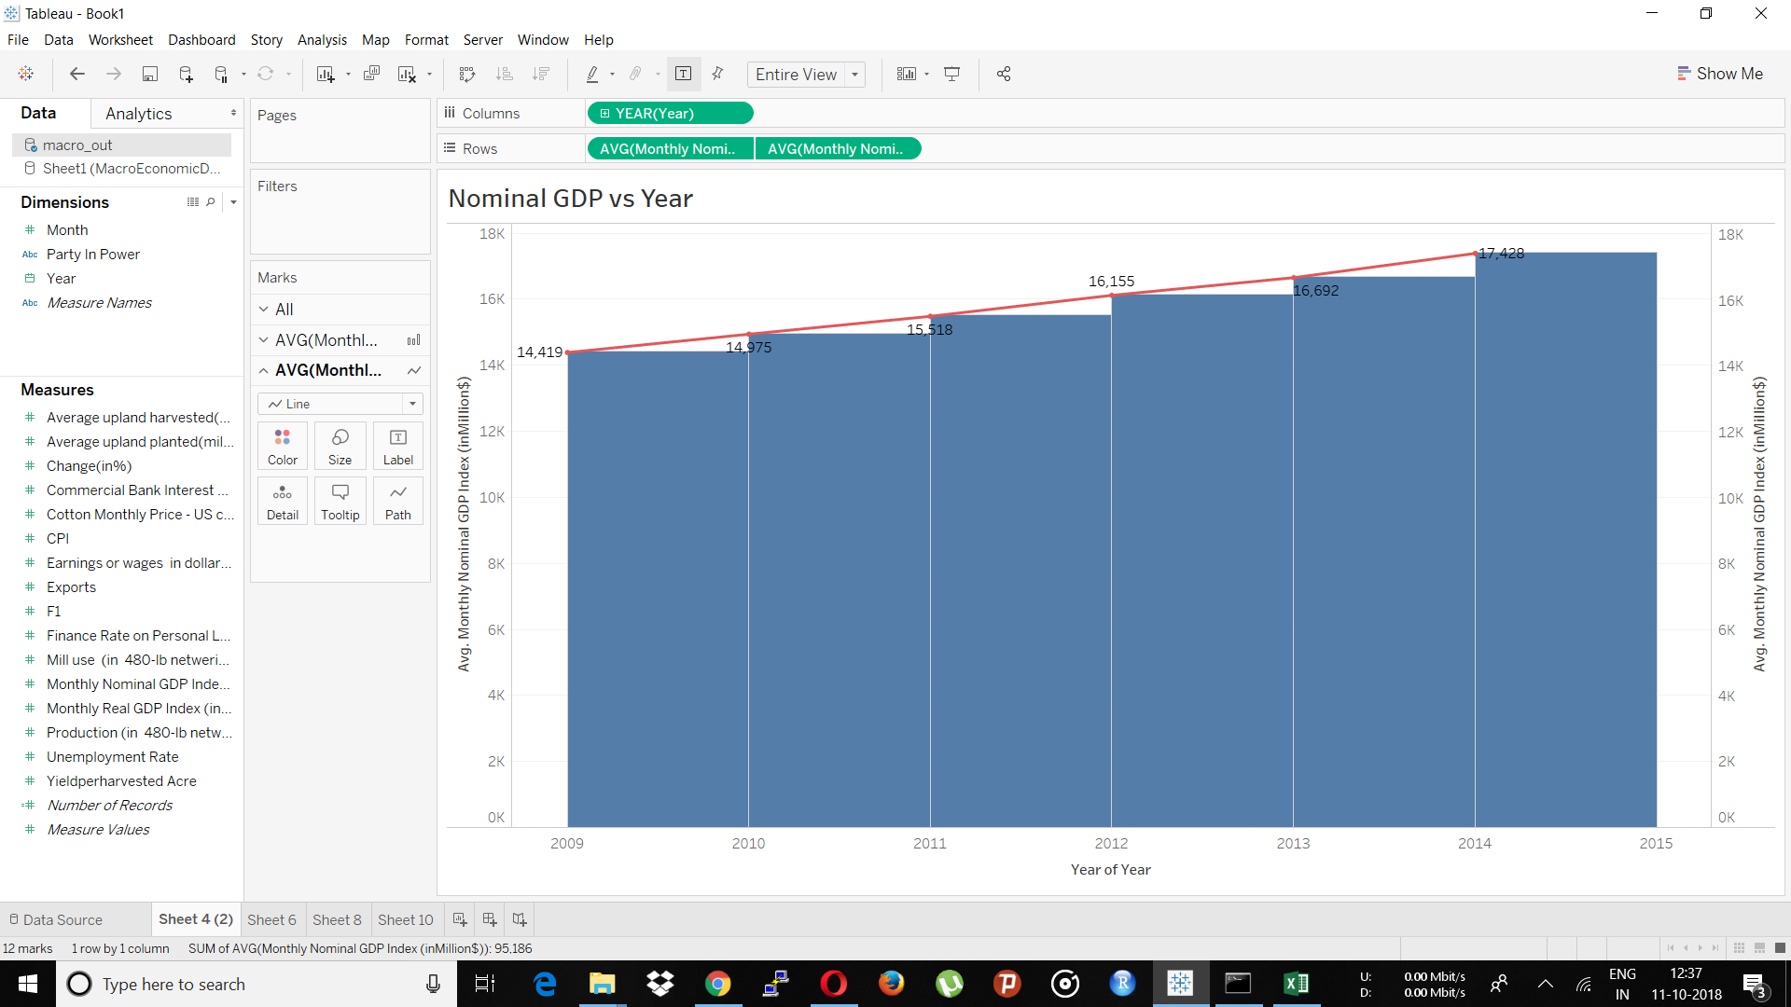
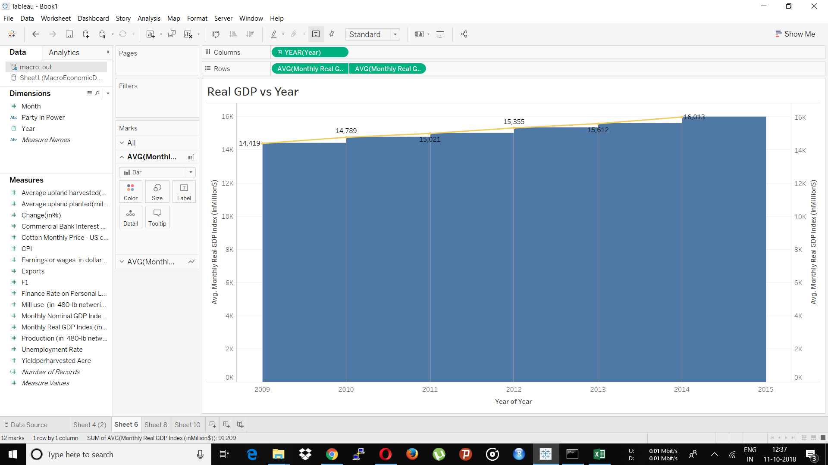
Inference:
Nominal and Real GDP increases with year.

Slide 9
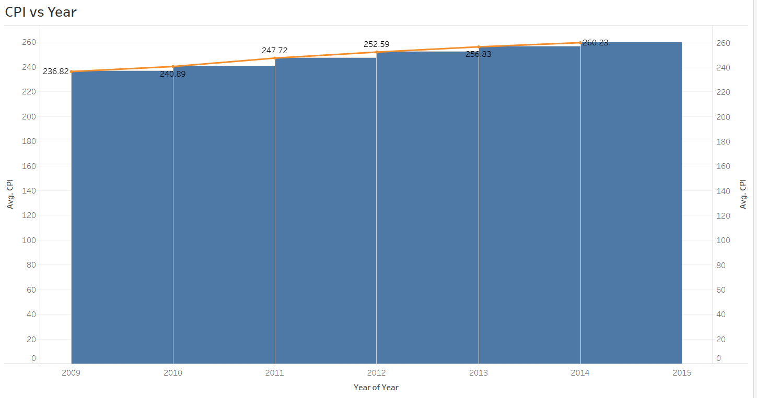
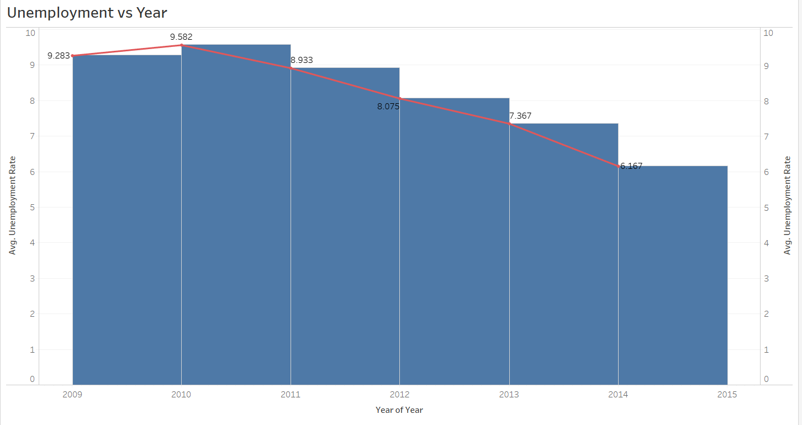
There is a increase in CPI over the years.
There is a Decrease in Unemployment over the years.

Slide 10
3
Feature Selection
1
Weather Dataset
Average weather values are used for building the model.
2
Event Dataset
Count of Federal and Event Holiday per month is aggregated.
3

Slide 11
4
Prediction
Model : Linear Regression
Test RMSE : 374.74
1
Women RMSE
2
Train : 636.37
4
3
Men RMSE
Train : 37.57
Other RMSE
Train : 175.63

Slide 12
5
Year
Improving Accuracy
2
Model : Gradient Boost
1
RMSE : 163.83
Month
3
5
Temp Low
4
Weather Event Count

Slide 13
IMPROVISATION TO MODELS WITH TIME
01
Feature Engineering
Finding important and hidden features that contribute to the sales.
02
Model Tuning & Ensemble
Try out different models and their hyper parameters and boost the RMSE using different ensemble techniques.

Slide 14
END

