Slide 1

2020
Prototype Spatial Equity Tool
Ajjit Narayanan

Slide 2
Introduction
INTRODUCTION
Governments want to make equitable policy decisions using reliable, representative data
Measuring representativeness of data is hard, time consuming, and expensive
Notes:
Both spatial and demographic representativeness

Slide 3
INTRODUCTION
Biased Algorithms
Biased Policy Decisions
Biased Data
Notes:
Work

Slide 4

INTRODUCTION
Biased Algorithms
Biased Policy Decisions
Biased Data
Notes:
Work

Slide 5
How the tool works

Slide 6

How the tool works
HOW THE TOOL WORKS
Geographic Representation Metrics
CSV with lat/lon
Spatial Equity Tool
Demographic Representation Metrics

Slide 7

How the Tool Works
HOW THE TOOL WORKS
Geocode the dataset to a specific city
Pull geographic and demographic data for that city
Compute which Census tract each data point falls into
Calculate spatial equity metrics
Calculate demographic equity metric
Assess statistical significance of our equity metrics
Washington DC

Slide 8

How the Tool Works
HOW THE TOOL WORKS
Geocode the dataset to a specific city
Pull geographic and demographic data for that city
Compute which Census tract each data point falls into
Calculate spatial equity metrics
Calculate demographic equity metric
Assess statistical significance of our equity metrics
Tool
American Community
Survey

Slide 9
How the Tool Works
HOW THE TOOL WORKS
Geocode the dataset to a specific city
Pull geographic and demographic data for that city
Compute which Census tract each data point falls into
Calculate spatial equity metrics
Calculate demographic equity metric
Assess statistical significance of our equity metrics

Slide 10
How the Tool Works
HOW THE TOOL WORKS
Geocode the dataset to a specific city
Pull geographic and demographic data for that city
Compute which Census tract each data point falls into
Calculate spatial equity metrics
Calculate demographic equity metric
Assess statistical significance of our equity metrics
40% of Data
10% of Population
30%

Slide 11

How do we measure representation in data?
HOW THE TOOL WORKS
Need ‘ground truth’ dataset to compare to
We use population density from ACS (Imperfect but useful)
Planning to add other baseline datasets in the future

Slide 12


How the Tool Works
HOW THE TOOL WORKS
Geocode the dataset to a specific city
Pull geographic and demographic data for that city
Compute which Census tract each data point falls into
Calculate spatial equity metrics
Calculate demographic equity metric
Assess statistical significance of our equity metrics
40% of Data
10% of Pop
50% White
50% White
All tracts
All tracts
Data Implied Average
Citywide Average
Notes:
If you were to construct an average neighborhood that the data comes from, what is the percentage of white residents in that neighborhood

Slide 13

How the Tool Works
HOW THE TOOL WORKS
Geocode the dataset to a specific city
Pull geographic and demographic data for that city
Compute which Census tract each data point falls into
Calculate spatial equity metrics
Calculate demographic equity metric
Assess statistical significance of our equity metrics

Slide 14
Couple of Caveats…

Slide 15
Questions this tool can answer
HOW THE TOOL WORKS
Compared to the population distribution in a city:
Are certain areas of the city over/underrepresented in my data?
Are certain demographic groups over/underrepresented in my data?
Are these results significant after taking into account variance in Census figures?

Slide 16
Questions this tool can’t answer
HOW THE TOOL WORKS
Why are certain areas / demographic groups overrepresented in my data?
Is the population distribution a good measure of the ‘ground truth’ in my data?

Slide 17
How do we ‘de-bias’ data?
LIVE DEMO
Unrepresentative data can signify:
Problems with data collection/reporting
Problems with previous policy decisions
Inaccurate ground truth data
Combination of the above
All require different solutions!

Slide 18
Live Demo!

Slide 19
What’s Next for the Tool?

Slide 20
Coming Soon:
LIVE DEMO
A snazzy new public frontend!

Slide 21
How we built the tool

Slide 22





How we built the tool
on
Geo

Slide 23

How we built the tool
Serverless Architecture

Slide 24

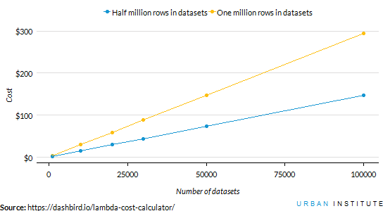


How we built the tool

Slide 25


How we built the tool
1 user
100 user
1,000,000 user
Doesn’t matter!

Slide 26
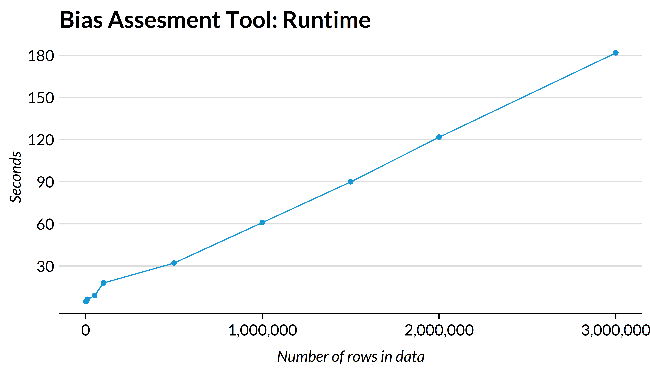


Slide 27
Questions? Feedback?

Slide 28

Get in Touch! @ajjit10 anarayanan@urban.org

