Slide 1
Advanced Scientific Calculator
Comprehensive Architectural Review & Code Clean-Up Analysis
An Object-Oriented Tkinter Implementation with Secure String Evaluation

Slide 2
Agenda & Presentation Index
02
01. Architecture Overview
System layer hierarchy and module topologies.
02. Tkinter Grid & Containers
Window partitions, sizing boundaries, and alignment rows.
03. State Management & Buffers
Dynamic evaluation workspace trackers and flags.
04. UI-to-Engine Synchronization
State mutator methods and core runtime updates.
05. The Keyboard Engine (kbd)
Hardware capture rules and raw token translation mappings.
06. The Core Math Engine (calc)
Four-stage processing workflow and parsing pipelines.
07. Evaluation Security Sandbox
Namespace isolation and secure scope resource tracking.
08. History Panel Mechanics
Timeline buffer captures and double-click retrieval triggers.
09. System Audit & QA Assessment
Refactoring code summaries and vulnerability logging.

Slide 3
01. Architecture Overview & System Topology
03
UI Layer (Tkinter)
• Frame Partitions: Isolates math keys from the timeline trackers. • Canvas Geometry: Enforces rigid 800x650 initialization controls. • Responsive Grids: Standardizes button sizing metrics symmetrically across rows.
Event Layer (Bindings)
• Capture Loops: Monitors low-level core window hardware interactions. • Mapping Mappings: Translates keystroke character values on the fly. • Intercept Pipelines: Overrides default triggers for operation keys.
Engine Layer (Eval)
• Sanitization Workflows: Pre-processes visual operators to raw symbols. • Pre-Parsing Arrays: Transforms trailing operators via regex patterns. • Sandbox Calculations: Isolates privilege access paths explicitly.

Slide 4
02. Tkinter Initialization & Structural Containers
04
Structural Layout Setup
self.main_container = tk.Frame(self, bg='#ffffff') self.main_container.pack(fill='both', expand=True) self.calc_frame = tk.Frame(self.main_container) self.calc_frame.pack(side='left', fill='both', expand=True) for i in range(7): self.grid_frame.columnconfigure( i, weight=1, uniform='cols' )
Container Segregation & Constraints
• Main Container: Splits the standard 800x650 canvas grid layout into separate standalone calculation and sidebar panel frames.
• Left Pane: Allocates active space padding for primary math keys and high-visibility digital display tracks.
• Right Pane: Locks down the persistent structural history logging timeline tracker safely away from basic key configurations.
• Uniform Weight Configurations: Enforces strict uniform options across columns and rows, forcing symmetry to scale perfectly when resized.

Slide 5
03. State Management & Buffers
05
self.current_expr
Primary workspace data tracker holding running evaluation strings before compute actions execute.
self.last_ans
Persistent context memory slot tracking the previous execution return result for prompt re-use.
self.is_deg
Trigonometric angular calculation switch (boolean flag for Degrees vs Radian math rules conversion).
self.is_inv
Inverse layout state modifier tracking standard vs arc-based identity transformations dynamically.

Slide 6
04. Display & Operational State Modification
06
Synchronized State Mutation Functions
update_dis()
Flushes runtime workspace strings directly onto the presentation layer display label.
app_n(char)
Validates numerical key inputs, handling string insertion logic and preventing leading zeros.
app_op(op)
Appends mathematical operators straight to current evaluation sequences.
backspace()
Slices the trailing character token out of execution string tracks sequentially.
Implementation Code Snapshots
def update_dis(self): text = self.current_expr if self.current_expr else '0' text = self.display_label.configure(text=text) def app_n(self, n): if self.current_expr == '0' and n != '.': self.current_expr = n else: self.current_expr += n self.update_dis()

Slide 7
05. The Keyboard Capture Engine (kbd)
07
Refactored Event Handler Code
def kbd(self, event): key = event.char if key in '0123456789.': self.app_n(key) elif key in '+-*/()!': alt_keys = {'*': '×', '/': '÷'} self.app_op(alt_keys.get(key, key)) elif key in ['\r', '\n', '=']: self.calc()
Hardware Event Routing Logic
• Captures low-level hardware event inputs via asynchronous Tkinter root window key bindings.
• Filters alphanumeric tracks natively from structural mathematical characters dynamically.
• Intercepts structural execution keys like Backspace, Escape, and Enter for state operations.
• Translates raw standard keyboard inputs ('*', '/') automatically into target visual UI typography representations ('×', '÷').

Slide 8
06. The Mathematical Evaluation Engine (calc)
08
1. Character Sanitization
Translates display formatting targets into raw Python execution operators (e.g., × -> *, ÷ -> /) seamlessly.
2. Regex Token Parsing
Precomputes trailing operator patterns like '5!' into structural functional parameters like 'fact(5)' at run-time.
3. Sandbox Evaluation
Passes localized execution dicts safely while isolating native global built-in namespaces completely.
4. Error Trapping & Recovery
Intercepts arithmetic division faults or syntax errors to keep desktop framework sessions stable.

Slide 9
07. Evaluation Security & Sandboxing Architecture
09
Secure Scope Dictionary Mapping
dct = { 'sin': lambda x: math.sin(d2r(x)), 'cos': lambda x: math.cos(d2r(x)), 'arcsin': lambda x: r2d(math.asin(x)), 'log': lambda x: math.log10(x), 'fact': lambda x: math.factorial(int(x)) } # Execution Endpoint res = eval(s, {'__builtins__': None}, dct)
Mitigating String Evaluation Risks
• Passing '__builtins__': None strips basic string parsing paths of malicious standard operations injection vulnerabilities.
• Locks down unsafe framework risks from command injection or system directory modifications entirely.
• Explicitly registers verified processing scopes through strict localized dictionary function bindings parameters.
• Allows standard mathematical execution functions while safely dropping unmapped shell execution pathway vectors.

Slide 10
08. Persistent History Panel Mechanics
10
Event Double-Click Retrieval Handler
def load_hist(self, e): try: idx = self.history_listbox.curselection() sel = self.history_listbox.get(idx) # Isolates expression out of 'Expr = Result' self.current_expr = sel.split('=')[0].strip() self.update_dis() except Exception: pass
Log Capture & Timeline Buffers
• Asynchronously writes verified computations straight into an isolated Tkinter Listbox widget array.
• Implements automated timeline vertical scrolling updates to focus visibility on recent evaluations.
• Hooks standard mouse double-click event triggers directly to history recovery execution pipelines.
• Parses selected log text records to recall expression details instantly back into the main workspace.

Slide 11
11
09. System Audit & QA Assessment
Identified Issues
• Input Interface Interruption: Incomplete physical keyboard listener layouts cut off character mapping pipelines halfway through runtime executions.
• Token Standardization Mismatch: Structural discrepancy identified between the front-end user interface labels (asin) and back-end execution keys (arcsin).
• Syntax Format Bottlenecks: Standard left-to-right calculation evaluation models caused runtime crashes when encountering trailing factorials (!).
• Unprotected Failure Risks: Exposed core calculation execution loops lacked fallback boundaries, risking complete system crashes during mathematical errors.
Applied Resolutions
• Pipeline Integration: Deployed a synchronized event listener system to capture, filter, and map keystroke inputs flawlessly.
• Lexicon Unification: Standardized functional lookups directly to sync key entries precisely with UI display triggers.
• Pre-Processing Implementation: Embedded a regular expression parser wrapper (re.sub) to reformat trailing factorials ahead of evaluation runtime paths.
• Fail-Safe Deployment: Wrapped active execution loops inside exception gates that print an 'Error' string instead of throwing a terminal process crash.

Slide 12
10. Core Operational Flowchart Diagram
[ User Action / Keystroke Input ]
▼
[ Hardware Capture Layer ] ──────► Intercepts event characters via kbd()
▼
[ Pre-Processing Engine ] ──────► Sanitizes operators & handles '!' via RegEx
▼
[ Execution Security Sandbox ] ────► Evaluates expression safely via eval()
┌───────┴───────┐
▼ ▼
[ Success Path ] [ Failure Path ]
▼ ▼
[ Log to Listbox ] [ Intercept Exception ]
▼ ▼
[ Display Result ] [ Display 'Error' Mask ]

Slide 13
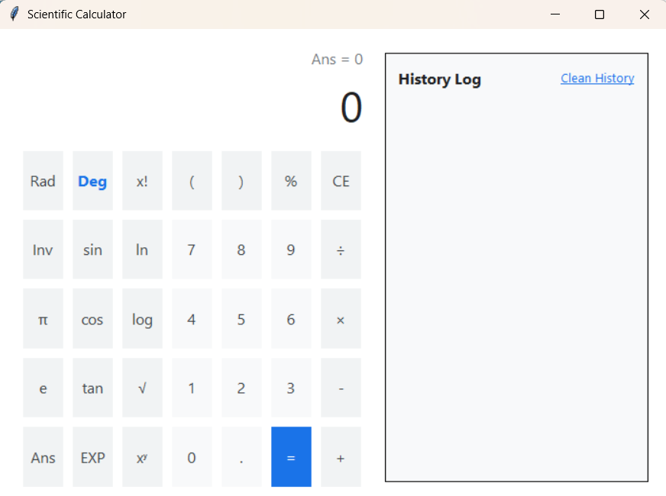
Advance Calculator - - Python Project
THANK YOU !

