Slide 1
Learning Android EECS 399/499 W13
Session 1

Slide 2
Agenda
Brief overview of Android
Some useful tools
Build our first app

Slide 3
Android
Over a half of a billion Android devices activated¹
Android controls the smartphone market share at 53.7%²
Many different devices run Android from phones to tablets and even cars!
¹According to CNET news
²According to comScore

Slide 4
AOSP (Android Open Source Project)
The whole OS and framework is available to the public
Source code for built-in apps (phone, SMS, etc)
Can view through developer.android.com or github.com/android

Slide 5
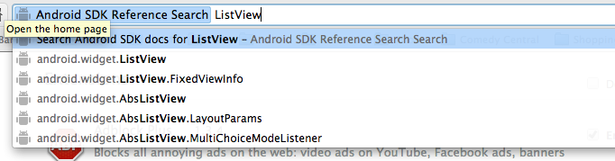
Android SDK Reference Search
Simple Chrome extension
Type “ad” then a space to start your search

Slide 6
Let’s Get Started
Demo

Slide 7
android.app.Activity
In Android, an Activity is something a user can do and/or see
The Activity class holds everything you see on the screen in a Window object
Each app must have an Activty to launch
Extends android.content.Context, which is a class that contains information about your app’s global state

Slide 8
AndroidManifest.xml
Each Activity must be declared in this file in order for the sytem to show it
Other important classes, such as Services, BroadcastReceivers, and ContentProviders, must also be declared in the manifest
Don’t forget to do this!

Slide 9
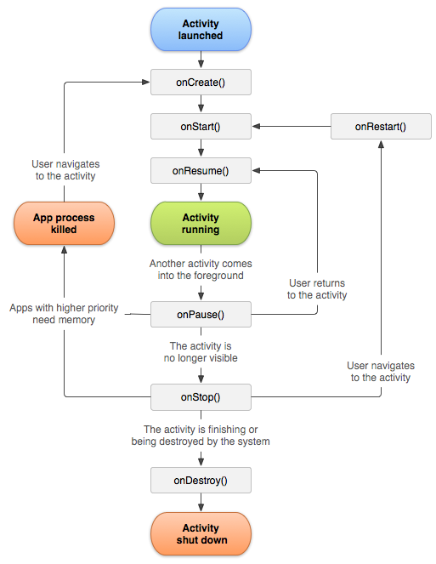
Activity Lifecycle

Slide 10
Setting Your Layout
In onCreate(), we call setContentView() to let the system know what to show for our Activity

Slide 11
android.view.View
A View object is a space on the screen in which we can draw and intercept touch events
Android has many useful built-in Views, which we will be using until we cover custom Views

Slide 12
android.view.ViewGroup
ViewGroups are special Views that contain other Views
Android also provides many useful built-in ViewGroups, such as Layouts and ListViews

Slide 13
Layouts
Layouts are just special ViewGroups that layout their children in unique ways
The main 4 Layouts are TableLayout, FrameLayout, RelativeLayout, and LinearLayout

Slide 14
XML Layouts
In Android, we can either instatiate Views and Layouts from code, or inflate them from xml
This offers a very powerful way to easily create rich View hierarchies

Slide 15
Layout in Code vs XML
Code:
@Override
protected void onCreate(Bundle savedState) { super.onCreate(savedState);
LinearLayout layout = new LinearLayout(this);
layout.setOrientation(LinearLayout.VERTICAL);
LinearLayout.LayoutParams params =
new LinearLayout.LayoutParams(
LayoutParams.WRAP_CONTENT,
LayoutParams.WRAP_CONTENT,
1.0);
TextView textView = new TextView(this);
textView.setTextSize(16);
textView.setText(“Hello”); // bad practice, but this is a demo
textView.setTextColor(Color.RED);
layout.addView(textView, params);
Button button = new Button(this);
button.setText(“OK”);
params =
new LinearLayout.LayoutParams(
LayoutParams.MATCH_PARENT,
LayoutParams.WRAP_CONTENT);
layout.addView(button, params);
setContentView(layout);
}

Slide 16
Layout in Code vs XML
XML (l_layout.xml):
<LinearLayout xmlns:android=“http://schemas.android.com/apk/res/android”
android:layout_width=“match_parent”
android:layout_height=“match_parent”
android:orientation=“vertical” >
<TextView
android:id=“@+id/tv”
android:layout_width=“wrap_content”
android:layout_height=“wrap_content”
android:layout_weight=“1.0”
android:text=“Hello”
android:textSize=“16sp”
android:textColor=“@color/red” />
<Button
android:id=“@+id/button”
android:layout_width=“match_parent”
android:layout_height=“wrap_content”
android:text=“OK” />
</LinearLayout>
Then in onCreate():
@Override
protected void onCreate(Bundle savedState) { super.onCreate(savedState);
setContentView) (R.layout.l_layout;
}

Slide 17
Quick Note about R.java
your.package.name.R.java is an auto-generated file that contains resource ids of all the xml resources you define in your res/ directory
Use these ids, such as R.drawable.icon, R.layout.main_layout or R.id.btn_ok, to inflate resources from xml

Slide 18
activity_main.xml
Demo

Slide 19
Interacting With Views
onCreate() is sort of like our Activity’s constructor
We do must of the initialization here
Use findViewById() (ids declared in xml files and defined in R.java) to get references to your View objects

Slide 20
Listeners and Callbacks
Common design pattern in Android
Provide a View with a Listener or Callback interface to respond to events, such as touch events or inflate events
Let’s check out some source!

Slide 21
OnClickListener()
Probably the most common Listener you will encounter in beginner Android development
Other listeners:
OnScrollListener()
OnTouchListener()
OnLongClickListener()
OnItemClickedListener()

Slide 22
Three Ways to Set a Listener
Activity implements the interface
Inner class implements the interface
Anonymous inner class

Slide 23
Activity Implements the Interface
public class MainActivity extends Activity
implements View.OnClickListener { // Code omitted
@Override
protected void onResume() {
super.onResume();
// Sets the activity as the listener mButton.setOnClickListener(this);
}
/**
* The activity must implement this function
* because it is now an instance of OnClickListener
*/
@Override
public void onClick(View view) { // Code to respond to click
}
}

Slide 24
Inner Class Implements the Interface
// Code omitted
private MyListener mListener = new MyListener();
// Code omitted
@Override
protected void onResume() {
super.onResume(); mButton.setOnClickListener(mListener);
}
private class MyListener
implements OnClickListener { @Override
public void onClick(View view) { // Code to respond to click
}
}
// Code omitted

Slide 25
Anonymous Inner Class
You will encounter these a lot
@Override
protected void onResume() {
super.onResume(); mButton.setOnClickListener(new OnClickListener() {
@Override
public void onClick(View view) { // Code to respond to click
}
});
}

Slide 26
Getting and Setting Text
Demo

Slide 27
Run the App
Demo

Slide 28
Class Resources
All the source code for the demos will be hosted at github.com/ajk1311/LearningAndroid
I will talk to Professor Ringenberg about posting the slides on CTools as well
Feel free to ask questions or share cool stuff on the mailing list

Slide 29
Thanks!
Coming up:
Lists and Adapters
Fragments
Services/Broadcasts
Multithreading
Custom Views/Layouts
Networking
SQLite
Animations
Design guidelines
Maps API (learn together)

