Slide 1
Developing HTML5 Games for iWin Games Console
<< Introductory message goes here >>
This document should be accompanied by a zip file containing the iWin Games Console and a placeholder game.

Slide 2
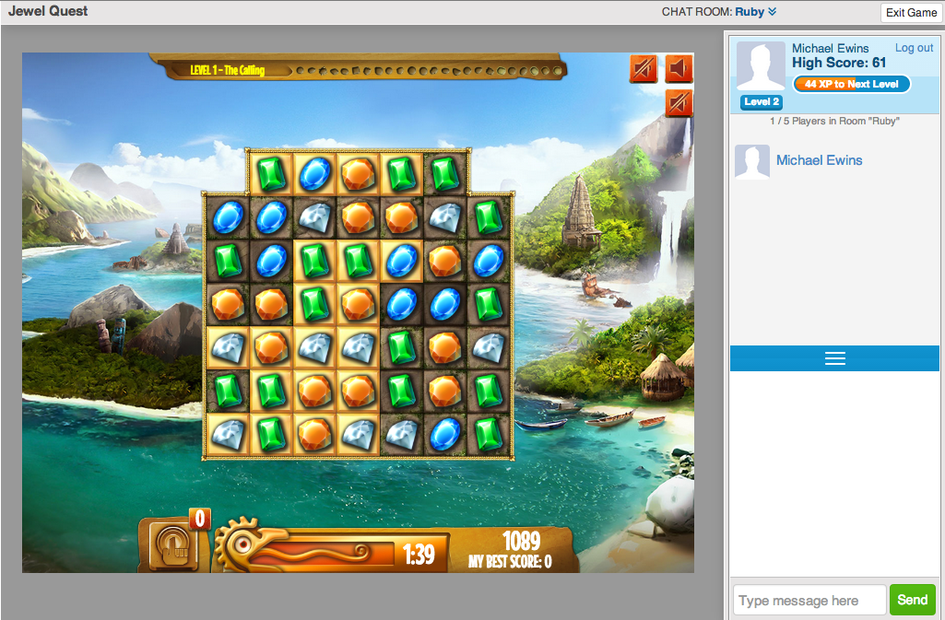
Jewel Quest running with iWin Games Console

Slide 3
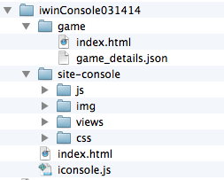
Getting Started
Unzip the SDK zip file and place it in a folder underneath a web server such as Apache / nginx.
The contents of this zip file are shown below:
All your code changes will happen inside the game folder.
Visit the top-level index.html file in your browser using http:// not file://

Slide 4
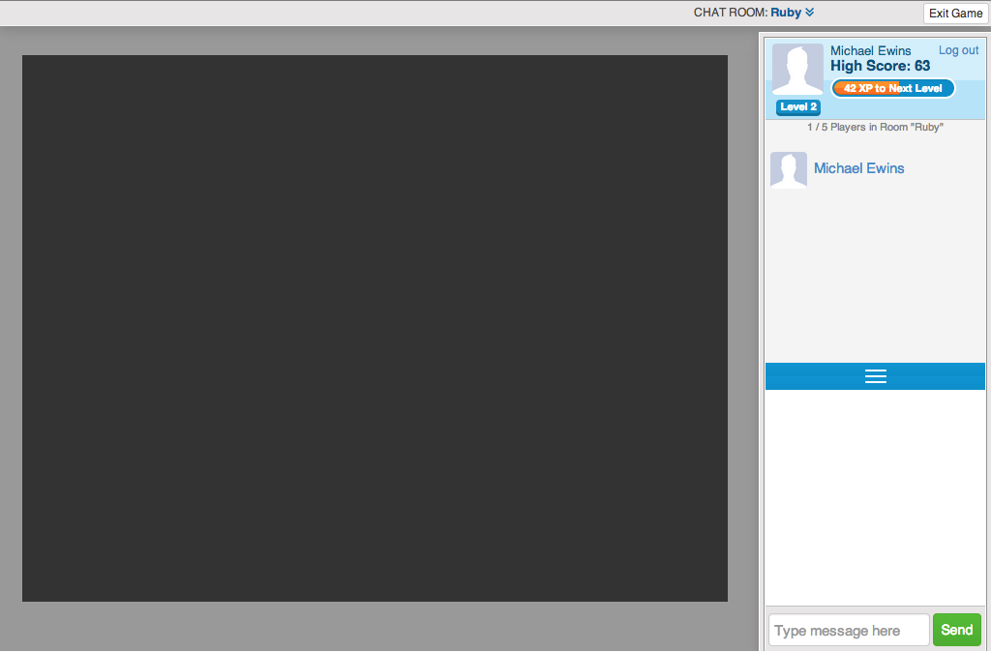
The iWin Games Console UI
Current
User
Profile
Console
Titlebar
Console
Chat
Room
Members
Game
Canvas
Console
Chat
Messages

Slide 5
Placeholder game
The SDK contains a placeholder game that consists of two files.
This “game” allows you to simulate the startup of a game within the console and the calls that are required.

Slide 6
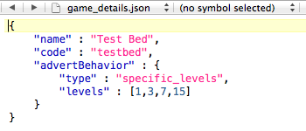
Required game files
The console expects a game to have an index.html file that will display the game. We have supplied a sample index.html file.
The console also expects to find game_details.json. This file contains”
  The game name that will be displayed to game players in the Console title bar.
  The game code. This is a unique code that will be used when the game is deployed on the iWin portal. We will likely change this value after you send it to us.
  Advert configuration. This allows us to define which levels will display adverts as the user plays the game. These are default values and will change as we launch the game.

Slide 7
Working with game/index.html
The game/index.html is served via an IFRAME that is dynamically created by the console, and all requests inside that IFRAME will be local to the game folder.
Internally, the system uses easyXDM to message between the game and the console (as they live in separate frames), but these calls are obfuscated through functions in ../iconsole.js (relative to the game folder). Therefore, any game implementing the console should load the iconsole.js from the parent folder as a script, before making any messages to the console.

Slide 8
Game Startup
As the game loads, it makes calls to the console to notify the console of it's progress. Typically this is done when pre-loading assets required for the game. This ensures that the game window stays hidden from the player until the game has fully loaded, and that the advert panel is visible until the game is ready to play.
Once the game assets have been fully loaded, the game calls the console to tell it has loaded the game. The console will remove the panel that is hiding the game, and signals that the advert can be removed (after minimum advert duration has been reached).

Slide 9
Game Startup Flow
User
Game
Console
Server
1. User visits URL
3. Console starts game
4. Game tells console ready to send/receive msgs
5. Advert starts
6. Game loads
6.1 progress
6.2 progress
etc
7. Game now loaded
8. Advert dismissed
9. Console notifies game advert dismissed
10. Play Game

Slide 10
Back-end Server
The SDK will speak to a test server hosted by iWin for certain API calls.
The test server URLs that we call are:
  https://sl.iwin.com: Stage Logon Server
  https://sc.iwin.com: Stage Chat Server
In order for chatroom and database persistence of user progress functionality to work, you should use develop with a hostfile entry of local.games.iwin.com pointing to your local development environment. If you use a different hostname, login/chat will not work, however, your data will be stored as an anonymous user in the html5 local storage object.

Slide 11
Level Start / Level Finished
The game can make further calls to the console such as loading level data. This allows the console to track player progress.
When the level is completed the console should be called. Here you pass in the score the user achieved in that level, the amount of time they took playing that level (you should be careful to exclude time the user hasn't had the game in focus), whether they won the level or not, and up to 2k of data that you can store regarding the level.

Slide 12
Level Started / Finished Flow
User
Game
Console
Server
1. User starts level
2. Game notifies console to show advert
3. Console optionally displays an advert.
4. Game loads level data for user
5. Console retrieves game / level data for current user
6. Console passes level/game data back to game
7. Play game
7. Console notifies game advert dismissed
9. Game saves level data for user
10. Console saves game / level data for user.
11. Game posts high score
12. Console posts to leaderboard
14. Start next level
13. Console finished with leaderboard

Slide 13
Some suggestions for improved game performance
Only load the required assets at startup and load level specific assets as they are needed.
Think about using JPEGs rather than PNGs (if you can)
Compress your image files.
Reduce the bit rate for audio files.
When pre-compiling data structures, consider breaking the computation blocks into smaller chunks and use timed callbacks to step through these chunks. This will ensure that the console gains some of the CPU time to ensure it can update the UI accordingly, and ensure that the browser doesn't consider the process to have died because it hasn't completed the call in a timely manner.

Slide 14
Testing Different Advert Behaviours
As mentioned earlier the game_details.json file allows different advert behaviours to be defined.
If you want to test your game without interstitial adverts then update game_details.json as follows:
"advertBehavior" : {
"type" : "none"
}

Slide 15
Chat Room Names
We will configure the chat room names appropriate to your game.
Please supply us a suitable list of names with your game.

