Slide 1
Client-Server Storage
By: Thomas O’Brien
January 22nd, 2018

Slide 2
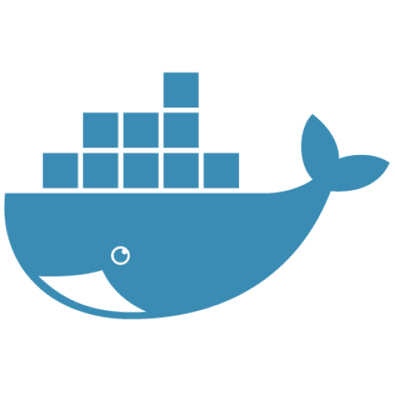
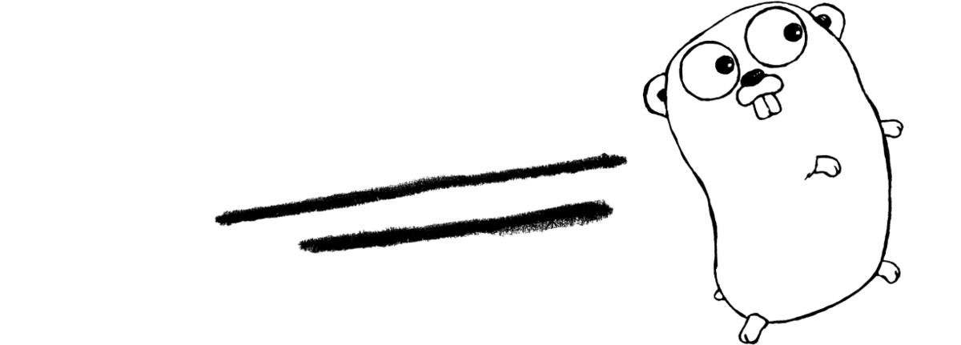

Description
Compile/run the server application
Creates a server listening to a port
Compile/run the client application
Makes a TCP connection with the server
Turns a file into packets, sends them to the server, and reassembles them in the desired directory
Ends TCP connection with the server

Slide 3
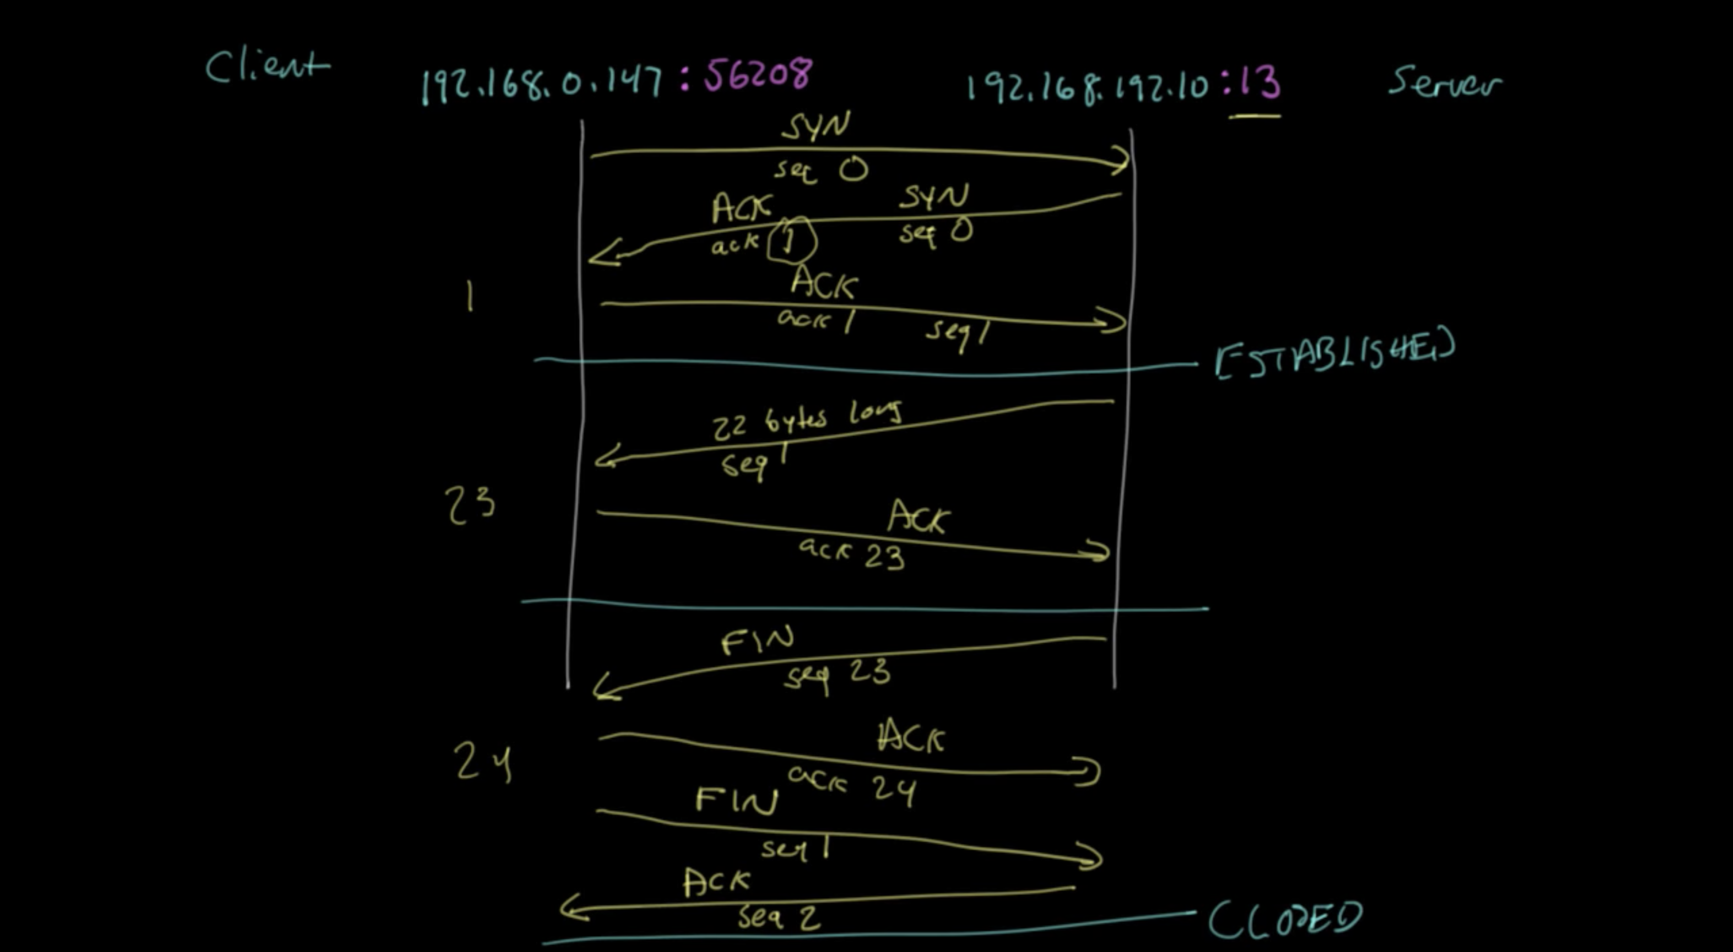

Slide 4
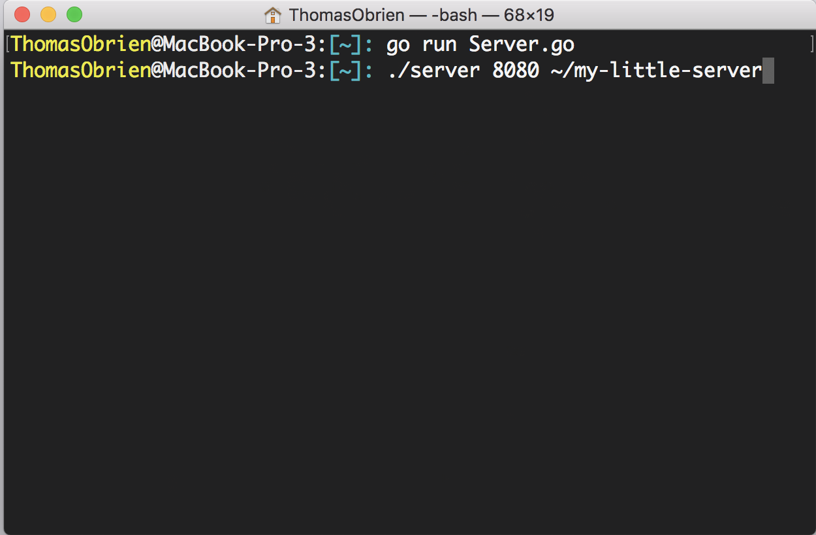
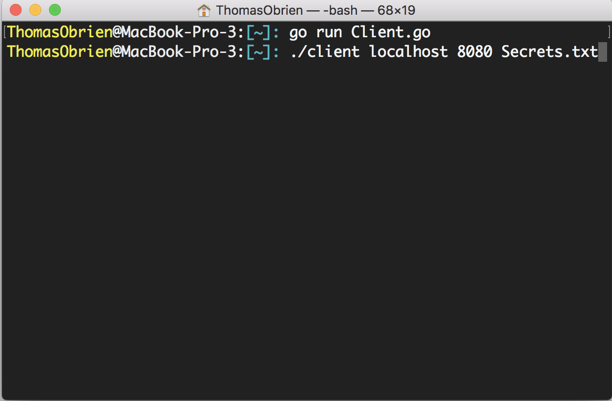
User’s Point of View

Slide 5
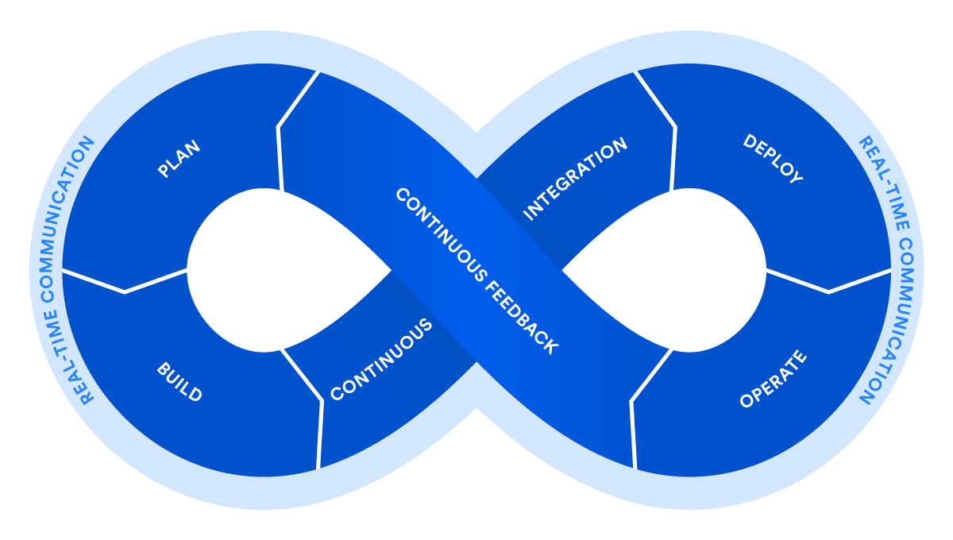
Why I’m Interested
SRE/DevOps
Computer Networks
Relevant coursework
CMSI 281, 284, 386, 387

Slide 6
Questions?

