Slide 1

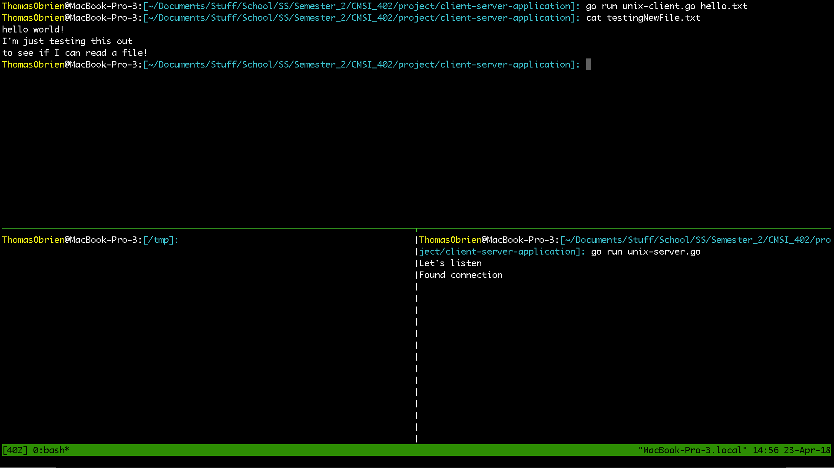


Client Server Application
Thomas O’Brien
An exercise in TCP communications via Unix programming
Justification
Client
Technologies
Server
To develop an in-depth understanding of the TCP/IP stack
Relevant to Site Reliability/DevOps Engineering
Golang is a powerful systems programming language gaining popularity in modern tech stacks
Unix programming libraries are utilized for lower level programming
Establishes ownership over an available port on some UNIX based machine
Listens for an incoming TCP request to make a 3 way handshake
Decodes incoming files and stores them at a given existing directory
Attempts to make a simulated TCP connection with a server
Utilizes a TCPHeader struct
Sends encoded files from the client side to the server side
Returns whether or not the file was sent over successfully
-
-
-
-
-
-
-
-
-
-
-

