Slide 1

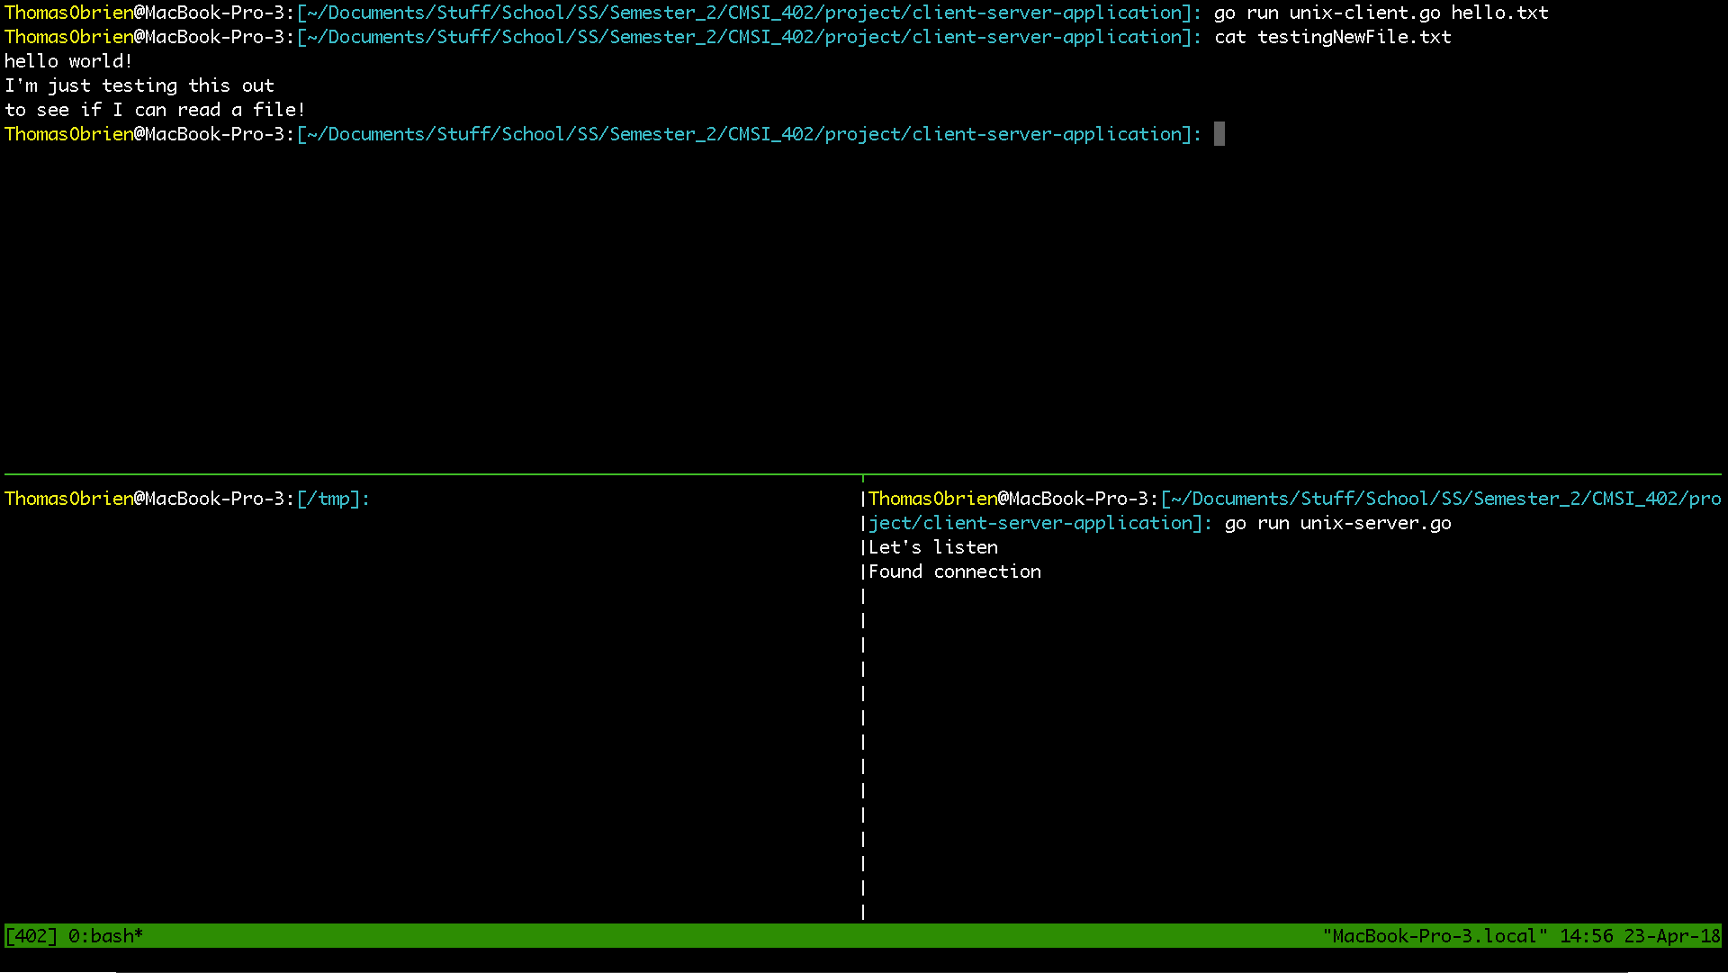


Client Server Application
Thomas O’Brien
An exercise in TCP communications via Unix programming
Justification
Client
Technologies
Server
Golang is a powerful systems programming language gaining popularity in modern tech stacks
Unix programming libraries are utilized for lower level programming
To develop an in-depth understanding of the TCP/IP stack
Relevant to Site Reliability/DevOps Engineering
-
-
-
-
Establishes ownership over an available port on some UNIX based machine
Listens for an incoming TCP request to make a 3 way handshake
Decodes incoming files and stores them at a given existing directory
Attempts to make a simulated TCP connection with a server
Utilizes a TCPHeader struct
Sends encoded files from the client side to the server side
Returns whether or not the file was sent over successfully
-
-
-
-
-
-
-

