Slide 1


ENGI 301
Stress Level
Stress Level
Stress-Level Indicator
10/05/13
Alex Lammers

Slide 2
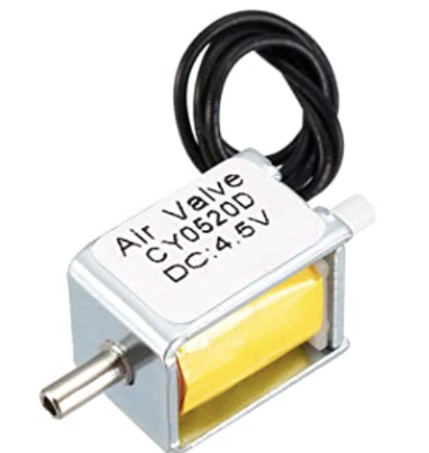
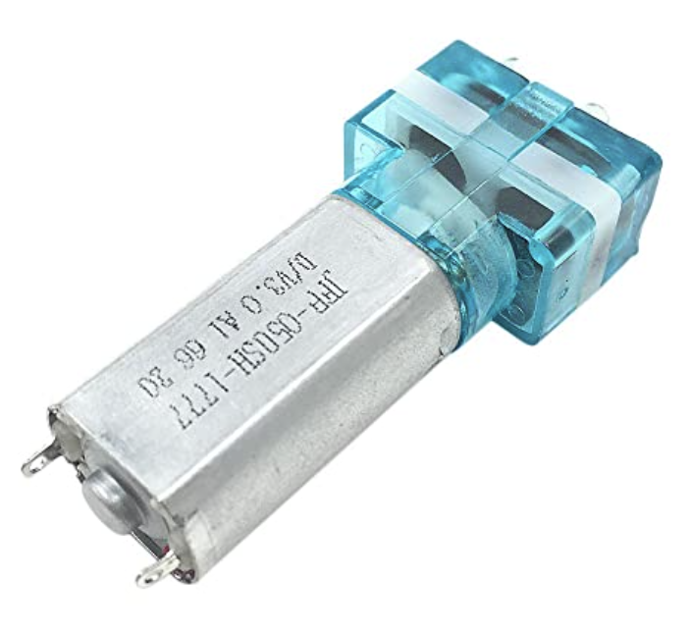
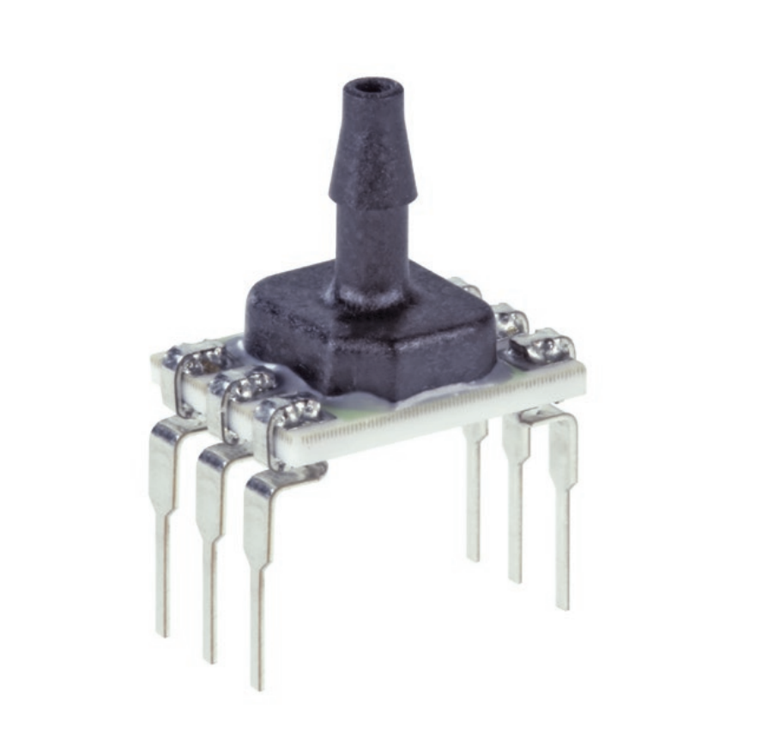
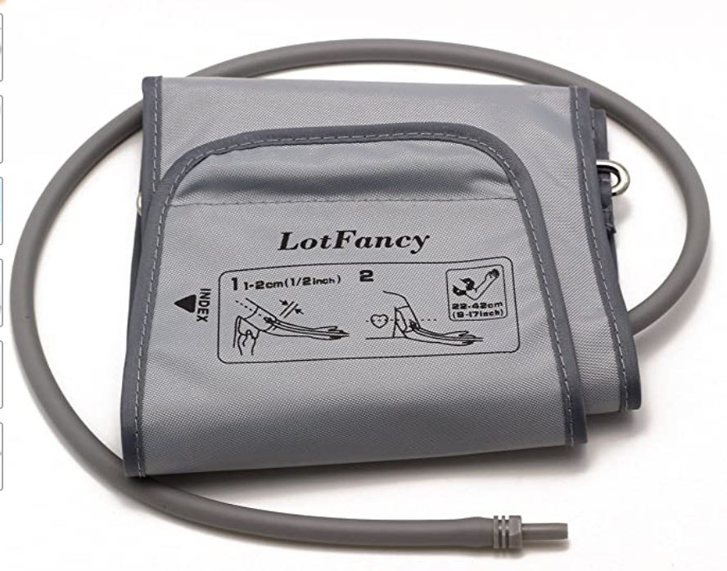
Background Information
Working from home has naturally provided people their separate space to cope with work-related stress.
As people transition back to working in the office, there is a need for a light-hearted way of indicating that you still need your individual space during stressful times.
Previous Projects to Draw On
Python Pressure Transducer Calibration with Manometer
Blood Pressure Monitor
Additions to Previous Projects
Holding a constant pressure through solenoid valve activation
Rescaling operational amplifier for 0-1.8V analog input pin
Stress Level
Main Components:
Solenoid valve
Air pump
Pressure Sensor
Blood Pressure Cuff

Slide 3
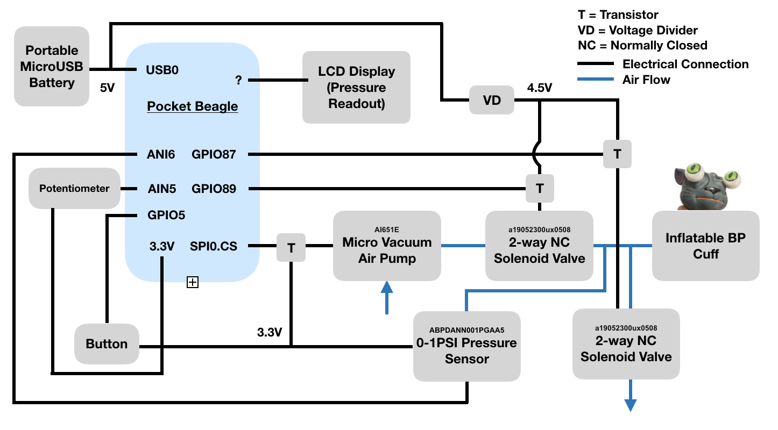
System Block Diagram
Operating Procedure
User turns potentiometer until LCD displays desired pressure
User pushes button initiating start of air pump, 1st solenoid opens, LCD display continuously displays pressure
Pressure sensor detects desired pressure, 1st solenoid closes
User presses button again, 2nd solenoid opens, cuff fully decompresses

Slide 4
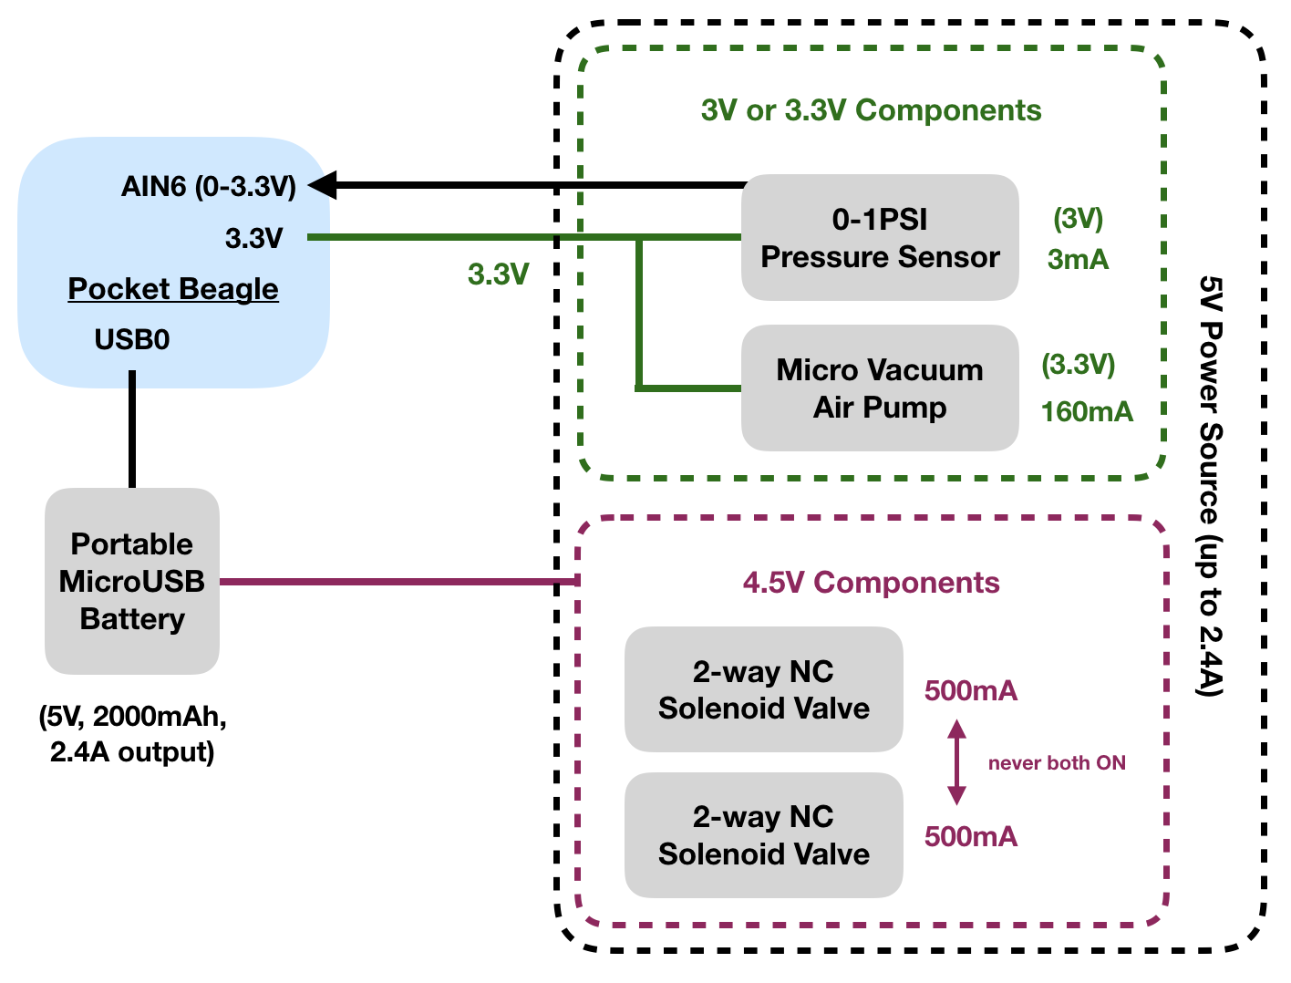
Power Block Diagram

Slide 5
Components / Budget
Component | Need to Buy | Cost
Lotfancy Large 9-17" D Ring Cuff Replacement | 1 order | $10
AIMELIAE 1PCS DC 3V Micro Vacuum Air Pump Mini Air Pressure Pump Medical Pump 30KPa 0.28L | 1 order | $12
uxcell Miniature Solenoid Valve 2 Way Normally Closed DC4.5V 0.5A Air Solenoid Valve, 2pcs | 1 order (2 pieces) | $10
Honeywell Board Mount Pressure Sensor ABPDANN001PGAA5 | 1 order | $25
Feelers 2mm ID x 4mm OD High-Strength Silicone Tubing Thick Food Grade High Temp Pure Silicon Tube High Temp Home Brewing Winemaking Silicone Hose Tubing, 9.84ft Length | 1 order | $8
5000mAh 5V External Battery Power Pack 0.22lb | 1 order | $20
Flippy Kitten Eye Popping Cat - Squishy Squeeze Toy for Stress Reduction | 1 order | $14
 | Total: | $99
Need all components to be purchased by instructor listed; additional components may be purchased by student

