Slide 1
ENGI 301 Stress Buddy PCB Proposal
11/16/21
Alex Lammers

Slide 2
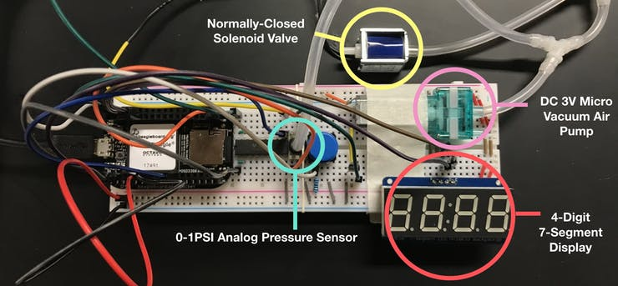
Background Information
Stress Buddy Prototype
A toy that sits on your desk and with the push of a button, signals to your coworkers that you are stressed.
Main Hardware Components:
PocketBeagle Board
Transistor Array
Push Button
4-Digit 7-Segment Display
0-1 PSI Analog Pressure Sensor
Normally Closed Solenoid Valve
DC 3V Micro Vacuum Air Pump
Project Documentation Links
Hackster: https://www.hackster.io/ajl12/stress-buddy-12f85d
GitHub repository: https://github.com/ajl12/ENGI301/tree/main/project_1
What changes (if any) are you going to make based on your prototype?
Removing NPN transistor and incorporating it into the transistor array

Slide 3
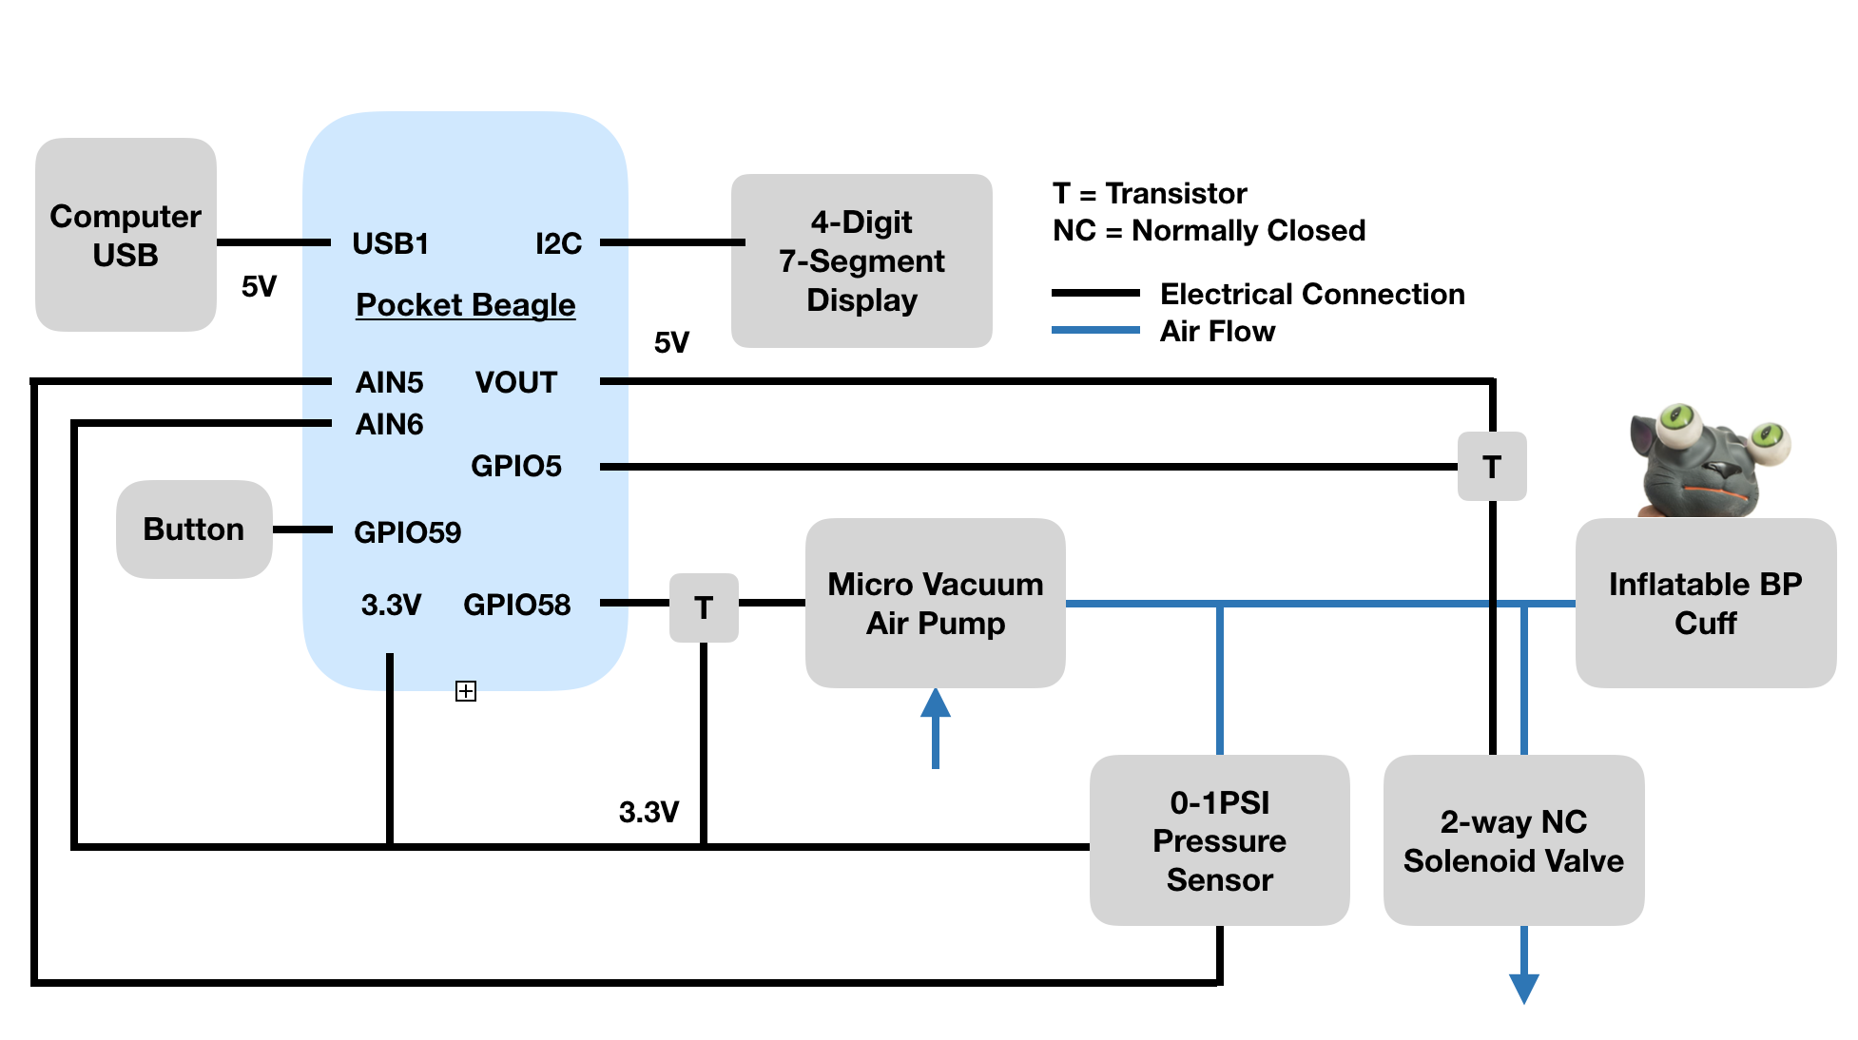
System Block Diagram

Slide 4
Mechanical Block Diagram
Air tubing
4”
2”
Hex Display
1.1”
ULN2803AN
ULN2803AN
Pocket Beagle
3”
Solenoid Valve
Air Pump
P1
USB
1.38”
Push
Button
PS
P2
2.17”
FRONT
BACK
(primarily user interface components)
(components connected to tubing)

Slide 5
Components Required
List:
PocketBeagle Board
ULN2803AN Transistor Array
Push Button
Adafruit 0.56” 4-Digit 7-Segment Display
ABPDANN001PGAA5 0-1 PSI Analog Pressure Sensor
Normally Closed Solenoid Valve
DC 3V Micro Vacuum Air Pump

