Slide 1
EEEE 547/647 AI EXPLORATIONS
Evolving CNN agents to learn from each other
Alex Lamarche (ajl3545@rit.edu)

Slide 2
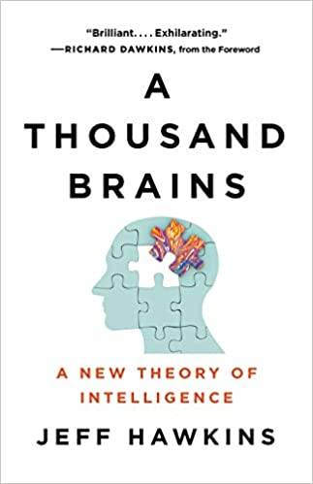
Book

Slide 3




Topic
Evolving CNN agents to learn from each other
“7”
G1
“7”
“1”
G1
+
A
B
then…
A
=
G2
“1”
?
C
B

Slide 4
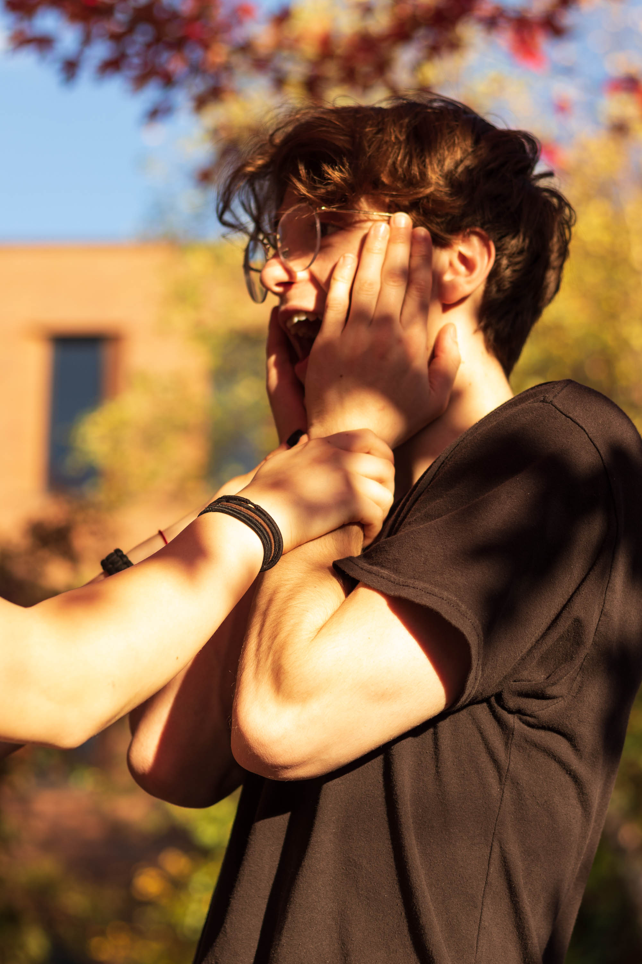
Team
Solo
Alexander Lamarche
Experience level:
SOIS Undergraduate Software Eng. Mix - currently in final year
Strengths: building software architectures
Weaknesses: mathematical modeling of systems (reason for project)

Slide 5
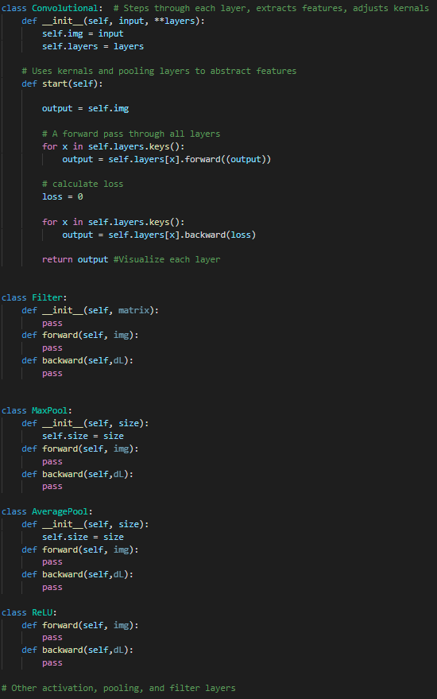
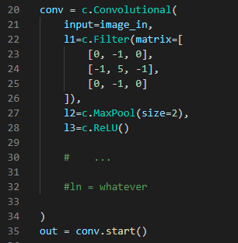
Outline
convolution.py
What I currently have vs. What needs to be done
What are genes?
Filter / kernel
Pools
Activations
main.py
What is genetic modification?
Adding and subtracting layers
Modifying kernel weights
Swapping activations
Swapping Pools

Slide 6
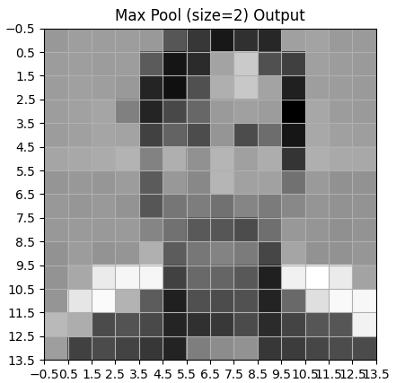
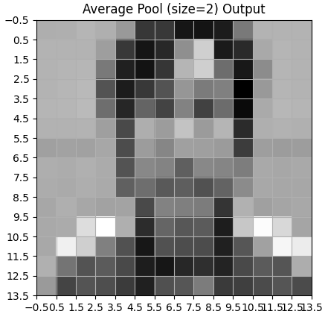
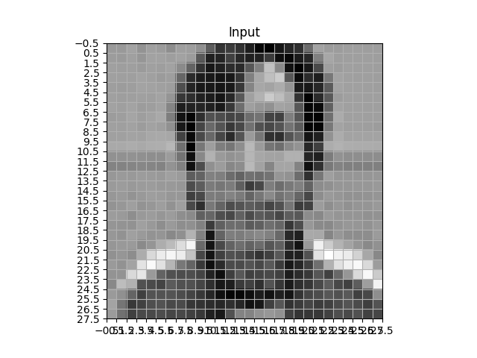
Demo results

Slide 7
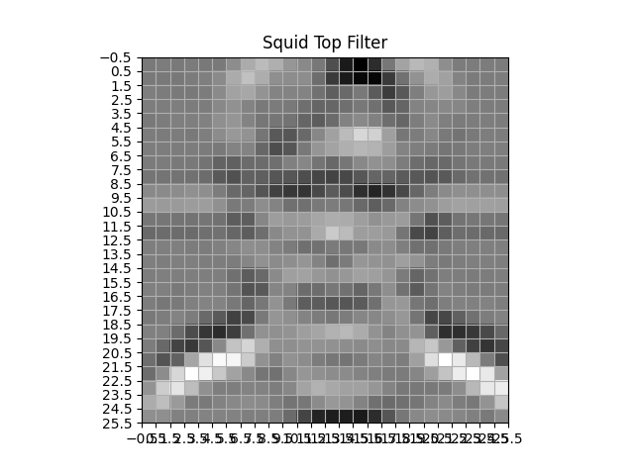
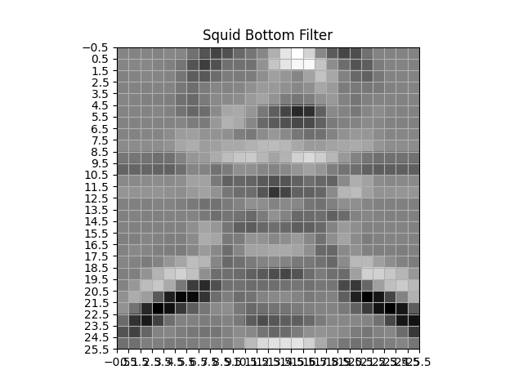
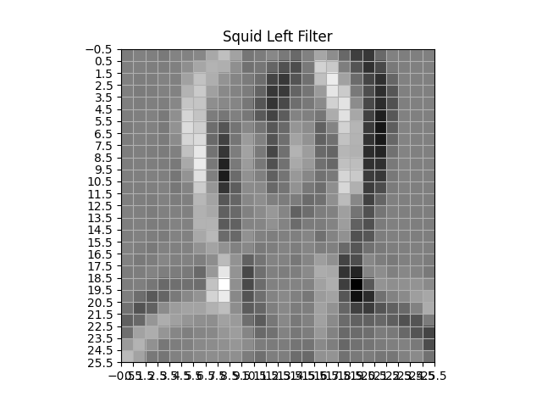
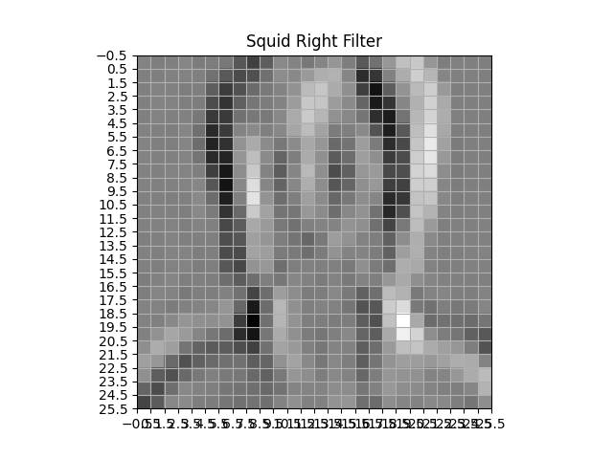




Demo results cont.
[
]
[
]
$$\begin{matrix} 2 & 1 & 2 \\ 0 & 0 & 0 \\ −1 & −2 & −1\end{matrix}$$
$$\begin{matrix} −2 & −1 & −1 \\ 0 & 0 & 0 \\ 1 & 2 & 1\end{matrix}$$
[
]
[
]
$$\begin{matrix} 2 & 0 & −2 \\ 1 & 0 & −1 \\ 2 & 0 & −2\end{matrix}$$
$$\begin{matrix} −2 & 0 & 2 \\ −1 & 0 & 1 \\ −2 & 0 & 2\end{matrix}$$

Slide 8
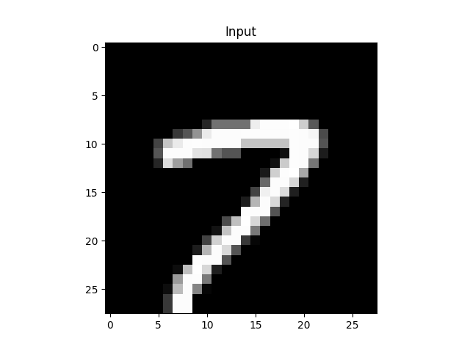
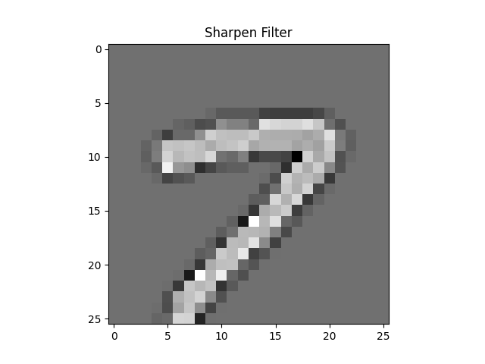
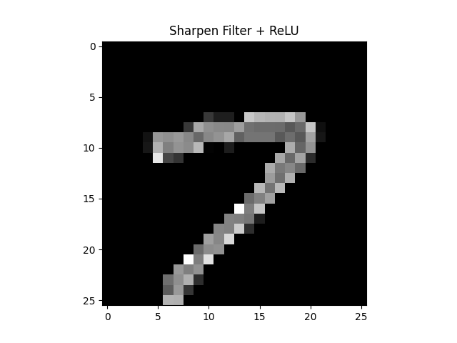
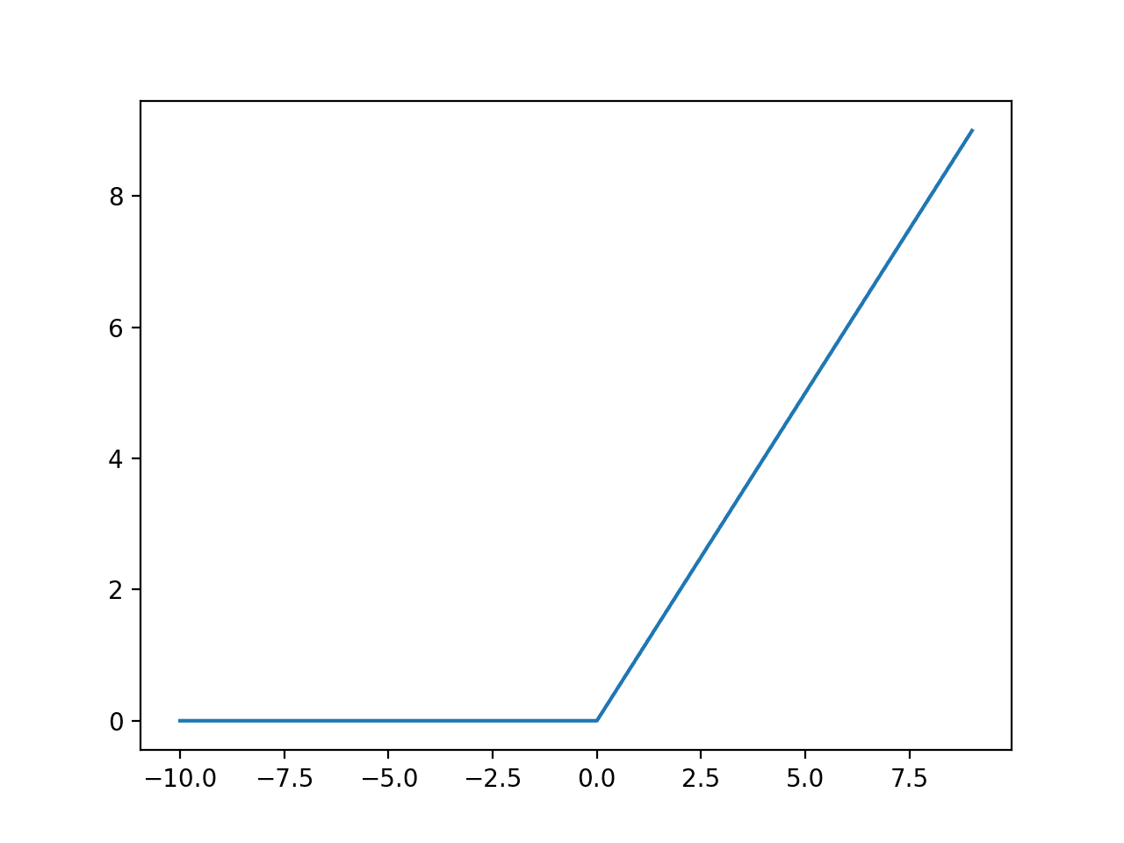

Demo results cont.
[
]
$$\begin{matrix} 0 & −1 & 0 \\ −1 & 5 & −1 \\ 0 & −1 & 0\end{matrix}$$

Slide 9

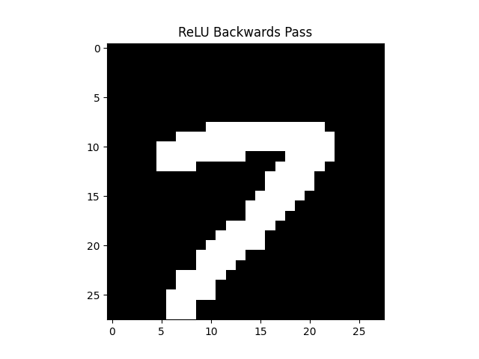
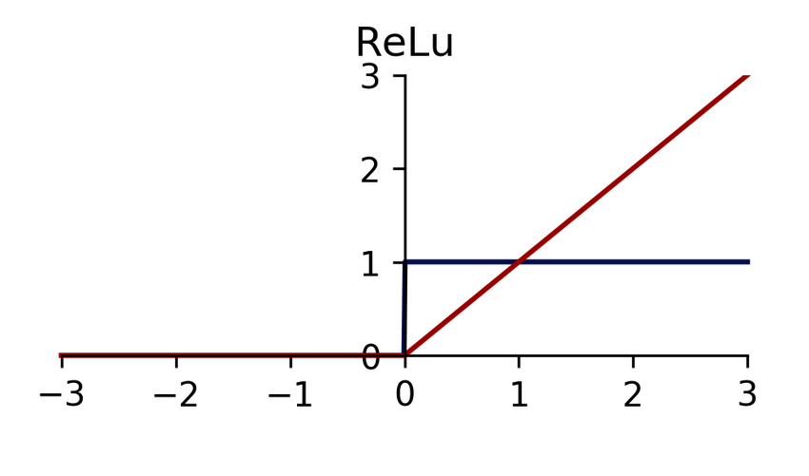
Demo results cont.

Slide 10
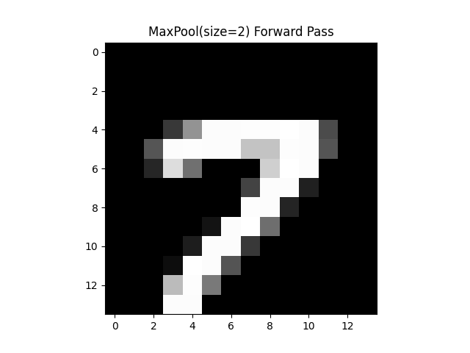
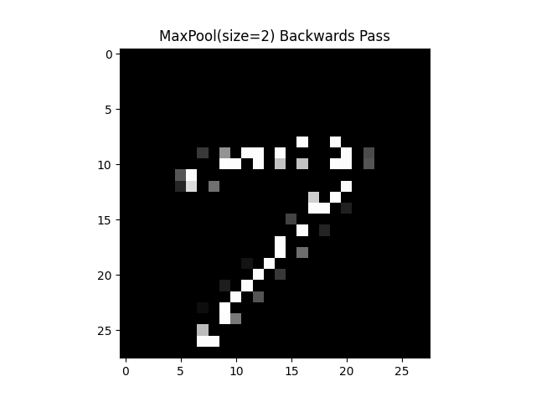
Demo results cont.

Slide 11
Questions?
Thank you!
Robot image : https://www.pinclipart.com/downpngs/xJhhx_vector-blueprint-robot-vector-freeuse-stock-computer-robotics/
ReLU : https://machinelearningmastery.com/wp-content/uploads/2018/10/Line-Plot-of-Rectified-Linear-Activation-for-Negative-and-Positive-Inputs.png
https://www.researchgate.net/profile/Jesper-Dramsch/publication/342435907/figure/fig3/AS:906156654469121@1593055990865/ReLU-activation-red-and-derivative-blue-for-efficient-gradient-computation.ppm
Book image : https://images-na.ssl-images-amazon.com/images/I/41OZTG+1b3L._SX321_BO1,204,203,200_.jpg

