Slide 1
The Evolution of the Game of Basketball
Alex Sun and Albert Li

Slide 2
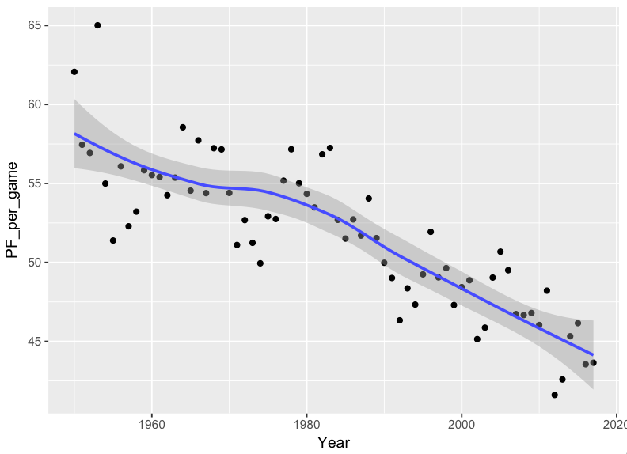
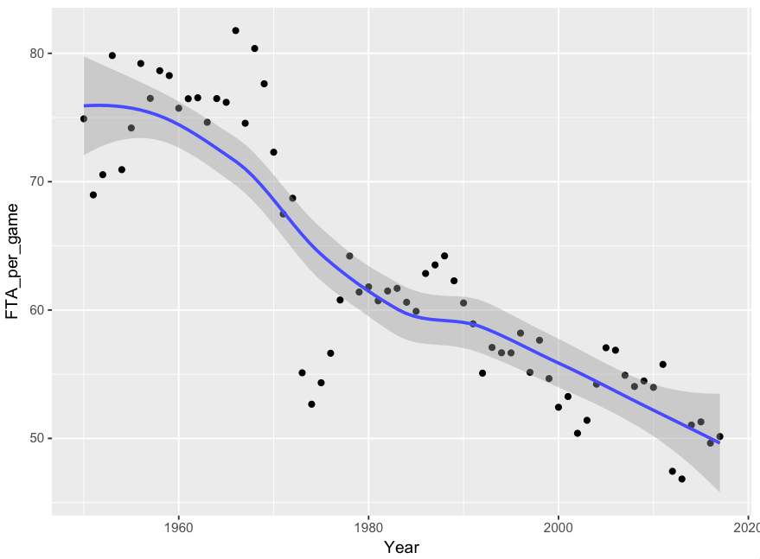
Physicality
Has the game of basketball become less physical over the years?

Slide 3
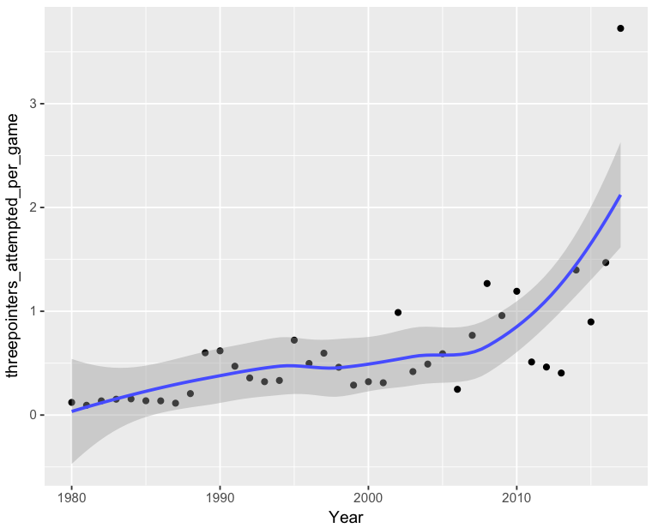
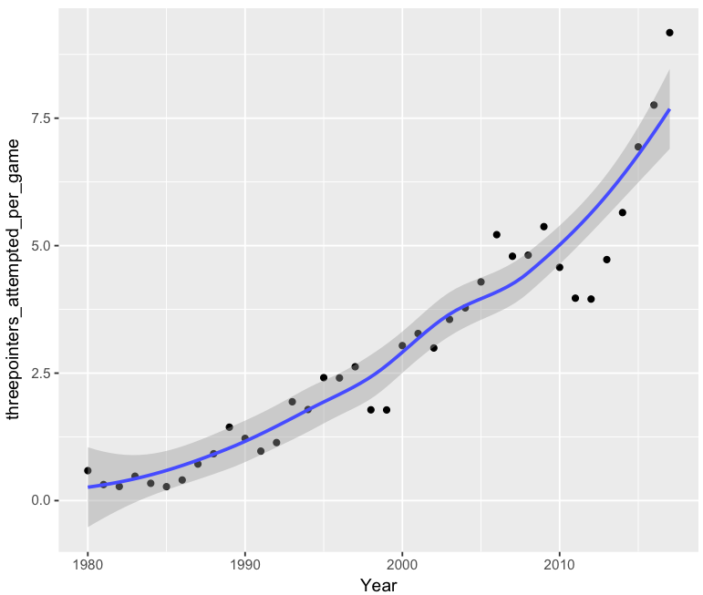
The Evolution of Big Men (3-pt attempted)
Do Centers and Power Forwards take more 3-point shots and are they making those shots?
Power Forward
Centers

Slide 4
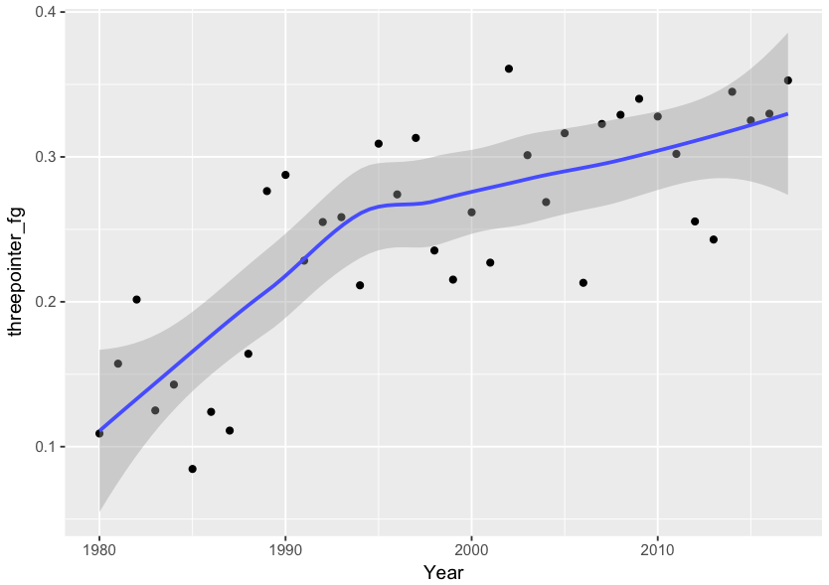
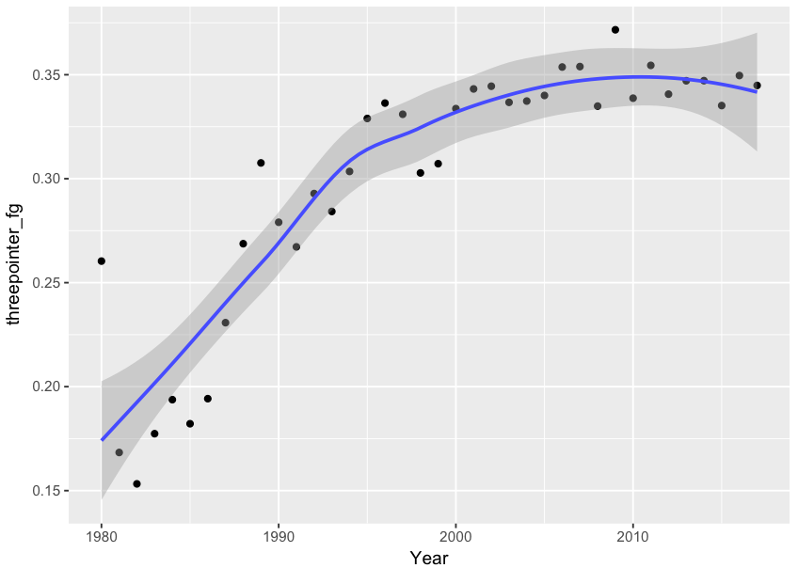
The Evolution of Big Men (3-pt %)
Centers
Power Forwards

Slide 5
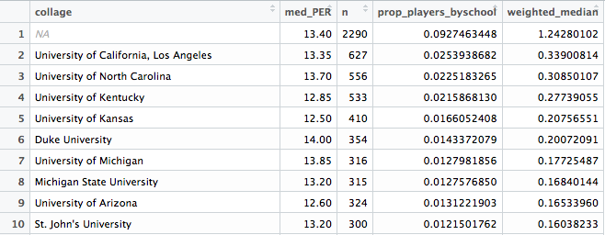
Which Schools Produce Better Players? (Player Efficiency Ratings)

Slide 6
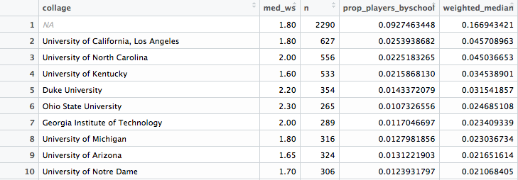
Which Schools Produce Better Players? (Win Shares)

