Slide 1
MATLAB for Scientists Lecture 3

Slide 2
Matrix indexing
Logical indexing
Simple input/output

Slide 3
Comparing elements from a matrix
We want to only study students who’s heartrate increased after 5 minutes compared to 1 minute (otherwise they are too fit!)
Pull out heart rates for 1 minute and 5 minutes of exercise only
Determine if there are heart rates that did not increase after 5 compared to 1 minute
If so, remove the rows that are outliers
Student | Heart rate (bpm)
 | 1 min of exercise | 2 min of exercise | 3 min of exercise | 4 min of exercise | 5 min of exercise
1 | 88 | 98 | 102 | 110 | 110
2 | 120 | 114 | 103 | 115 | 118
3 | 87 | 100 | 112 | 112 | 130
4 | 93 | 109 | 115 | 120 | 122

Slide 4
Comparing elements from a matrix
We want to only study students who’s heartrate increased after 5 minutes compared to 1 minute (otherwise they are too in shape!)
Pull out heart rates for 1 minute and 5 minutes of exercise only
Determine if there are heart rates that did not increase after 5 compared to 1 minute
If so, remove the rows that are outliers
Student | Heart rate (bpm)
 | 1 min of exercise | 2 min of exercise | 3 min of exercise | 4 min of exercise | 5 min of exercise
1 | 88 | 98 | 102 | 110 | 110
2 | 120 | 114 | 103 | 115 | 118
3 | 87 | 100 | 112 | 112 | 130
4 | 93 | 109 | 115 | 120 | 122

Slide 5
Matrix indexing
Indexing into a matrix, or matrix indexing, is a means of selecting a subset of elements from a matrix.
$$\left[\begin{matrix}1 & 3 & 2 \\ −1 & 7 & 4 \\ \begin{matrix}−1 \\ 22\end{matrix} & \begin{matrix}2 \\ 8\end{matrix} & \begin{matrix}1 \\ −5\end{matrix}\end{matrix}\right]$$
$$\left[\begin{matrix}3 & 2 \\ 7 & 4 \\ 2 & 1\end{matrix}\right]$$
MATLAB has pre-defined syntax to make this easy for us

Slide 6
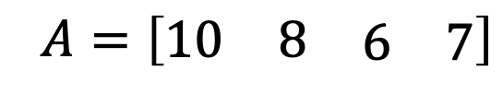
Index notation for vectors
Index notation is used to specify the location of elements in an array, and is denoted by subscripts
Elements of a vector are described by a single index. For a vector with n elements, then:
This allows us to identify individual elements based on their location. For the vector , then a₁ = 10 is the element at index 1
$$A=\left[\begin{matrix}a_{1} \\ a_{2} \\ \begin{matrix}: \\ a_{n}\end{matrix}\end{matrix}\right]$$
$$A=\left[\begin{matrix}a_{1} & a_{2} & \begin{matrix}.. & a_{n}\end{matrix}\end{matrix}\right]$$
$$A=\left[\begin{matrix}10 & 8 & \begin{matrix}6 & 7\end{matrix}\end{matrix}\right]$$

Slide 7
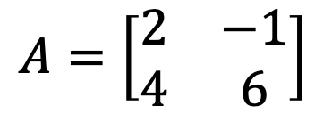
Index notation for matrices
Index notation is used to specify the location of elements in an array, and is denoted by subscripts
Elements of a matrix are described by two indices. For a matrix with mxn elements, then:
For the matrix , then a₂₁ = 4 is the element located at the index (2,1), which is in the 2nd row, 1st column
$$A=\left[\begin{matrix}a_{11} & \begin{matrix}a_{12} & ⋯\end{matrix} & a_{1n} \\ \begin{matrix}a_{21} \\ ⋮\end{matrix} & \begin{matrix}\begin{matrix}a_{22} & ⋯\end{matrix} \\ \begin{matrix}⋮ & ⋱\end{matrix}\end{matrix} & \begin{matrix}a_{2n} \\ ⋮\end{matrix} \\ a_{m1} & \begin{matrix}a_{m2} & ⋯\end{matrix} & a_{mn}\end{matrix}\right]$$
$$A=\left[\begin{matrix}2 & −1 \\ 4 & 6\end{matrix}\right]$$

Slide 8
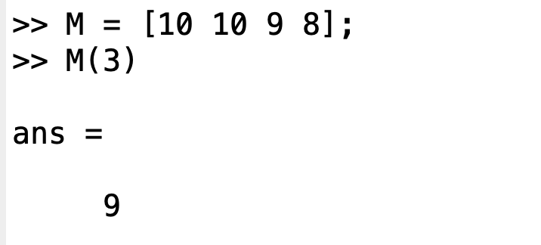
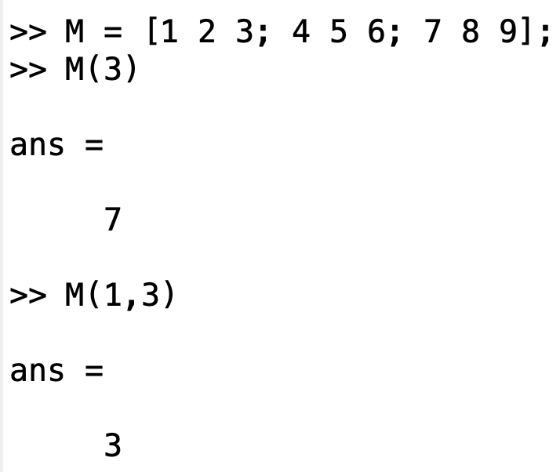
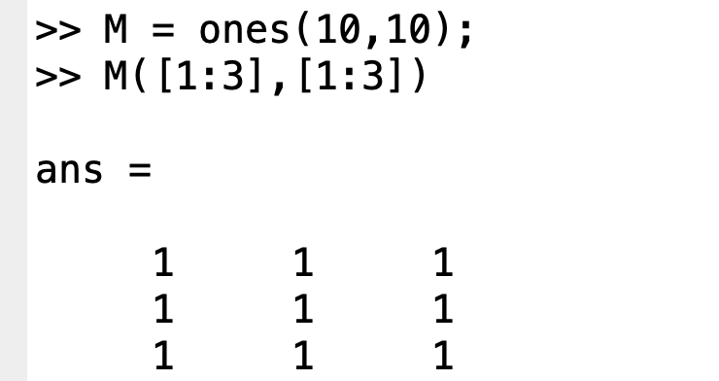
Matrix indexing in MATLAB
M(idx)
Returns a single element of M located at the index idx, where idx is a scalar.
M(idx1,idx2)
Returns the elements of M at the row index idx1 and column index idx2
M([idx1:idx2],[idx3:idx4])
Returns the elements of M beginning at the index idx1 and ending at idx2
*Note the parentheses are the syntax for indexing!

Slide 9
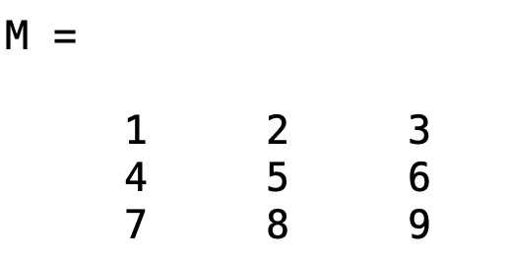
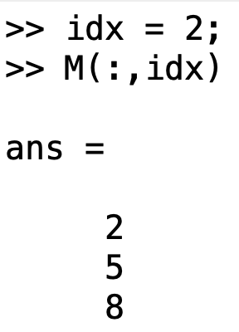
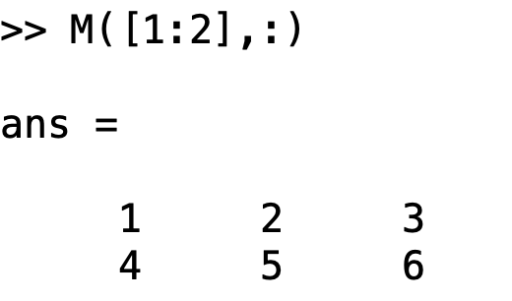
Matrix indexing: accessing matrix slices
M(:,idx) Returns all row elements in column idx
M(:,end) Returns all rows in the last column
M(idx,:) Returns all column elements in row idx
M(:,[idx1,idx2])Returns all row elements in columns idx1 & idx2
What will this return?
How do we get this output?

Slide 10
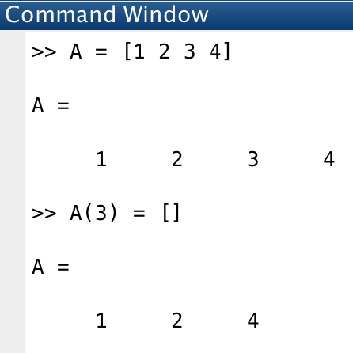
Matrix indexing: reducing matrices
You can remove elements from a matrix by setting it as empty

Slide 11
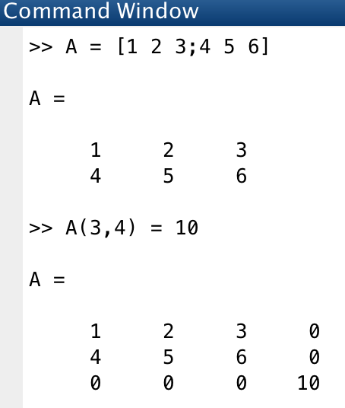
Matrix indexing: expanding matrices
You can add one or more elements to a matrix by placing them outside of the existing row and column index boundaries
MATLAB pads matrices with zeros

Slide 12
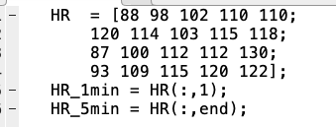
Comparing elements from a matrix
We want to only study students who’s heartrate increased after 5 minutes compared to 1 minute (otherwise they are too in shape!)
Pull out heart rates for 1 minute and 5 minutes of exercise only
Determine if there are heart rates that did not increase after 5 compared to 1 minute
If so, remove the rows that are outliers

Slide 13
Matrix indexing and modification (lecture3_liveEx1.m)
Indexing matrix rows and columns
Indexing multiple rows and columns simultaneously
Adding elements to a matrix
Removing elements from a matrix
Changing specific elements of a matrix

Slide 14
Comparing elements from a matrix
We want to only study students who’s heartrate increased after 5 minutes compared to 1 minute (otherwise they are too in shape!)
Pull out heart rates for 1 minute and 5 minutes of exercise only
Determine if there are heart rates that did not increase after 5 compared to 1 minute
If so, remove the rows that are outliers
Student | Heart rate (bpm)
 | 1 min of exercise | 2 min of exercise | 3 min of exercise | 4 min of exercise | 5 min of exercise
1 | 88 | 98 | 102 | 110 | 110
2 | 120 | 114 | 103 | 115 | 118
3 | 87 | 100 | 112 | 112 | 130
4 | 93 | 109 | 115 | 120 | 122

Slide 15
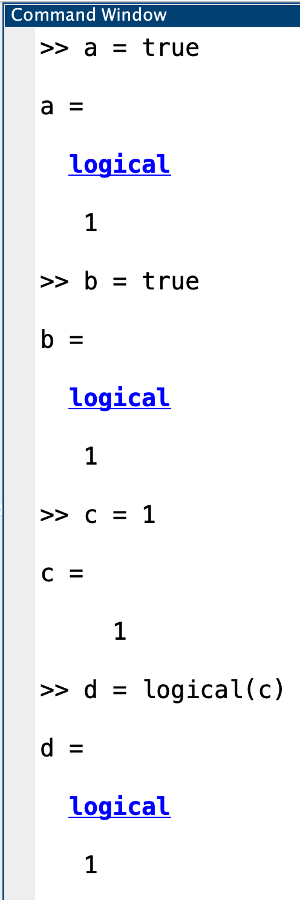
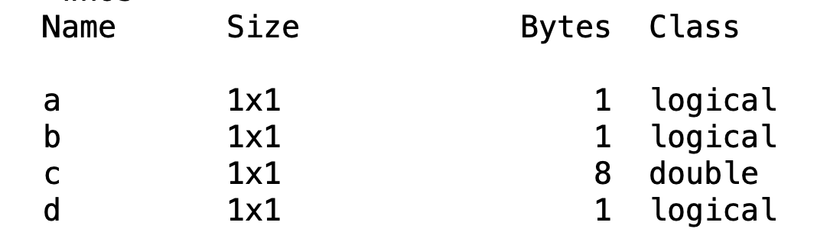
Logical variable class
logical | Variable class AND function to Convert double values to logicals
true | Logical 1
false | Logical 0
MATLAB has a logical variable class with values of true and false, sometimes referred to as Boolean conditions
Notice although a and b were set as true and false, their values appear as 1’s and 0’s, and the workspace class is logical:

Slide 16
Logical and relational operators and functions 1
Relational operators compare the elements in two arrays. The result of a relational comparison is a logical array indicating the locations where the relation is true (1), or false (0)
== | Relational operator: equal to
~= | Relational operator: not equal to
< | Relational operator: less than
<= | Relational operator: less than or equal to
> | Relational operator: greater than
>= | Relational operator: greater than or equal to
***Note that a single = denotes variable assignment and never tests for equality!

Slide 17
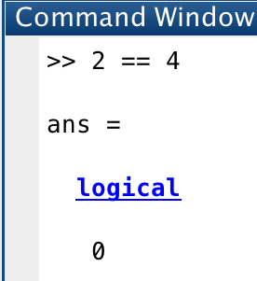
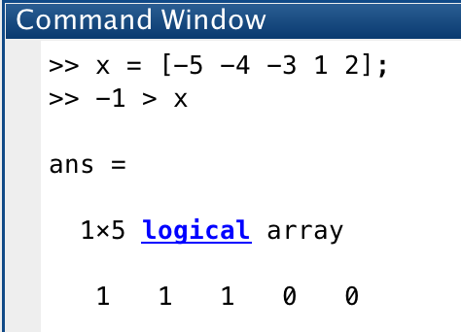
Logical statements for evaluating scalars
Comparing scalars to other scalars
Comparing scalars to a matrix:

Slide 18
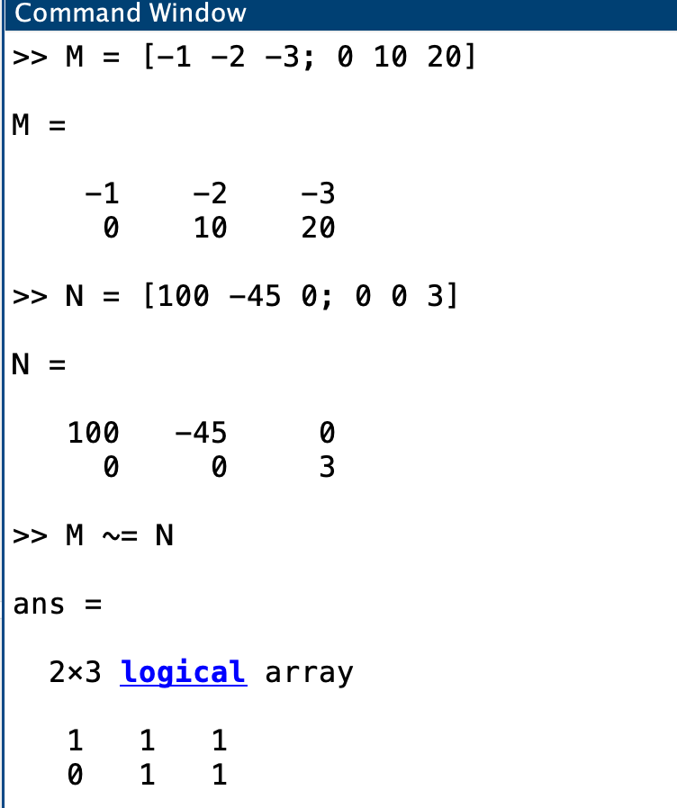
Logical statements for evaluating matrices
Comparing matrices to matrices

Slide 19
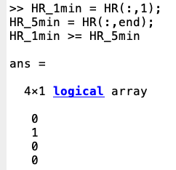
Comparing elements from a matrix
We want to only study students who’s heartrate increased after 5 minutes compared to 1 minute (otherwise they are too in shape!)
Pull out heart rates for 1 minute and 5 minutes of exercise only
Determine if there are heart rates that did not increase after 5 compared to 1 minute
If so, remove the rows that are outliers
Yes…but what if there were too many students to visually inspect?

Slide 20
Logical and relational operators and functions 2
Logical operators return logical values to indicate fulfillment of a condition
& | Find logical AND
~ | Find logical NOT
| | Find logical OR
xor() | Find logical exclusive-OR
all() | Determine if all array elements are nonzero or true
any() | Determine if any array elements are nonzero
find() | Find indices and values of nonzero elements
islogical() | Determine if input is logical array

Slide 21
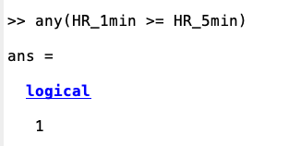
Comparing elements from a matrix
We want to only study students who’s heartrate increased after 5 minutes compared to 1 minute (otherwise they are too in shape!)
Pull out heart rates for 1 minute and 5 minutes of exercise only
Determine if there are heart rates that did not increase after 5 compared to 1 minute
If so, remove the rows that are outliers
Yes!!!

Slide 22
Comparing elements from a matrix
We want to only study students who’s heartrate increased after 5 minutes compared to 1 minute (otherwise they are too in shape!)
Pull out heart rates for 1 minute and 5 minutes of exercise only
Determine if there are heart rates that did not increase after 5 compared to 1 minute
If so, remove the rows that are outliers
Student | Heart rate (bpm)
 | 1 min of exercise | 2 min of exercise | 3 min of exercise | 4 min of exercise | 5 min of exercise
1 | 88 | 98 | 102 | 110 | 110
2 | 120 | 114 | 103 | 115 | 118
3 | 87 | 100 | 112 | 112 | 130
4 | 93 | 109 | 115 | 120 | 122

Slide 23
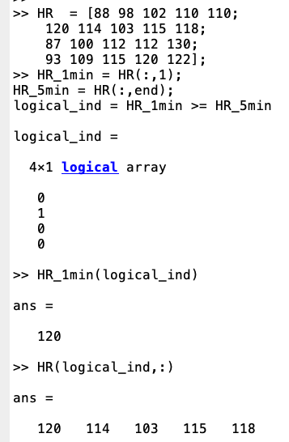
Logical indexing
Logical indexing allows us to access elements in a matrix that meet a certain condition
Indexing a matrix is performed with a variable of the class logical
This is a special type of general indexing that returns elements in the positions where a logical is true (e.g., equals 1)

Slide 24
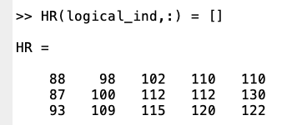
Comparing elements from a matrix
We want to only study students who’s heartrate increased after 5 minutes compared to 1 minute (otherwise they are too in shape!)
Pull out heart rates for 1 minute and 5 minutes of exercise only
Determine if there are heart rates that did not increase after 5 compared to 1 minute
If so, remove the rows that are outliers
How do we remove that row?

Slide 25
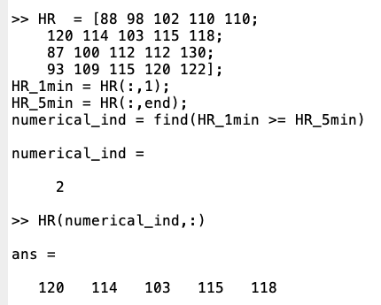
Finding specific indices in a matrix with find
The find command returns the indices corresponding to the nonzero elements of a logical vector.
This function is an alternative way of accessing elements in a matrix that meet a specific condition
The results of find are indices that can be used to reference different datasets

Slide 26
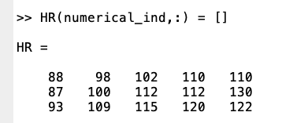
Comparing elements from a matrix
We want to only study students who’s heartrate increased after 5 minutes compared to 1 minute (otherwise they are too in shape!)
Pull out heart rates for 1 minute and 5 minutes of exercise only
Determine if there are heart rates that did not increase after 5 compared to 1 minute
If so, remove the rows that are outliers
How do we remove that row?

Slide 27
Logical statements with multiple inputs
What if we now need to exclude any values outside of our devices accurate detection limit? (below 90 and above 120)
Student | Heart rate (bpm)
 | 1 min of exercise | 2 min of exercise | 3 min of exercise | 4 min of exercise | 5 min of exercise
1 | 88 | 98 | 102 | 110 | 110
2 | 120 | 114 | 103 | 115 | 118
3 | 87 | 100 | 112 | 112 | 130
4 | 93 | 109 | 115 | 120 | 122

Slide 28
Truth table for logical operators
X | Y | ~X | X | Y | X&Y | xor(X,Y)
1 | 1 | 0 | 1 | 1 | 0
1 | 0 | 0 | 1 | 0 | 1
0 | 1 | 1 | 1 | 0 | 1
0 | 0 | 1 | 0 | 0 | 0
Inputs are logical variables (e.g., the result of a relational comparison)
Truth table shows expected output for combinatorial logical statements
See help precedence for order of operation precedence
Always use parentheses to make your intention clear to the reader of your code.

Slide 29
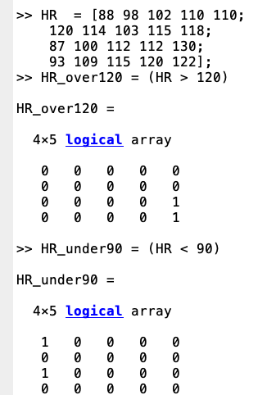
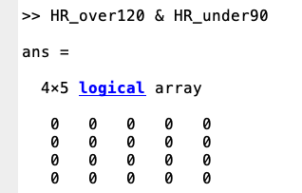
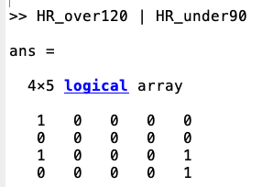
Logical statements with multiple inputs
What if we now need to remove any any heart values outside of our devices accurate detection limit? (below 90 and above 120)
How do we get the heart rates that are both above 90 and below 120?
Logical AND indicates two truth’s
Logical OR indicates either one can be true

Slide 30
Matrix indexing and modification (lecture3_liveEx2.m)
Using relational operators (==, ~=) and indexing
Using logical functions (ex: any)
Using logical operators
Using find
Notes:
BREAK

Slide 31
Finding the # of elements that meet a condition
Use length(find(condition)) or sum the logical indices
Ex: To find the number heartrates that fall outside our detection limit:
length(find(HR_over120 | HR_under90))
or
sum(HR_over120 | HR_under90)

Slide 32
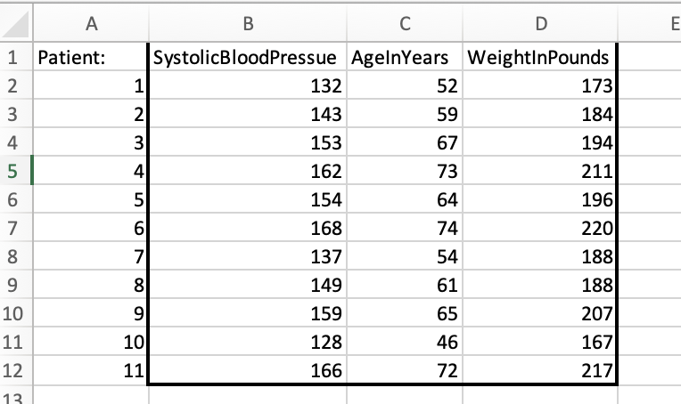
Lecture3_GrpEx1_HRData.mat contains data from the following excel file in three separate column vectors:
Load in and concatenate the data
Logical indexing
Filter and re-save the data
Group exercise 1
Notes:
BREAK

Slide 33
HOMEWORK FORMATTING
Complete each question in an individual script. Each individual script should be named according to: HW#Q#_script.m, where <#> indicates the corresponding HW number or question. These will be considered for grading.
Submit all files (including the provided data, but excluding any tables/files that are saved as a result of the HW question) as a compressed .zip folder with the name <HW#_studentID.zip>. *Do not name it after zipping*
Each script must run entirely through without error. If you did not finish part of a question, comment it out so it runs.
Suppress all intermediate outputs other than your answer to the question; only the answer should display on the command line.
Absolutely no hard coding beyond the minimum specified.
Everything must be commented. Uncommented codes get zero credit!

Slide 34
HOMEWORK FORMATTING
Hand in all your files as a compressed (zipped) folder
On Mac:
Put all files into one folder
Rename as HW#_<studentID>
Right click on folder
Select Compress
Submit the .zip file as HW#_<studentID>.zip
On PC:
Put all files into one folder
Rename as HW#_<studentID>.zip
Right click on folder
Select (or point to) Send to, and then select Compressed (zipped) folder.
Submit the .zip file as HW#_<studentID>.zip

