Slide 1
MATLAB for Scientists Lecture 4

Slide 2
Algorithms
If statements
For loops
User-defined functions
Notes:
https://docs.google.com/spreadsheets/d/14H-iRVxEagUF6No9YJbKxAKDjQTcAw87NxeWAF4NRlM/edit#gid=0

Slide 3
What is an algorithm?
An algorithm is a sequence of steps that performs a particular task or set of tasks
The steps must be non-ambiguous (e.g., bake until done vs. bake at 375F for 40 mins)
Algorithmic steps:
Get the input(s)
Calculate the result(s)
Display the result(s)

Slide 4
Algorithm examples
Problem 1
Input: A bag of 100 marbles that are either red, blue, or yellow.
Output: 3 piles of marbles sorted by color.
Problem 2
Input: A bag of 100 marbles.
Output: Piles of marbles sorted by color.
Problem 3
Input: A bag.
Output: Sort the marbles in the bag into individual piles by color.

Slide 5
Control structure in scripts
What happens if we only want to execute a command if some set of conditions are met?
MATLAB provides several built-in functions that allow us to implement controlled structure
If/elseif/else statements
For loop

Slide 6
Control structure
Selection statements: to evaluate specific conditions
if, elseif, else | executes a group of statements when the expression is true.
For loop: to implement repetitive steps
for | executes a group of statements in a loop for a specified # of times
continue | Continues to next loop
break | Breaks current loop

Slide 7
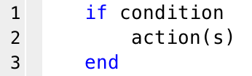
The IF statement
Statement header: begin with if, followed by space, then a Boolean expression
Boolean expression/a logical or relational expression for scalars
Actions to be performed if the condition is TRUE
Reserved words for if statements: if and end

Slide 8
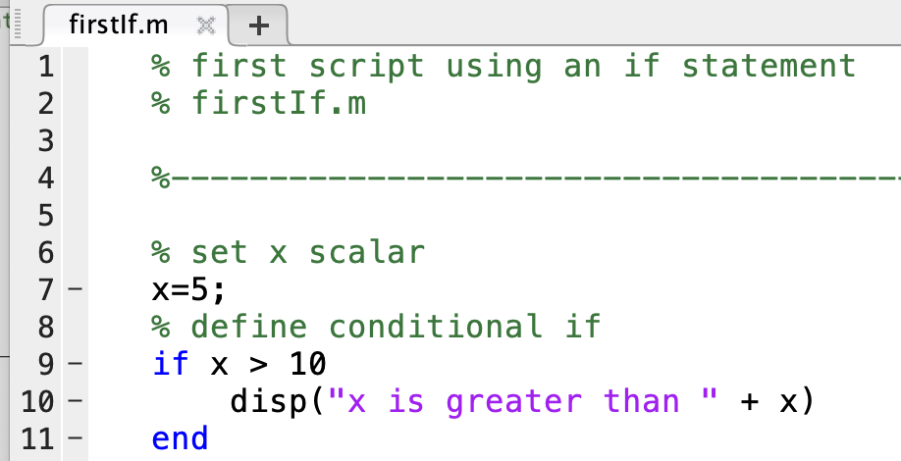
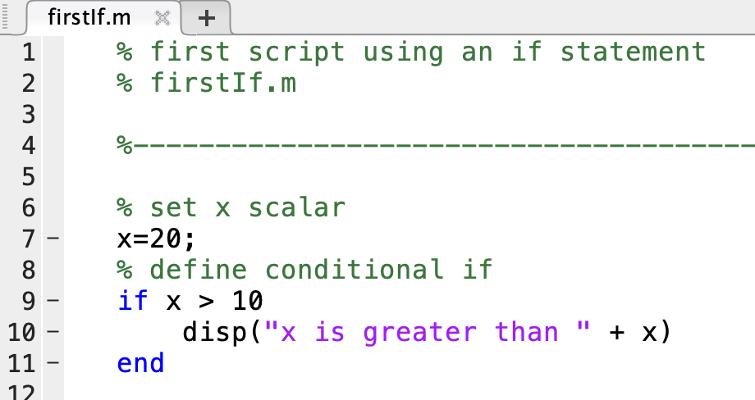
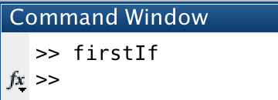
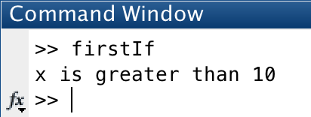
The IF statement inside of scripts

Slide 9
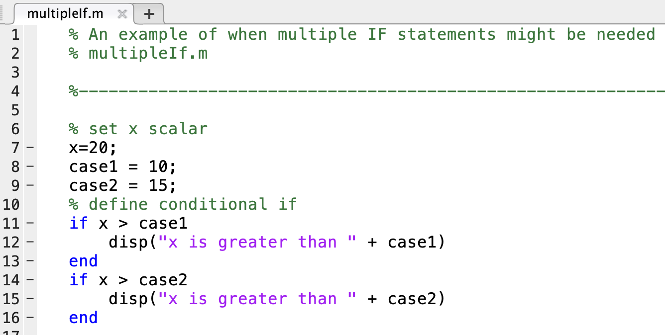
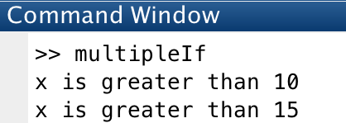
Duplicate IF statements
Use duplicate IF statements when one or multiple conditions might be true

Slide 10
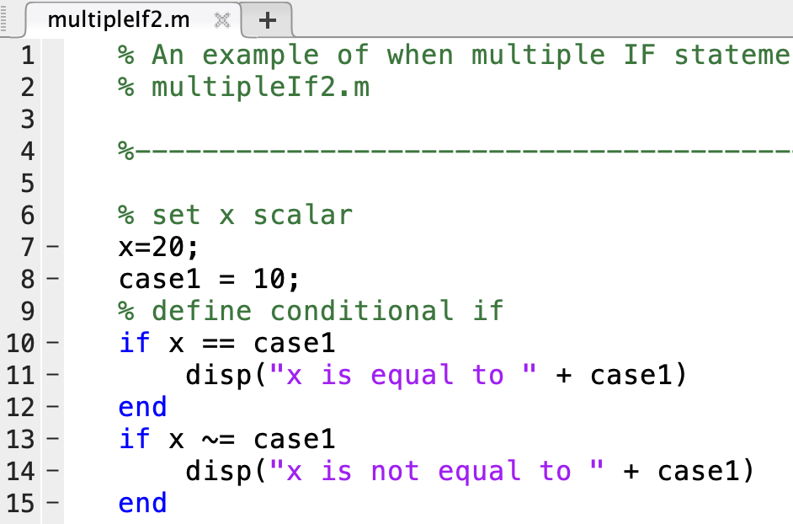
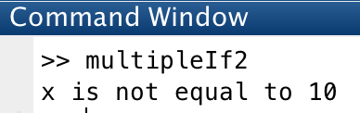
Duplicate IF statements
What do you think about this?
Each statement must be checked individually
Inefficient and computationally intensive

Slide 11
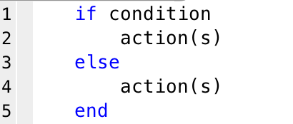
The IF-ELSE statement
Actions to be performed if the condition is TRUE
Actions to be performed if the condition is FALSE
else keyword separates case 1 from all other cases

Slide 12
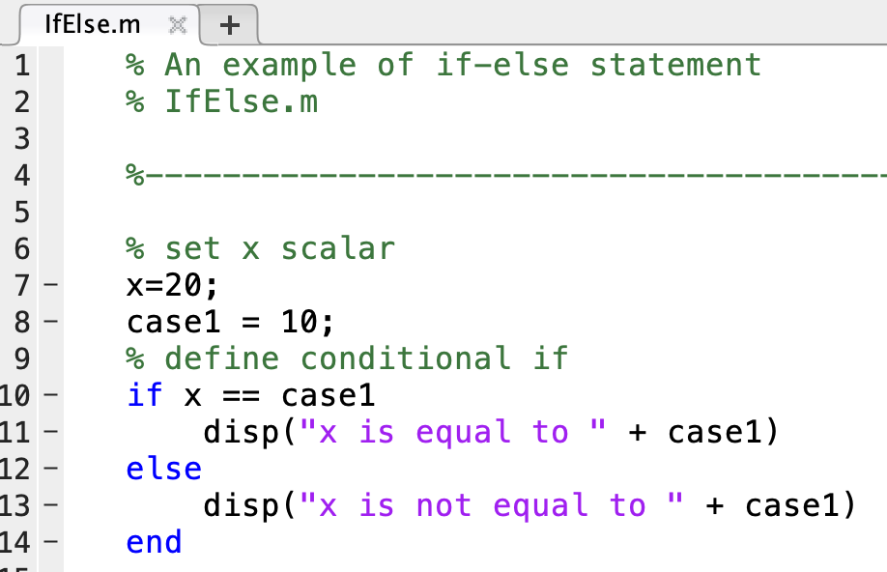
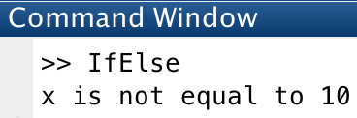
IF-ELSE statements instead of duplicate IF statements
Much cleaner code! It does the same thing logically, but
More efficient
Better style
Easier to interpret the logic

Slide 13
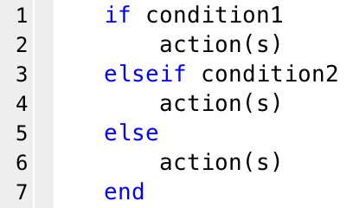
The IF-ELSEIF-ELSE statement
Only executed if condition1 is TRUE
Only executed if condition1 is FALSE and condition2 is TRUE
Only executed if condition1 and condition2 are both FALSE
elseif keyword to check if the next condition is met
Note: You can have as many elseif lines as you want/need

Slide 14
If-else statements (lecture4_liveEx1.m)
Write a script that generates a random vector of integers between 0 and 10 of length 5. If at least one of the elements is equal to 10, display “At least 1 number equals 10!”. If none of the elements equals 10, but at least one of the numbers equals 5, display “At least 1 number equals 5!”. If none of the elements equals either a 5 or a 10, display “Better luck next time.”

Slide 15
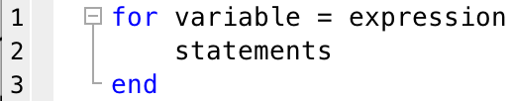
The for loop
Statement header: must begin with for, space, expression
Actions to be performed
Iterations of the loop, where variable becomes your index
for and end words that define the for loop
Usually, ‘variable = expression’ is of the form n = a:b

Slide 16
What variable is changing, what values does it take, and what # loops?
for n = 1:10 % for n = 1,2,3,4,5,6,7,8,9,10
Vec1 = 1:2:10
for n = vec1 % for n = 1,3,5,7,9
Vec2 = [1,5,6,10:14]
for q = Vec2 % for q = 1,5,6,10,11,12,13,14
Mat = rand(5,3);
for var = 1:size(Mat,2) % var = 1 2 3

Slide 17
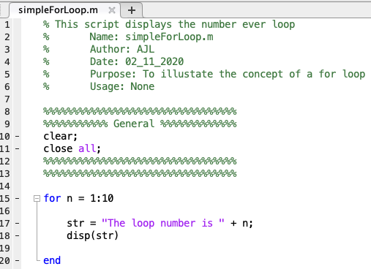
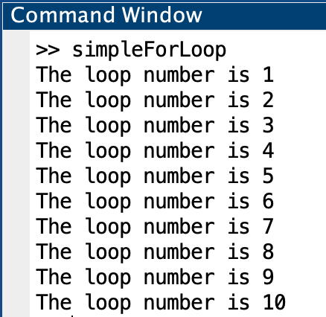
The for loop: iterating through indices

Slide 18
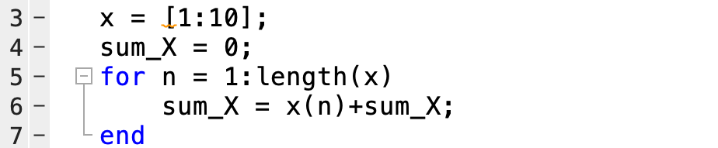
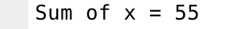
The for loop: incrementing a value
Automating the # of loops (no hard coding)
To sum every element in x:
Initializing the variable

Slide 19
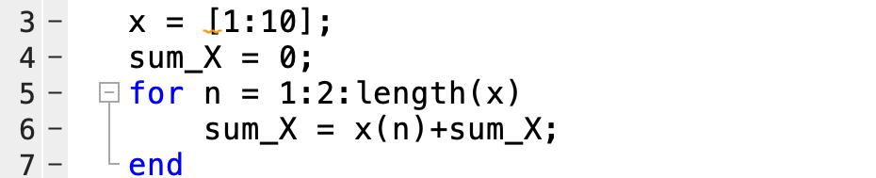

The for loop: incrementing in any step size
To sum every other element in x:
Every 2 steps

Slide 20
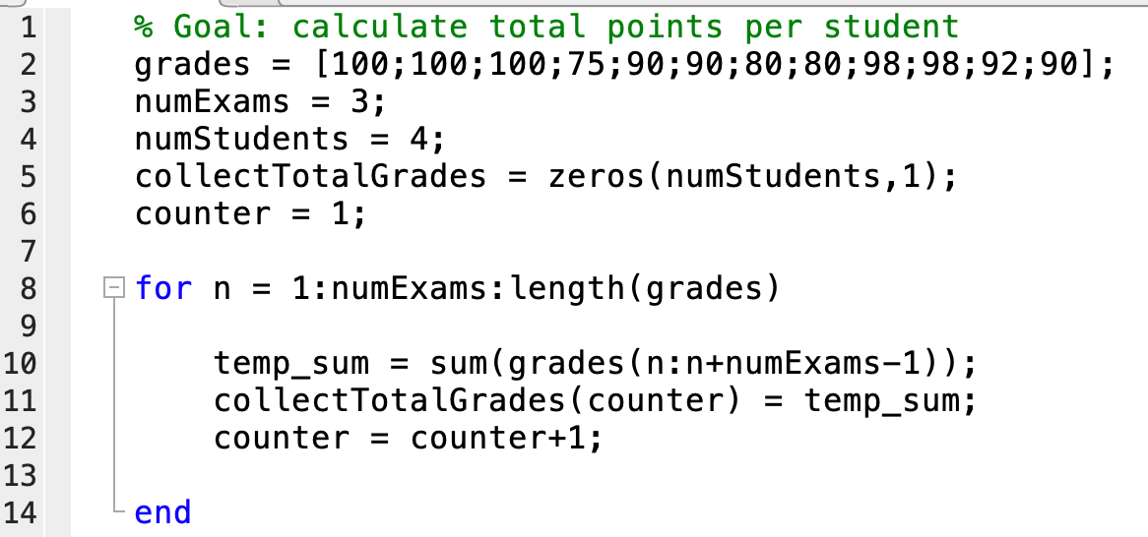
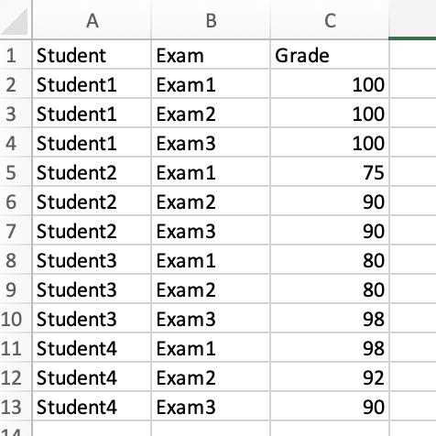
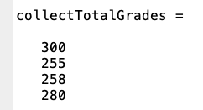
The for loop: collecting data into a vector or matrix
To collect the total points earned per student
Creating a zeros matrix of known size to be filled in

Slide 21
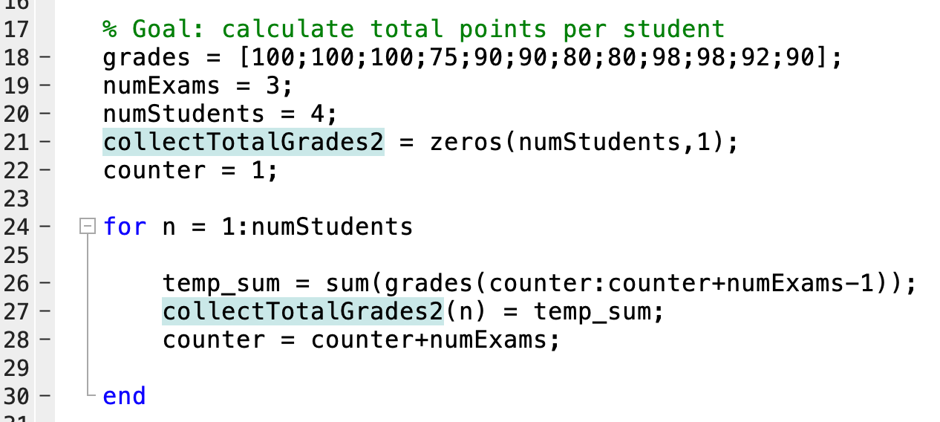
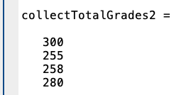
The for loop: collecting data into a vector or matrix
Alternative:

Slide 22
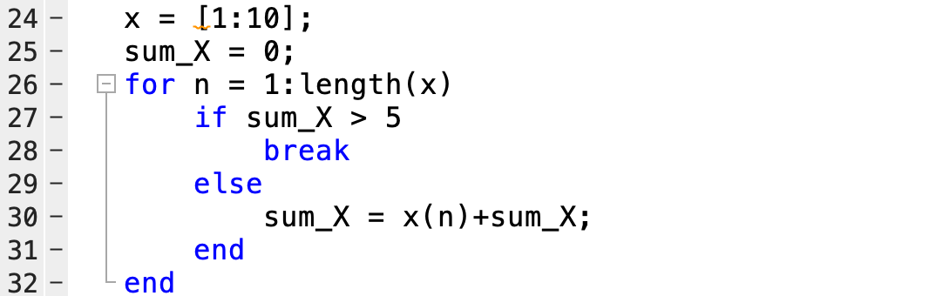
The for loop: integrating with if statements
To collect the sum of elements in x until a condition is met:
continue works the same way

Slide 23
Initiating a vector with unknown size:
Initiate empty vector:
Filler_vector = [ ];
To fill it in, we can use the index <end + 1> to access the next row/column, or we can concatenate:
Ex:
1. Filler_vector(end+1) = mat;
2. Filler_vector = [Filler_vector , mat];
Since this is concatenation, can also use ;
You can do the same thing with matrices!!

Slide 24
Does my script need a for loop?
What is the task you are doing? (plotting, calculating, etc.). (If no task→why are you coding? Exit MATLAB)
Is there anything repetitive? (if not → no loop!) If yes, continue to step 3
What goes inside the loop?
The action is repeated and changing → this goes inside the loop
The variable is constant → this stays outside
How any times is it being repeated? → This decides how many loops you need
What needs to change? → This decides how we use the looping index
Are we collecting anything? → This decides if we need a collection matrix

Slide 25
For loops (lecture4_liveEx2.m)
Generate one random vector of integers between 0 and 10 of length 12. Loop through all of the elements in this vector. Every time you reach a number 10, display “Number 10 identified”. However, if you reach a number 3, display “Number 3 identified”

Slide 26
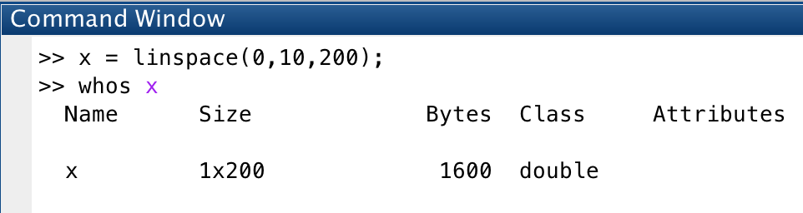
Functions
Functions are a way of automating processes that you do frequently
We have already used many built-in functions (e.g., sin, cos, linspace, plot)
They don’t run like scripts. We call them from the command line or from within another script
open linspace.m to see syntax
The ‘Call’, aka calling function
The input variables
Where the return value is stored

Slide 27
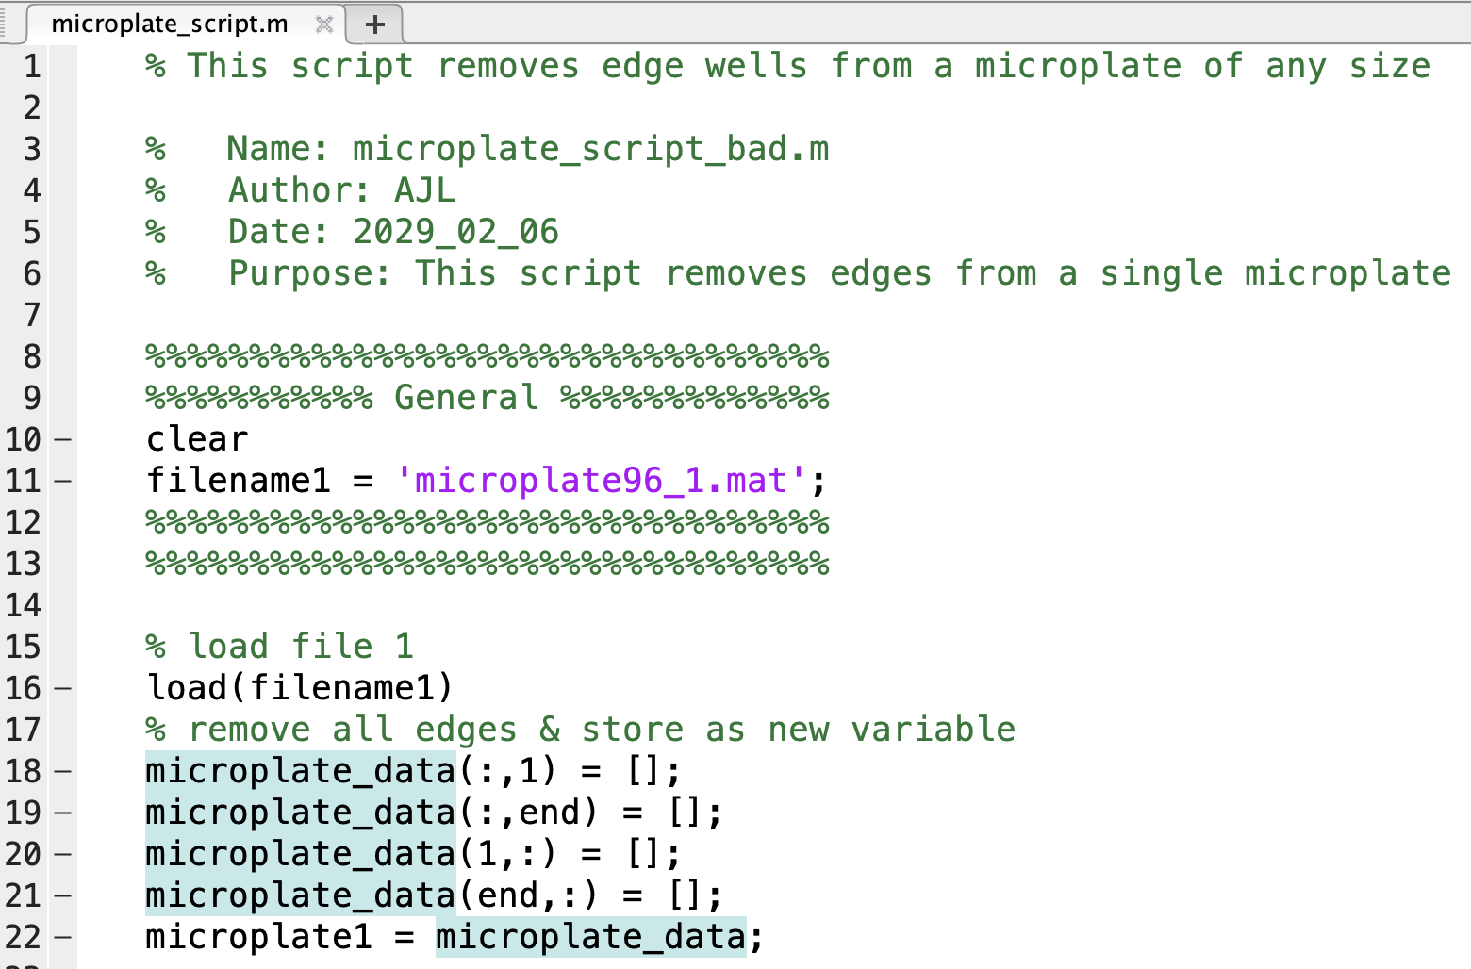
Ex: script writing
Goal: Remove edges from a microplate
Algorithm steps:
Import microplate data
Remove edges

Slide 28
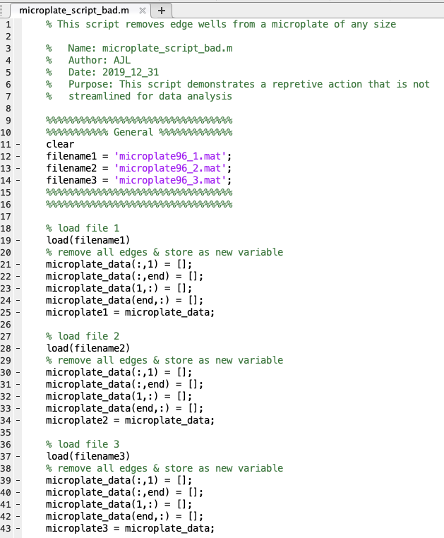
Ex: poor script writing
Goal: Remove edges from 3 files of microplates
Algorithm steps:
Import data from plate 1
Remove edges from plate 1
Import data from plate 2
Remove edges from plate 2
Import data from plate 3
Remove edges from plate 3

Slide 29
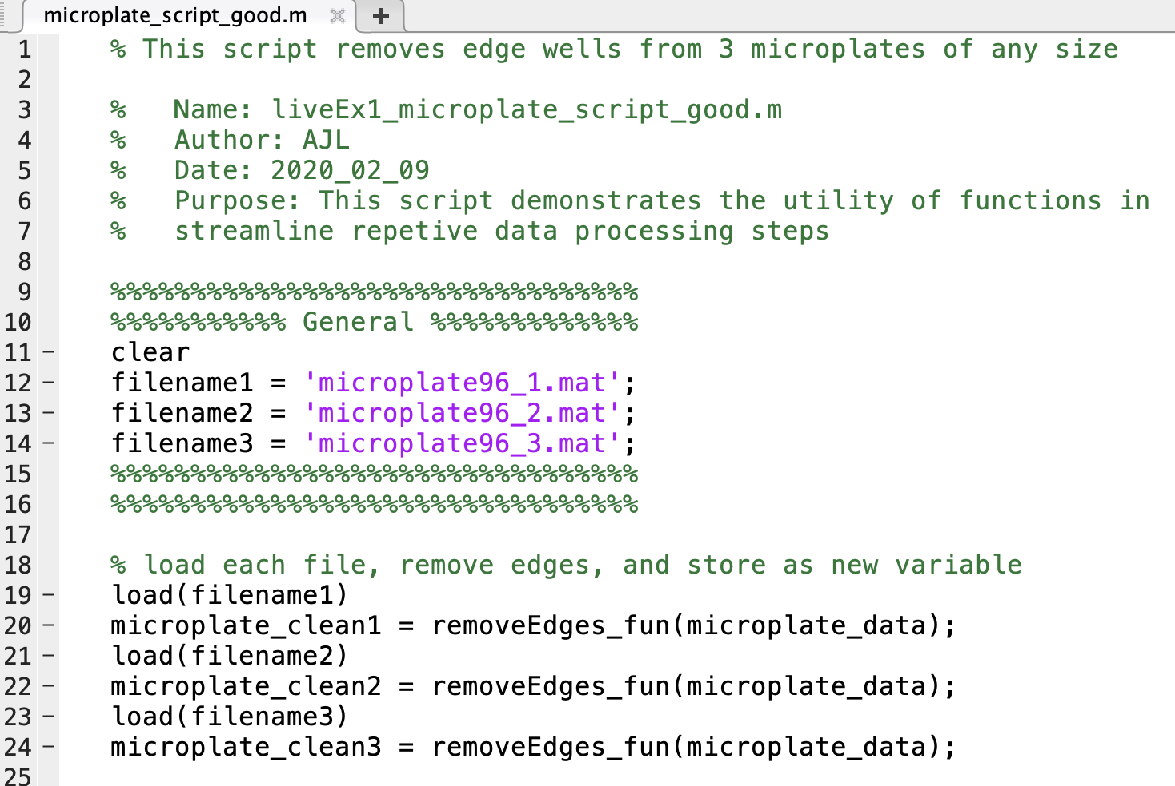
Ex: good script writing
Goal: Remove edges from 3 files of microplates
Algorithm steps:
Import data from plate 1
Remove edges from plate 1
Import data from plate 2
Remove edges from plate 2
Import data from plate 3
Remove edges from plate 3

Slide 30
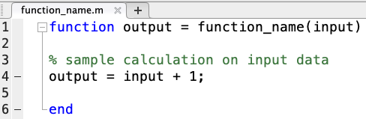
User-defined functions
A function must be in your current directory
Function header at the top of every function (below comment header)!
Input arguments (provided by user)
Name of function (must be identical to name of file without .m)
Value that is returned
The reserved word “function” (1st line must start with this) and “end”

Slide 31
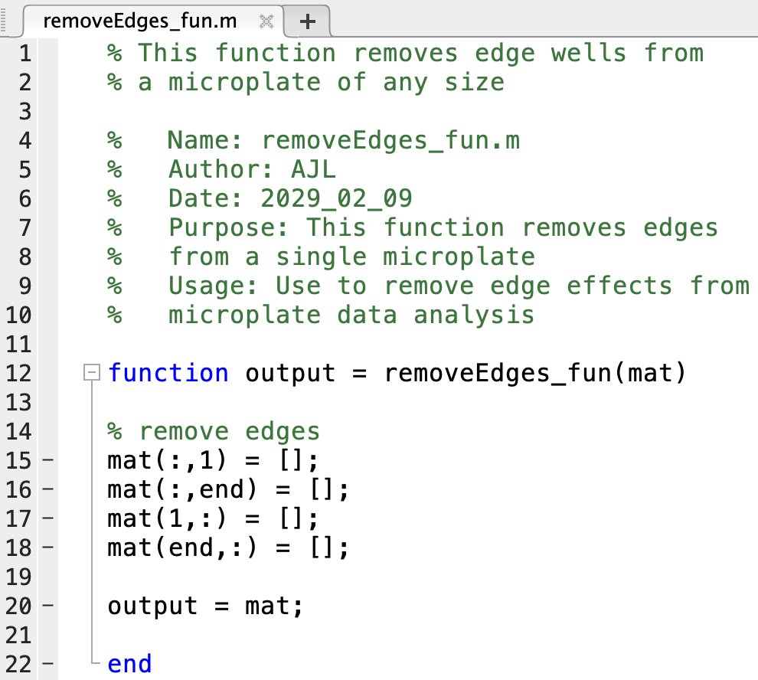
Removing edges
Function name
Function usage
Function header
Input arguments
Name of function
Value that is returned
The reserved words

Slide 32
Removing edges
Things to note:
Script (or command line) calls the function (cannot run functions independently)
The function name (highlighted in blue) needs to exactly match the .m file name (at top)
Usage is filled out in the header
Script input names don’t need to match function input names

Slide 33
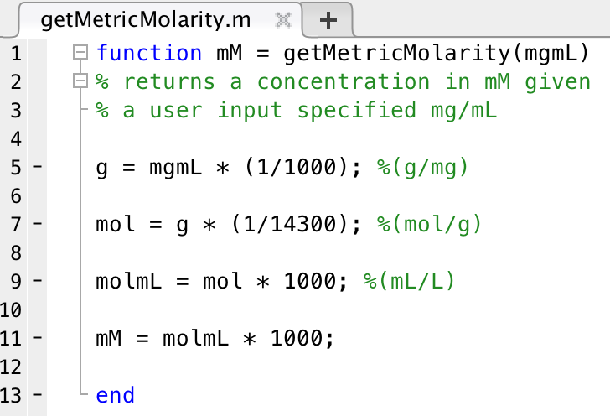
User-defined functions: concentration conversions
Problem: We want to be able to convert 10 mg/mL lysozyme into mM
Solution: We write a function to convert mg/mL into mM concentration units
What are we really doing?
-A series of dimensional conversions
-None of these variables are seen by the user
Is this function general?
WHY?
$$\frac{mg}{mL}×\frac{g}{1000 mg}×\frac{mol}{14300 g}×\frac{1000 ml}{L}=M×\frac{1000 mM}{M}=mM$$

Slide 34
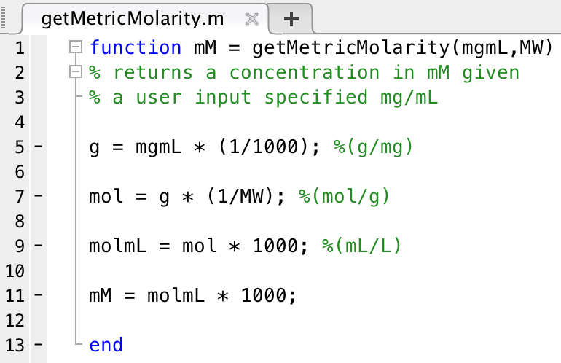
User-defined functions: an example
Functions can accept more than 1 argument
They can also output more than one variable
Make sure to suppress intermediate statements
Hard-coding is bad
Why?
2 inputs. Now this function is general

Slide 35
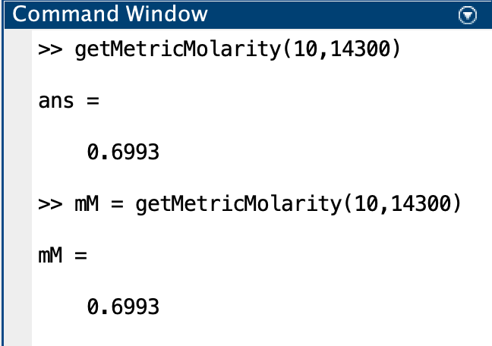
All variables inside of a function are local
Doesn’t have to match the variable name in the function
Variables inside of functions are local
Define the variable name when you call it!

Slide 36
How to write a function
function [y1, y2, ... , yN] = function_name(x1, x2, ... , xM)
Sketch out the basic algorithm
Write it out first as a script and identify the inputs
Determine all inputs: anything the user is allowed to define:
Anything that may change between calls
Anything internally hard-coded that is not general to the function purpose
Determine all outputs: anything the function returns
Generalize to a function once it’s working
Not every function returns an output variable (e.g., plot) (what would syntax be?)
If a function does not require an input, it should be left as a script
If you want multiple outputs, you can define that in the function header

Slide 37
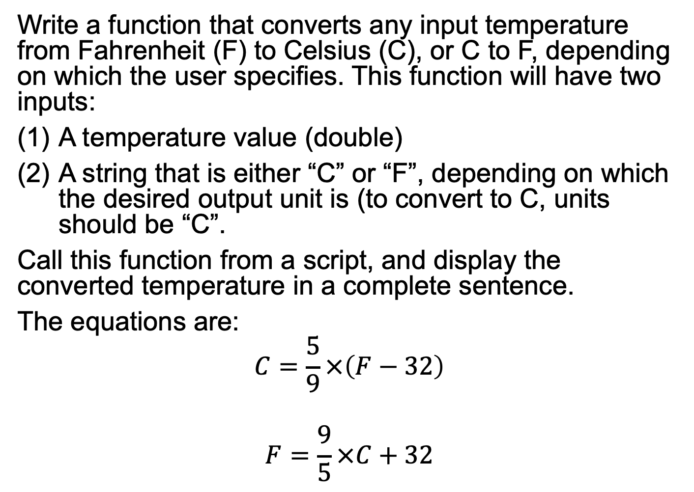
Write a function that converts any input temperature from Fahrenheit (F) to Celsius (C), or C to F, depending on which the user specifies. This function will have two inputs:
A temperature value (double)
A string that is either “C” or “F”, depending on which the desired output unit is (to convert to C, units should be “C”.
Call this function from a script, and display the converted temperature in a complete sentence.
The equations are:
$$C=\frac{5}{9}×\left(F−32\right)$$
$$F=\frac{9}{5}×C+32$$
lecture4_GrpEx1_FUN.m
lecture4_GrpEx1_SCRIPT.m

Slide 38
Exam information
Study guide: on courseworks under files→exam1→exam 1 study guide
HW4: First 4 questions are on the exam, last 2 are for the next week

