Slide 1
MATLAB for Scientists Lecture 5

Slide 2
Plotting
Data input/output
Cell arrays/string comparisons

Slide 3
What makes a bad plot?
BAD
GOOD
Not enough points to make a smooth line
Lines too thin

Slide 4
What makes a bad plot?
BAD
GOOD
Can’t tell lines apart
Axis labels? Title? Axis numbers?

Slide 5
A good plot!!!
Axis limit (x and y)
Legend
Line width and color

Slide 6
Plotting on a figure
figure() | Opens new figure handle
close() | Closes figure handle inside ()
close all | Closes all figures
hold on | Holds the data on a figure
plot(x,y,’LineSpec’) | creates a 2-D line plot of the data in Y versus X.

Slide 7
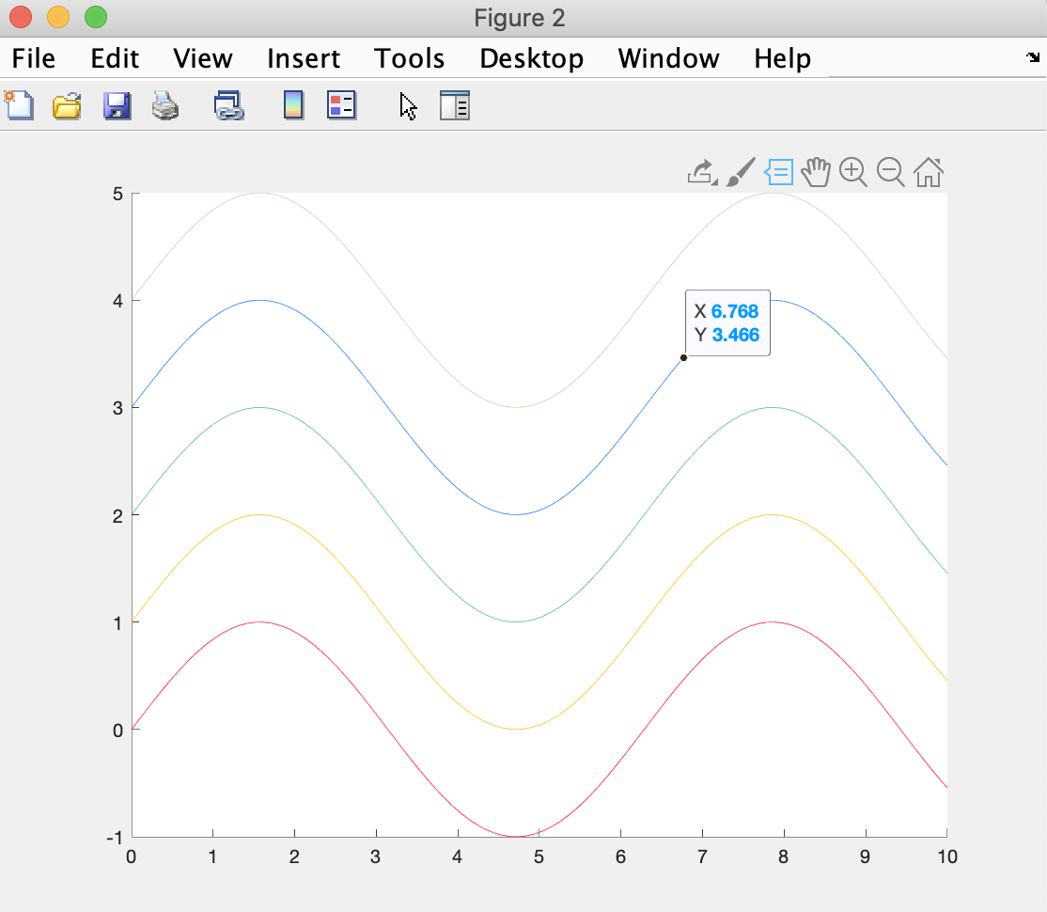
Anatomy of a MATLAB plot
MATLAB figure window
Dock figure in MATLAB desktop
Edit plot
Axis which MATLAB plots data
Data selector
Line plots representing data

Slide 8
Line properties overview
Line properties set visual aspects of the data itself
By default MATLAB plots solid lines
By default, multiple lines on the same plot are displayed in distinct colors
You can change the default properties by passing in line specifications at the time of plotting (e.g., don't plot something, and then go back and modify it later):
plot(x,y,’LineSpec’)

Slide 9
Line specifications
‘Color’ | Color
y | yellow
m | magenta
c | cyan
r | red
g | green
b | blue
w | white
k | black
‘LineStyle’ | Style
- | Solid
-- | Dashed
: | Dotted
-. | Dash-dot
‘Marker’ | Shape
o | Circle
+ | Plus sign
* | Asterisk
. | Point
x | Cross
s | Square
d | Diamond
^ | Carrot
v | V-shape
> | Right triangle
< | Left triangle
p | Pentagram
h | Hexagram

Slide 10

Plotting: y as a function of x
figure;
plot(x,y1)

Slide 11
Setting line specifications: the 4 most commonly used
figure;
plot(x,y1,’linestyle’,’--’)
figure;
plot(x,y1,’marker’,’s’)
figure;
plot(x,y1,’color’,’r’)
figure;
plot(x,y1,’linewidth’,3.0)

Slide 12
Setting line specifications: multiple specs at once
figure;
plot(x,y1,'color','r','linewidth',4.0,'linestyle’,’:','Marker','s')
**Order doesn’t matter
**Note that this does not change the x and y axes, only the plotted data

Slide 13
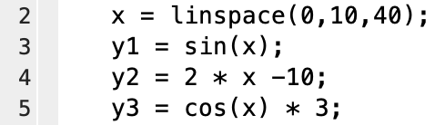
Only 1 ‘hold on’ is needed per figure
figure; hold on
plot(x,y1,'color','r','linewidth',4.0,'linestyle',':','Marker','s')
plot(x,y2,'color','b','linewidth',4.0,'linestyle','--’)
plot(x,y3,'color','g','linewidth',4.0,'linestyle','-.')

Slide 14
Labeling a plot
Labeling
title(‘enter title here’) | Label title of a plot
xlabel(‘enter label here’) | Label x-axis od a plot
ylabel(‘enter label here’) | Label y-axis of a plot
legend(‘data1’,’data2’,…,’dataN’) | Insert a legend
Axis limits
ylim([min max]) | Label y-axis of a plot
xlim([min max]) | Label x-axis of a plot
axis square | Use axis lines with equal lengths. Adjust the increments between data units accordingly.

Slide 15
Only need a square axis when the ranges of x and y are equal
xlabel(‘This is x’)
ylabel(‘This is y’)
title(‘example’)
legend(‘y1’,’y2’)
xlim([-10 10])
ylim([0 10])
Square axis?
No!

Slide 16
Only need a square axis when the ranges of x and y are equal
xlabel(‘This is x’)
ylabel(‘This is y’)
title(‘example’)
legend(‘y1’,’y2’)
xlim([0 10])
ylim([0 10])
axis square
Square axis?
Yes!

Slide 17
Setting axes properties
set(gca,’name’,value) | Sets axis properties
The only ones you need to know:
Linewidth
Fontsize

Slide 18
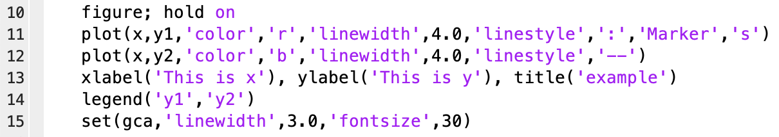
Add set at the end of each figure

Slide 19
Subplots
subplot(r,c,n) | Suplots with r rows, c columns, at the n’th location
Open figure and hold on
Open subplot and hold on. Why? We’re creating a eparate set of axes
Treat EACH subplot as you treat figure:
Must hold on to plot multiple lines
Must set the axes for each subplot
Must set titles/limits/legends for every subplot

Slide 20
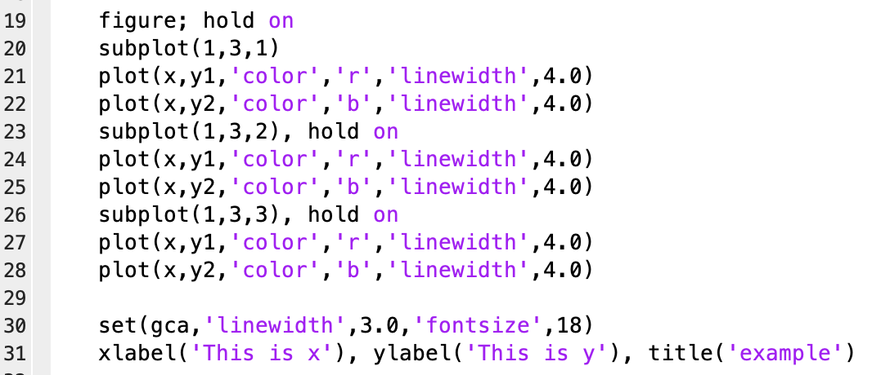
Subplot example

Slide 21
Plotting and subplots (lecture5_liveEx1.m)
Heartrates of two individual were tracked with high resolution over 15 minutes to examine the variability. This data is contained in lec5_liveEx1_heartrates.mat.
mins is a vector of time measurements
heartrates is a matrix where each column contains the data from each individual.
1. Load the data
2. Define hr1 and hr2 to contain the heartrates for each individual
3. Plot each heart rate as a function of time on the same plot according to the following specifications:
HR1 is plotted in blue
HR2 is plotted in red
Both plotting lines are 3.0 thickness
Axes linewidth is 3.0
Fontsize is 30
X, Y axes are labeled
Contains title and legend
Ylimit is set to between 50 and 150

Slide 22
Working with tables as inputs and outputs
Working with .txt, .csv, .xlsx files:
readtable(‘filename’) | Read in a table from .txt, .csv, or .xlsx files
table(var1,var2,…) | Writing variables to table structure
table2array(T(ind1,ind2)) | Converts numeric data from T into a matrix
writetable(T,’filename’) | Write table T to filename
Note: xlsread is available but we won’t be learning it here

Slide 23
New variable class: table
Tables store column-oriented or tabular data, such as columns from a text file or spreadsheet.
Within a table, each column-oriented vector of data is stored in a variable.
We can access individual variables (e.g., columns) using tableName.columnName
Table variables must have the same number of rows.

Slide 24
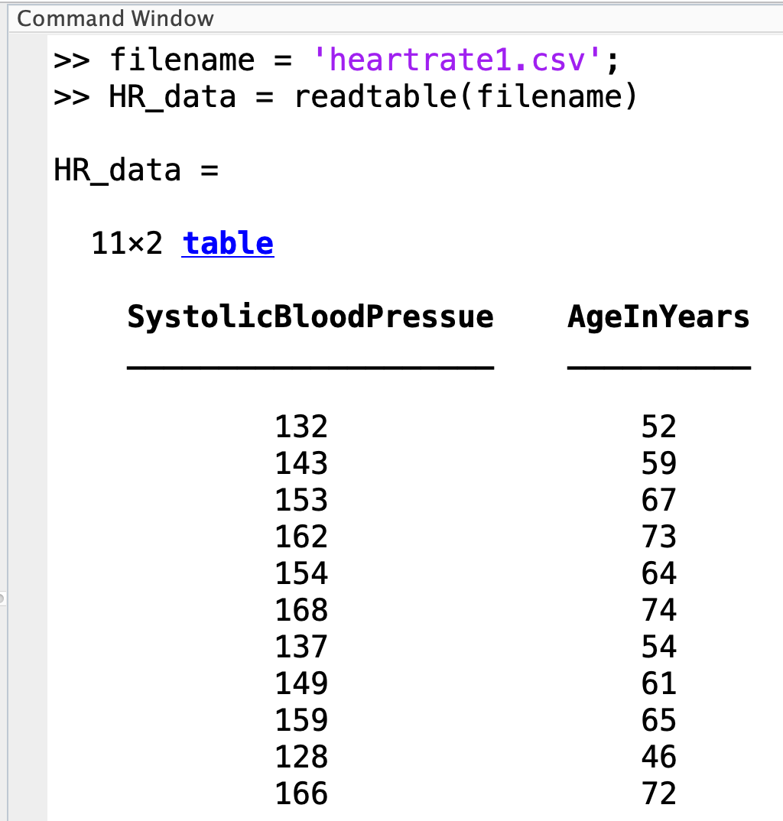
Reading in data files
readtable(‘filename’) creates a table from any file with the extension .txt, .dat, .csv, .xls, or .xlsx (most relevant to us)

Slide 25
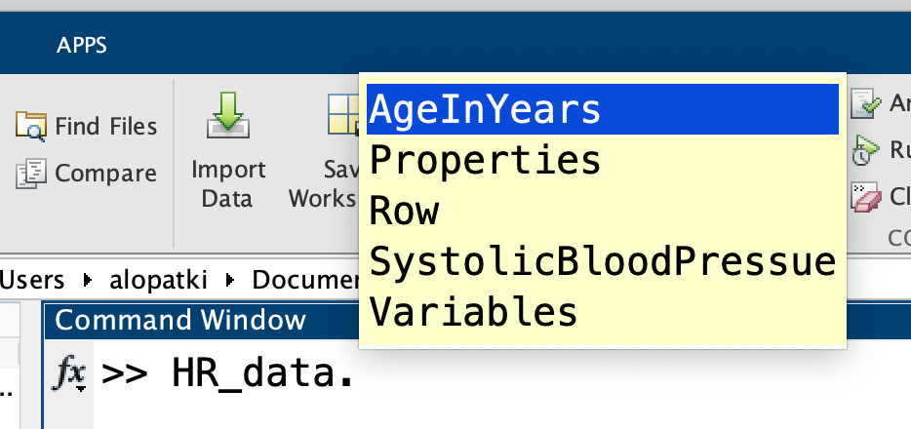
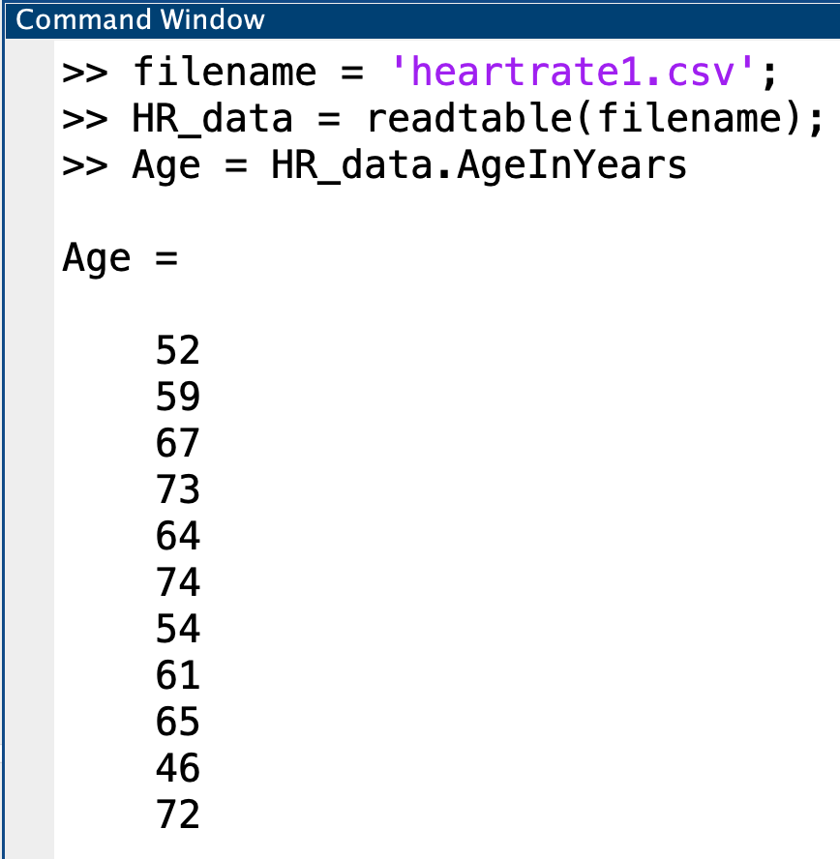
Accessing data in tables directly
Use the period + tab key to look up all variables stored in the table
Can define new variables for the columns you are interested in working with

Slide 26
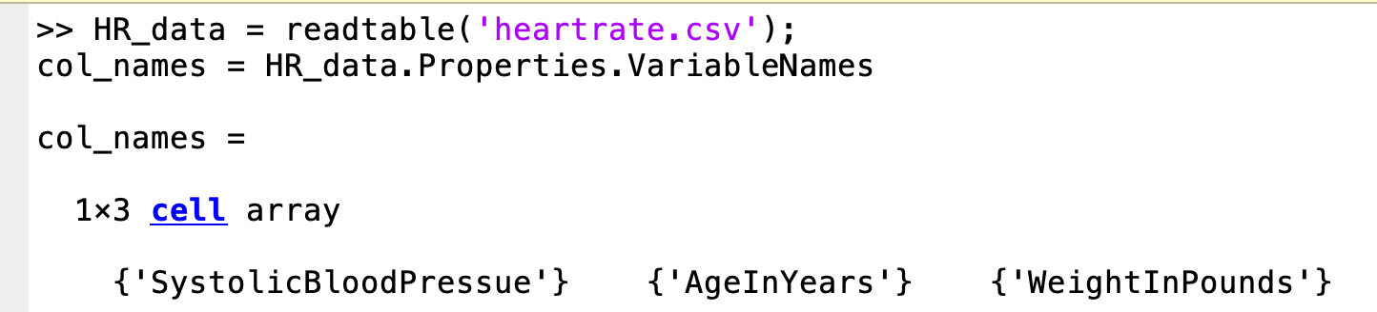
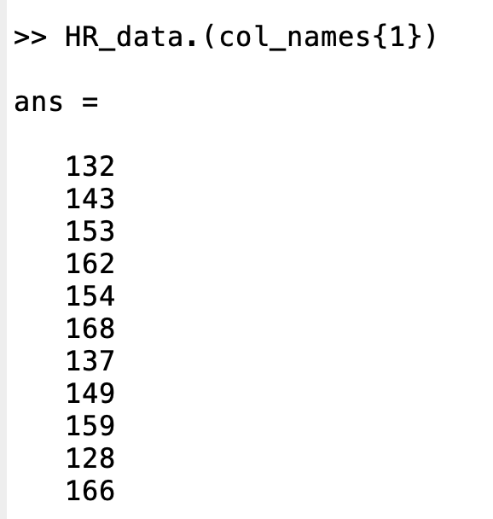
Accessing data in tables dynamically
Use variables and parentheses to access the table columns dynamically
For example, here you could loop through all column names without having to know each one
***IMPORTANT CONCEPT***

Slide 27
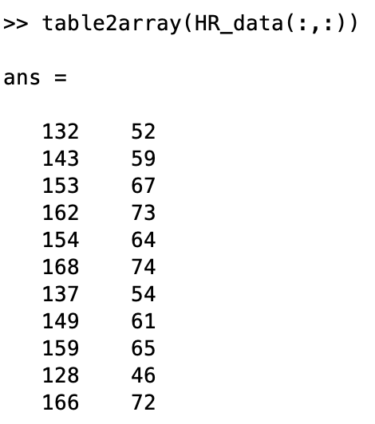
Converting multiple entries into a matrix with table2array
Specify the indices to convert into a numeric matrix
Here, (:,:) is specifying all indices. If you only want a subset of data, you can use regular matrix indexing

Slide 28
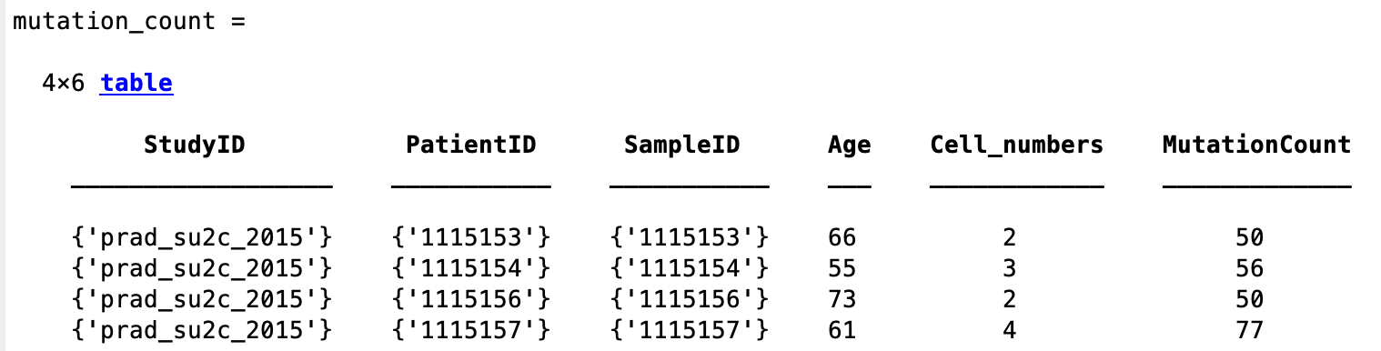
Converting multiple entries into a matrix with table2array
What if columns in a table have mixed strings and numbers:
Table2array only works for numeric entries (converts to double)

Slide 29
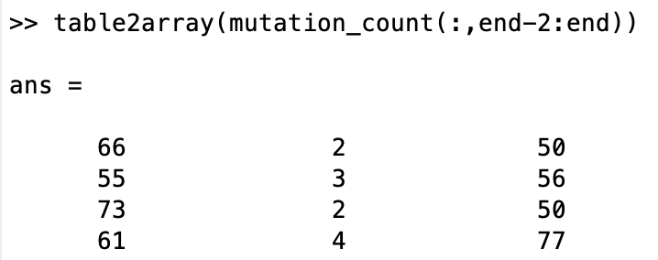
Converting multiple entries into a matrix with table2array
What if columns in a table have mixed strings and numbers:
Table2array only works for numeric entries (converts to double)

Slide 30
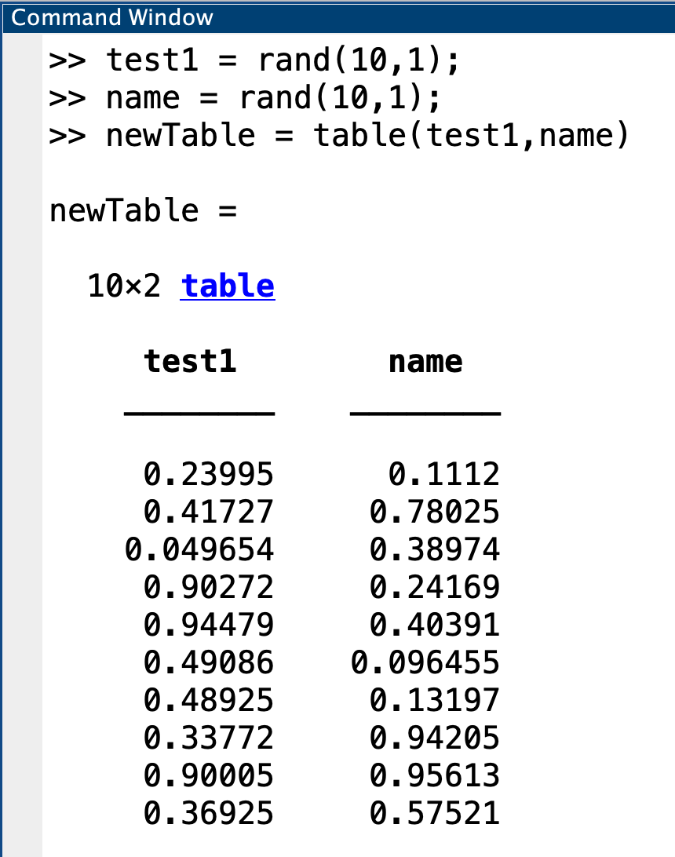
Creating a new table
Define column vectors with variable names. These become the column headers when you create a new table using the function table

Slide 31
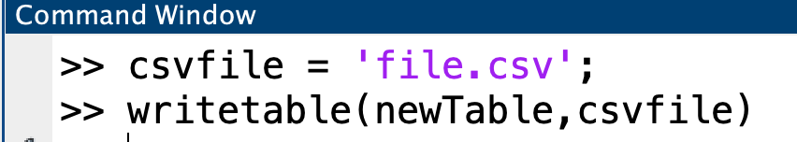
Writing a table to a .csv file
Use writetable to save the table as a file
*Note if you don’t specify the filename, MATLAB defaults to saving a .txt file with the file name = the variable you called the table

Slide 32
Summary: steps for reading and writing tables
To read/analyze:
Import data in the form of a table using readtable
Use the period: ‘.’ to access variables stored in the table (e.g., Table.variable)
Use table2array(T(:,ind)) to convert numeric entries into a single matrix, where ind specifies the columns you want to convert
To write:
Store data into individual column vectors; the variable name you use to store this vector becomes the column header in the table
Define a new table with these variables using table
Define a new filename with extension (we will stick with .csv)
Write the table to the file using writetable

Slide 33
Download heartrate.csv and follow the steps in lecture5_grpEx1_template.m to do the following:
Inputs
Read in table stored in lec5_grpEx1_heartrate.csv
Define 3 column vectors, one each for age, BP, and weight
Plotting with correct formatting
One full figure with line plots of BP as a function of age
One 1x2 subplot with scatter plots of BP as a function of age on left and weight as a function of age on right
Outputs
Convert all data to a single matrix, and exclude data from any patients > 70 years old
Saves a new file with tables that specify correct column headers of BP, age, weight
Practice with working with tables and plotting

Slide 34
Cell arrays
cell | Creates cell array
{ } | Accessing elements from a cell
strcmp(‘si’,’s2’) | Compare to strings → logical output
contains(‘str’,’pattern’) | Compare string to pattern

Slide 35
Variable class: cell
A cell in MATLAB is a variable class that acts as a container. In other words, cells can store any type of variable
Individual cells can be arranged into an array as we would arrange individual elements into a matrix
Contents of individual cells within an array don’t have to be the same size
Cells are how we store words or strings (instead of matrices for numbers)

Slide 36
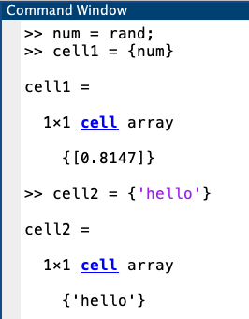

Creating a 1x1 cell array
Use curly braces { } to define individual elements of a cell
The element can be any variable type (numbers, characters, strings, etc.)

Slide 37
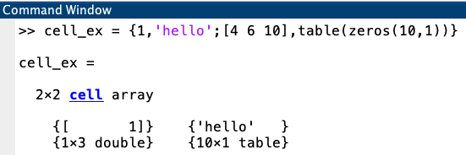

Creating a cell array with many elements
Use , and ; to define rows & columns within a cell array as we would do with numbers in a matrix

Slide 38
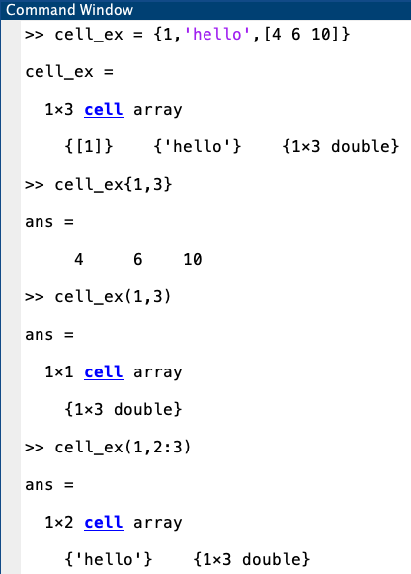
Indexing into a cell
Use curly braces { } for setting and getting the contents of cells within arrays
Use parentheses ( ) for indexing into a cell array to collect a subset of cells together into another cell array
In other words, parentheses return another cell

Slide 39
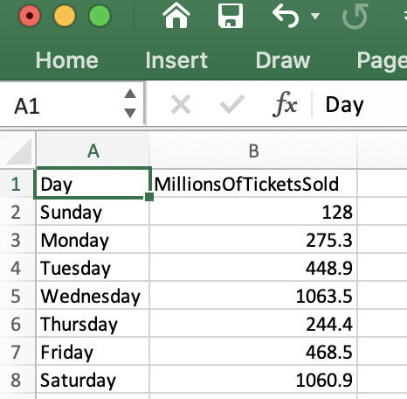
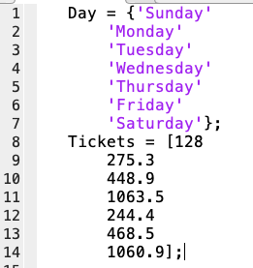

Using cells with strcmp
Ex: Powerball tickets sold per day

Slide 40
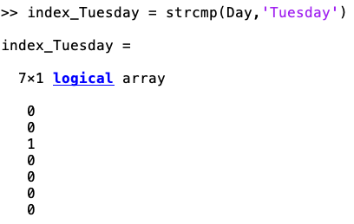
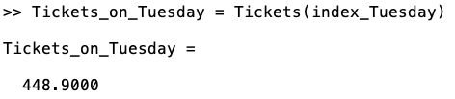
Using cells with strcmp
Ex: Powerball tickets sold per day
How do we find the number of tickets (in millions) sold on Tuesday?

Slide 41
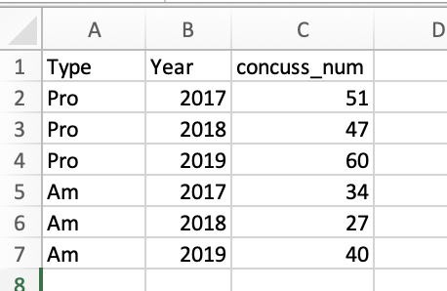
Lecture5_GrpEx2_concussion_subset.mat contains data from the following excel file:
Defining cell arrays
Logical indexing and indexing with cell arrays
Defining new cell arrays
Group exercise 2
Notes:
BREAK

