Slide 1
MATLAB for Scientists Lecture 6

Slide 2
Descriptive statistics
Hypothesis testing

Slide 3
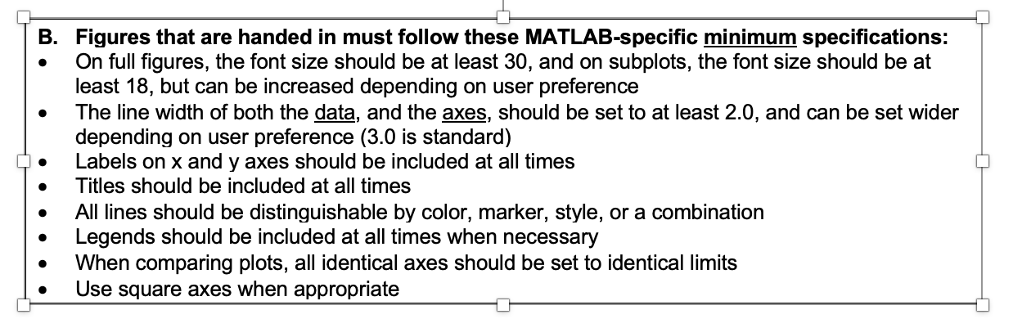
Figure guidelines
On courseworks: General resources folder → Guidelines for graphics.pdf

Slide 4
Descriptive statistics
Descriptive statistics: Methods for organizing and summarizing data obtained from a population sample.
Measures of central tendency: Describe the ”typical” behavior of a data set
Measures of variability: Describe the “spread” or how far away the measurements are from the center of a data set

Slide 5
The normal distribution
Mean = μ
Standard deviation = σ
Probability
μ−2σ
μ−σ
μ
μ+σ
μ+2σ

Slide 6
Descriptive statistics
mean(A,dim) | M = mean(A) returns the mean of the elements of A along the first array dimension whose size does not equal 1.
median(A,dim) | M = median(A) returns the median value of A.
mode(A,dim) | M = mode(A) returns the sample mode of A,
std(A,[],dim) | S = std(A) returns the standard deviation of the elements of A along the first array dimension whose size does not equal 1.
var(A,dim) | V = var(A) returns the variance of the elements of A along the first array dimension whose size does not equal 1.
min(A,dim) | M = min(A) returns the minimum elements of an array.
range(A) | Difference between min and max in a dataset
max(A,dim) | M = max(A) returns the maximum elements of an array.

Slide 7
Dimensionality and descriptive statistics
mean(A,dim) | M = mean(A) returns the mean of the elements of A along the first array dimension whose size does not equal 1.
Dim = 1 average of rows (one value per column in a matrix) → output = row vector
Dim = 2 average of cols (one value per row in a matrix) → output = column vector
$$A=\left[\begin{matrix}2 & 4 \\ 3 & 10 \\ 1 & 6\end{matrix}\right]$$
mean(A,2) = $\left[\begin{matrix}3 \\ 6.5 \\ 3.5\end{matrix}\right]$
mean(A,1) = $\left[\begin{matrix}2 & 6.67\end{matrix}\right]$

Slide 8
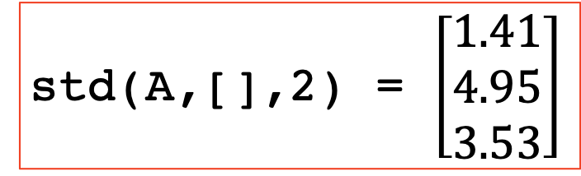
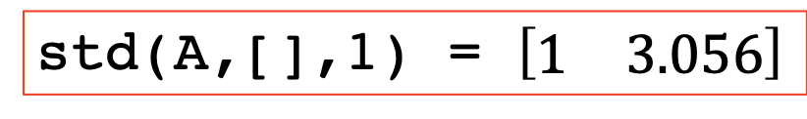
Dimensionality and descriptive statistics
std(A,[],dim) | S = std(A) returns the standard deviation of the elements of A along the first array dimension whose size does not equal 1.
Dim = 1 std of rows (one value per column in a matrix) → output = row vector
Dim = 2 std of cols (one value per row in a matrix) → output = column vector
$$A=\left[\begin{matrix}2 & 4 \\ 3 & 10 \\ 1 & 6\end{matrix}\right]$$
std(A,[],2) = $\left[\begin{matrix}1.41 \\ 4.95 \\ 3.53\end{matrix}\right]$
std(A,[],1) = $\left[\begin{matrix}1 & 3.056\end{matrix}\right]$

Slide 9
Descriptive statistics: visualizing
bar(x,y) | Bar plot
errorbar(x,mean(y),std(y)) | Plots the error as a bar around each point
histogram(x,n) | Plots the distribution of x with n number of bins
boxplot(x,g) | Boxes according to the matrix in x; optional g
Setting labels for a bar plot:
set(gca,’xtick’,[vec],’xticklabel’,{‘label1’,’label2’,...})

Slide 10

Error bars with the line plots: errorbar
ATP assay standard curve:
ATP = Purified ATP concentrations
RLU = relative light units
By default, errorbar plots a line and the error bars

Slide 11
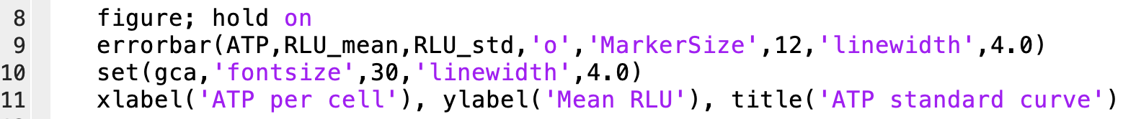
Error bars without the line: errorbar
Use the designation ‘.’ or ‘o’ as the first line spec to include bars without the line (leave out the word ‘marker’)

Slide 12
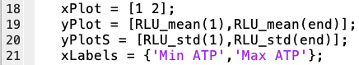

Error bars on a bar graph: errorbar
Specify an equally spaced x axis to plot a bar graph
Bar has different specification commands; see doc bar

Slide 13
Vasopressin is an anti-diuretic hormone. lec6_GrpEx1_Vasopressin.csv contains in vitro data for initial testing efficacy using kidney cells. The ‘Treatment’ column indicates whether each cell was exposed to the drug (enhanced), or not (control). The ‘Percent’ column contains the % water retention for each cell.
Calculate the mean and standard error (std/sqrt(n), where n is the # of samples), and plot this on a bar graph that looks like the following (error bars represent the standard error):
lecture6_grpEx1.m Practice with descriptive statistics

Slide 14
Hypothesis testing for comparing means
Does Vasopressin significantly increase water retention?
Hypothesis testing is the process of deciding whether the findings of an investigation reflect chance or real effects at a pre-determined significance level
H₀ (Null hypothesis): There is no association between the variable(s) and outcome(s) of interest (μ_{Α}=μ₀)
H_{A}(Alternative hypothesis): There is an association between the variable(s) and outcome(s) of interest (μ_{Α}=/=, >, or <μ₀)

Slide 15
Hypothesis testing for comparing means of normal data
Normal data = normally distributed
Test Type | Test statistic |  | When To Use
z-test | z |  | Compare the mean of a data set against a fixed/known mean when the standard deviation of the population is known
t-test | t | One-sample | Compare the mean of a data set against a fixed or known mean when the standard deviation of the population is unknown
 |  | Paired-sample | Compare the means of multiple measurements within the same data set, i.e., before/after treatment
 |  | Two-sample | Compare the means of two independent data sets
ANOVA | F | One-way | Compare the means from 3 or more data sets, testing only one condition (i.e., 1 exercise time for 5 students)
 |  | Two-way | Compare the means from 3 or more data sets, testing only one condition (i.e., 2 exercise times for 5 students)
 |  | N-way* | Compare the means from 3 or more data sets, testing N (i.e., 3 or more) conditions (i.e., all 5 exercise times for 5 students)
*we will only focus on one- and two-way ANOVA

Slide 16
The p-value and its limitations
α specifies the significance level of a hypothesis test. Typically α =0.05 (e.g., 5% chance that our findings occurred due to chance). If we use a smaller α −> more stringent test
The p-value is the outcome of our hypothesis test.
Comparing α and p leads to one of two conclusions:
p < α → reject null hypothesis
p >= α → fail to reject null hypothesis
The size of the p-value does not necessarily indicate the importance of the results
Notes:
The p-value reflects both the magnitude of the difference between the study groups AND the sample size

Slide 17
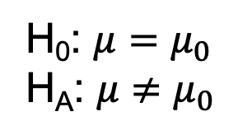
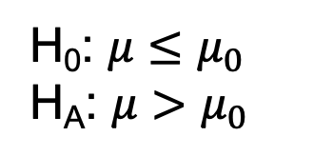
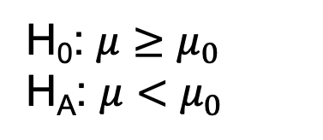
Directionality of hypothesis tests
One-tailed hypothesis test: Tests for alternative means that are strictly greater than or less than the null mean
Left
Right
H₀: $μ≥μ_{0}$
H_{A}: $μ<μ_{0}$
H₀: $μ≤μ_{0}$
H_{A}: $μ>μ_{0}$
Both
Two-tailed hypothesis test: Tests for alternative means that are different than the null mean (regardless of whether it’s greater than or less)
H₀: $μ=μ_{0}$
H_{A}: $μ≠μ_{0}$

Slide 18
Hypothesis testing for Vasopressin
Does Vasopressin significantly increase water retention?
Is this one or two tailed? One
H₀: Vasopressin does not significantly increase the percent water retention in kidney cells (μ_{Α}=μ₀)
H_{A}: Vasopressin does significantly increase the percent water retention in kidney cells (μ_{Α}>μ₀)

Slide 19
MATLAB functions for statistical testing
ztest | One-sample z-test
ttest | One-sample and paired-sample t-test
ttest2 | Two independent sample t-test
anova1 | One-way ANOVA
anova2 | Two-way ANOVA
multcompare | Compare pair-wise output of an ANOVA

Slide 20
The z-test
z-test | Compare the mean of a data set against a fixed/known mean when the standard deviation of the population is known
h = ztest(x,m,sigma)
[h p] = ztest(x,m,sigma)
[h p ci] = ztest(x,m,sigma)
x is vector data of interest
m is known population mean
sigma is known population std deviation
Confidence interval for true mean of x
P-value for test result
Hypothesis test decision
(1=reject null, 0=fail to reject null)

Slide 21
z- (and t-) test MATLAB options
Specify the alpha value with num:
ztest(x,m,s,’alpha’,num)
Specify the direction:
ztest(x,m,s,’tail’,’right’)
ztest(x,m,s,’tail’,’left’)
ztest(x,m,s,’tail’,’both’)
Use both together:
ztest(x,m,s,’alpha’,num,’tail’,’right’)
*Can be done with ttest, ttest2, or ztest

Slide 22
The t-test
One-sample | Compare the mean of a data set against a known mean when the std of the population is unknown
Paired-sample | Compare the means of 2 measurements within the same data set, i.e., before/after treatment
Two-sample | Compare the means of two independent data sets
1. One sample t-test
x is data of interest, m is sample mean
h = ttest(x,m)
[h p] = ttest(x,m)
[h p ci stats] = ttest(x,m)
2. Paired t-test
x and y are paired data of interest
h = ttest(x,y)
[h p] = ttest(x,y)
[h p ci stats] = ttest(x,y)
3. Two sample t-test
x and y are two independent data sets
h = ttest2(x,y)
[h p] = ttest2(x,y)
[h p ci stats] = ttest2(x,y)

Slide 23
Practice with t-tests (lecture6_liveEx1.m)
Gene expression differences between cancerous glioblastoma (GBM) and oligodendroglioma (GBM-O) cells are used to identify disease biomarkers. The expression of neural marker SYT1 was measured in both cell types in the file lec6_LiveEx1_glio_subset.xlsx. The 1st column contains the cell type (C-GBM or C-GBMO), and 2nd column contains the gene expression levels. Is under-expression of SYT1 in GBM-O cells a potential biomarker? Use the correct t-test.
What are the null and alternative hypotheses, and is it one or two-tailed? If one-tailed, which direction?
Write a script in MATLAB to calculate the p-value. Do you reject the null?

Slide 24
ANOVA
One-way | Compare the means from 3 or more data sets, testing only one condition (i.e., 1 exercise time for 5 students)
Two-way | Compare the means from 3 or more data sets, testing > one condition (i.e., 2 exercise times for 5 students)
P tests whether at least one of the means is statistically diff. from the other groups; reports F statistic
1. One-way ANOVA*
2. Two-way ANOVA
p = anova1(y,group)
[p tbl] = anova1(y)
[p tbl stats] = anova1(y)
p = anova2(y, reps)
[p tbl] = anova1(y, reps)
[p tbl stats] = anova1(y, reps)
y can either be a an m x n matrix or a column vector of m*n rows
If y is mxn, group = 1 x n cell array of names
If y is m*n x 1, group = m*n x 1 cell array where the group name is repeated for each category

Slide 25
multcompare
The multcompare function provides a way to determine which of the means is statistically different
The input variable stats comes directly from anova1 or anova2
c = multcompare(stats)
Overlapping horizontal bars = groups are not statistically different
Highlighting one bar in blue reveals those significantly different to it in red

Slide 26
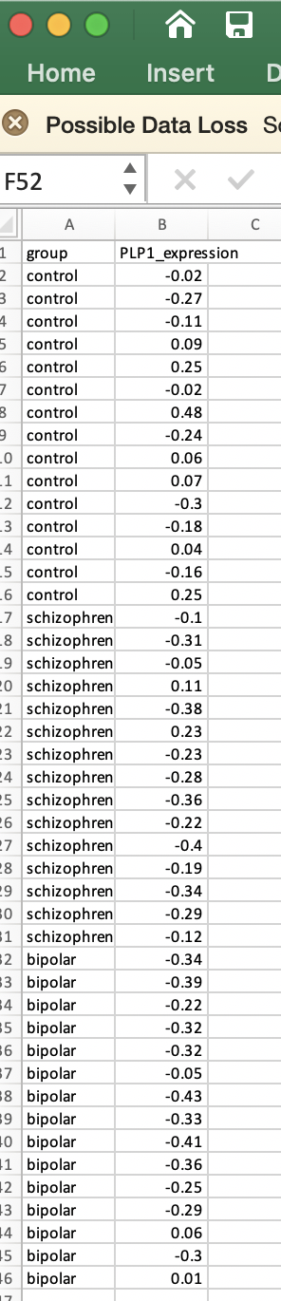
3. One-way ANOVA (ANalysis Of VAriance)
Researchers hypothesized that PLP1 expression levels were linked to certain mental health disorders. To test this, PLP1 levels were measured in a cohort of patients with bipolar disorder, schizophrenia, or no history of mental illness (control). What is the null hypothesis, and which groups are significantly different than one another?
H0: μ control PLP1 = μ schizophrenia patients = μ bipolar patients
H0: μ control PLP1 =/= μ schizophrenia patients =/= μ bipolar patients

Slide 27
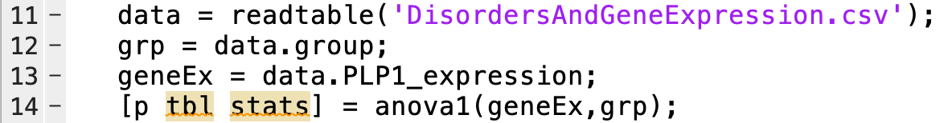
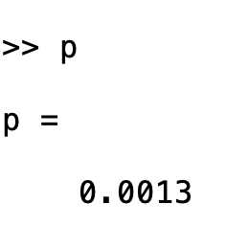
3. One-way ANOVA (ANalysis Of VAriance)
Note for geneEx oriented as a 1xN, group names is a 1xN cell,
If geneEx was oriented as an nxm matrix, group names would be a 1xm cell array

Slide 28
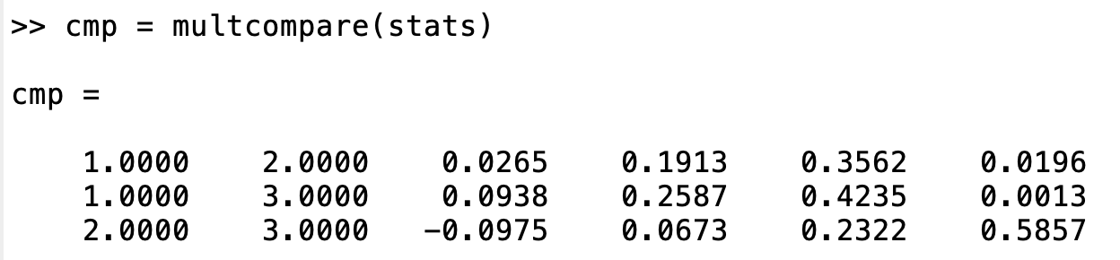
3. One-way ANOVA (ANalysis Of VAriance)
Columns 1&2: show the groups that are compared.
Column 4: The difference between the estimated group means.
Columns 3&5: Lower and upper limits for 95% confidence intervals for the true mean difference.
Column 6: p-value for a hypothesis test that the corresponding mean difference is equal to zero
Which groups are significantly different?

Slide 29
3. One-way ANOVA (ANalysis Of VAriance)

Slide 30
The file lec6_GrpEx2_carbon_emissions_borough.xls contains carbon emission data for several boroughs in England for 2005-2014. This is arranged with one borough per column, and each row as a year. We’d like to determine which of the boroughs has significantly higher pollution than others overall.
Load the table into MATLAB, and extract the values and variable names.
Perform a one-way ANOVA on this data; the groups should be each borough.
Run multcompare on the results; which borough(s) do not vary significantly from others?
lecture6_grpEx2.m
anova1 and multcompare

