Slide 1
MATLAB for Scientists Lecture 7

Slide 2
Fitting linear data
Fitting non-linear data
Numerical differentiation

Slide 3
Linear regression and polynomial curve fitting
polyfit(x,y,n) | Polynomial fitting
polyval(p,x) | Interpolation/extrapolation
corrcoef(x,y) | Correlation coefficients

Slide 4
Linear regression
A regression is a formula that describes the relationship between variables
A linear regression models the relationship between two variables with the equation of a line (polynomial with degree = 1)
Input: X and Y data
Output: Estimated b and a and predicted Y (yFit):
Y
Regression line
X
yFit = b * X + a

Slide 5
Correlation coefficients in MATLAB
P-value associated with linear regression
[r p] = corrcoef(x,y)
r is the correlation coefficient between two data sets X and Y.
r will always be between -1 and 1.
If r = -1: data are perfectly negatively correlated
If r = 0: data are linearly uncorrelated
If r = 1: data are perfectly positively correlated
In general, as r² increases, the relationship between two datasets is more linear
r = 1
r = 0
y
r = -1
x

Slide 6
Performing linear regression in MATLAB
Find the regression coefficients a and b that best fit the data stored in X and Y with n=1
Calculate yFit for polynomial p using the equation of a line for yFit = bX + a:
Calculate the correlation coefficient and p-value for the statistical regression on X and Y
p = polyfit(X,Y,1)
yFit = p(1) .* X + p(2)
[R Pval] = corrcoef(X,Y)

Slide 7
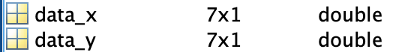
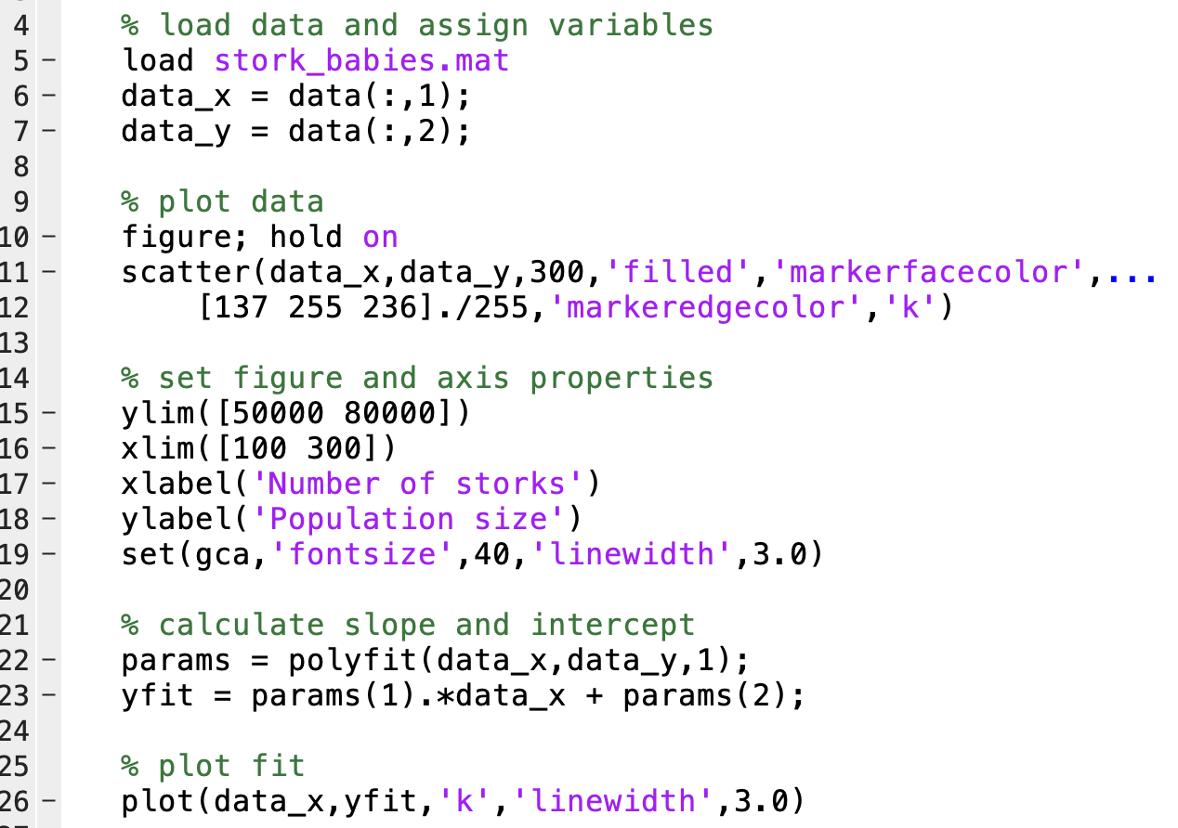
Do storks bring babies?
data_x = # of storks
data_y = population size

Slide 8
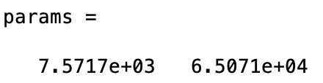
Determining the coefficients of the regression line with polyfit
What is the size of params?
What is the equation of the fitted line?
Since yFit = bx+a, our regression line is:
Fitted_populationSize = b*storkNumber + a
yfit = params(1) * data_x + params(2)

Slide 9
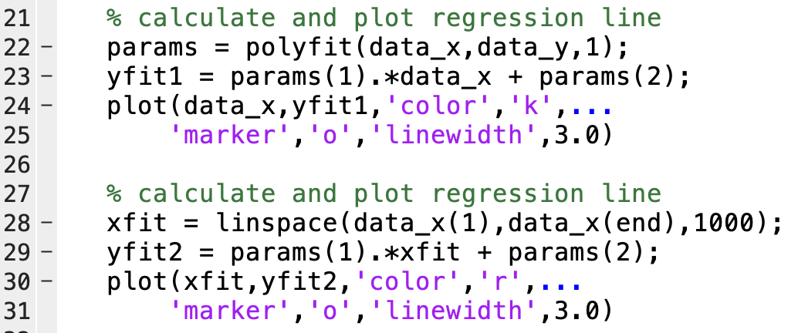
Plotting the line of best fit with actual or interpolated x data
Using actual data_x
Interpolating x data with linspace

Slide 10
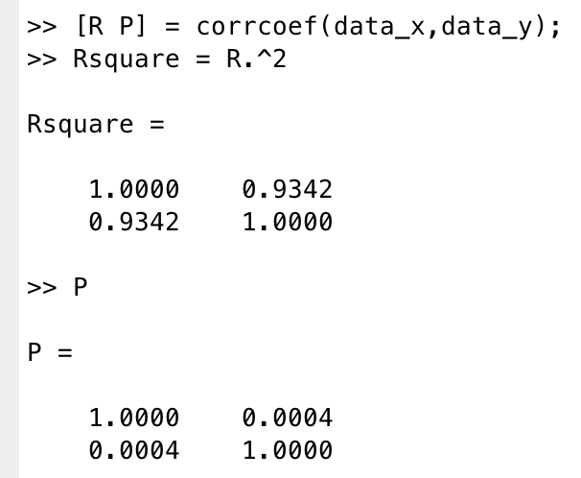
Correlation coefficients with corrcoef
R² value
Off-diagonal elements give correlation between different variables
Diagonal elements give correlation between a variable and itself (i.e., the diagonal is always 1)
p-value
Tests the null hypothesis that there is no correlation between the vectors x and y

Slide 11
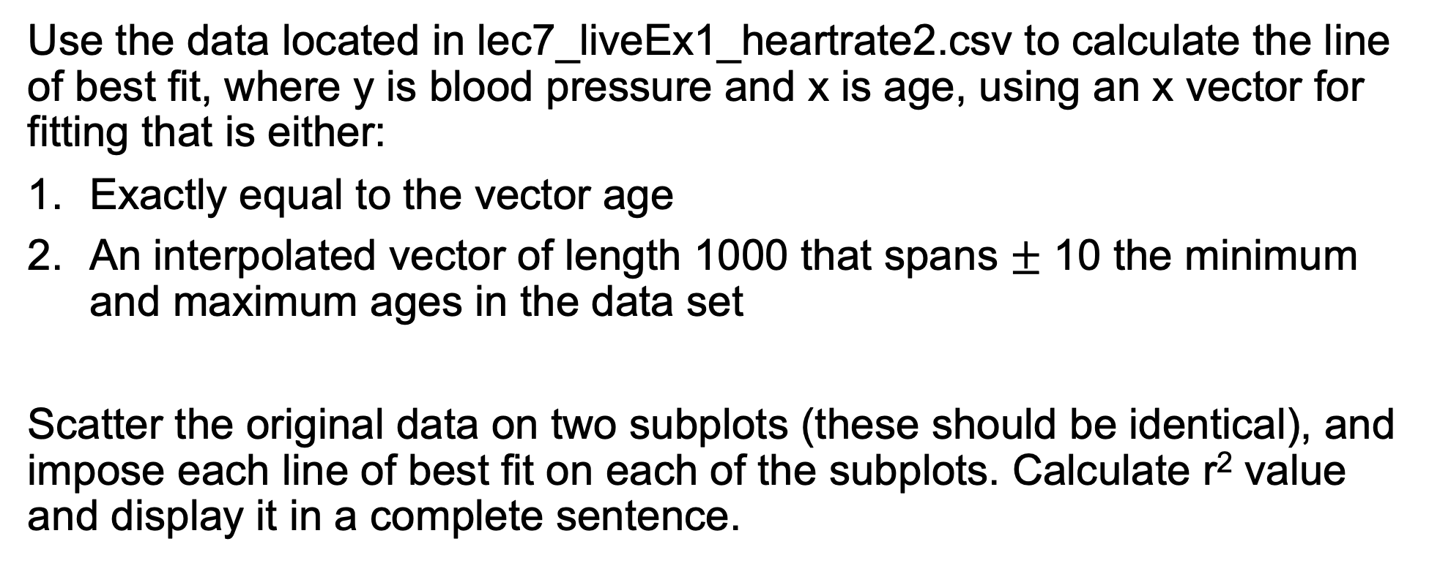
Practice with linear regression (lecture7_liveEx1.m)
Use the data located in lec7_liveEx1_heartrate2.csv to calculate the line of best fit, where y is blood pressure and x is age, using an x vector for fitting that is either:
Exactly equal to the vector age
An interpolated vector of length 1000 that spans $±$ 10 the minimum and maximum ages in the data set
Scatter the original data on two subplots (these should be identical), and impose each line of best fit on each of the subplots. Calculate r² value and display it in a complete sentence.

Slide 12
Generic curve fitting
lsqcurvefit(@fun,x0,xdata,ydata) | Solves nonlinear curve fitting using least-squares method

Slide 13

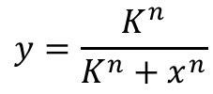
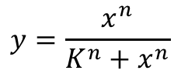
Non-linear curve fitting
Often in biology, curves cannot be transformed into a linear space. In such cases, non-linear curve fitting is required. How do we fit these?
Common equations include:
$$y=\frac{x^{n}}{K^{n}+x^{n}}$$
$$y=\frac{K^{n}}{K^{n}+x^{n}}$$
$$y=Ae\left\{−e^{\frac{μ_{M}e}{A}\left(λ−t\right)+1}\right\}$$
Activating sigmoidal
Inhibiting sigmoidal
Growth with delay

Slide 14
Non-linear fitting using lsqcurvefit
a = lsqcurvefit(@fun_name,a0,xdata,ydata)
lsqcurvefit calculates the coefficients a to best fit the nonlinear function fun_name to the data ydata over the range xdata. ydata must is the same size as the vector (or matrix) returned by fun_name. Fitting is based on a user-designated a0.
fun_name: name of fitting function
a0: initial guess for fitting parameters
xdata: independent variable data
ydata: dependent variable data
a: best-fit parameters

Slide 15
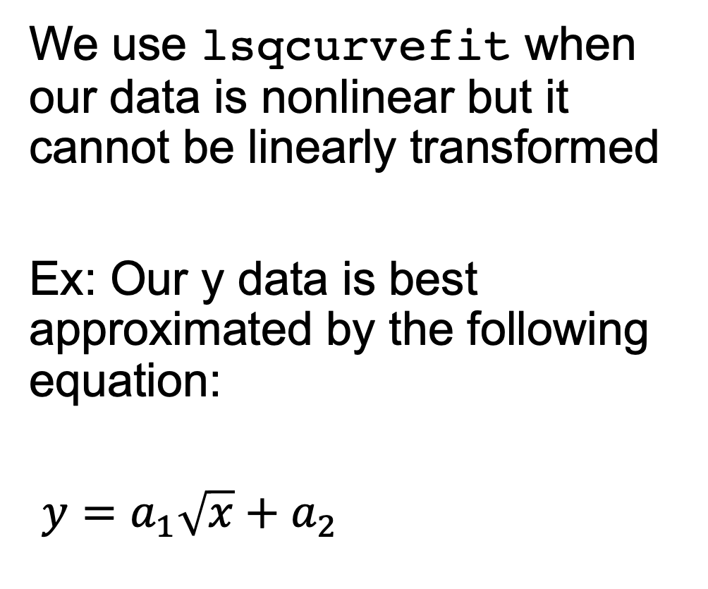
When do we use lsqcurvefit?
We use lsqcurvefit when our data is nonlinear but it cannot be linearly transformed
Ex: Our y data is best approximated by the following equation:
$y=a_{1}\sqrt{x}+a_{2}$

Slide 16
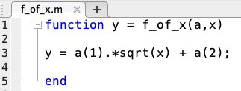
Function that is called by lsqcurvefit
Define a function with one output (y) and two inputs (a,x)
y is the output
a is a vector corresponding to each of the unknown model parameters
x is the vector over which y is calculated

Slide 17
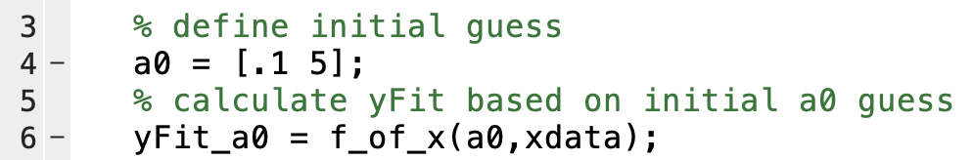
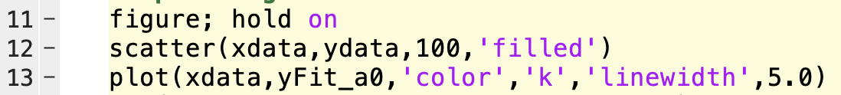
Determine initial guess for equation parameters
Choose a0 based on your best guess. To see how good it is, use it as an input to f_of_x and plot

Slide 18
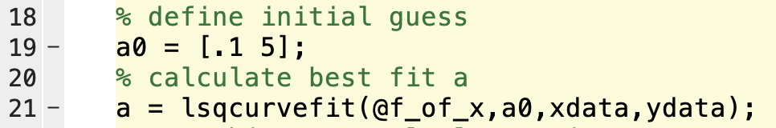
Use lsqcurvefit to calculate equation parameters
Calculate a using lsqcurvefit
@ symbol
f_of_x inputs (in order)

Slide 19
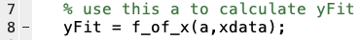
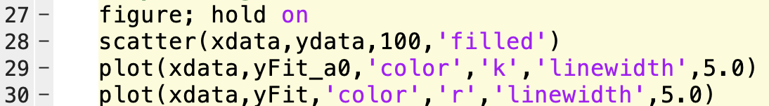
Use lsqcurvefit to calculate equation parameters
Calculate yFit and plot over data to see

Slide 20
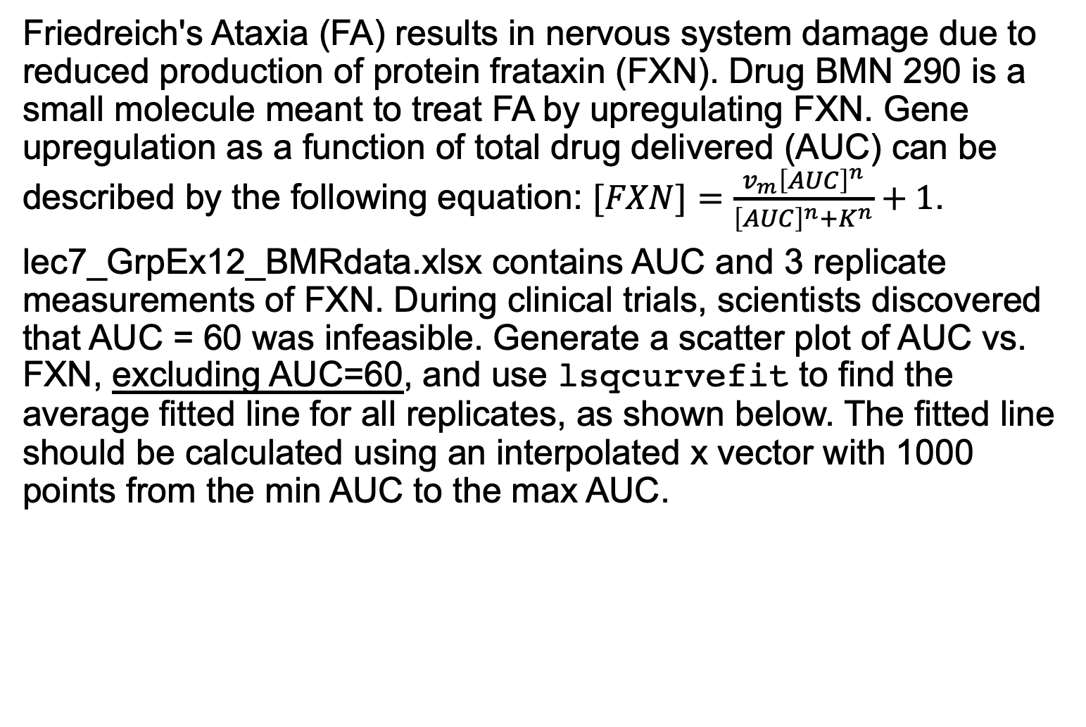
Friedreich's Ataxia (FA) results in nervous system damage due to reduced production of protein frataxin (FXN). Drug BMN 290 is a small molecule meant to treat FA by upregulating FXN. Gene upregulation as a function of total drug delivered (AUC) can be described by the following equation: $[FXN]=\frac{v_{m}{\left[AUC\right]}^{n}}{{\left[AUC\right]}^{n}+K^{n}}+1$.
lec7_GrpEx12_BMRdata.xlsx contains AUC and 3 replicate measurements of FXN. During clinical trials, scientists discovered that AUC = 60 was infeasible. Generate a scatter plot of AUC vs. FXN, excluding AUC=60, and use lsqcurvefit to find the average fitted line for all replicates, as shown below. The fitted line should be calculated using an interpolated x vector with 1000 points from the min AUC to the max AUC.
Group example 1: Practice with lsqcurvefit

Slide 21
Numerical differentiation and smoothing
diff(x) | Returns a vector d containing the differences between adjacent elements in the vector x.
smooth(x) | Smooths noisy data in vector x

Slide 22
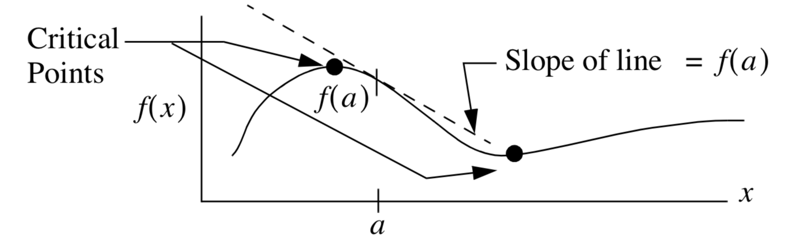
Derivative overview
The derivative of f(x) at a is the slope of the line tangent to f(x) at a
Points where the derivative of f(x) = 0 are critical points

Slide 23
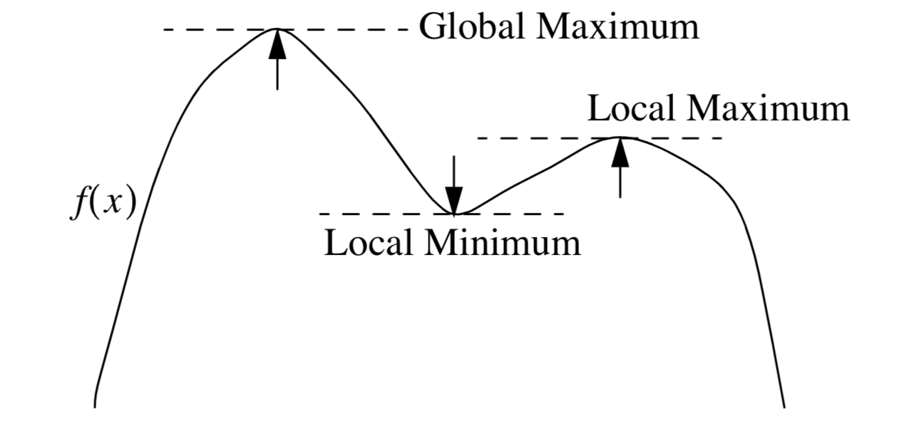
Derivative overview
When the tangent line has a slope of 0 (or the derivative f’(x)=0), we have reached a local extrema
If the second derivative is positive, the extrema is a maximum
If the second derivative is negative, the extrema is a minimum

Slide 24
diff
The diff function is used for computing derivative estimates.
Its syntax is d = diff(x), where x is a vector of values, and the result is a vector d containing the differences between adjacent elements in x.
That is, if x has n elements, d will have n − 1 elements, where
d = [x(2) − x(1), x(3) − x(2), . . . , x(n) − x(n −1)].
EX:
x = [5, 7, 12, -20]
diff(x) = [2, 5, -32].

Slide 25
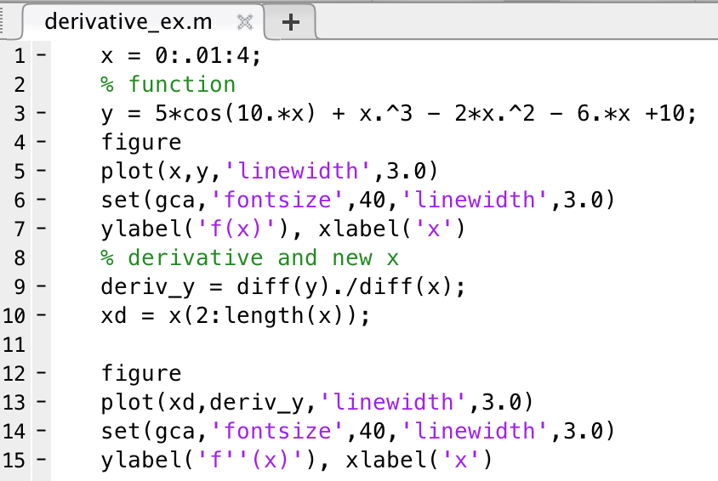
Finding derivative with diff
$$f\left(x\right)=5\cos\left(10x\right)+x^{3}−2x^{2}−6x+10$$
The derivative of y=f(x) at the corresponding values of x can be estimated using:
Deriv_y = diff(y)./diff(x)

Slide 26
Calculate the derivative dy/dx, where y is the fitted best fit line from Group Example 1, and find the point (ie, the x value) at which this derivative achieves its maximum value. Plot this point on the graph of y vs x using scatter and a square marker. Note that the plotted point should be in terms of y; ie, if xmax is the point at which dy/dx is at its maximum, you should plot y(xmax).
Group example 2: Practice with diff

