Slide 1
A
(-2)
Maximizing ply
B
(-6)
C
(-2)
D
(-4)
Minimizing Ply
E
F
G
H
I
J
L
M
N
(9)
(-6)
(0)
(0)
(-2)
(1)
(-4)
(-3)
(1)

Slide 2
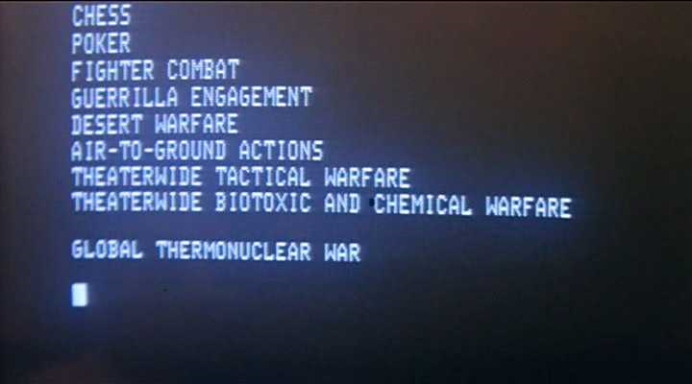
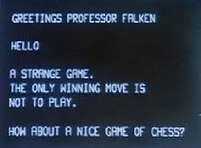
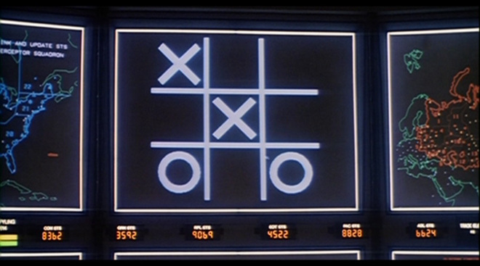


Slide 3
Artificial Neuron
x1
w1
x2
w2
w3
S
F(S)
x3
...
wn
xn

Slide 4
Many Layers
detectors
decisors
Complex detectors
input
output

Slide 5
Generic Structure
Initialization
Genetic Operators
Evaluation
CrossOver
Mutation
Selection

