Slide 1
Automated Archery Target Scoring
Aidan MacLEllan-O’Brien

Slide 2
Introduction
App is designed to take a picture of a target archery face and score the arrows that are in it
This can be useful for both competitions and practice
Could speed up scoring at competitions and ensure scoring accuracy
Would make it easier for people to score their shots in practice, which could yield data that would enable improvement
Notes:
Dihcotomous.

Slide 3
Goals
Primary Goal
Develop an app that scores an archery target in a quick and accurate manner
Reach Goals
Collect data regarding arrow grouping patterns
Allow user to optionally specify details about the arrows that were scored
Notes:
1 primary goal check timeData to provide more in depth insight into performe that could assist with sight adjustment and finding potential form issues
Many target archers label there arrows knowing if one is performing worse would be worthhile

Slide 4
Technology Stack
Implemented in Android Studio using Java
Vision processing was handled by OpenCV

Slide 5
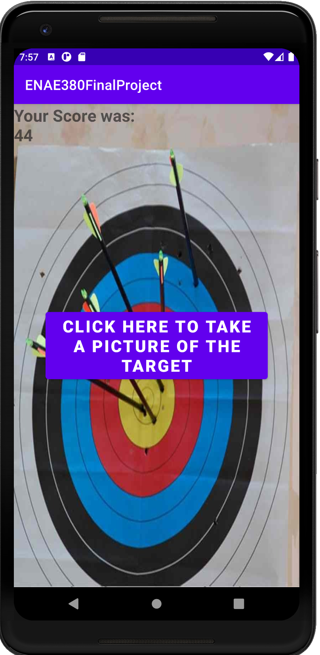
Current user interface
Initially prompts the user to press a button, which activates the phone’s camera
After a photo Is taken
Button is still displayed
The score is displayed
The photo is displayed

Slide 6


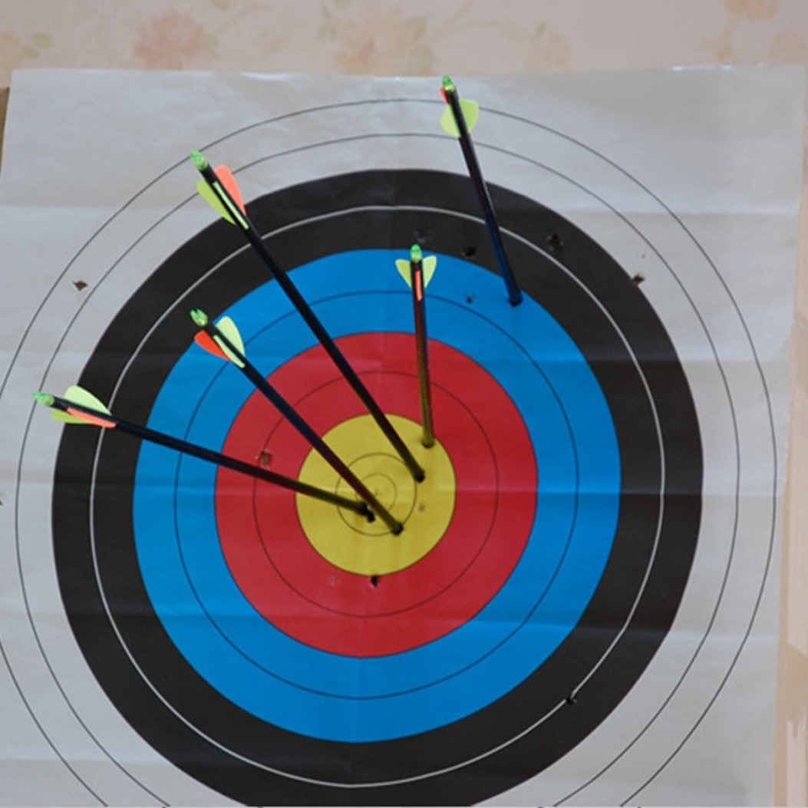
Scoring Method
Attempted multiple methods with limited accuracy.
Settled on using edge detection combined with the known colors and geometric features of the targets faces to get best accuracy

