Slide 1
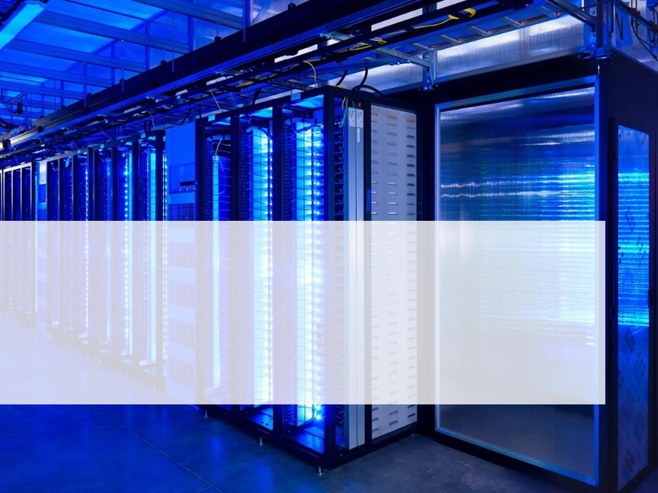
Kubernetes
Presenter: Alex Maidak
Organization: QCLUG

Slide 2
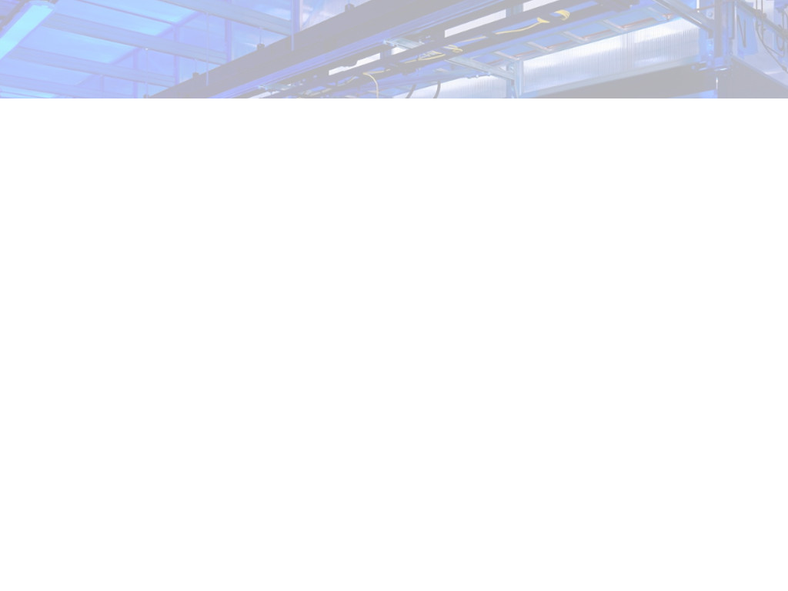
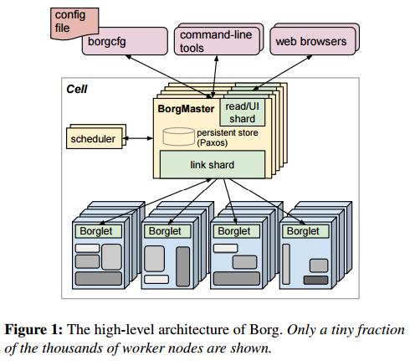
In the Beginning there was Borg
Google Created Borg in 2004
At somepoint Google Attempted to Replace Borg with “Omega” which did not succeed
Internally Google still runs most services on Borg including most GCP services
Notes:
First some history.
* In 2004 Google Developed Borg
* Borg was created to do job scheduling and time sharing on google's compute clusters
* A paper describing the borg system was not published until 2015, long after kubernetes release

Slide 3
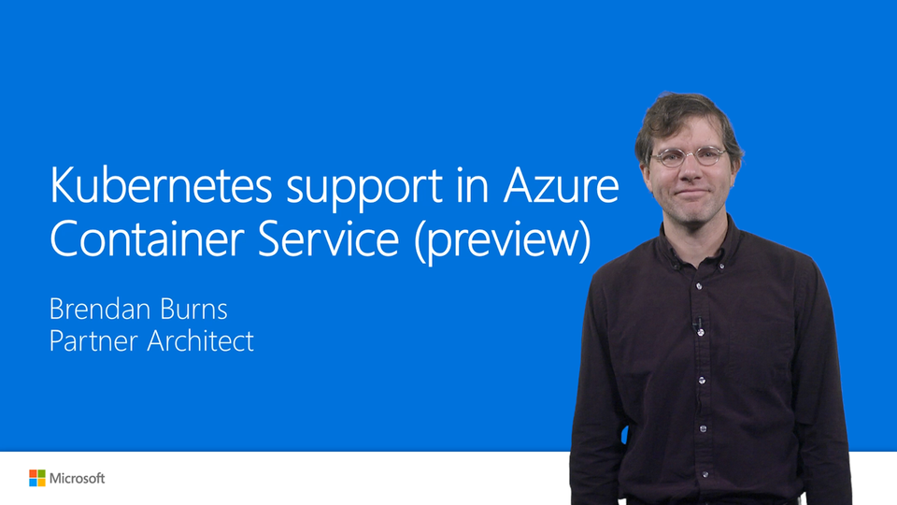

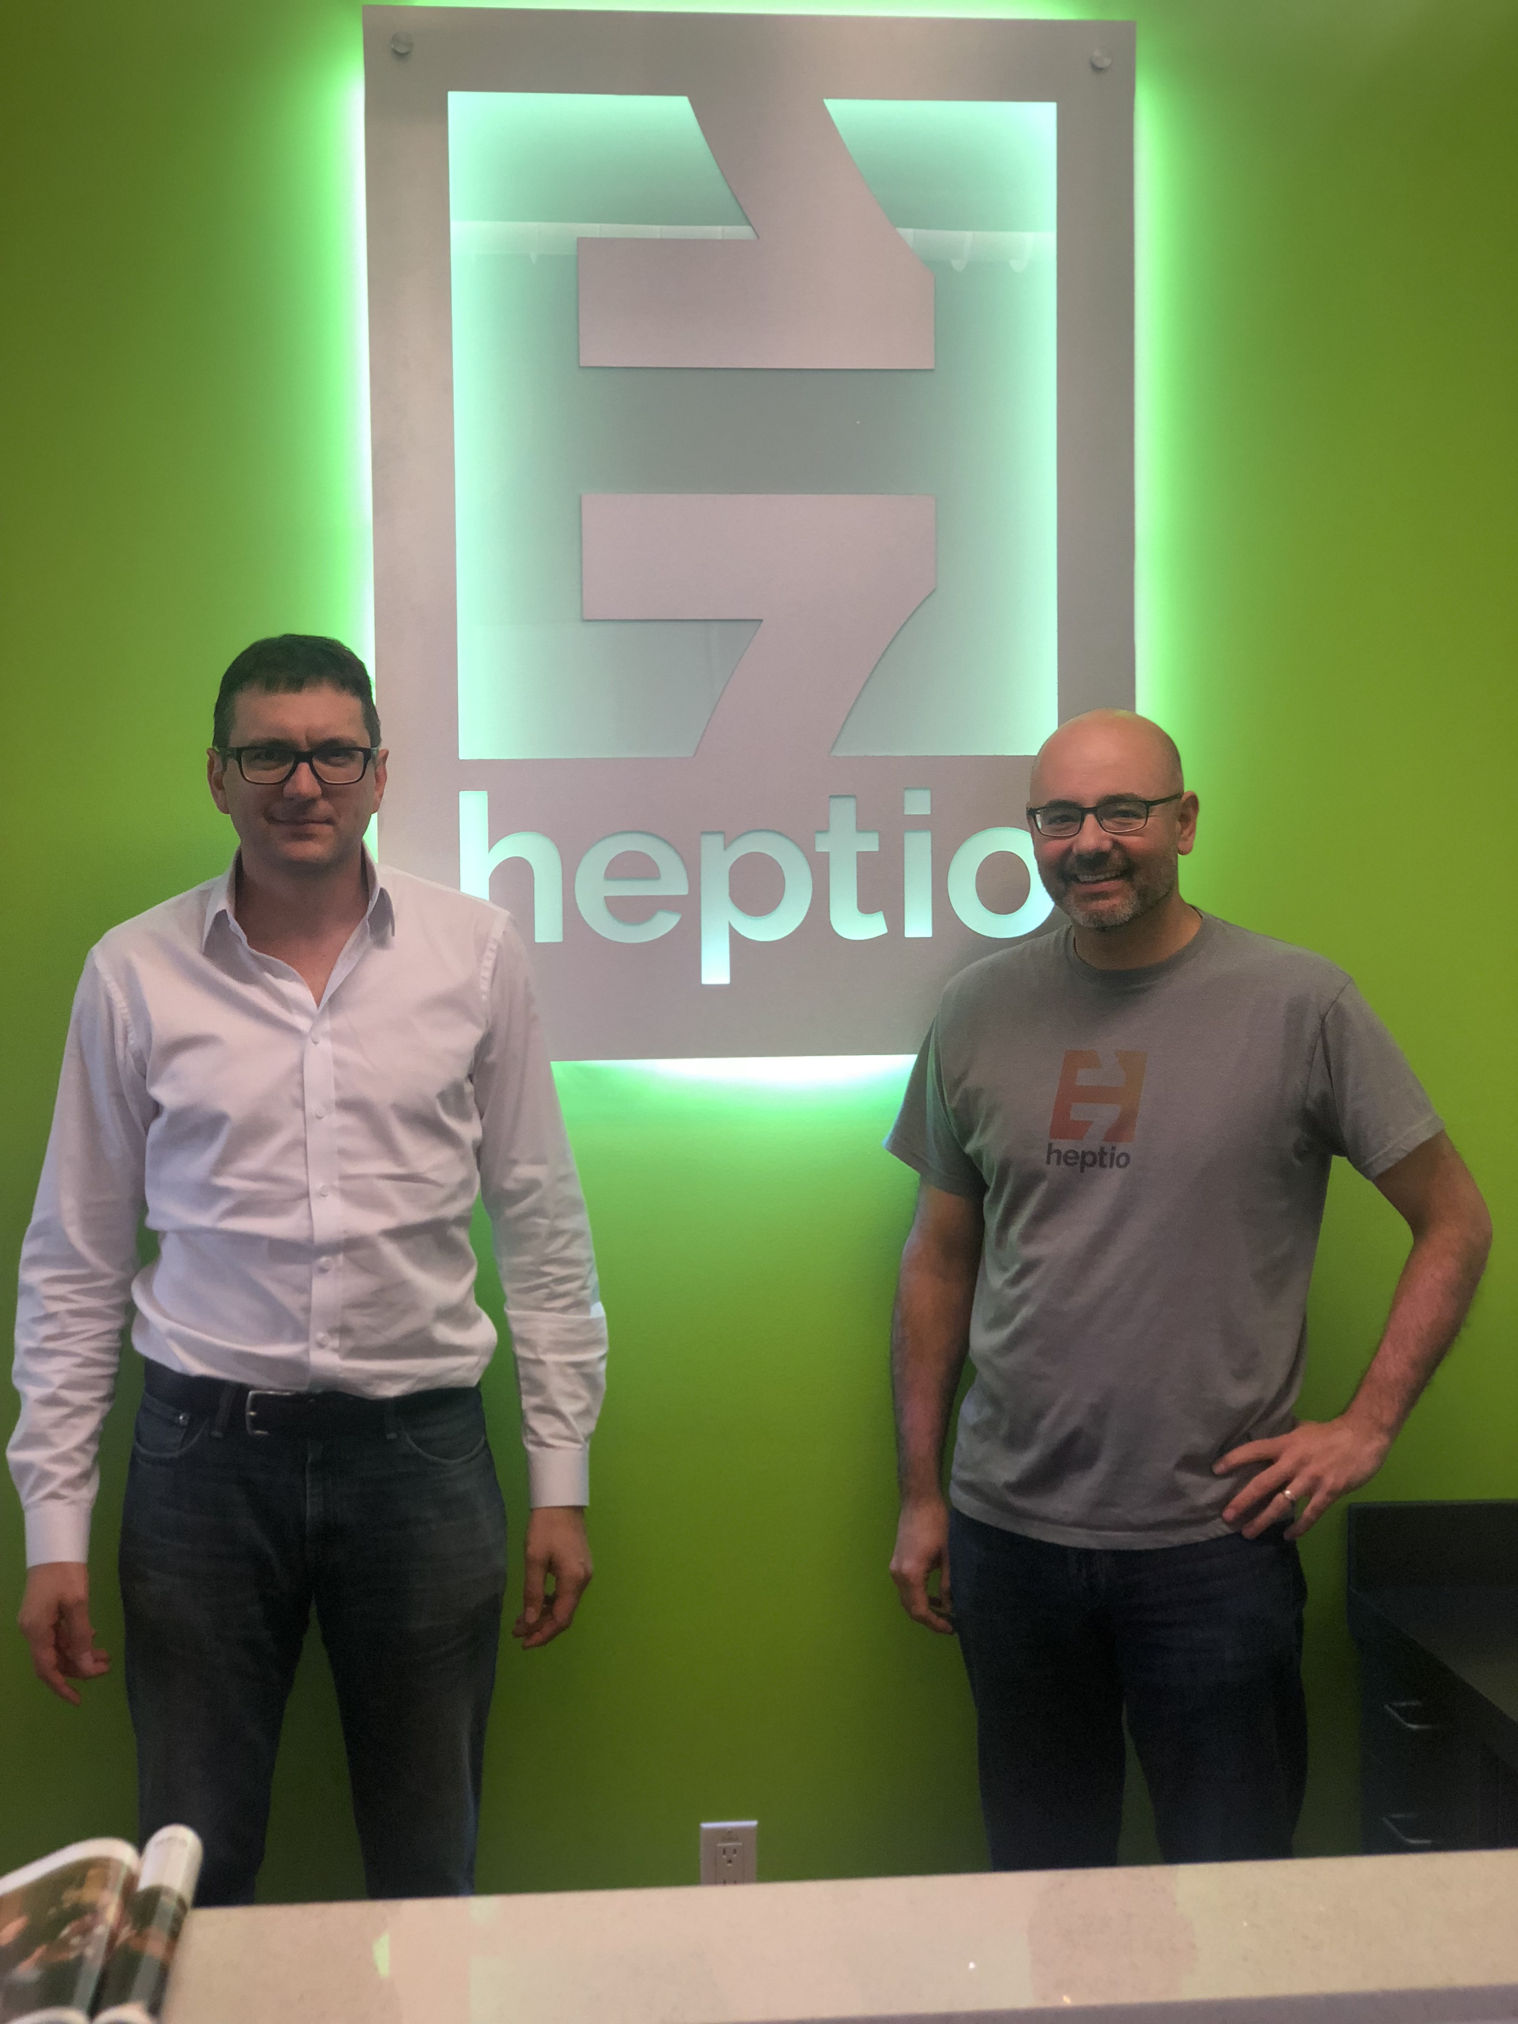
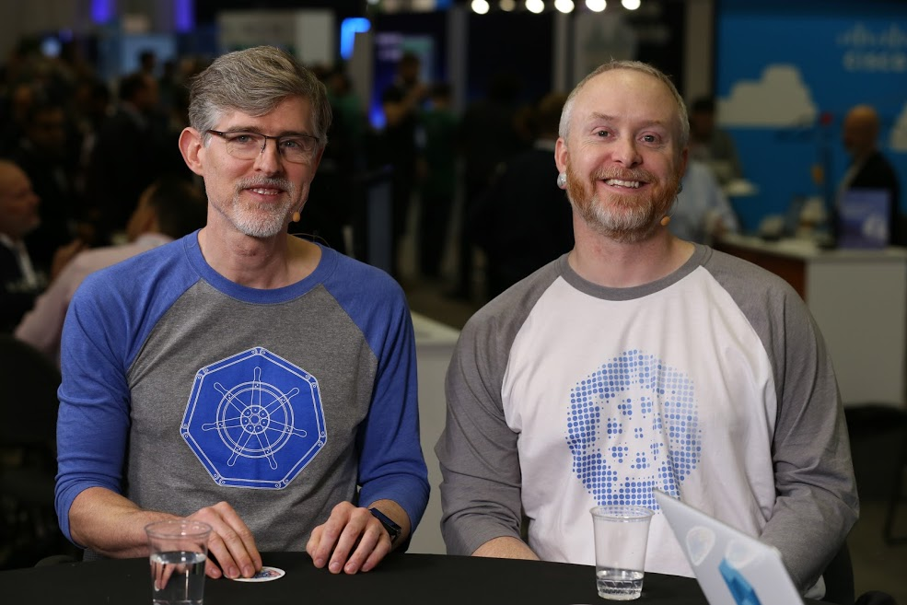

Creators – Lets get rich off docker craze
Brendan Burns
Craig McLuckie & Joe Beda
Brain Grant and Tim Hockin
Notes:
December 21 2013: Docker is released and people start to really use containers.
After seeing the excitement around docker Joe Beda, Brendan Burns, Craig McLuckie, Brian Grant and Tim Hockin. decide its time to create a OpenSource equivalent to Google borg. Intially they call the project Seven - A Star Trek reference to the "nice" borg character Seven of Nine from the voyager series.
Eventually they rename the project Kubernetes which is Greek for "Helmsman" or "Captain". Sailing references are now an epedemic around kubernets projects.
On June 6 2014 Joe Beda releases the initial kubernetes code to Github.
On August 21 2014 I saw Joe Beda present on Kubernetes at LinuxCon.
I still remember the presentation I also remember thinking: What's the big deal?

Slide 4
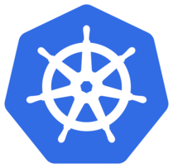
Result: Kubernetes
Originally called “Seven” as a Star Trek Voyager Reference
On June 6 2014 Joe Beda releases the initial Kubernetes code to Github
Greek for "Helmsman" or "Captain" nautical references are now an epidemic around Kubernetes projects
Also known as K8S or “K-ate-s”

Slide 5
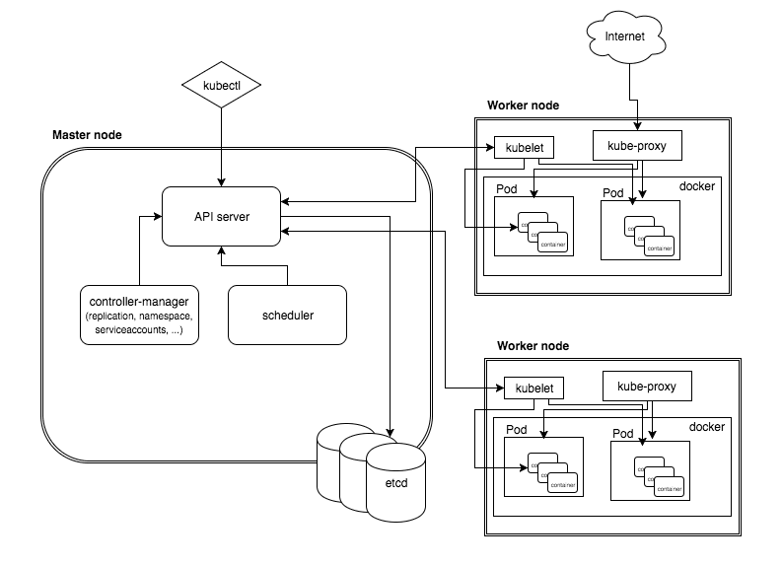
Architecture
Notes:
Kubernetes Architecture
* Cluster Control Plane (often referred to as the "Master")
- API Server
- Cluster State store (etcd)
- Controller-Manager server
- Scheduler
* A "compute" node
- Kubelet - "nova-compute"
- Container Runtime (CRI) - Typically Docker
- Kube-Proxy - A network proxy which reflects Kubernetes networking services on each node.

Slide 6
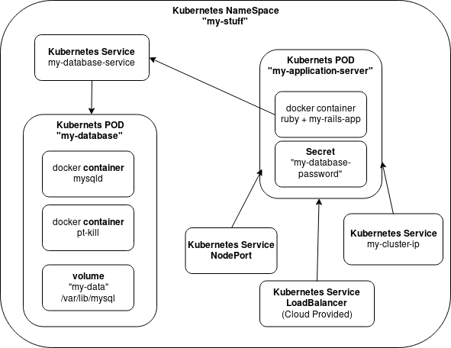
Base Kubernetes Objects
Pod
Volume
Service
Namespace

Slide 7
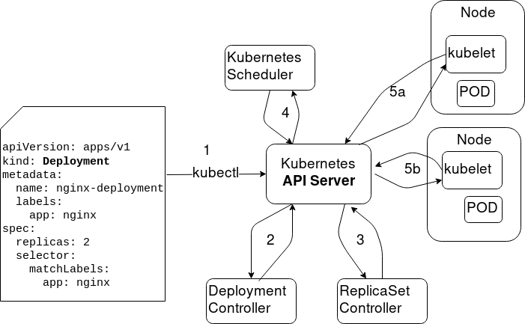
Declarative System (Controllers)
State changes are posted to the api via kubectl
State is defined in the API
Controllers Converge on state
Controllers are often composed together (Deployment controller mutates ReplicaSet)

Slide 8
Built-In Contollers
ReplicaSet - A set of identical Pods
Deployment - Rolls out changes to Pods or ReplicaSets
StatefulSet - Manages the deployment and scaling of a set of Pods , and provides guarantees about the ordering and uniqueness of these Pods
DaemonSet - A pod for every Kubernetes compute node
Job - A Pod that runs to completion and exits
CronJob - Creates Jobs at a scheduled Time

Slide 9
Typical add-on Controllers
DNS – allow service discovery internally via DNS
Ingress Controller – allow network ingress into the cluster
Heapster – monitoring for nodes and pods
Dashboard - GUI

Slide 10
Networking Model
All containers can communicate with all other containers without NAT
All nodes can communicate with all containers (and vice-versa) without NAT
The IP that a container sees itself as is the same IP that others see it as

Slide 11
Kubernetes Networking (CNI)
Container Network Interface
  Network Policy – Connectivity rules between PODs
  Network Routing – How packet A travels from POD X to POD Y
Recommendations
  Use a managed solution with VPC integration
  If DIY Calico seems default for policy
  Routing? - Flannel or Weave

Slide 12
Ok, How do I get it?
On your desktop: minikube
Managed Kubernetes
  GKE, Azure, AWS EKS, Digital Ocean
D.I.Y. Insanity
  On OpenStack!
  On VMware!
  YOLO, I only run HARDWARE!

Slide 13
Kubernetes Ecosystem
Operators
Helm

Slide 14
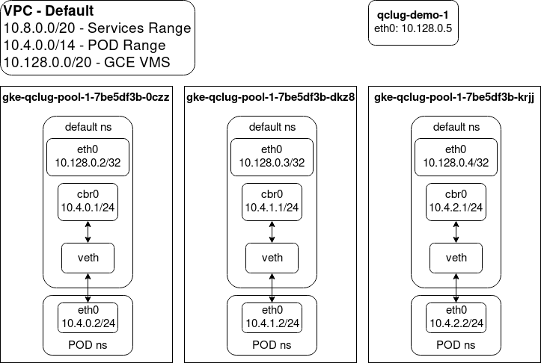
GKE Demo
Kubernetes Up and Running

Slide 15
Alex’s Thoughts
Kubernetes is a platform NOT a PaaS
If (Want to Build a Custom PaaS); then
  Kubernetes A-OK
elseif (Running Infra and tired of CFMGMT)
  Maybe Kubernetes?
else
  NOT Kubernetes

Slide 16
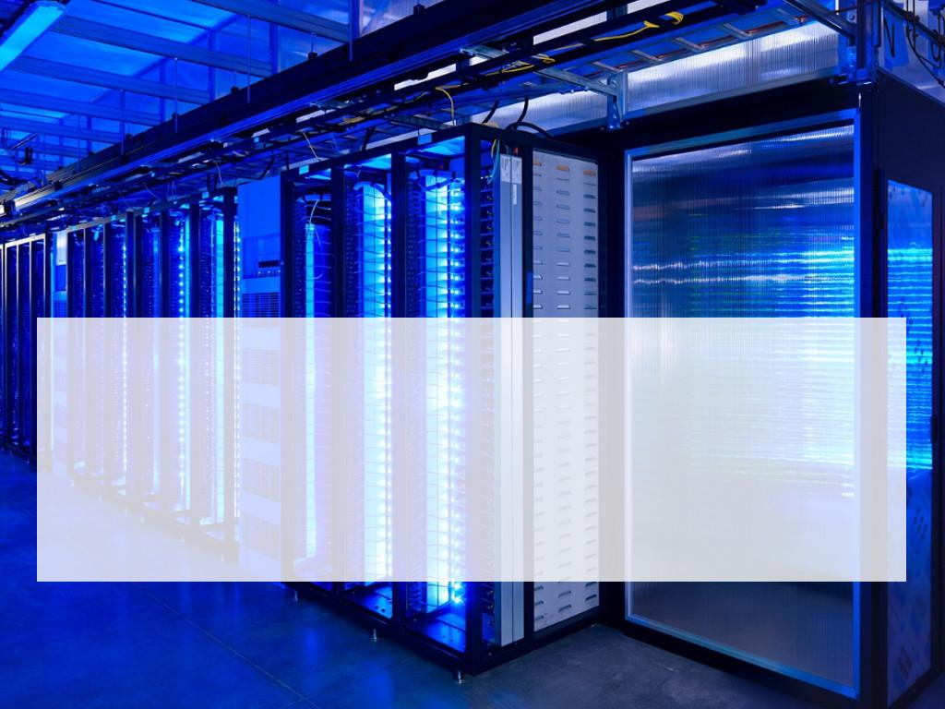
Questions?
Presenter email@example.com

