Slide 1

Fucking, Google Go
The New Programmer Hipster Thing

Slide 2
Go = Google Go = golang
Lots of people call it Google Go or golang to avoid confusion with the game “Go” or Pokemon GO
I'll pretty much use the three names interchangably, in this presentation they are all the same thing.

Slide 3

Why Should I give a shit?
Lots of new fancy toys are written in golang:
  All the new things from hashi-corp (packer, consul)
  Fucking Docker
  etcd, gogs!
If you want to support and use these tools you need to at least know a little about go.
Maybe, Just maybe its actually useful...

Slide 4
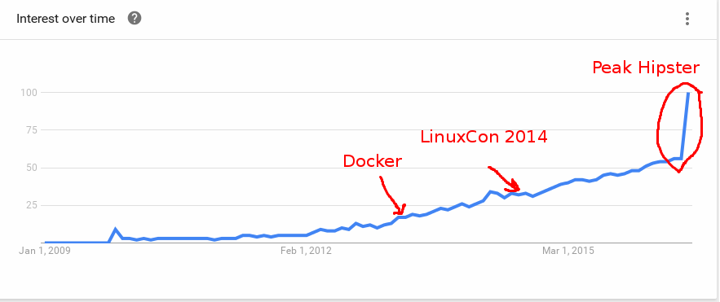
History – Peak Hipster is here
Notes:
I attended LinuxCon in August 2014, that's the first time I heard about google go at a Kubernetes talk.
As you can see from the Google Trends Graph we've hit the Gartner Hype Cycle of Go so its team to learn at least a little about it.

Slide 5

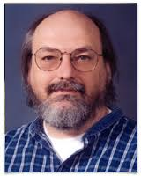
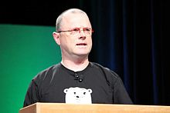
Golang History
Who's Fault is this...
Robert Griesemer
This guy is overlooked...
Ken Thompson
Rob Pike
I would mostly blame this Guy
Notes:
Robert Griesemer is really overlooked. This guy has either victimized OR benfitted computing more then anyone in history (depending on your perspective). Without Robert Griesemer neither the Java Virtual Machine (hotspot) nor the Google V8 JavaScript engine be performant as they are. Without Robert nodejs wouldn't be a thing. Your browser would render Javascript slow as crap and billions of lines of Java software would have never been written.
We'll Give Ken Thompson a pass on this one… He did invent Unix
Rob Pike is the creator of Plan 9 – the follow on research operating system from Bell labs…. I don't know much about plan 9 but is mascot is a cool looking bunny called Glenda.
If you ever google BLIT you will see the weird terminal thing that Rob Made, its pretty cool for 1984.
All three of these guys were hanging around google in 2007. They were burnt out on C and decided we needed a new systems programing language.
Rob Pike is the most public face of Go these days and I would say more then the other two is responable for the philosophy and structure of the language.

Slide 6
Overview
Go was written with the intention of replacing C, C++ and to a lesser extent Java.
Go is an attempt to combine the ease of programming of an interpreted, dynamically typed language with the efficiency and safety of a statically typed, compiled language
Go has a garbage collector, no manually managing memory

Slide 7
Go has an opinion
What I like about Go is it has an opinion on how you should program and how go programs should look.
What I don't like about go is that I don't always agree with its opinions

Slide 8
Fuck you, you’re a bad programmer.
Go doesn't have assertions (A hob-goblin for a small minds)
Go doesn't have ?: operator (Have ever heard of if/else moron?)
Go has begrudging exception support (How dumb people write confusing code.)
Go has one true style enforced by “gofmt”
Because: Fuck you, you’re a bad programmer*
* Adam Leventhalhttp://dtrace.org/blogs/ahl/2016/08/02/i-love-go-i-hate-go/

Slide 9
“easy” tooling
Go does not use a Makefile, Gemfile, Puppetfile, Make::ExaMaker, setuptools, pbr, gradel, maven or other crazy pile of goo for its build and dependancy management
The “go” tool does all go's building, it accepts NO configuration, everything is done via convention.
The “go” tool is intended as a build tool only for the Go language not as a generic build tool
Go comes with tow other significat tools in addition to the go command:
  gofmt – the one true way to write g
  gofix – automatically refactor go code to new API's

Slide 10
Go Summary
Clear dependencies
Clear syntax
Clear semantics
Composition over inheritance
Simplicity provided by the programming model (garbage collection, concurrency)
Easy tooling (the go tool, gofmt, godoc, gofix)

Slide 11
Begin Go coding Disaster!!!

Slide 12
Return to Talking...
Go programmers typically keep all their Go code in a single workspace.
A workspace contains many version control repositories (managed by Git, for example).
Each repository contains one or more packages.
Each package consists of one or more Go source files in a single directory.
The path to a package's directory determines its import path.

Slide 13
Example Workspace Layout
bin/
hello # command executable
outyet # command executable
pkg/
linux_amd64/
github.com/golang/example/
stringutil.a # package object
src/
github.com/golang/example/
.git/ # Git repository metadata
hello/
hello.go # command source
outyet/
main.go # command source
main_test.go # test source
stringutil/
reverse.go # package source
reverse_test.go # test source
golang.org/x/image/
.git/ # Git repository metadata
bmp/
reader.go # package source
writer.go # package source
Notes:
The tree above shows a workspace containing two repositories (example and image). The example repository contains two commands (hello and outyet) and one library (stringutil). The image repository contains the bmp package and several others.
A typical workspace contains many source repositories containing many packages and commands. Most Go programmers keep all their Go source code and dependencies in a single workspace.
Commands and libraries are built from different kinds of source packages. We will discuss the distinction later.

