Slide 1
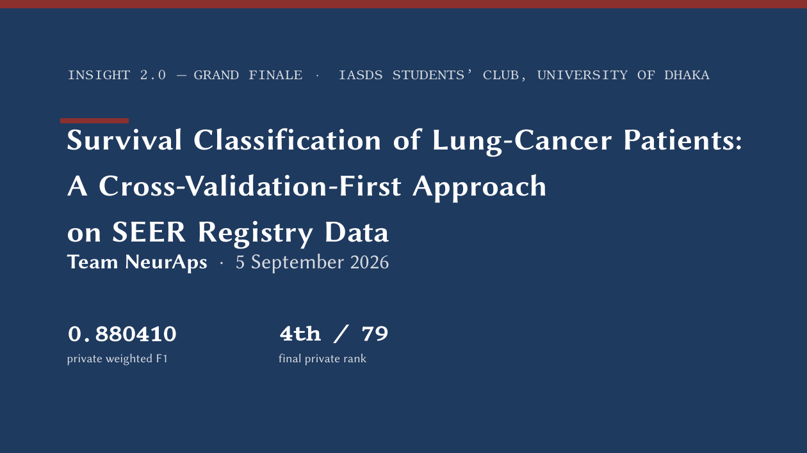
Notes:
[Slide 1 · 0:15 · clock 0:15]
Good morning. We are Team NeurAps. Our entry finished 4th of 79 teams on the private leaderboard with a weighted F1 of 0.880410. The story we want to tell in ten minutes is how a cross-validation-first discipline got us there, and why it moved us from 30th on the public board to 4th on the private one.

Slide 2
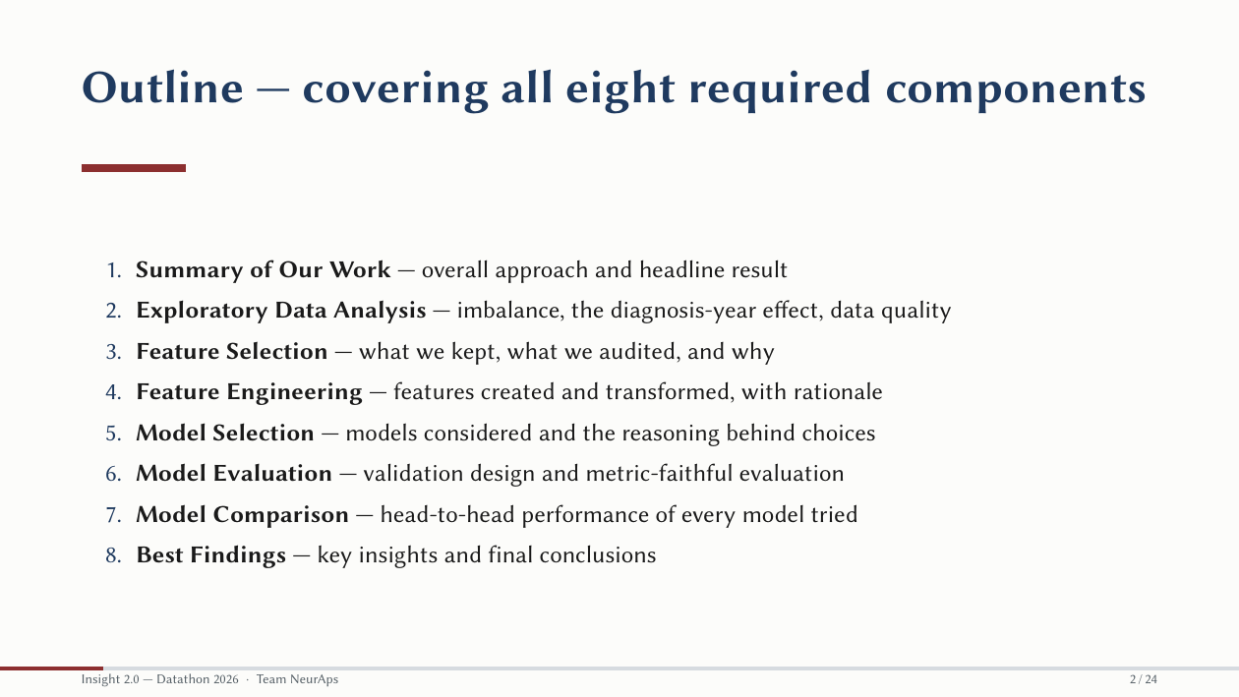
Notes:
[Slide 2 · 0:15 · clock 0:30]
We'll walk the eight required components in order: summary, EDA, feature selection, feature engineering, model selection, evaluation, comparison, and findings. One thread runs through all eight: every decision was gated by honest out-of-fold evidence.

Slide 3

Notes:
[Slide 3 · 0:03 · clock 0:33]
Section one: summary.

Slide 4
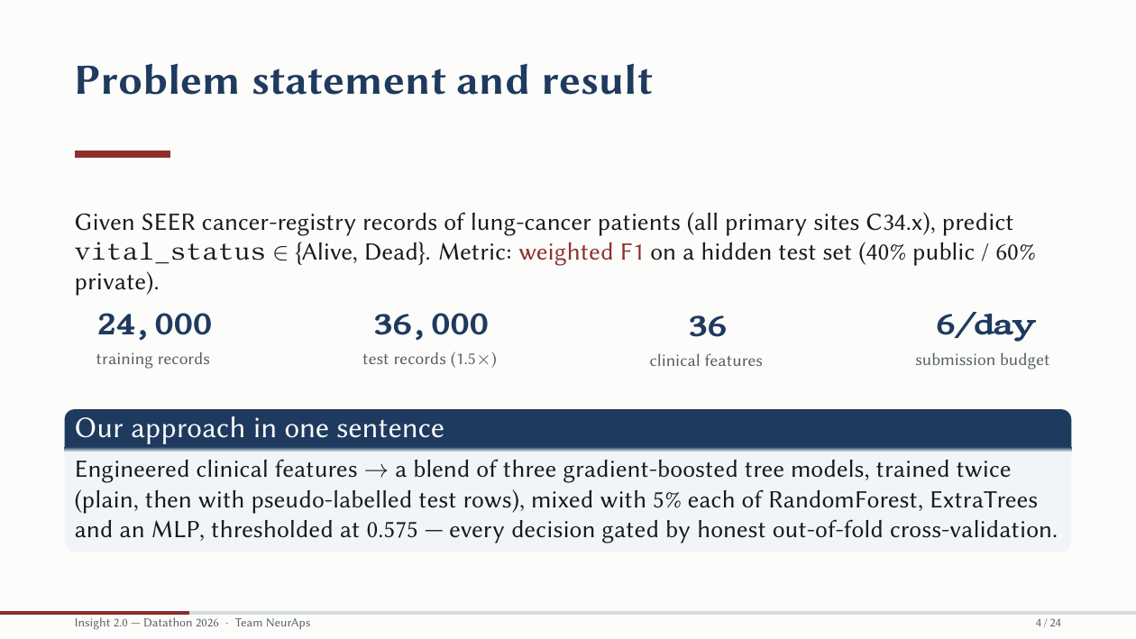
Notes:
[Slide 4 · 0:45 · clock 1:18]
The task: SEER registry records of lung-cancer patients; predict vital status, Alive or Dead. 24,000 training rows, 36,000 test rows, 36 clinical features, six submissions a day. Metric: weighted F1 on a hidden 40/60 public-private split. Our approach in one sentence: engineered clinical features, a blend of three gradient-boosted tree models trained twice, plain and then with pseudo-labelled test rows, mixed with five percent each of RandomForest, ExtraTrees and an MLP, thresholded at 0.575. Nothing exotic. What was unusual was the verification behind each of those choices.

Slide 5

Notes:
[Slide 5 · 0:03 · clock 1:21]
Section two: exploratory data analysis.

Slide 6
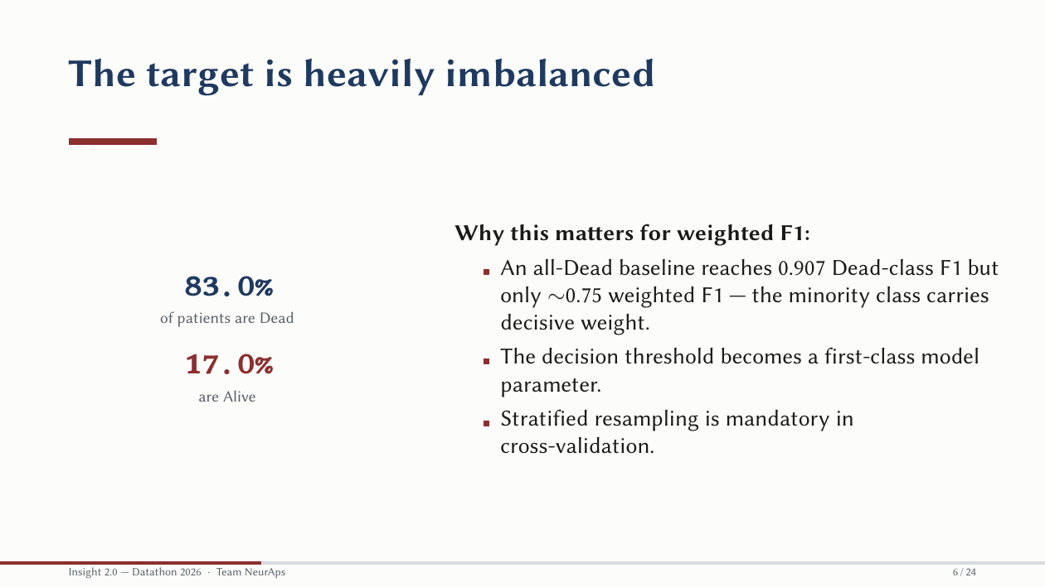
Notes:
[Slide 6 · 0:30 · clock 1:51]
Eighty-three percent of patients are Dead. That matters because weighted F1 weights each class by its frequency, but the Alive F1 is far lower, around 0.63 versus 0.93 for Dead, so the minority class is where the score moves. Two consequences: the decision threshold becomes a model parameter we tune, and stratified folds are mandatory.

Slide 7
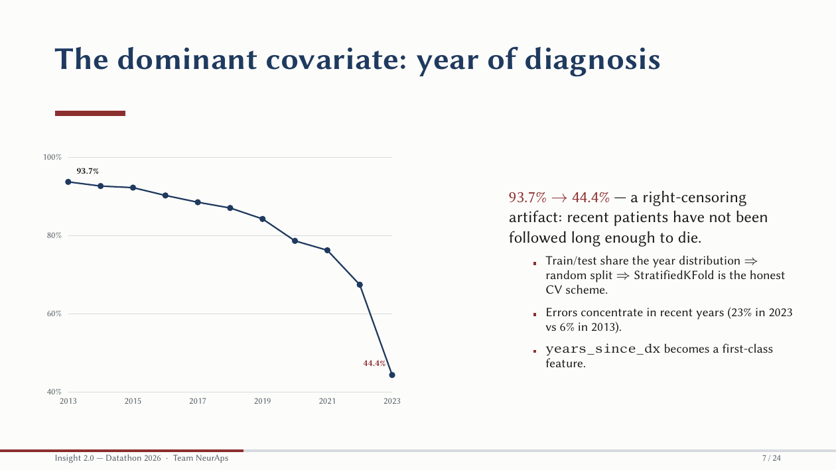
Notes:
[Slide 7 · 0:45 · clock 2:36]
The single most important EDA finding. Death rate by diagnosis year falls from 94 percent in 2013 to 44 percent in 2023. That is not medical progress at that scale; it is right-censoring. A 2013 patient has had a decade to die; a 2023 patient, months. Three things followed. Train and test share this year distribution, so the split is random and stratified K-fold is the honest CV scheme. Errors concentrate in recent years, 23 percent in 2023 versus 6 percent in 2013; those are the genuinely uncertain patients. And years-since-diagnosis becomes a first-class feature, the follow-up-window proxy.

Slide 8
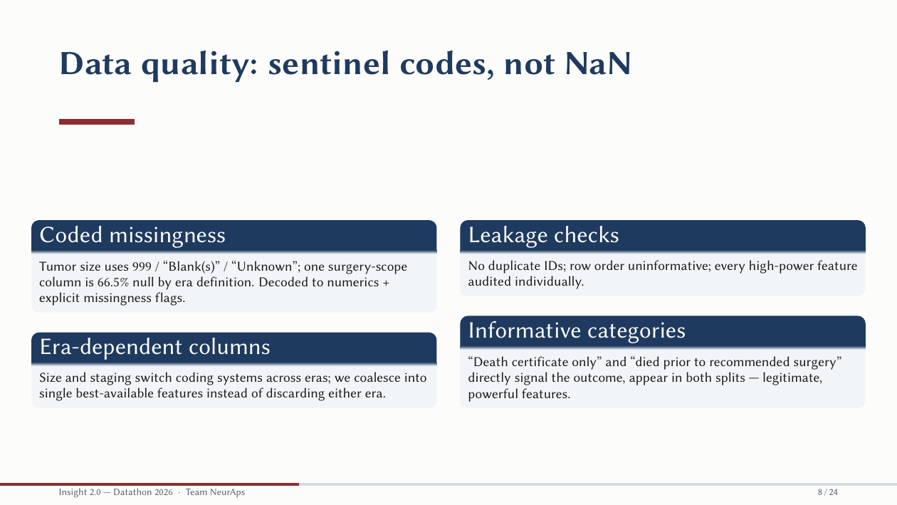
Notes:
[Slide 8 · 0:30 · clock 3:06]
SEER doesn't use NaN; it uses sentinel codes: 999, Blank, Unknown. Tumor size lives in three era-specific columns. We parsed the numerics, flagged missingness explicitly, and coalesced the eras instead of discarding either. We audited every high-power feature for leakage. Categories like 'death certificate only' are directly informative, but they exist in both splits as provided data, so they are legitimate signal, not leakage.

Slide 9

Notes:
[Slide 9 · 0:03 · clock 3:09]
Section three: features. [Suggested hand-off point if two speakers: speaker A has covered problem and data; speaker B takes features, models and results. Alternatively hand off at slide 12.]

Slide 10
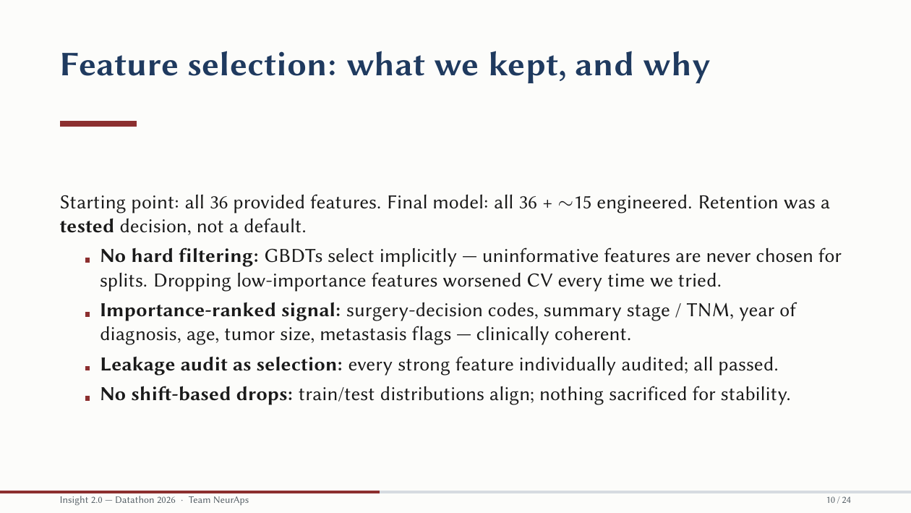
Notes:
[Slide 10 · 0:30 · clock 3:39]
We kept all 36 provided features plus about 15 engineered ones, and that retention was a tested decision. Gradient-boosted trees select implicitly: uninformative features never get chosen for splits. Every time we tried dropping low-importance features, CV got worse. The importance ranking is clinically coherent: surgery-decision codes, stage, year, age, tumor size, metastasis. Train and test distributions align, so nothing was sacrificed for stability.

Slide 11
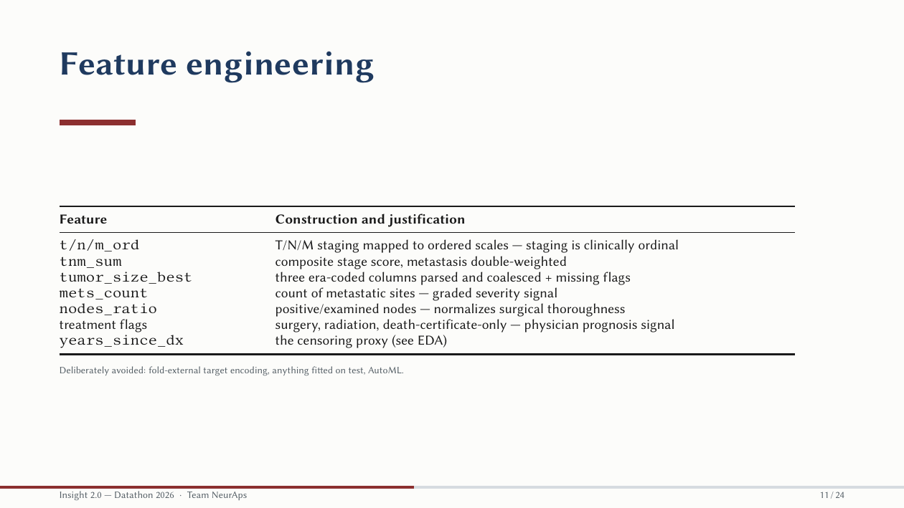
Notes:
[Slide 11 · 0:35 · clock 4:14]
Each engineered feature has a one-sentence clinical story. T, N and M staging mapped to ordered scales, because staging is ordinal. A composite TNM score with metastasis double-weighted. The coalesced tumor size. A count of metastatic sites, a graded severity signal. The positive-to-examined node ratio, which normalizes out surgical thoroughness. Treatment flags, which encode physician prognosis. And years since diagnosis. What we deliberately avoided: target encoding outside folds, anything fitted on test, and AutoML.

Slide 12

Notes:
[Slide 12 · 0:03 · clock 4:17]
Section four: model selection and evaluation.

Slide 13
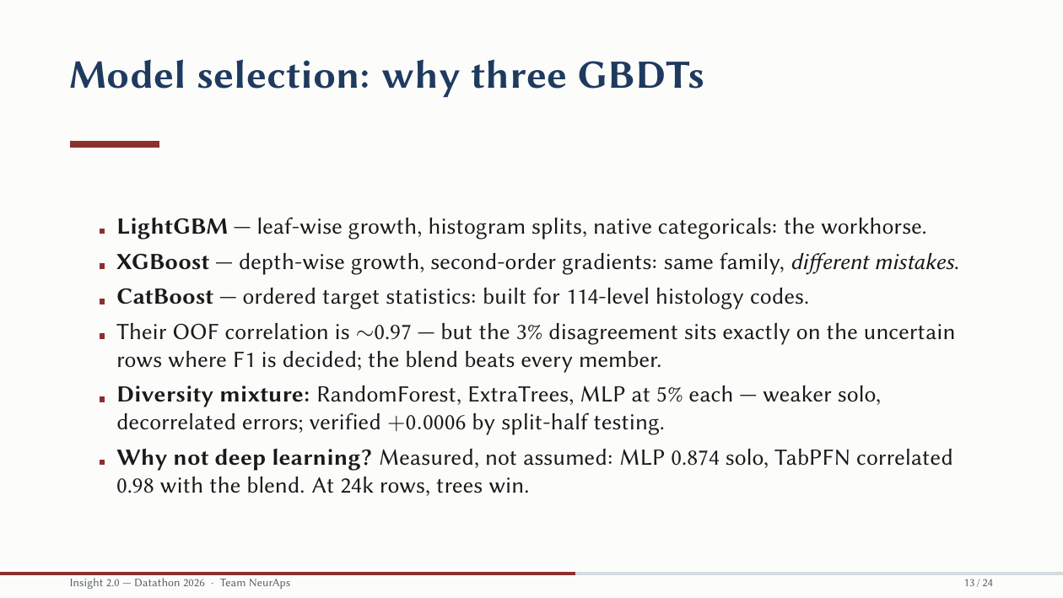
Notes:
[Slide 13 · 0:45 · clock 5:02]
Why three gradient-boosted models? LightGBM grows leaf-wise with native categoricals. XGBoost grows depth-wise with second-order gradients. CatBoost uses ordered target statistics, built for our 114-level histology codes. They correlate 0.97, but the three percent where they disagree sits exactly on the uncertain rows where F1 is decided, and the blend beats every member. Then a diversity mixture: RandomForest, ExtraTrees and an MLP at five percent each, weaker alone but with decorrelated errors, verified at plus 0.0006 by split-half testing. Why not deep learning? We measured rather than assumed: the MLP scored 0.874 solo and TabPFN correlated 0.98 with our blend. At 24,000 rows, trees win.

Slide 14
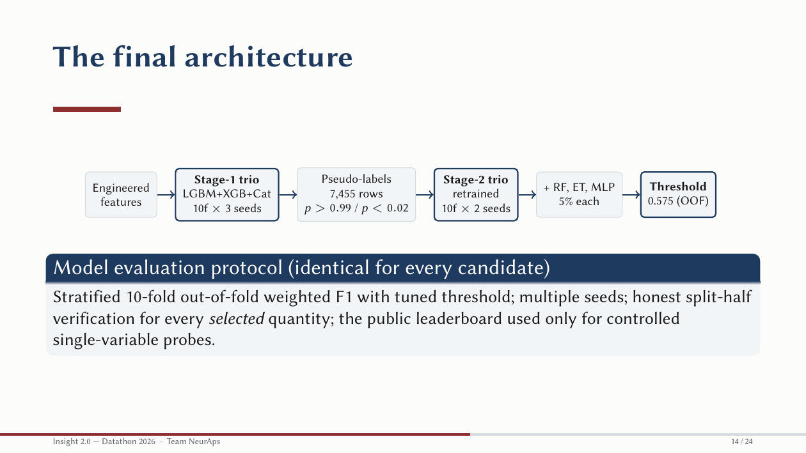
Notes:
[Slide 14 · 0:40 · clock 5:42]
The full pipeline. Engineered features feed a stage-one trio, ten folds by three seeds. Its most confident test predictions, above 0.99 or below 0.02, become 7,455 pseudo-labelled rows. A stage-two trio retrains on train plus pseudo-rows. We add the diversity models at five percent each and threshold at 0.575, chosen on out-of-fold predictions. The evaluation protocol was identical for every candidate: stratified ten-fold OOF weighted F1 with a tuned threshold, multiple seeds, split-half verification for every selected quantity, and the public leaderboard used only for controlled single-variable probes.

Slide 15
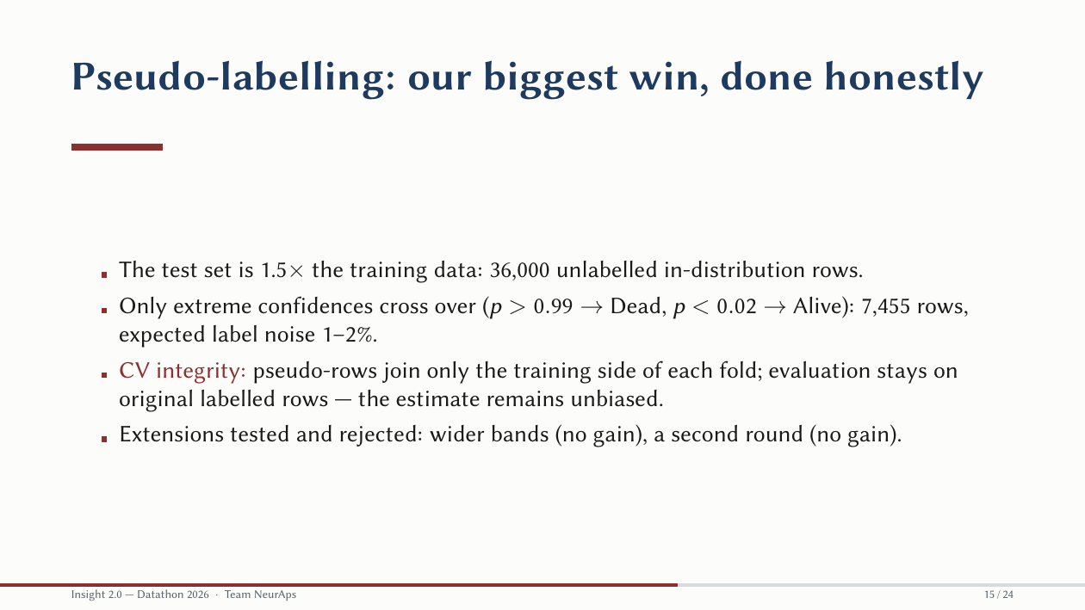
Notes:
[Slide 15 · 0:35 · clock 6:17]
Pseudo-labelling was our biggest single win, and the detail that makes it honest is the CV-integrity rule: pseudo-rows join only the training side of each fold; evaluation stays on original labelled rows, so the estimate stays unbiased. The test set is 1.5 times our training data, so 36,000 in-distribution rows were too valuable to ignore. Only extreme confidences cross over, with expected label noise of one to two percent. We tested wider bands and a second round; neither helped, and both rejections are logged.

Slide 16
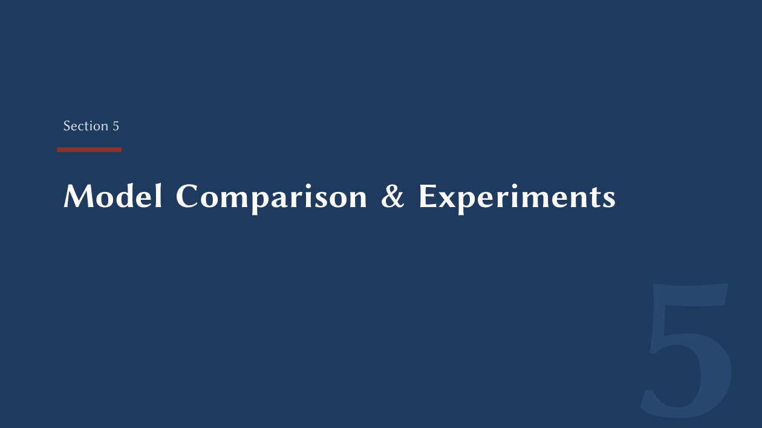
Notes:
[Slide 16 · 0:03 · clock 6:20]
Section five: model comparison and experiments.

Slide 17
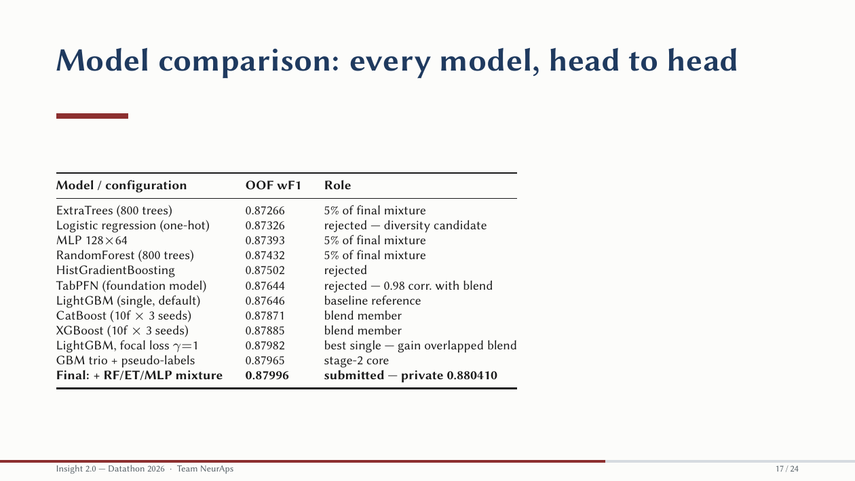
Notes:
[Slide 17 · 0:30 · clock 6:50]
Every model we tried, head to head, on the same protocol. The ladder runs from ExtraTrees at 0.8727, through logistic regression, the MLP, RandomForest, HistGradientBoosting and TabPFN, a default LightGBM at 0.8765, up to the seed-averaged CatBoost and XGBoost near 0.8788. Focal-loss LightGBM was our best single model at 0.8798, but its gain overlapped what blending already recovered. The GBM trio with pseudo-labels reached 0.87965, and the final mixture 0.87996, which scored 0.880410 on private.

Slide 18
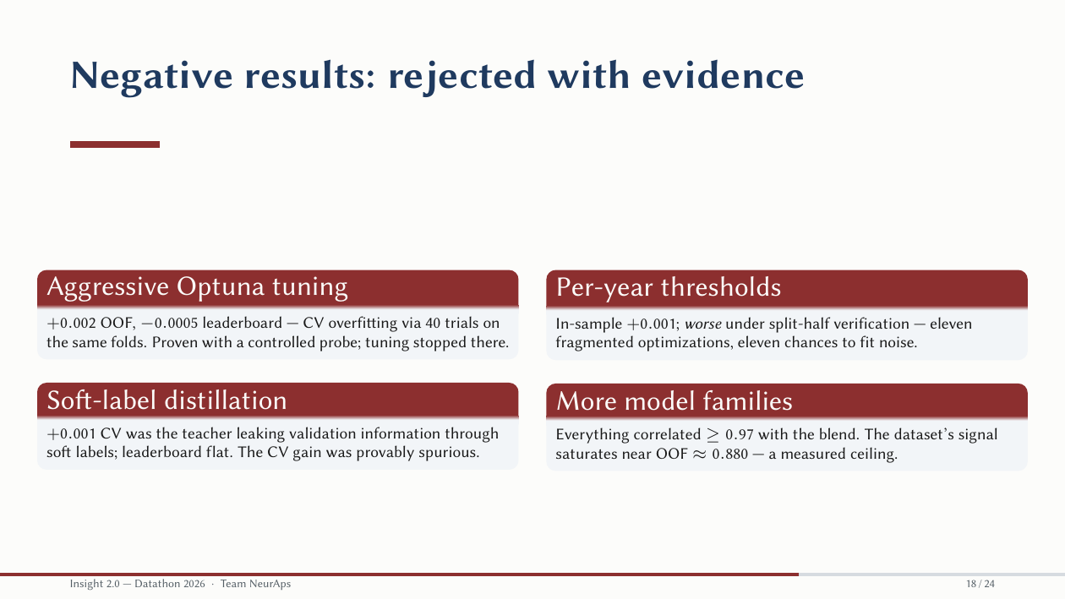
Notes:
[Slide 18 · 0:45 · clock 7:35]
More than half of our logged experiments were rejections, and each has a named failure mode. Aggressive Optuna tuning: plus 0.002 OOF, minus 0.0005 on the leaderboard. Forty trials on the same folds is CV overfitting by multiple comparisons, proven with a controlled probe, so we stopped tuning there. Soft-label distillation: a plus 0.001 CV gain that was the teacher leaking validation information through soft labels; leaderboard flat. Per-year thresholds: better in-sample, worse under split-half verification, eleven chances to fit noise. And more model families: everything correlated 0.97 or above with the blend. The dataset's signal saturates near 0.880, a measured ceiling.

Slide 19
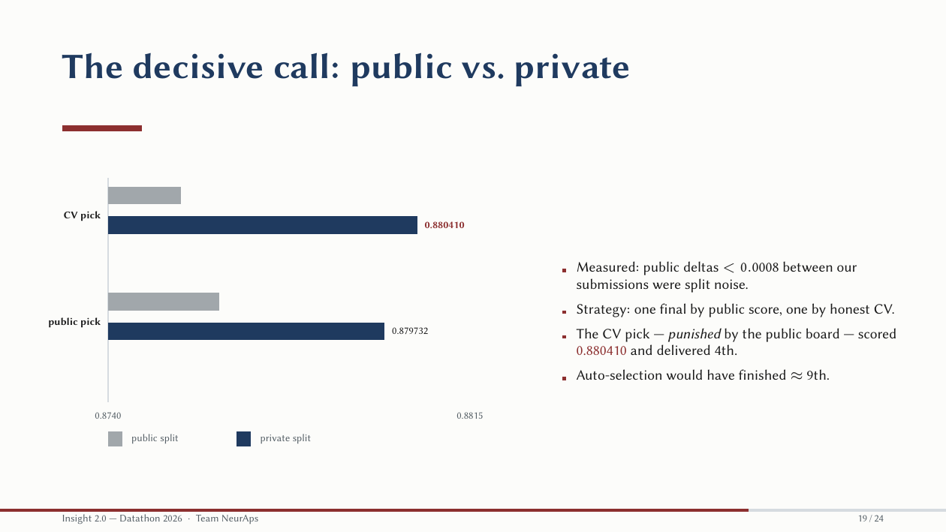
Notes:
[Slide 19 · 0:45 · clock 8:20]
This is the decision that made 4th place. Comparing our own submissions, public deltas under 0.0008 were split noise: label agreement above 99 percent, with an ordering that contradicted OOF. So we selected one final by public score and one by honest CV. Grey bars are the public split, navy bars the private split. The CV pick was punished by the public board at 0.8755, and scored 0.880410 on private. Auto-selection would have finished around ninth. One informed click, worth five places.

Slide 20

Notes:
[Slide 20 · 0:03 · clock 8:23]
Section six: best findings.

Slide 21
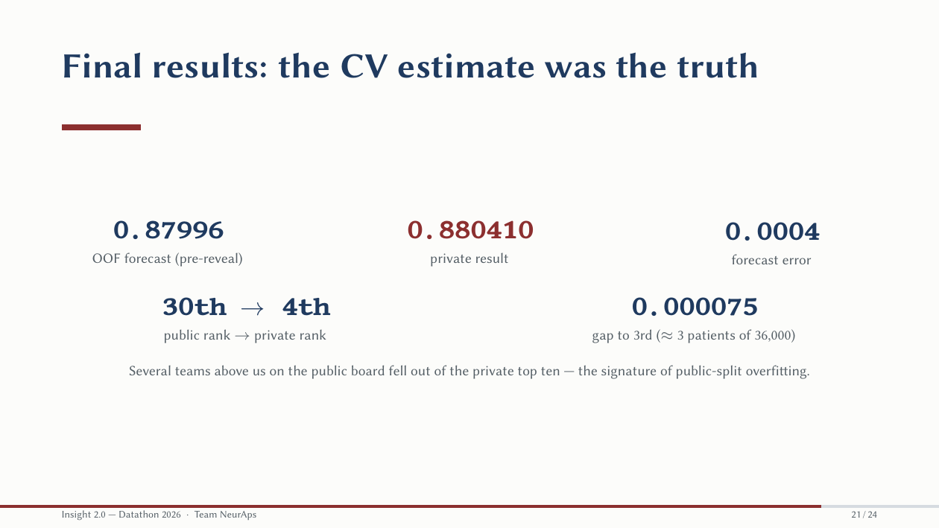
Notes:
[Slide 21 · 0:30 · clock 8:53]
Our OOF forecast before the reveal was 0.87996. The private result was 0.880410; forecast error 0.0004. We went from 30th on the public board to 4th on private, 0.000075 behind third, about three patients out of 36,000. Several teams above us on the public board fell out of the private top ten, the signature of public-split overfitting.

Slide 22
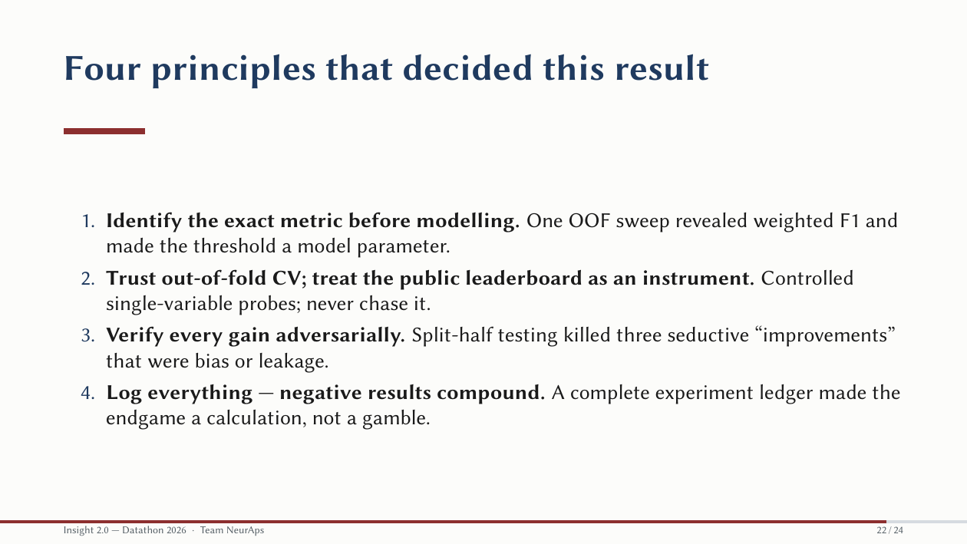
Notes:
[Slide 22 · 0:35 · clock 9:28]
Four principles decided this result. Identify the exact metric before modelling: one OOF sweep revealed weighted F1 and made the threshold a parameter. Trust out-of-fold CV and treat the leaderboard as an instrument; never chase it. Verify every gain adversarially: split-half testing killed three seductive improvements. And log everything: a complete experiment ledger made the endgame a calculation, not a gamble.

Slide 23
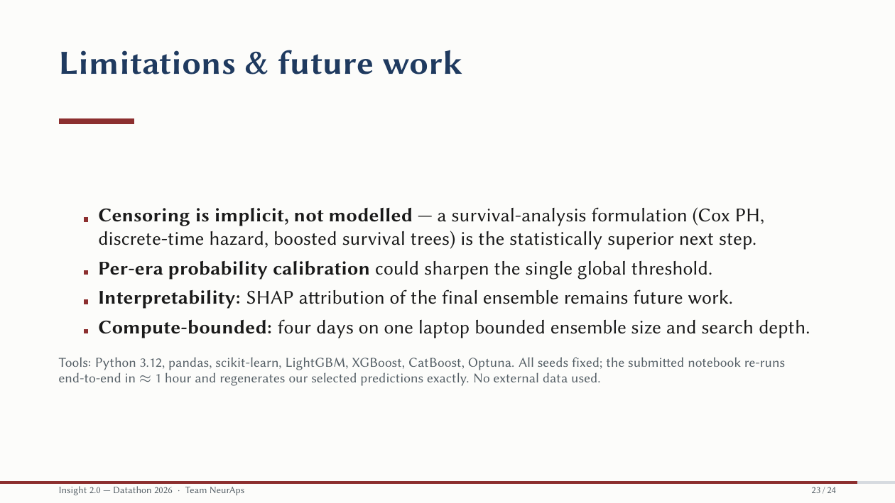
Notes:
[Slide 23 · 0:20 · clock 9:48]
Limitations, honestly. Censoring is implicit, not modelled; a survival-analysis formulation is the statistically superior next step. Per-era calibration could sharpen the global threshold. SHAP interpretation of the ensemble remains future work. Everything is seeded; the submitted notebook re-runs end to end in about ninety minutes and regenerates our predictions exactly. No external data.

Slide 24
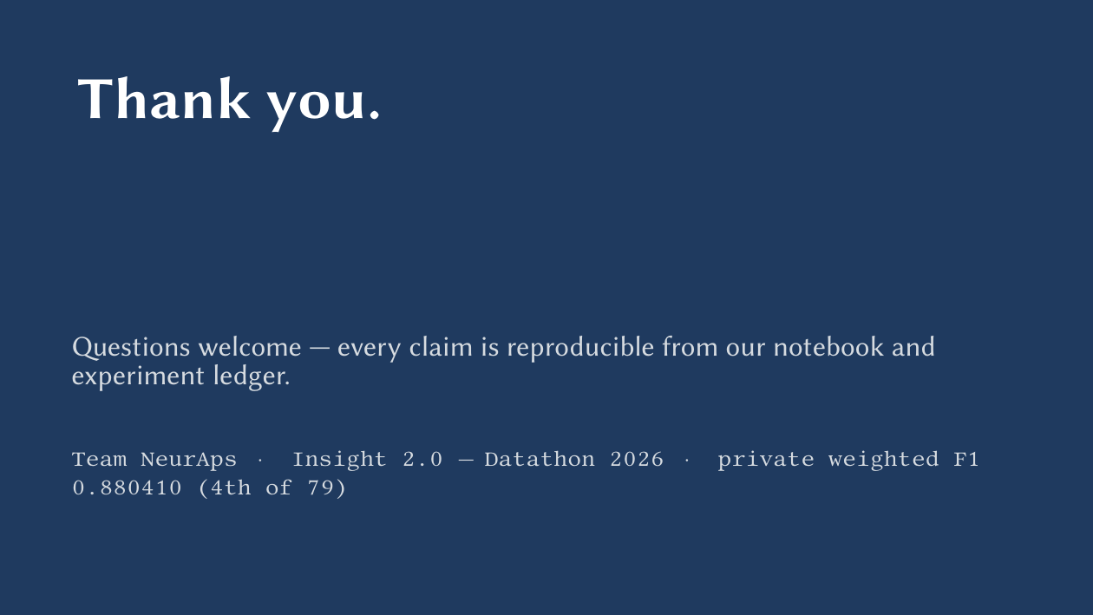
Notes:
[Slide 24 · 0:10 · clock 9:58]
Thank you. Every claim is reproducible from our notebook and experiment ledger. We welcome questions.

