Slide 1
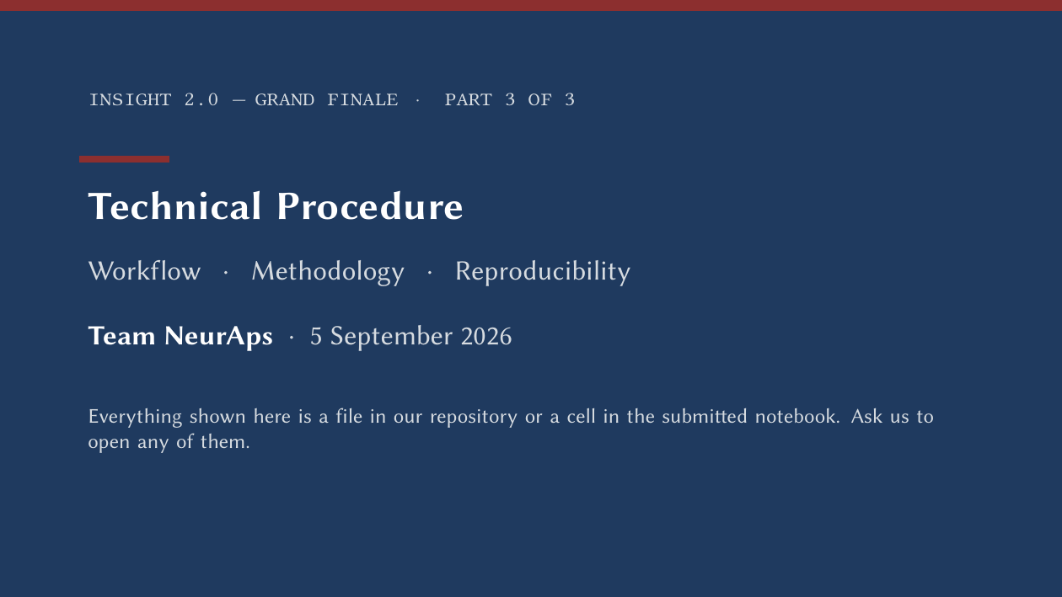
Notes:
[Slide 1 · 0:15 · clock 0:15]
Part three: the technical procedure. Everything on these slides is a file in our repository or a cell in the submitted notebook, and we're happy to open any of them.

Slide 2

Notes:
[Slide 2 · 0:03 · clock 0:18]
Section one: workflow.

Slide 3
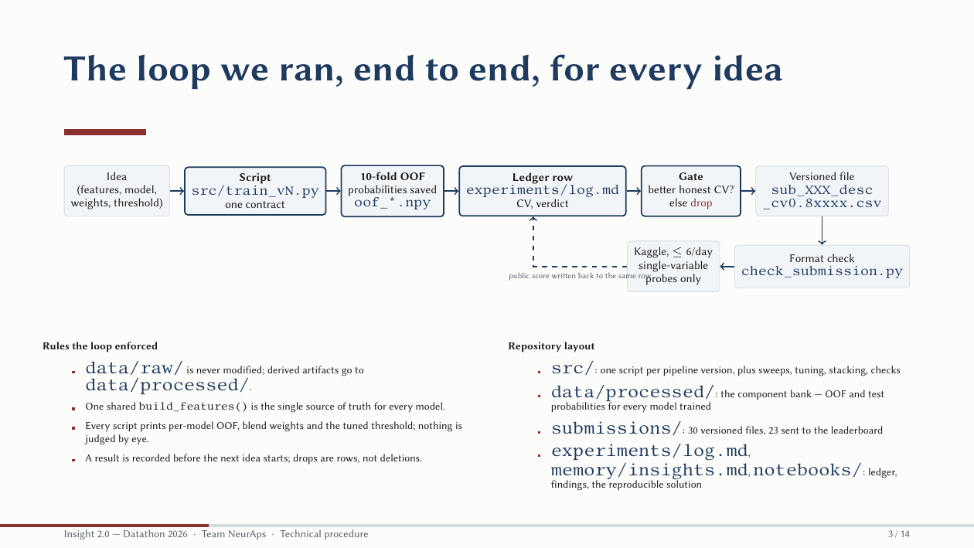
Notes:
[Slide 3 · 1:00 · clock 1:18]
This is the loop we ran for every idea, for four days. An idea becomes a script that follows one contract: it reads the raw CSVs, which we never modified; it builds features through one shared function; it runs ten-fold stratified cross-validation and saves the out-of-fold probabilities to disk, so every model we ever trained is still available for blending. It prints per-model OOF, blend weights and the tuned threshold, and that result goes into the ledger before the next idea starts. Only if the honest CV improved does a versioned submission file get written, named with its description and CV score, and only after the format checker passes does it go to Kaggle, at most six a day, and only as single-variable probes.

Slide 4
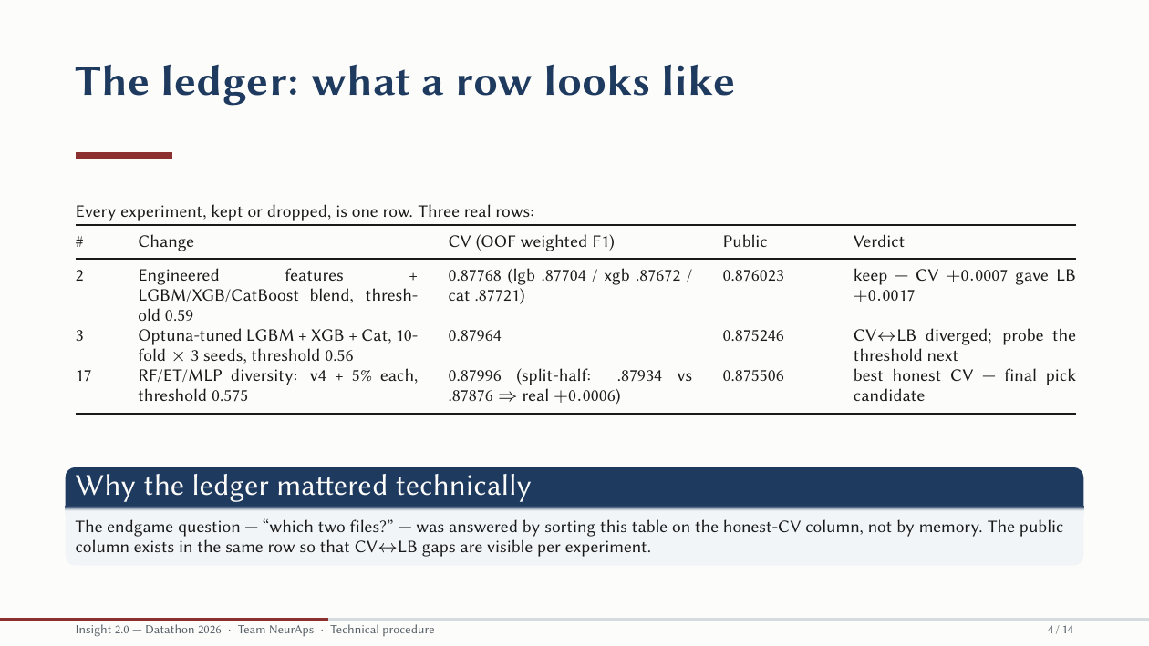
Notes:
[Slide 4 · 1:00 · clock 2:18]
The ledger is one row per experiment, kept or dropped. Here are three real rows. Row two: engineered features plus the three-model blend, CV up seven ten-thousandths, leaderboard up seventeen. Row three: the Optuna-tuned trio, where CV and leaderboard diverged, and the verdict says what we did next: probe the threshold. Row seventeen: the diversity mixture, with the split-half numbers that made it the final pick. The technical point is that the endgame decision was made by sorting this table on the honest-CV column, and the public score sits in the same row so every CV-to-leaderboard gap is visible per experiment.

Slide 5

Notes:
[Slide 5 · 0:03 · clock 2:21]
Section two: methodology.

Slide 6
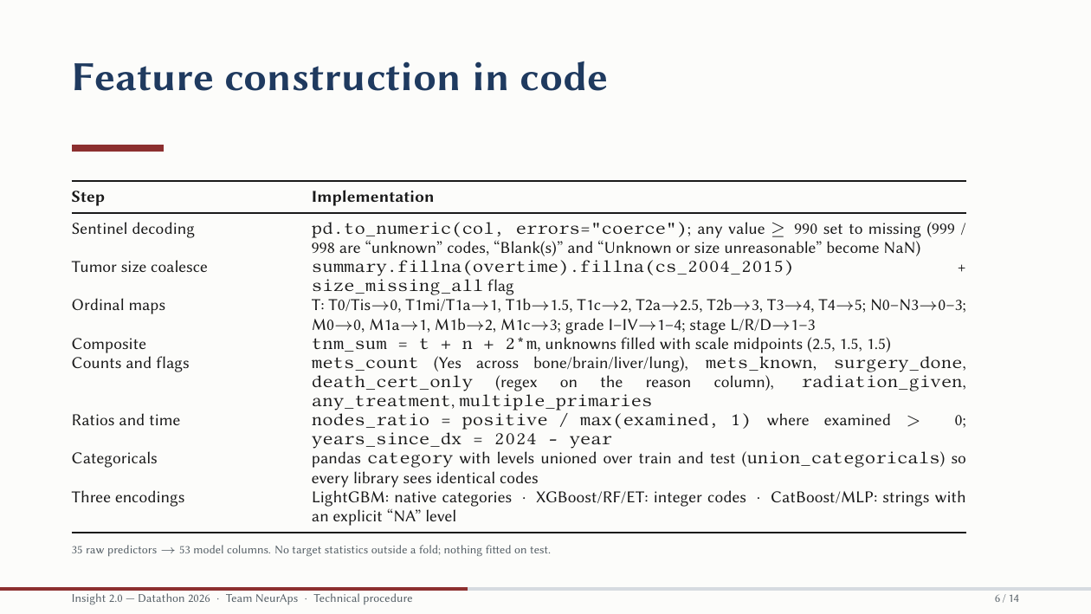
Notes:
[Slide 6 · 1:00 · clock 3:21]
Feature construction, as code. Sentinel decoding: coerce to numeric, and treat anything at or above 990 as missing, because 999 and 998 are registry codes for unknown. Tumor size is coalesced across the three era columns in a fixed order, with a flag when all three are missing. The ordinal maps are explicit dictionaries; you can see the T values, with T1b at one and a half and T2 at two and three quarters where the code is ambiguous. The composite TNM score doubles metastasis. Counts and flags come from string matches on the treatment columns. Categoricals are pandas categories with levels unioned over train and test, so every library sees identical codes, and we keep three encodings because LightGBM, XGBoost and CatBoost each want a different one. Thirty-five raw predictors become fifty-three columns, and nothing is fitted on the target outside a fold or on test.

Slide 7
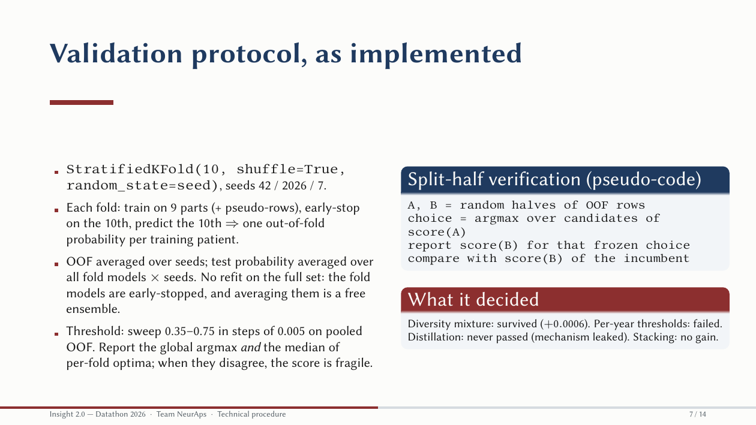
Notes:
[Slide 7 · 1:10 · clock 4:31]
The validation protocol as implemented. Stratified ten-fold with shuffling, seeds 42, 2026 and 7. In each fold we train on nine parts, early-stop on the tenth, and predict the tenth, so every training patient gets exactly one out-of-fold probability per seed; we average across seeds. Test probabilities are the average over all fold models and seeds; we never refit on the full set, because the fold models are early-stopped and averaging them is a free ensemble. The threshold is swept from 0.35 to 0.75 in steps of 0.005 on pooled OOF, and we report both the global argmax and the median of per-fold optima; when those disagree, the score is fragile. Split-half verification is four lines: random halves A and B, choose on A, score the frozen choice on B, compare with the incumbent on B. It certified the diversity mixture and rejected per-year thresholds and stacking.

Slide 8
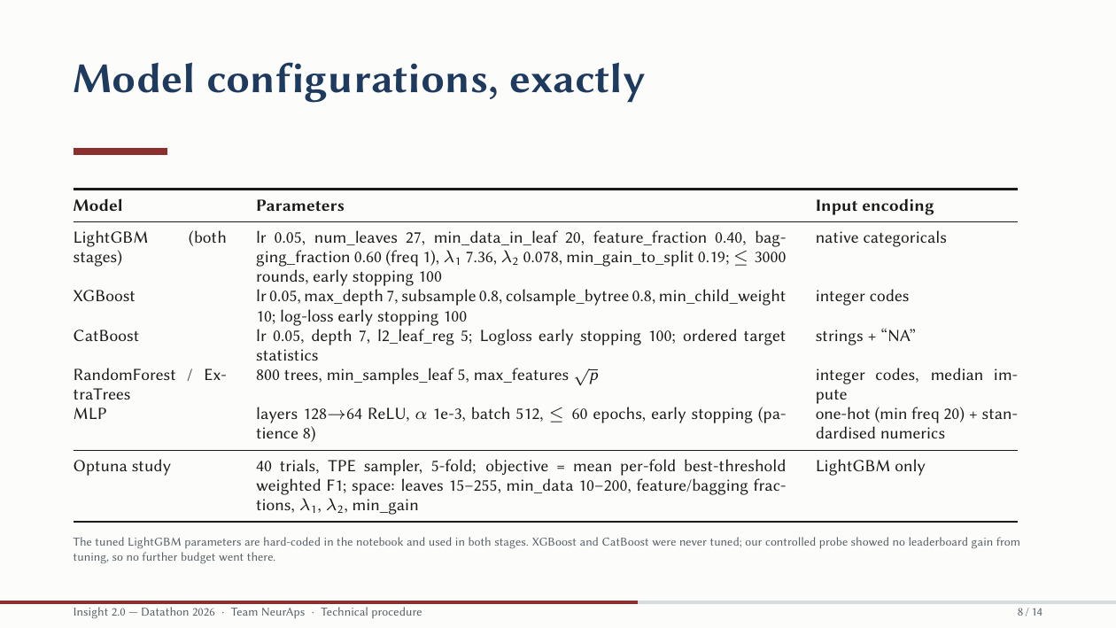
Notes:
[Slide 8 · 1:05 · clock 5:36]
The model configurations, exactly. LightGBM uses the Optuna parameters in both stages: 27 leaves, 20 rows per leaf minimum, feature fraction 0.40, bagging 0.60, L1 7.36, up to three thousand rounds with early stopping at a hundred. XGBoost: depth 7, subsample and column sample 0.8, min child weight 10, on integer codes. CatBoost: depth 7, L2 leaf regularisation 5, on string categories with an explicit NA level. RandomForest and ExtraTrees: 800 trees, at least five rows per leaf, square-root features. The MLP: 128 then 64 ReLU units on one-hot categoricals and standardised numerics, early stopping. The Optuna study was 40 trials of TPE on five folds, objective the mean per-fold best-threshold weighted F1. XGBoost and CatBoost were never tuned; the controlled probe showed no leaderboard gain from tuning, so no more budget went there.

Slide 9
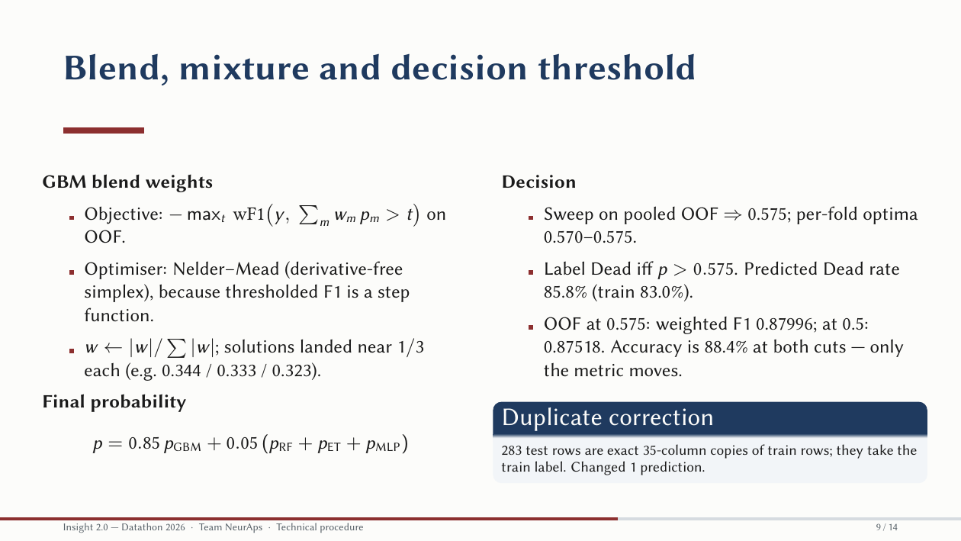
Notes:
[Slide 9 · 0:50 · clock 6:26]
Blending and the decision. The blend weights maximise best-threshold weighted F1 of the weighted average of OOF probabilities; because thresholded F1 is a step function, we use Nelder-Mead, a derivative-free simplex search, on absolute normalised weights. They came out near a third each. The final probability is 0.85 times the GBM blend plus 0.05 times each of RandomForest, ExtraTrees and the MLP. The threshold sweep gave 0.575, with per-fold optima between 0.570 and 0.575. Label Dead when p exceeds 0.575; predicted Dead rate 85.8 percent. One detail judges like: accuracy is 88.4 percent at both 0.5 and 0.575; only the weighted F1 moves, from 0.875 to 0.880. And the duplicate correction: 283 test rows are exact copies of train rows and take the train label, which changed one prediction.

Slide 10
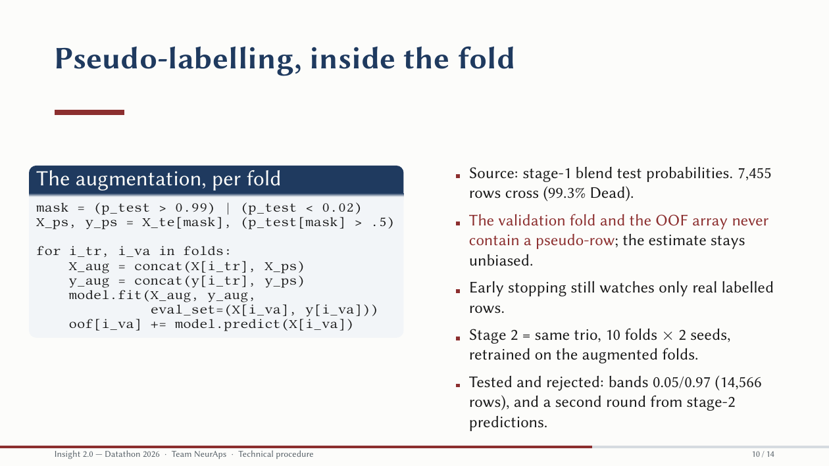
Notes:
[Slide 10 · 0:55 · clock 7:21]
Pseudo-labelling inside the fold, as code. The mask selects test rows with stage-one probability above 0.99 or below 0.02; 7,455 rows, 99.3 percent Dead. Inside each fold, the augmented training set is the fold's training rows plus those pseudo-rows, and the model early-stops on the fold's real validation rows. The validation fold and the OOF array never contain a pseudo-row, so the estimate stays unbiased. Stage two is the same trio, ten folds by two seeds, retrained on the augmented folds. We tested wider bands, 0.05 and 0.97, which doubled the pool to 14,566 rows, and a second round from stage-two predictions. Neither improved honest CV, and both are in the ledger.

Slide 11
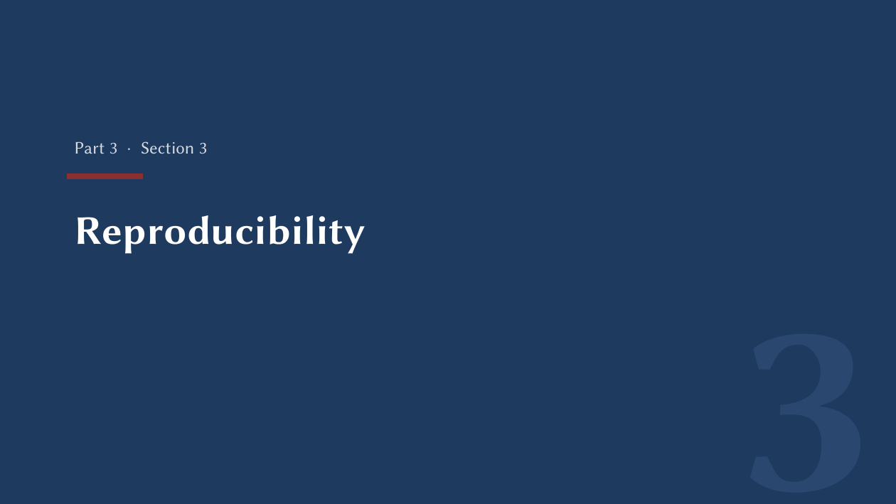
Notes:
[Slide 11 · 0:03 · clock 7:24]
Section three: reproducibility.

Slide 12
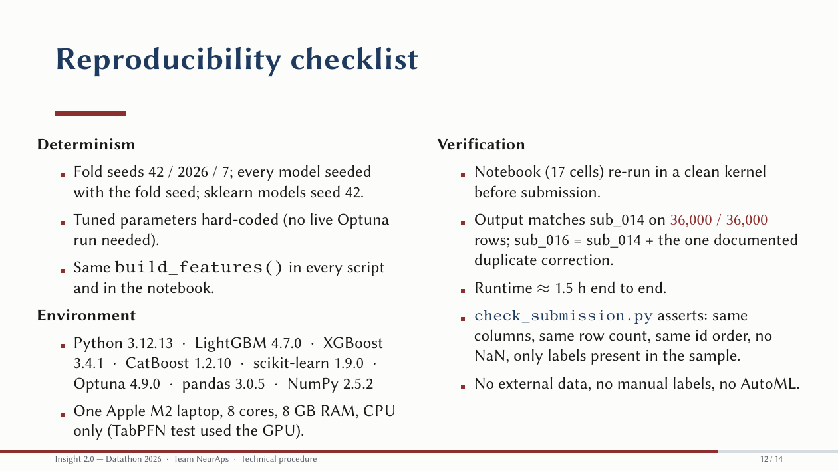
Notes:
[Slide 12 · 1:10 · clock 8:34]
The reproducibility checklist. Determinism: fold seeds 42, 2026 and 7; every model seeded with its fold seed; the tuned parameters are hard-coded so no live Optuna run is needed; the same feature function is used in every script and in the notebook. Environment: Python 3.12, LightGBM 4.7, XGBoost 3.4, CatBoost 1.2, scikit-learn 1.9, Optuna 4.9, pandas 3.0, NumPy 2.5, on one Apple M2 laptop with eight cores and eight gigabytes, CPU only. Verification: the seventeen-cell notebook was re-run in a clean kernel before submission and reproduced sub_014 on all 36,000 rows; the selected sub_016 is that file plus the one documented duplicate correction. Runtime about ninety minutes end to end. The submission checker asserts identical columns, row count and id order, no missing values, and only labels present in the sample. No external data, no manual labels, no AutoML.

Slide 13
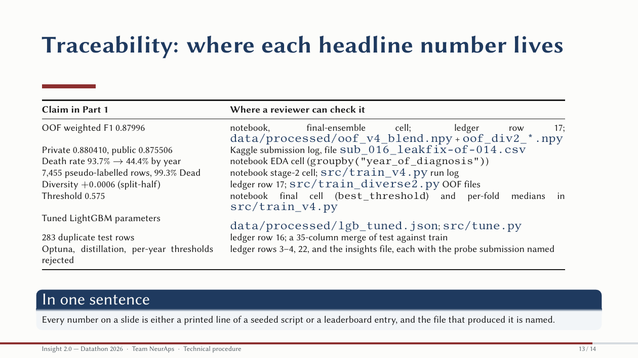
Notes:
[Slide 13 · 0:50 · clock 9:24]
Traceability. For each headline number in part one, this table says where a reviewer can check it: the OOF score is a printed line of the final ensemble cell and ledger row seventeen, with the probability arrays on disk; the private and public scores are Kaggle entries for a named file; the year effect is a one-line groupby in the EDA cell; the pseudo-label count is printed by the stage-two cell; the split-half result is ledger row seventeen; the threshold is the final cell; the tuned parameters are a JSON file produced by the tuning script; the duplicate count is a merge of test against train. In one sentence: every number on a slide is either a printed line of a seeded script or a leaderboard entry, and the file that produced it is named.

Slide 14
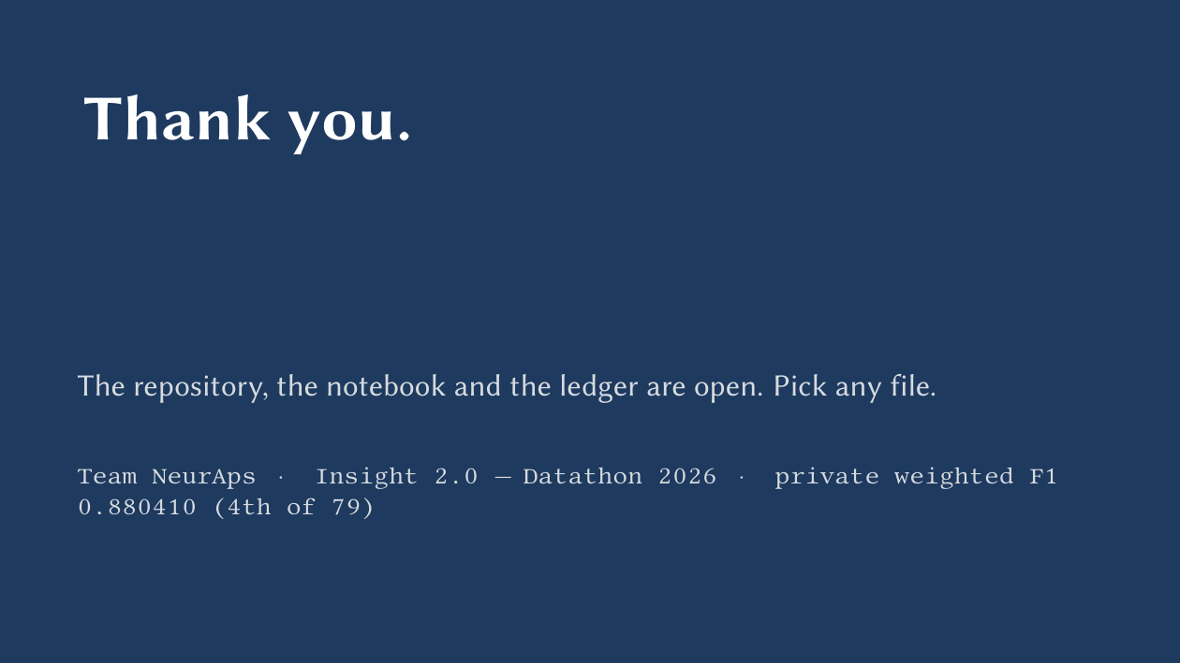
Notes:
[Slide 14 · 0:15 · clock 9:39]
Thank you. The repository, the notebook and the ledger are open; pick any file and we'll walk through it.

