Slide 1
ARIMA모델을 활용한 YG 주가 예측
souljoin0229@gmail.com
kimseojeong

Slide 2


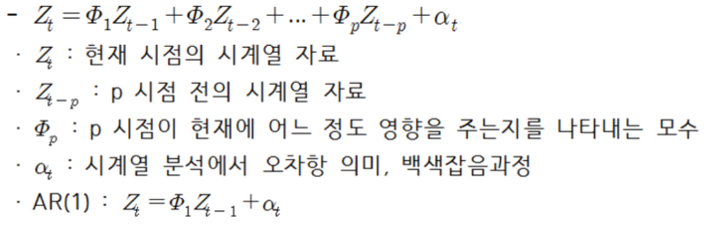
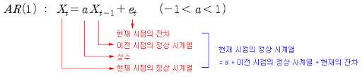
1) AR(Auto Regressive)모형?
전제 : 과거의 값은 현재의 값에 영향을 미친다
P(시점)?
-특정 시점에서의 시계열 값
-상수항
-오차항(잔차)

Slide 3
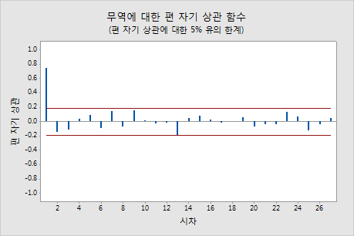
적절한 P(시점)는 어떻게 구하는가?
PACF그래프
PACF is a partial auto-correlation function.
The correlation between observations at two time spots given that we consider both observations are correlated to observations at other time spots
For example, today's stock price can be correlated to the day before yesterday, and yesterday can also be correlated to the day before yesterday. Then, PACF of yesterday is the real correlation between today and yesterday after taking out the influnce of the days before yesterday.
PACF에서 significant한 lag : 현재의 값에 유의미한 영향을 주는 과거 시점 도출가능
Lag=0 : 자기자신과의 상관성이므로 항상 1
Lag=1에서 자기상관도가 유의수준을 넘음, 이후값들은 유의수준 이하
P=1

Slide 4
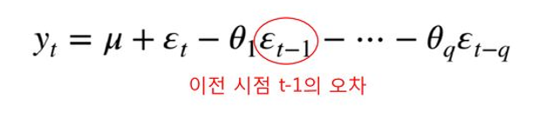
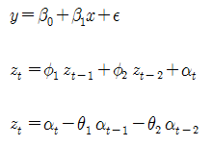
2) MA(Moving Average)모형?
가설 : 데이터는 특정한 평균을 가지고 있으며, 이 상태에서 현재의 독립변수(y)는 이전 오차 항의 변동성에 의해 결정된다 -> 데이터의 평균도 오차항의 변동성에 의해 이동된다
이전 항에서의 오차(e(t-1)) 혹은 변동값을 이용하여
현재 항의 상태를 추론
뮤 : yt의 평균
q : 시점

Slide 5
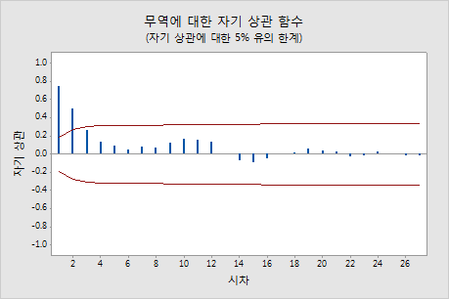
적절한 q(시점)는 어떻게 구하는가?
ACF그래프
ACF is an (complete) auto-correlation function which gives us values of auto-correlation of any series with its lagged values.
The correlation between the observation at the current time spot and the observations at previous time spots
현재 시점에 가장 영향을 주는 과거시점은 어디까지인지 도출
Lag=2에서 통계적으로 유의한 상관이 있음
q=2

Slide 6
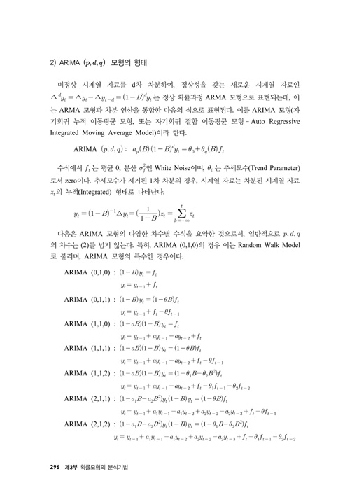
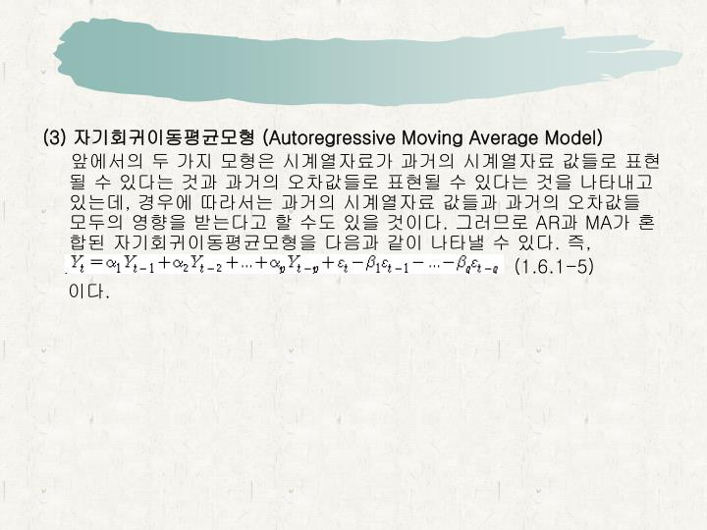
3) ARIMA모형?
*ARMA모형
ARMA(1,1) :

Slide 7
3) ARIMA모형?

Slide 8
정상성 확인방법 :
- Original 그래프 형태 확인
- Augmented Dickey-fuller Test
- Box-Cox() (only can be used for positive data values) OR CUBE-Root (세제곱근)
- ACF, PACF그래프
But box-cox transformation can be used only for strictly positive target values. If you have negative values in your target (dependent) variable, the box-cox and log transformation cannot be used.
Cube root can be used to transform negative, zero and positive data values

Slide 9
Augmented Dickey-fuller Test
The Augmented Dickey-Fuller test is a type of statistical test called a unit root test.
The intuition behind a unit root test is that it determines how strongly a time series is defined by a trend.
There are a number of unit root tests and the Augmented Dickey-Fuller may be one of the more widely used. It uses an autoregressive model and optimizes an information criterion across multiple different lag values.
- The null hypothesis of the test is that the time series can be represented by a unit root, that it is not stationary (has some time-dependent structure).
- The alternate hypothesis (rejecting the null hypothesis) is that the time series is stationary.
Null Hypothesis (H0): If failed to be rejected, it suggests the time series has a unit root, meaning it is non-stationary. It has some time dependent structure.
Alternate Hypothesis (H1): The null hypothesis is rejected; it suggests the time series does not have a unit root, meaning it is stationary. It does not have time-dependent structure.
Notes:
https://machinelearningmastery.com/time-series-data-stationary-python/

Slide 10
1 2 3 4 5 6 | ADF Statistic: -4.808291 p-value: 0.000052 Critical Values: 5%: -2.870 1%: -3.449 10%: -2.571
p-value > 0.05: Fail to reject the null hypothesis (H0), the data has a unit root and is non-stationary.
p-value <= 0.05: Reject the null hypothesis (H0), the data does not have a unit root and is stationary.
Running the example prints the test statistic value of -4.
The more negative this statistic, the more likely we are to reject the null hypothesis (we have a stationary dataset).
As part of the output, we get a look-up table to help determine the ADF statistic. We can see that our statistic value of -4 is less than the value of -3.449 at 1%.
This suggests that we can reject the null hypothesis with a significance level of less than 1% (i.e. a low probability that the result is a statistical fluke).
Rejecting the null hypothesis means that the process has no unit root, and in turn that the time series is stationary or does not have time-dependent structure.

Slide 11
데이터로 ARIMA model 만들기

Slide 12
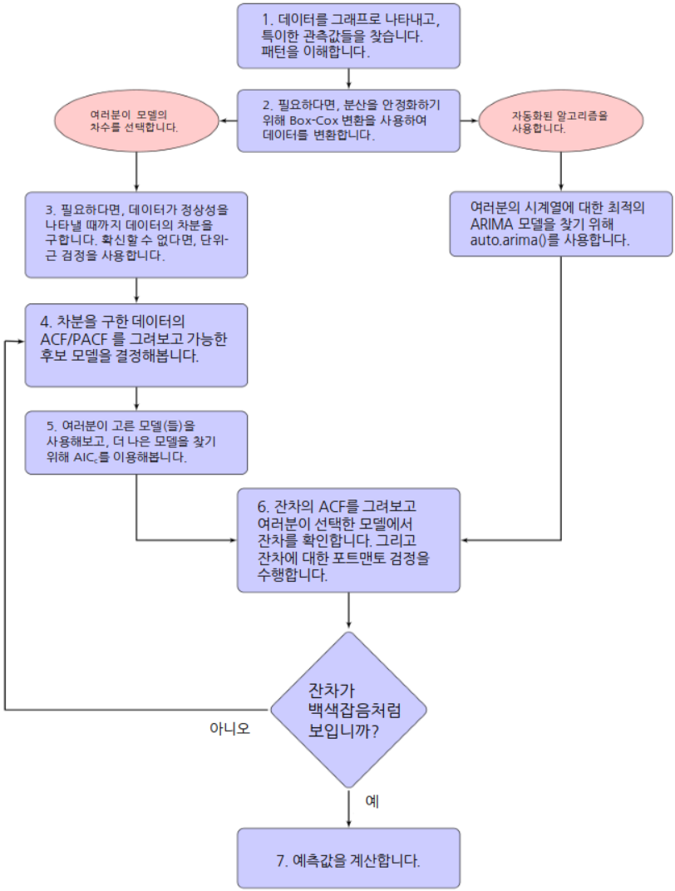

Slide 13
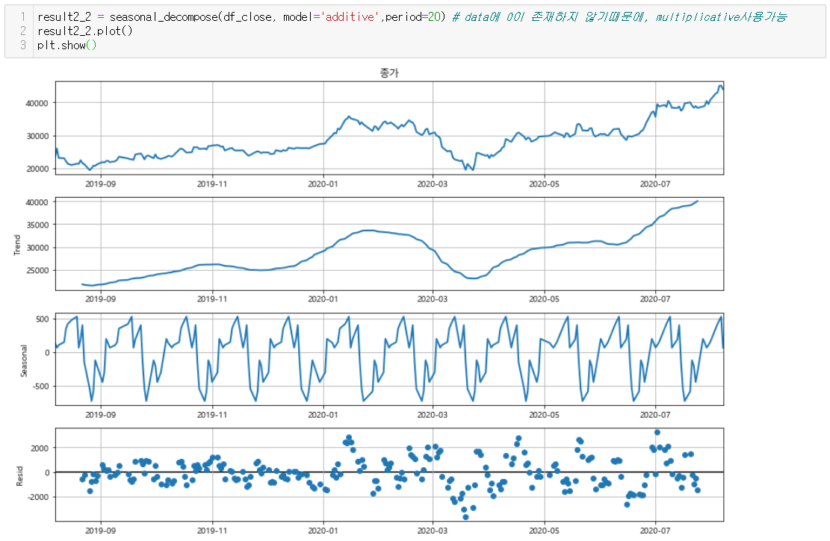
패턴이해
- 시계열 분해 (Additive model)
Data :
Train(2019-07-01 ~ 2020-07-01)
Test(2020-07-02 ~ 2020-08-31)

Slide 14
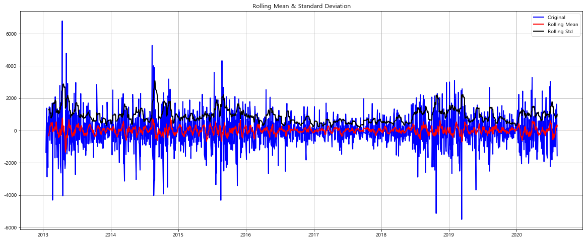
- 1차 차분값의 이동평균과 이동 표준편차

Slide 15
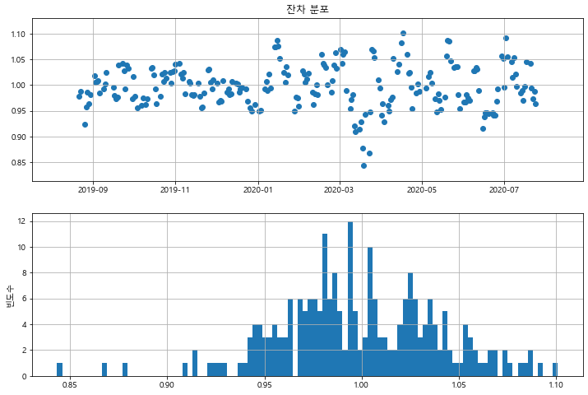
- Residual 분포

Slide 16
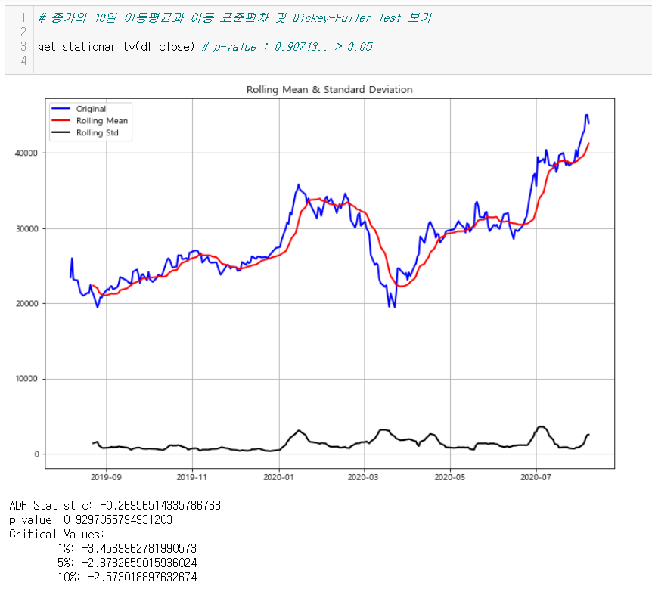
정상성 확인 방법 : Augmendted Dickey-Fuller, ACF, PACF
<Augmented Dickey-Fuller>
종가
> 0.05 (유의수준 5%)

Slide 17
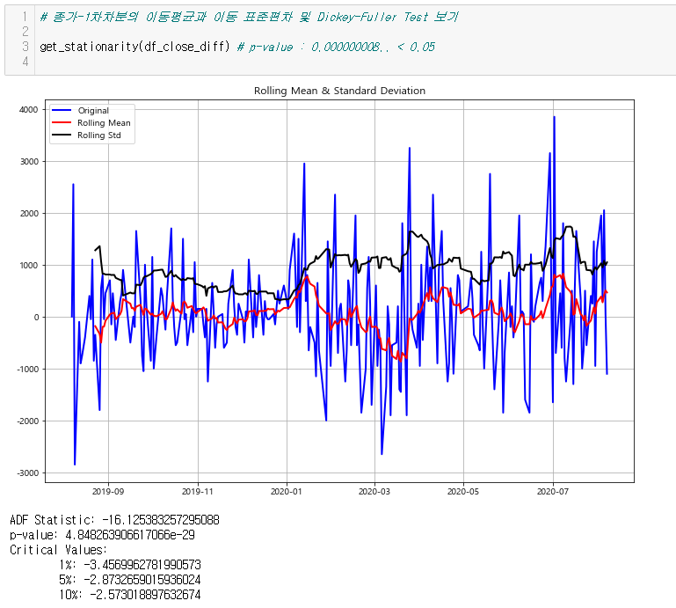
정상성 확인 방법 : Augmendted Dickey-Fuller, ACF, PACF
<Augmented Dickey-Fuller>
종가_1차차분
차분으로인한 음수발생,
boxcox를 사용x
< 0.05 (유의수준 5%)

Slide 18
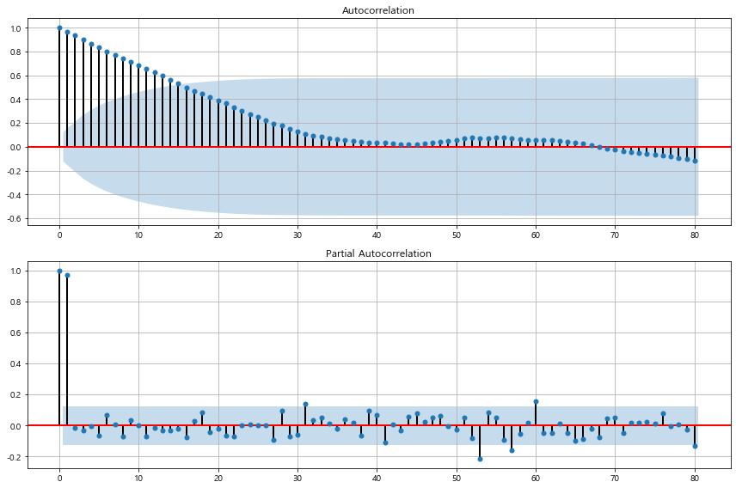
<종가>
ACF
PACF
ACF그래프 : 점점 감소하는 모양
PACF그래프 : 1에서 상관성 ↑, lab가 커질 수록, 감쇠모양이아니라 불규칙하게 변동
=> Non-Stationary

Slide 19
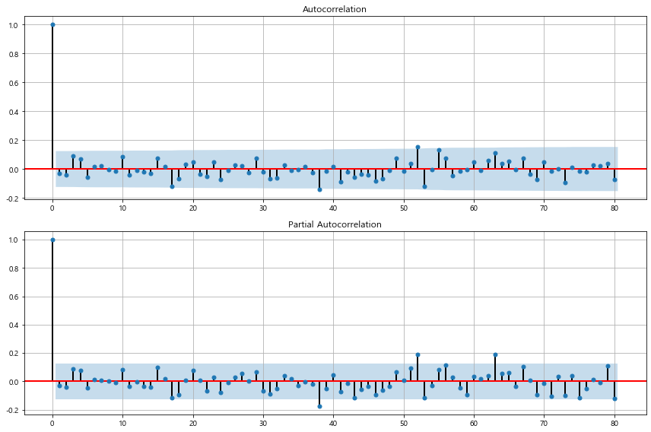
<종가_1차차분>
ACF
PACF
ACF :
PACF :
q=0
1차차분 -> d=1
p=0
=> Stationary
ARIMA(0,1,0)

Slide 20
ARIMA모델
- SARIMA((P,D,Q), (P,D,Q)m)
(P,D,Q) : Non Seasonal part of the Model
(P,D,Q)m : Seasonal part of the Model
m= number of observations per year.
The seasonal part of the model consists of terms that are similar to the non-seasonal components of the model, but involve backshifts of the seasonal period
Ex) ARIMA(1,1,1)(1,1,1)4 : quarterly data (m=4)
(P,D,Q)의 P,Q와 (P,D,Q)m 의 P,Q : Auto_arima 반복을 통해 AIC,BIC값이 가장 적게 나온 parameter로 결정
(P,D,Q)의 D와 (P,D,Q)m 의 D : 차분값의 Dickey-fullertest를 통해 유의값(0.05)이하 였을때의 parameter로 결정
(P,D,Q)m의 m : 분기별 변동성 고려 (주가특성) -> 60(5*4*3)으로 결정
Notes:
https://otexts.com/fpp2/seasonal-arima.html

Slide 22
예측 및 MSE

Slide 23
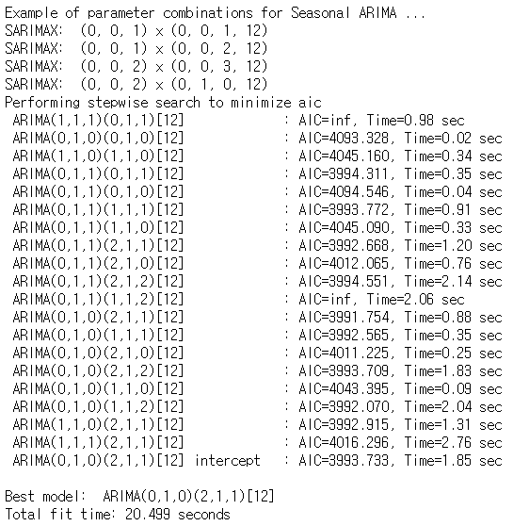
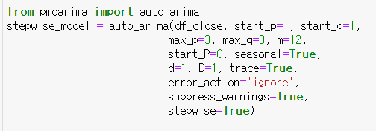
Auto-Arima
AIC설명 :
The AIC value will allow us to compare how well a model fits the data and takes into account the complexity of a model, so models that have a better fit while using fewer features will receive a better (lower) AIC score than similar models that utilize more features.

Slide 24
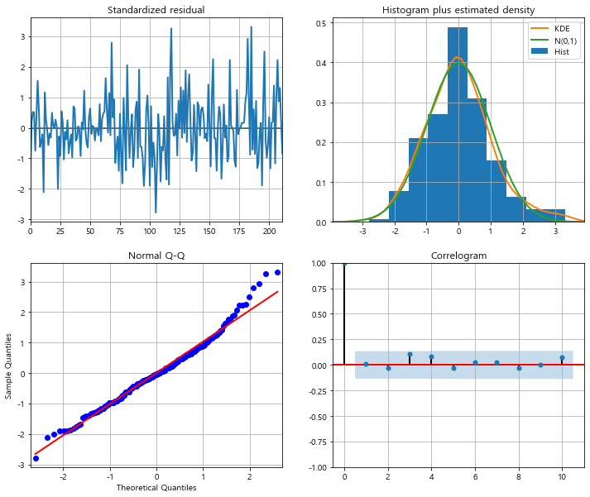
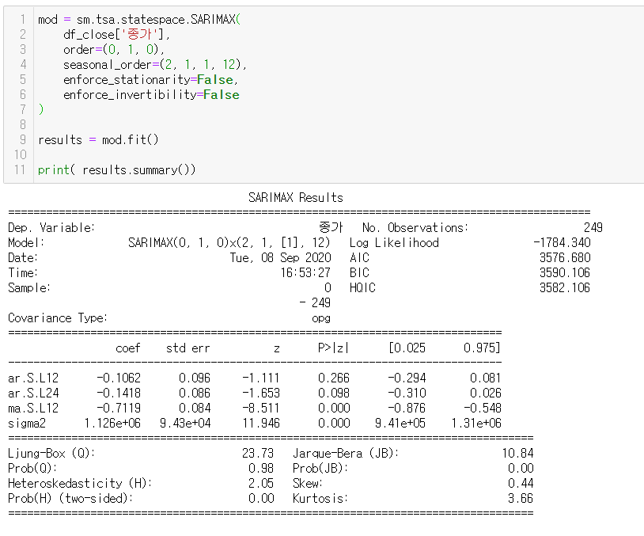

Data_Fitting
Residual_EDA

Slide 25
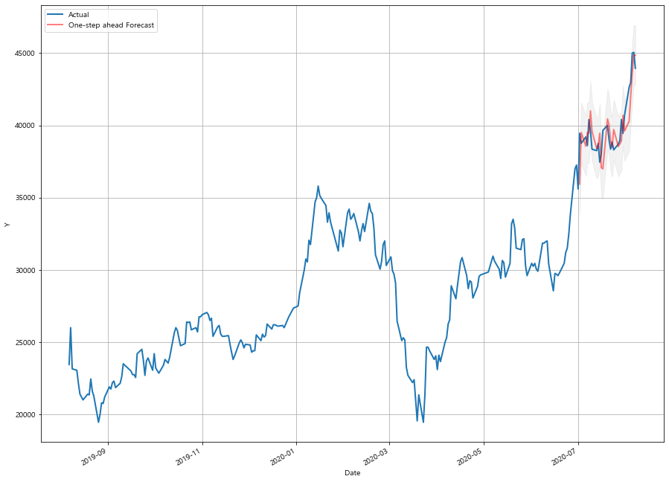
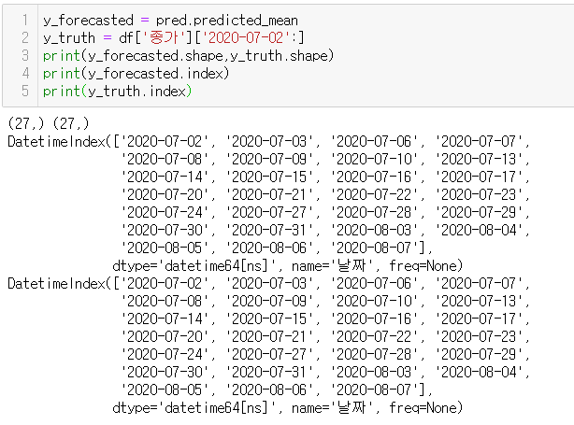
Forecast
1 month 예측

Slide 26
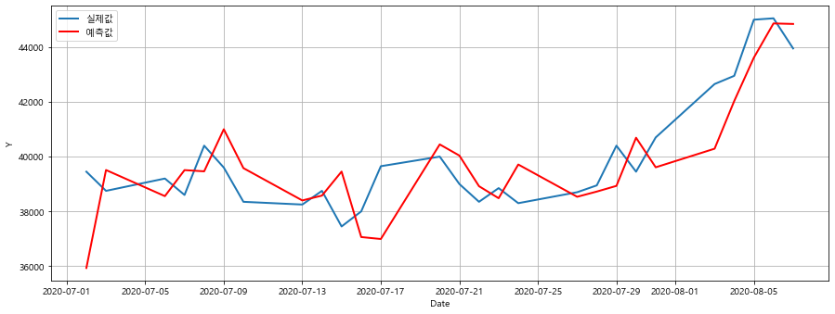
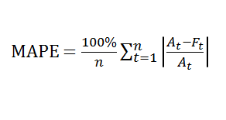
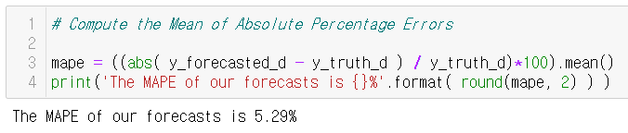
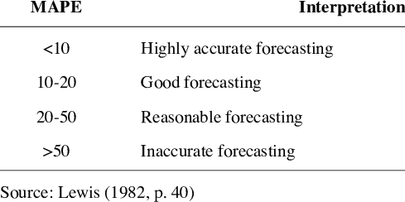
Notes:
https://ehfgk78.github.io/2018/01/21/DataScience07TimeSeriesData01/

Slide 27
Facebook – Prophet모델
https://zzsza.github.io/data/2019/02/06/prophet/

Slide 28
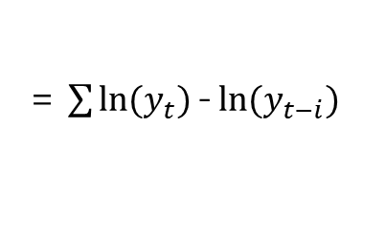
정상성 확인 방법 : Augmendted Dickey-Fuller, ACF, PACF
<Augmented Dickey-Fuller>
종가_변화율
= $\sum{\ln{(y_{t})}\text{−}\ln{(y_{t−i})}}$

Slide 29
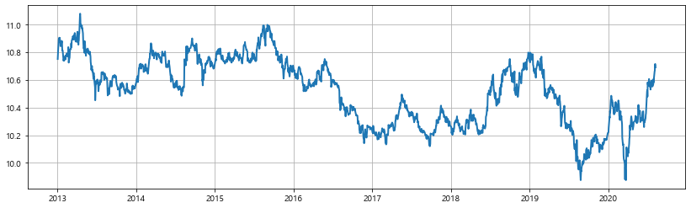
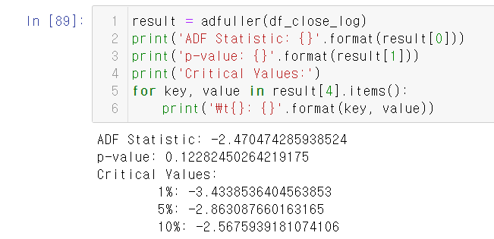
정상성 확인 방법 : Augmendted Dickey-Fuller, ACF, PACF
<Augmented Dickey-Fuller>
종가_로그
> 0.05 (유의수준 5%)

Slide 30
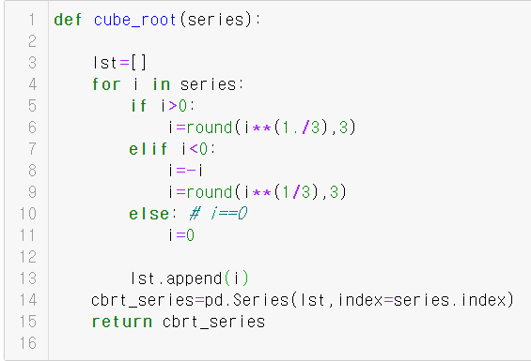
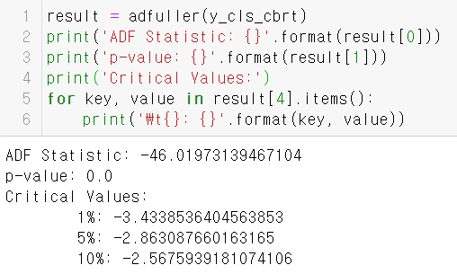
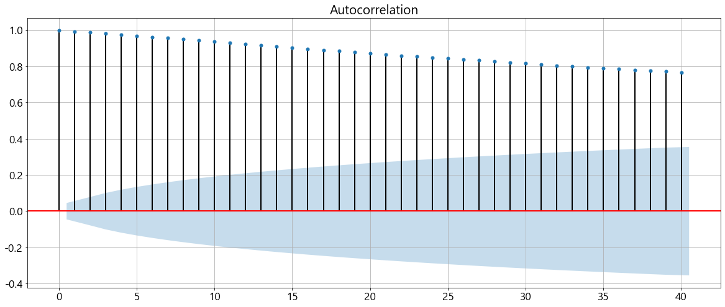
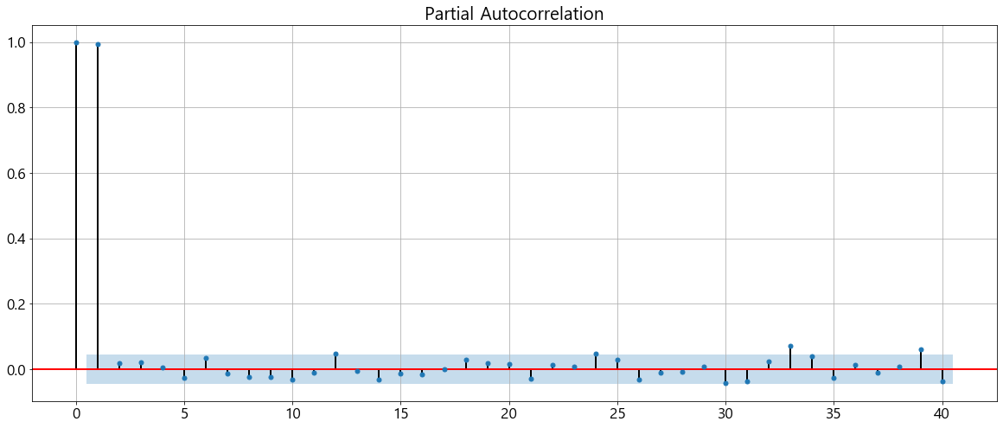
정상성 확인 방법 : Augmendted Dickey-Fuller, ACF, PACF
<Cube-root Test>
종가_1차차분
< 0.05 (유의수준 5%)
<종가_log>
ACF
PACF
Ljung-Box 검정 통계
- 잔차에 자기상관이 존재하는지 여부를 검증

