Slide 1
Stock Market Analysis
MIHIR DESHPANDE
IST-652

Slide 2
The Data
Alphavantage API returns the stock data for a company in Json format
The data has 6 columns namely date,open,close,high,low and volume
Wrote a function to make repeated calls to the API to get the stock data for top 50 companies by market cap
Tranformed from Json to pandas dataframe
Saved as csv to disk

Slide 3
The Data
Date column is pretty self-explanatory
Open is the opening price of a stock on the day
Close is the closing price of a stock on the day
High is the daily highest price of the stock
Low is the daily lowest price of the stock
Volume is the daily traded volume for the stock
All the datatypes are numeric except for date

Slide 4
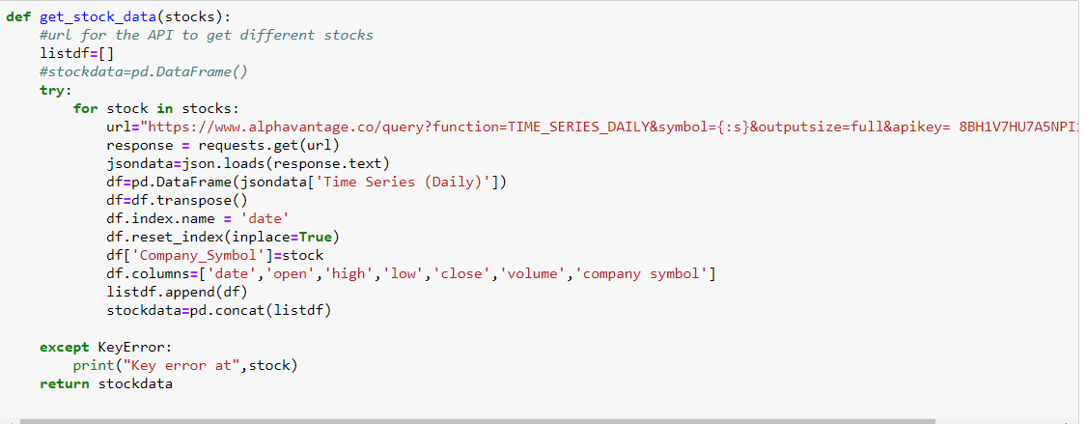
This is the function to get the stock data from the API, process it and convert to a dataframe. It takes a list of stock names as the input and returns a dataframe as the output

Slide 5
Analysis Obectives
To write custom functions and get technical Indicators for a stock
To get plots from these indicators
To Decide Buy and Sell calls for a stock using the indicators
Twitter Sentiment Analysis

Slide 6
Basic Steps involved
Get the data in pandas dataframe
Convert dates to datetime objects
Aggregation using pandas groupby
SMA,EMA and MACD using pandas rolling mean and ewm
Writing a investment strategy using MACD and
Plotting using matplotlib
Sentiment Analysis using Vader Sentiment

Slide 7
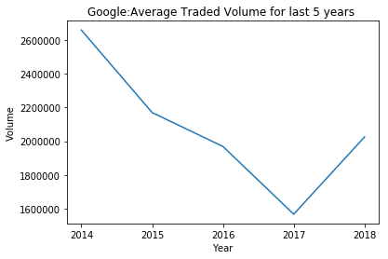
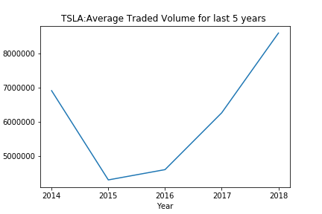
Technical Indicators-Volume
Volume indicates the amount of shares that are bought and sold
Following high volume is generally a good idea
Plotted Average yearly volume using pandas groupby and matplotlib

Slide 8
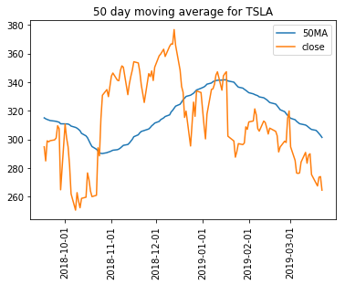
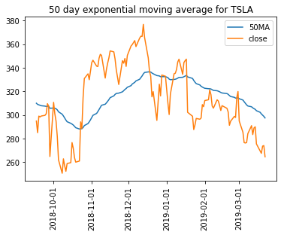
Technical Indications- SMA and EMA
Simple Moving average is the rolling mean of the close price for a n time period
Exponential Moving average is similar but gives more weight to the most recent data points
Wrote functions for to calculate and plot these two using pandas and matplotlib
Input to the function is the date from which the calculations need to be done and the company symbol

Slide 9
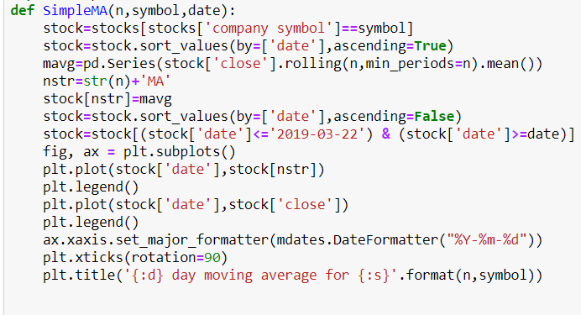
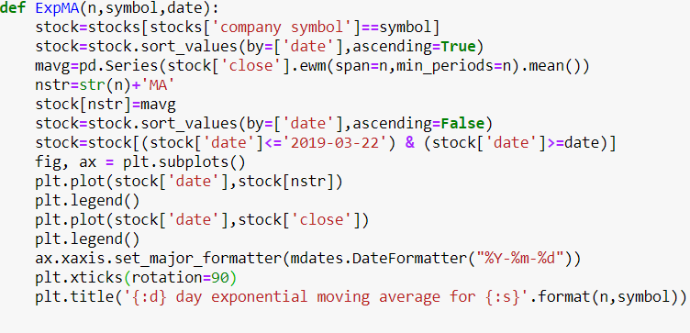
Functions to get the plots

Slide 10
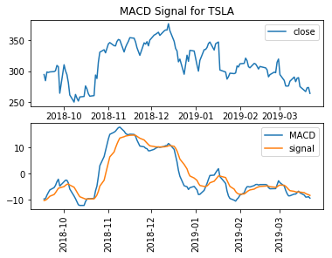
Techical Indicators-MACD
Moving Average converge divergence is the difference of 12 day EMA and 26 day EMA and signal line is the 9 day EMA of the moving average
When MACD line crosses the signal line from below, it’s a buy signal
When MACD line crosses the signal line from above, it’s a sell signal

Slide 11
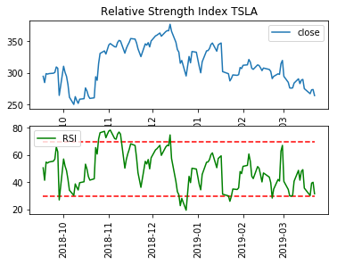
Techical indicator-RSI
Relative Strength index is a momentum indicator
It gives overbought and oversold levels
It is calculate using average gains and losses for previous 14 day period
RSI over 70 indicates overbought and RSI under 30 indicates oversold

Slide 12
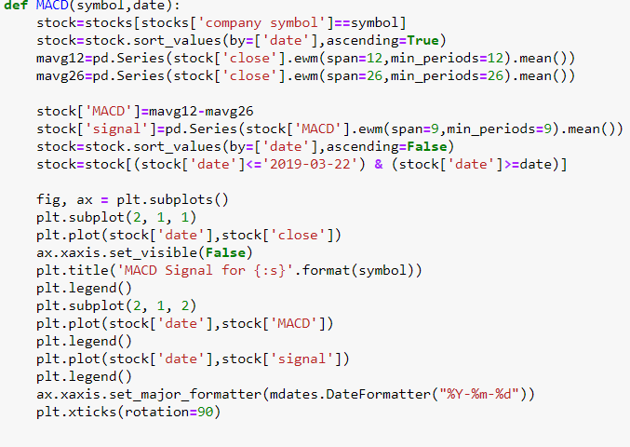
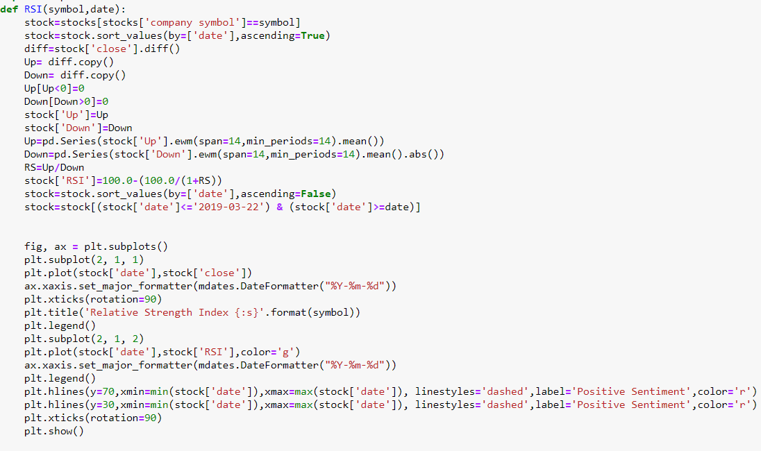
MACD and RSI functions

Slide 13
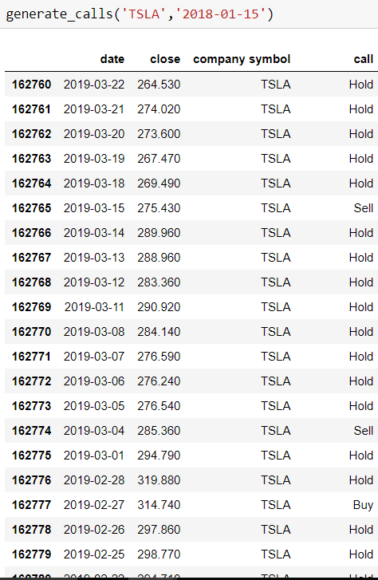
Buy and Sell calls
Used MACD and volume to write a strategy
If volume > average volume for last 3 days and MACD line crosses the signal line from below-BUY
If volume > average volume for last 3 days and MACD line crosses the signal line from above-SELL
Otherwise Hold

Slide 14
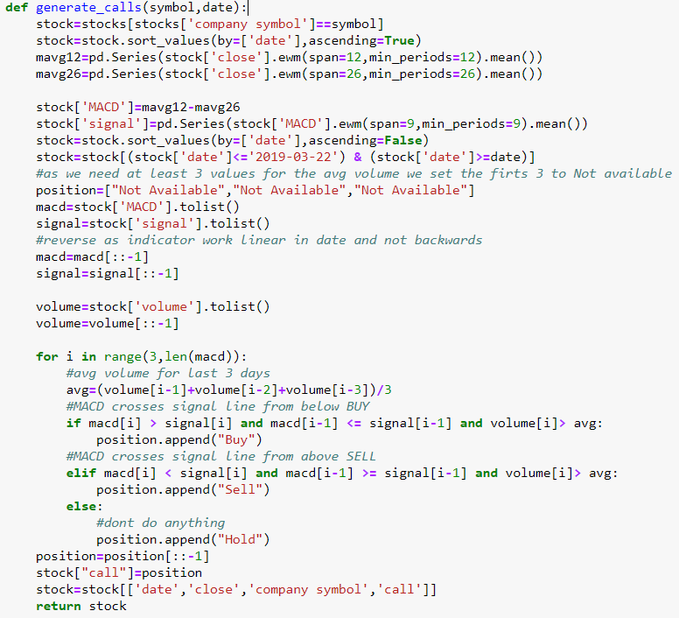
Function to generate calls

Slide 15
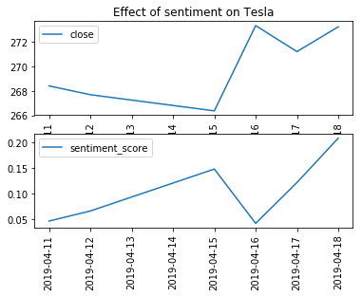
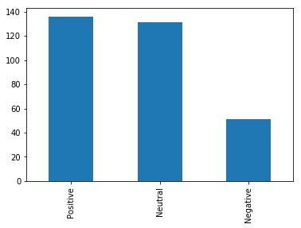
Twitter sentiment Analysis
Twitter API to collect tweets for the stock
Used text preprocessing using nltk(removed stopwords and tokenized)
Used Vader Sentiment Analsyser to get the sentiment scores(Used compound Scores)
Matched the sentiment with the close price by date

Slide 16
THANK YOU!

