Slide 1

XML Data
Introduction, Well-formed XML

Slide 2
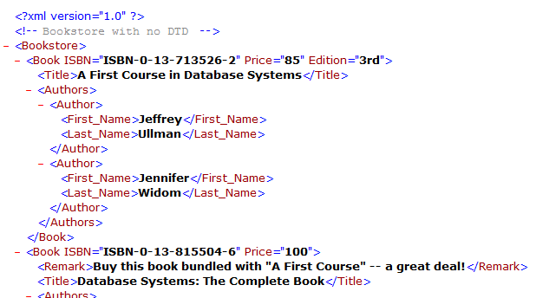
Well-Formed XML
Extensible Markup Language (XML)
Standard for data representation and exchange
Document format similar to HTML
Tags describe content instead of formatting
Also streaming format

Slide 3
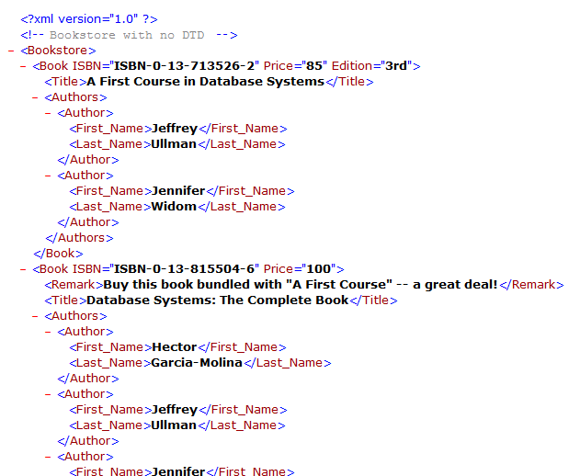
Well-Formed XML
Basic constructs
Tagged elements
(nested)
Attributes
Text

Slide 4
Well-Formed XML
Relational Model versus XML
 | Relational | XML
Structure
Schema
Queries
Ordering
Implementation

Slide 5
Well-Formed XML
“Well-Formed” XML
Adheres to basic structural requirements
Single root element
Matched tags, proper nesting
Unique attributes within elements

Slide 6
Well-Formed XML
“Well-Formed” XML
Adheres to basic structural requirements
Single root element
Matched tags, proper nesting
Unique attributes within elements
XML
Document
XML
Parser
Parsed XML
“Not well-formed”

Slide 7
Well-Formed XML
Displaying XML
Use rule-based language to translate to HTML
Cascading stylesheets (CSS)
Extensible stylesheet language (XSL)

Slide 8
Well-Formed XML
Displaying XML
Use rule-based language to translate to HTML
Cascading stylesheets (CSS)
Extensible stylesheet language (XSL)
Rules
XML
Document
(data)
HTML
Document
(look at)
CSS/XSL
interpreter

Slide 9
Well-Formed XML
Extensible Markup Language (XML)
Standard for data representation and exchange
Formal specification is enormous; we cover most
important components

