Slide 1
Instant Issuance Solution for Debit/Credit/Prepaid Card
David Tang
Hengbao International Pte Ltd

Slide 2
Introduction to Instant Issuance

Slide 3
Instant Issuance
Objectives:
To instantly issue a complete EMV cards (Debit/Credit/Prepaid) at a remote location in real-time.
End-to-end personalization process from card application, data preparation to physical personalization.
Target Markets:
Financial Institutions that are looking to increase capacity on to of existing central issuance system
Financial Institutions with branches across the city or country
Financial Institutions that are looking to expand their card issuing locations i.e. shopping mall, airport, etc.

Slide 4
Why Instant Issuance?
Lower Total Card Costs
Eliminates costs of mailing/postage of card and PIN Mailers
Increased Security
Eliminates delivery failure due to theft and costs
Reduces Fraud Impact of Stolen Card
Enhanced Customer Experience
Single visit to obtain a card that can be used immediately
Reduces wait time from days to minutes
Quick replacement of lost/stolen/damaged cards
Additional cross selling opportunity
Customer face time at the financial institution

Slide 5
Xpressi Instant Issuance Solution

Slide 6

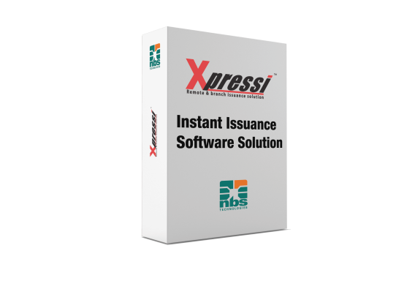

Xpressi Family
Central / batch issuance
Remote & branch issuance solution
Mobile Payments Solutions
Instant issuance of EMV, contact , contactless magnetic stripe encoded, and pin management for
debit and credit cards
EMV Smart Card /
Central Issuance Software
for production and personalization
for issuers, banks, and service bureaus
Enables Service Providers to distribute and manage their eWallet on NFC-enabled handsets

Slide 7
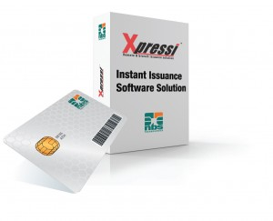
Xpressi Instant Issuance Details
Xpressi™ Server Software
SmartPrep - scheduler
Data Preparation – input file, card programs, production file
Key Management – import/export, generate keys
Card Issuance – sends information to issue a card on printer
Xpressi™ Print Server Software
Connected to the Printer at the Branch and prints the card.
Xpressi™ Client Web browser
Browser based interface which gathers card holder account information.
Branch Issuance Printer
Choice of an embosser, flat graphics or Re-transfer Printers

Slide 8
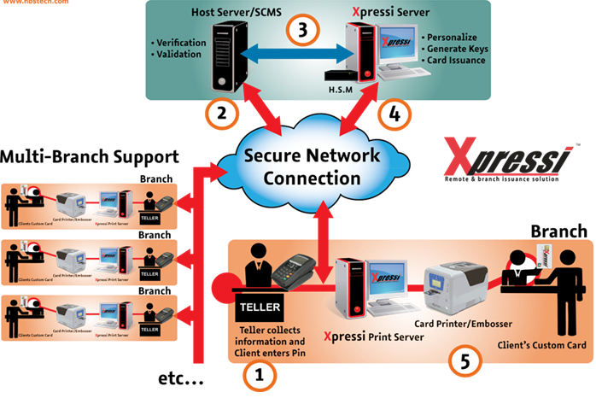
Xpressi Architecture

Slide 9
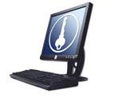
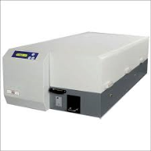
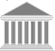
End-to-end Instant Issuance
Branch A
Card Application
BANK CMS
Xpressi
Bank
Secure
Intranet
Branch B
Card Application
Card Application
Branch C

Slide 10

Unattended Instant Issuance
Branch A
Card Application
BANK CMS
Xpressi
Bank
Secure
Intranet
Branch B
Branch C
Card Application
Card Application

Slide 11
Implementation Features
1: End-to-end Instant Issuance
From card application to personalization
Card application via Xpressi Client Web Browser
Host connection must be established between Xpressi Server and Card Management System
2: Central / Batch Personalization
Process starts from receiving embossing files from CMS
Card application via existing CMS application
Branch code must be included for branch destination
3: Unattended Instant Issuance
Similar to Option 1
Personalization by an Unattended Personalization Kiosk

Slide 12
Solution Features
Scalable Architecture:
Xpressi Solution is designed and built to handle hundreds of branches within the Instant Issuance architecture.
Up to four (4) HSMs can be added at the Xpressi Server to manage increased number of branches.
Flexible Input File Format:
The input file to Xpressi Software Server from a Host can be a CSV, XML, a text file or any format that is defined by an API.
Two host connection:
Xpressi Server Software has the capacity to connect to multiple (two) Host software simultaneously which allows the Bank to connect to Debit Card system as well as Credit Card system.
Unlimited BINs:
Xpressi Software has a unique capability to allow unlimited number of BINS per Issuer
Allows each Issuer to have multiple card programs per BIN

Slide 13
Solution Features
Preview of personalized cards at the Branch:
Xpressi Print Server software allows you to preview (WYSIWYG) the personalized card before printing.
Output file format to Batch processing:
Xpressi software can not only be used for branch issuance but has the ability to generate Production files to be issued on high speed machines for batch issuance.
Monitoring capabilities:
Xpressi Software allows you to monitor HSM utilization, throughput of Card per hour, real time monitoring of Branch PC (up/down) and jobs running in production.
Auto card embossing in Branches:
Xpressi Print Server software offers an optional feature that allows unattended card printing/embossing capability at the branches.

Slide 14
Security Features
PCI DSS Compliant:
Xpressi Software solution is PCI DSS Compliant.
RSA certificates used in Xpressi Server:
RSA Certificates are supported through UBCA application, which is part of Xpressi Solution.
RSA Certificate is used as a Public-Private Key
End to End data encryption:
Once authenticated all data is encrypted from the input file until a card is printed/embossed at the branch.
SSL/https encryption:
SSL is used for TCP/IP connections and HTTPs is used for Web connections.
2 way authentication between Xpressi Server and Print Server:
Server can only accept connections from authentic branches and branch can only accept jobs from authentic servers (prevents the man-in-the-middle attack).
Audit Logs:
Every operator action is logged including Key creation/deletion, Import/Export Keys, permissions on users changed, card program creation/deletion, executing data preparation, etc. Not all users will have access to this audit log.

Slide 15
Xpressi Advantages
Flexibility
Solution for contact, contactless, and magnetic stripe encoding
EMV compatible
Security
Use industry standard security protocols-HTTPS, SSL
No data stored in branches
All keys are encrypted
Using bank’s own backbone data network
Centralized Card Management
Implement a card program once centrally, for use in all branches.
Multi-card support for any card vendor
MULTOS, Global Platform and brands from any card vendors etc.
Multi-printer support
Supports both embossers and flat graphics card printers
EMV & NFC ready
We have implemented over 200 EMV smart card programs around the globe. Our Xpressi Cloud can be used for NFC & HCE mobile platform

Slide 16
Xpressi System Plan
HQ | Branch
Xpressi Software (SmartPrep, Data Preparation, KMS, Xpressi Server) | Xpressi Print Server
Card Program (Visa/MasterCard/etc) | Card Printer/Embosser
HSM
PC | PC
Project Management
Annual License & Maintenance

Slide 17
Xpressi Screenshot

Slide 18
Client Browser-Login

Slide 19
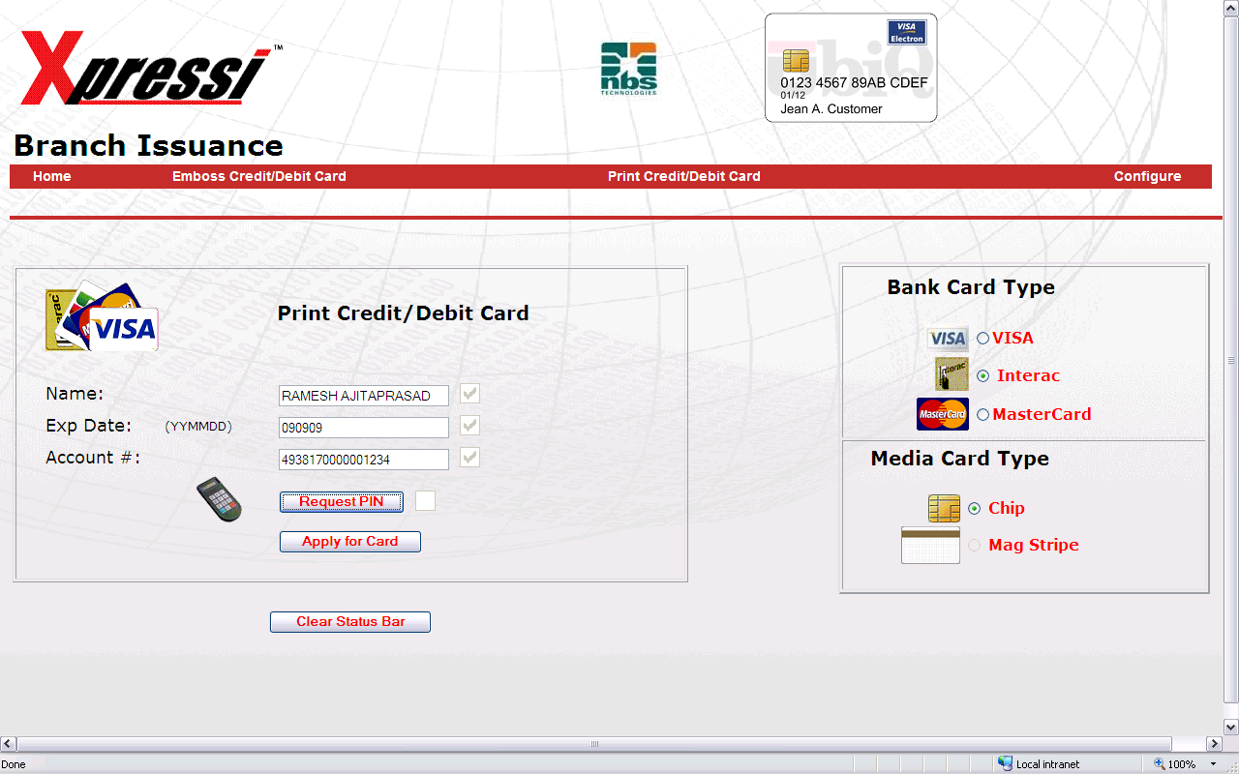
Client Browser-Select Application

Slide 20
Print Server-Select Printer

Slide 21
Print Server-WYSWYG

Slide 22
Xpressi Report

Slide 23
Powerful Reports
Ready to go Predefined Reports
Successful Cards
Failed Cards
Cards by Branch
Cards by Operator
Cards by Account Number
Cards by Cardholder name
Customized Reports
Specify Start and End Dates for above fields
All Reports can be viewed on screen
Print option to view before you print

Slide 24
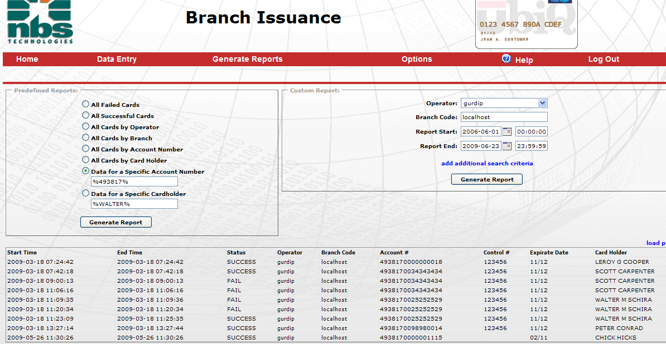

Custom Report

Slide 25
Xpressi Background
Xpressi Instant Issuance Solution is developed and supported by a company that is specialized in design and manufacture of equipment and software for smart card manufacturing, card printing, embossing, card personalization and cloud-based mobile payment applications.
Xpressi Centralize and Instant Issuance have been deployed in hundreds of service bureaus and issuing banks worldwide
Xpressi Centralize and Xpressi Instant Issuance Solutions have been deployed since 2000 and 2009 respectively
We have now active sites in more than 25 countries worldwide
We have completed over 200 EMV integrations worldwide
We have developed nearly 1000 card programs or personalization scripts for Visa, MasterCard, Union Pay, JCB, etc.

Slide 26
Xpressi Instant Issuance Installations
CitiBank, Poland
CitiBank, London
Citi Bank, Dubai
Vancity, Canada
CIMB, Malaysia
Ripley, Chile
Oeschle, Peru
Procesos Bank, Latin America
IBK Bank, Latin America
AFS, Bahrain
Burwha Bank, Middle East
Skye Bank, Nigeria
Bank of Ayudhya, Thailand
C. Hoare Bank, London
Equity Bank, Rwanda
The Group, Qatar
Thai British, Thailand
NIBL, Nepal
BOK, Rwanda
UAB, Myanmar

Slide 27
PersoMaster-Xpressi Installation
Bank Islam, Malaysia
BCB, Malaysia
EON Bank, Malaysia
CIMB, Malaysia
MBf Cards, Malaysia
ASCC, Malaysia
ACB, Vietnam
HDB, Vietnam
Nam A Bank, Vietnam
BIBD, Brunei
CB Bank, Myanmar
Mekong Bank, Cambodia
PPCB, Cambodia
CAB, Cambodia
Canadia bank, Cambodia
Marshall, Pakistan
UAB Bank, Myanmar

Slide 28


Case Study
Xpressi instant card issuance solution enables our bank to instantly issue EMV Debit/Credit cards to its customers right at the branch.
“Compared to an average of days' or weeks’ timeline with conventional issuance, our bank credit card applicants now only need approximately an hour from submitting the application form plus supporting documents at the selected branches to obtain a new credit card in their hands.”

Slide 29
THANK YOU!

