Slide 1
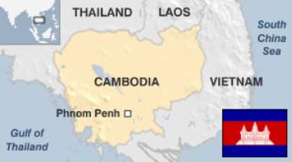
Cambodia Markets and Opportunities

Slide 2

Criteria for Business Into Cambodia Markets
Does new businesses help in promoting company core business – cards?
Do HBI have expertise in this area?
Does HBI have good partners to leverage upon?
Can new business bring in new opportunities for business in other fields i.e. managed services?

Slide 3
Leverage On Digital / Mobile Payments for Other Businesses

Slide 4
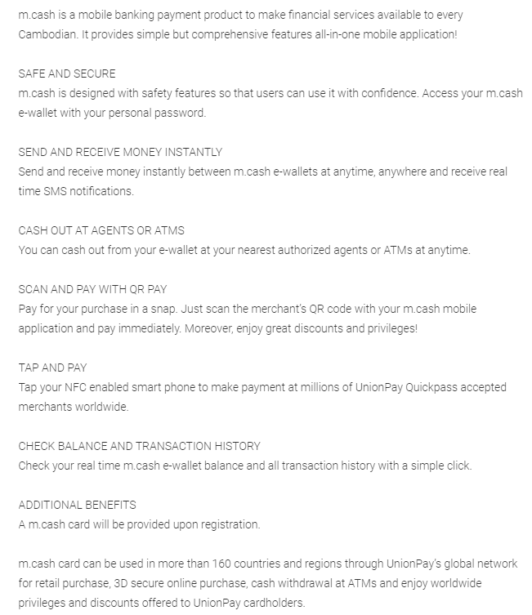
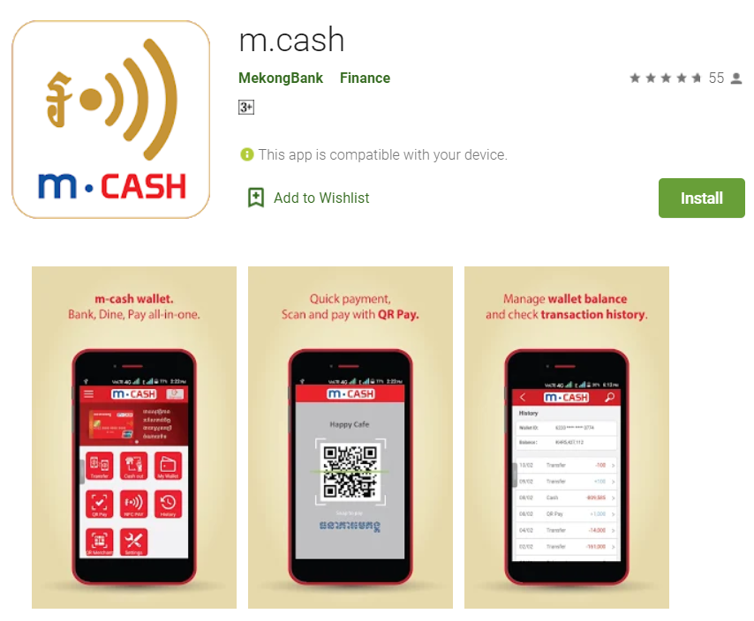
Mobile Payments – Mekong Bank
https://play.google.com/store/apps/details?id=com.mekong.bank.mcash

Slide 5
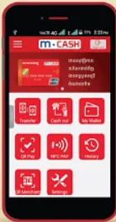
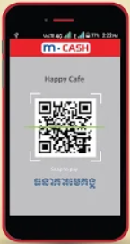
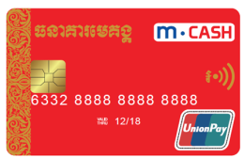
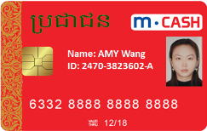

Mobile Payments – Mekong Bank
Phase 1
Phase 2
Phase 3
Phase 4
Phase 5
Physical
Bank Card
(completed)
Social Security
+ Bank Card
(starting)
Virtual Card
Host Card Emulation
(completed)
QC Code
(completed)
Social Security
On Bank App
(future request)
Business Opportunities:
Cards, Card Personalisation, Software Changes/Upgrade Maintenance Fees, System Maintenance Fees

Slide 6
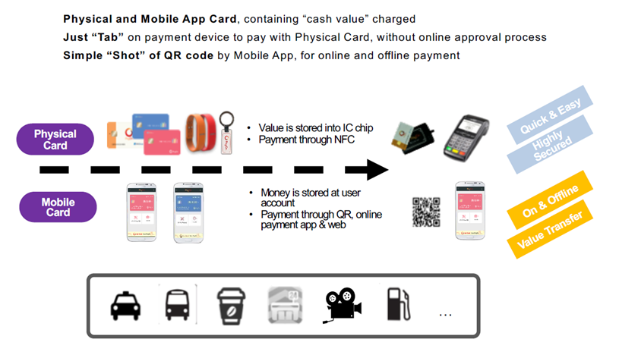
Mobile Payments – Mekong Bank
Other Opportunities: Building/Improving The Eco-System. Introduce Other Payment Devices – Wrist Band, Key-Holder, Health-Tracking, IOT Devices

Slide 7
2. Instant Cards Centralised
Personalisation & Fulfilment

Slide 8
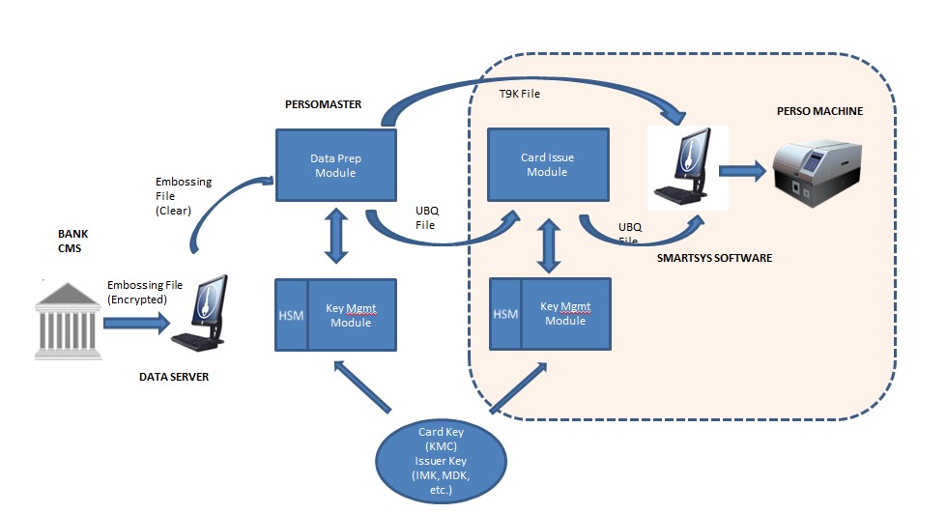
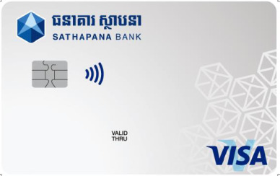
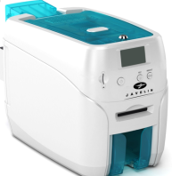
Centralized Personalization with Instant Issuance – Sathapana Bank
4501 3825 1927
Card Center
Cardholder name
4501 3825 1927
Bank Branches
John Chen

Slide 9
3. Instant Cards De-Centralised
Personalisation & Fulfilment

Slide 10
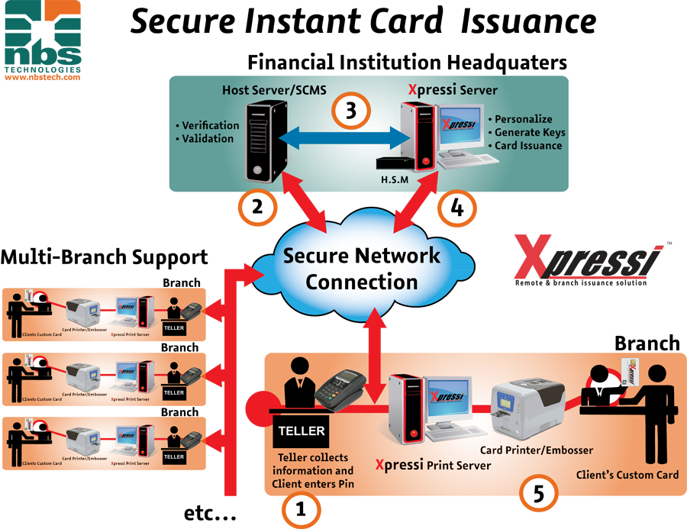
De-centralised Instant Card Issuance – Bred Bank

Slide 11

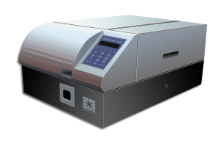
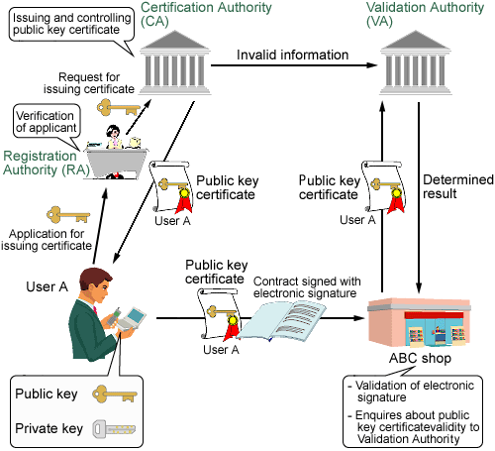
De-Centralized Personalization with Instant Issuance – Bred Bank
Cambodia
Bred Bank Branch
PRINT SERVER
PERSO MACHINE
Embossing File
(Clear)
BANK
CMS
UBQ File
Data Prep
Module
Xpressi
Server
UBQ File
DATA SERVER
Card Key (KMC)
Issuer Key (MKA, IMK, MDK, etc.)
HSM
Key Mgmt
Module
Embossing File
(Encrypted)
UBQ File
PRINT SERVER
PERSO MACHINE
Thailand – Bred IT Center
Vanuatu
Bred Bank Branch

Slide 12

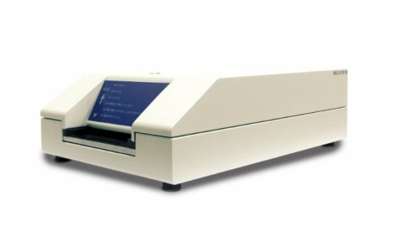

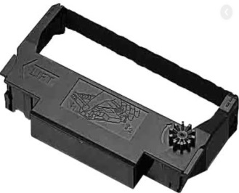
Card Personalisation Business Opportunities:
Embosses, Printers, Consumables - Ribbons, Software Changes/Upgrade Maintenance Fees, System Maintenance Fees, Managed Services

Slide 13
4. BANK PASSBOOK AUTOMATION SYSTEM

Slide 14
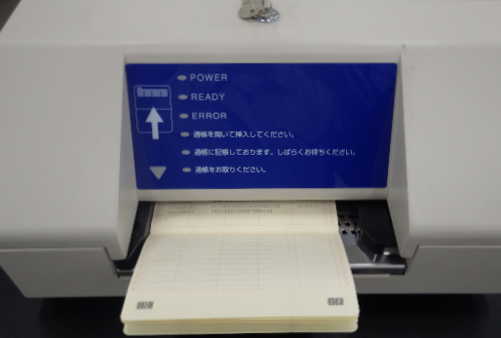


Bank Passbook Automation – Sathapana Bank
3 Easy Steps:
Open Passbook
Insert Passbook
Collect Passbook

Slide 15
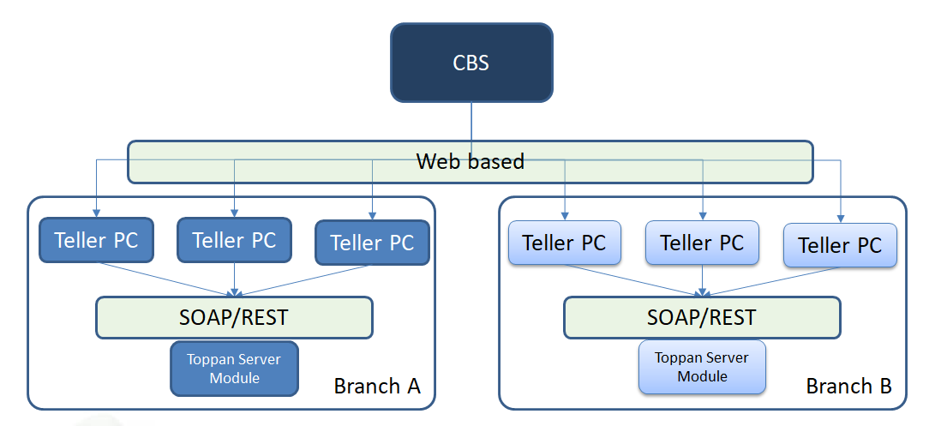
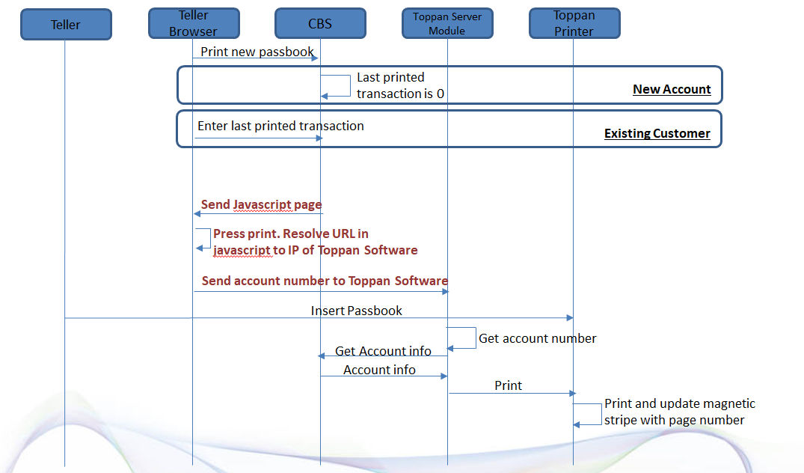
Bank Passbook Automation Work-Flow – Sathapana Bank
Proof-Of-Concept PASSED!

Slide 16

Business Opportunities:
Passbooks, Printers, Consumables - Ribbons, Software Changes/Upgrade Maintenance Fees, System Maintenance Fees

Slide 17
THANK YOU

