Slide 1
Credit EDA Case Study
BY MOHAMMAD AJMAL

Slide 2
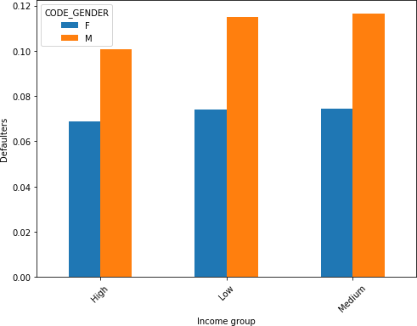
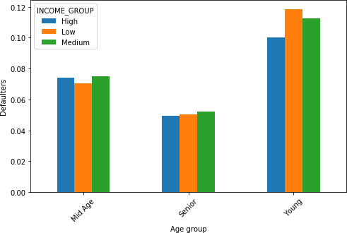
Current applications
Income groups & gender
Income groups & age groups
Observations:-
High income groups are less defaulter than comparatively lower income groups.
Mid age and senior people with all income groups are less defaulted.
Recommendation:-
Safer to grant loan for mid age and senior citizen clients with higher income.
Risky to grant loans for young people with low income groups.

Slide 3
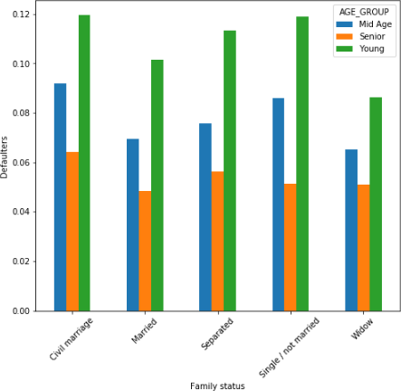
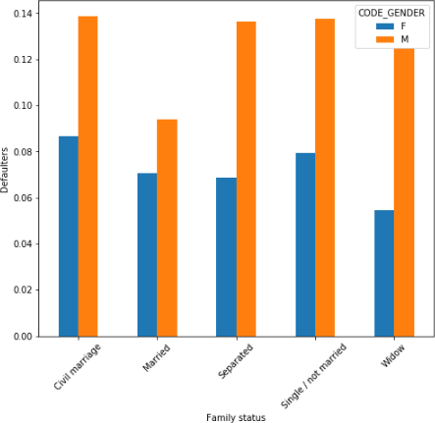
Family status & age group
Family status & gender
Observations:-
Senior people irrespective of family status are less likely to be defaulted.
Young people are more likely to be defaulted in all family status.
Males are more like to be defaulted than females.
Recommendations:-
Better to grant loan for senior citizen of all family status.
It is risky to grant loan for single, separated and civil marriage young men.

Slide 4
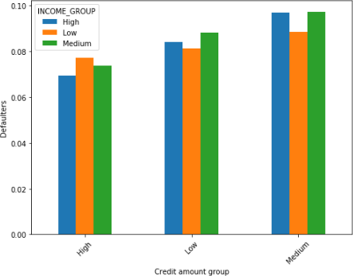
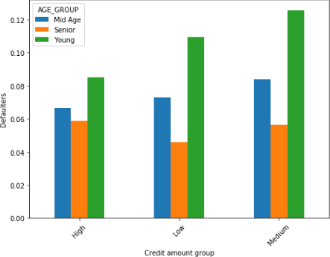
Credit amount group & income group
Credit amount group & age group
Observations:-
Across all income groups clients with medium amount credited is highly defaulted followed by low and high credit amount.
Young clients with medium and low amount credited are most likely defaulted.
Recommendations:-
Recommended to grant slightly higher amount of loan to all income groups.
It is very risky to grant medium and low amount of loan to young clients.

Slide 5
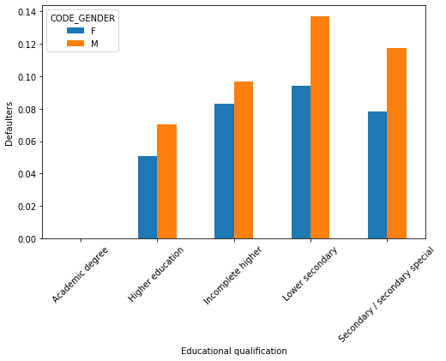
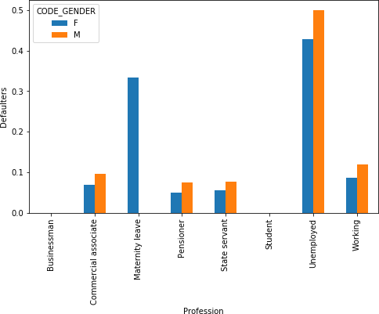
Educational qualification & gender
Profession & gender
Observations:-
Higher educated people are less defaulted and lower secondary educated people are more.
Unemployed clients along with clients with maternity leave are heavily defaulted.
Recommendations:-
Safe to grant loans to higher educated clients across all profession except unemployed and women with maternity.

Slide 6
Loan application status relations
Current and Previous

Slide 7
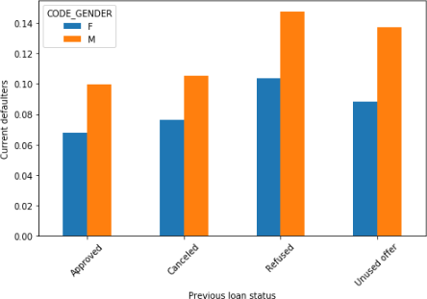
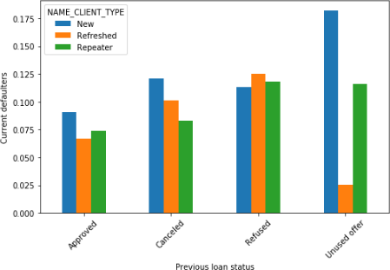
Previous loan status & gender
Previous loan status & client type
Observations:-
Previously refused and unused offer applications were more defaulted in male.
New clients with previously unused offer are more defaulted.
Recommendations:-
It is recommended to provide loans to previously approved females.
There is a risk to grant loans for clients, whose applications were refused or unused previously.

Slide 8
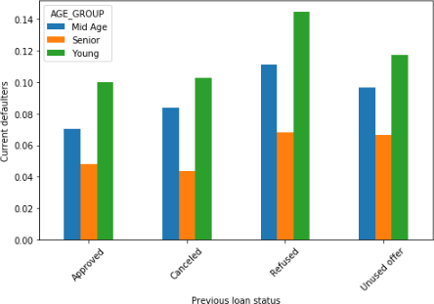
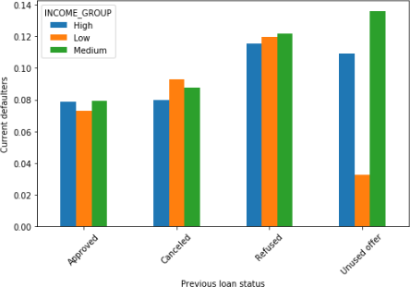
Age group & previous loan status
Income group & previous loan status
Observations:-
Young people, who were previously refused are mostly defaulted.
The senior citizens are less defaulted irrespective of their previous loan status.
In all income groups previously refused applicants are more defaulted.
Recommendations:-
Safer to grant loans for senior citizen.
Lesser risk to grant loans for approved applicants to all income groups.

Slide 9
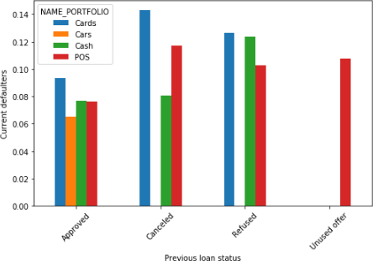
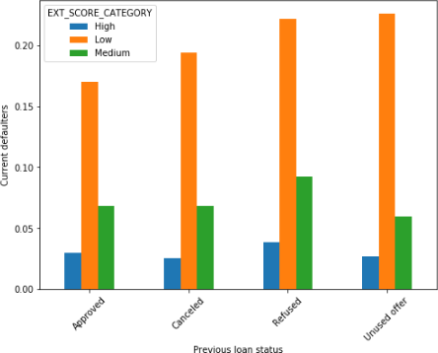
External source score & previous loan status
Portfolio & previous loan status
Observations:-
The previous applications for portfolio Cards and POS are mostly defaulted .
Previously refused applications for Cash are also defaulted in higher rate.
Low external source scorer are highly defaulted irrespective of their previous loan status.
Recommendations:-
It is safer to grant loans for any portfolio for previously approved applicants.
It is high risk to grant loans for applicants, who have poor external source score specially whose loan were previously refused, unused or cancel.

Slide 10
Final note
Highly recommended groups:-
Approved clients in their previous applications.
Highly educated clients with higher income.
Clients with higher external source score.
Senior citizens in all categories.
Married clients compared to other family status.
Females are comparatively favourable than male.
High risk groups:-
Previously refused, cancelled or unused offer clients.
Low income groups with previously refused status.
Unemployed clients.
Poor external source scorer.
Young clients are comparatively riskier than mid age clients and senior citizens.
Lower secondary and secondary educated clients.

Slide 11
Thank you !

