Slide 1
2-D CVM Code: Block Structures and Documentation
A.J. Maren, Ph.D.
Northwestern University, School of Professional Studies (SPS) Master of Science in Data Science Program
alianna@aliannajmaren.com
Alianna.maren@northwestern.edu
For Blog Discussions, Publications, and More:
www.aliannajmaren.com

Slide 2
Documentation Overview
The Configuration Variables: Overview of how they are counted in a 2-D CVM, including degeneracy and configuration of the unitArray (with both horizontal and vertical wrap-arounds).
Functionality:
Analytic computations - for specified, known-equilibrium values of configuration variables and enthalpy parameters, and
Probabilistic computations - generating a unitArray to meet certain probability specifications, then altering it to achieve free energy minimization for specific h-values.
Crucial Variables: Details of the essential list variables, containing the specific variables returned by various high-level core functions.
Program Structure: Identifies high-level functions and procedures:
What-calls-what
Primary functionality
Sub-procedures / functions called
Variables passed in and returned out
Verification and Validation
Illustrative Results

Slide 3
Documentation Overview
The Configuration Variables
Code Functionality
Crucial Variables
Program Structure
Verification and Validation
Illustrative Results

Slide 4
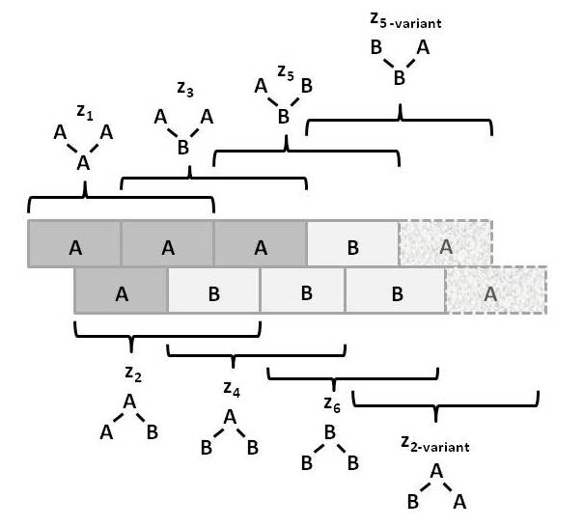
Counting Configuration Variables
Single zig-zag chain (1-D CVM) consisting of eight units and one instance each of each of eight different Z_{i} triplet configurations.
NOTE: Because this is only a single zigzag chain (1-D CVM array) and not a full 2-D CVM unit array, the total number of Z_{i} triplets equals the total number of units.
In a full 2-D CVM, the total count of Z_{i} triplets equals 2*N, where N is the total number of units.
Likewise, in a 2-D CVM, the total count of Y_{i} and W_{i} pairs each equals 2*N.

Slide 5
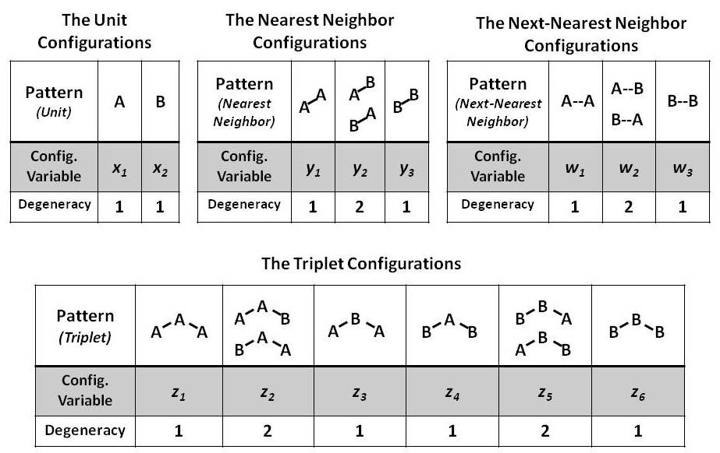
Identification of and Degeneracy in Counting Configuration Variables
The total numbers of Y₂ and W₂ pairs and of Z₂ and Z₅ triplets can be each counted two ways, giving a degeneracy of 2 for each.

Slide 6
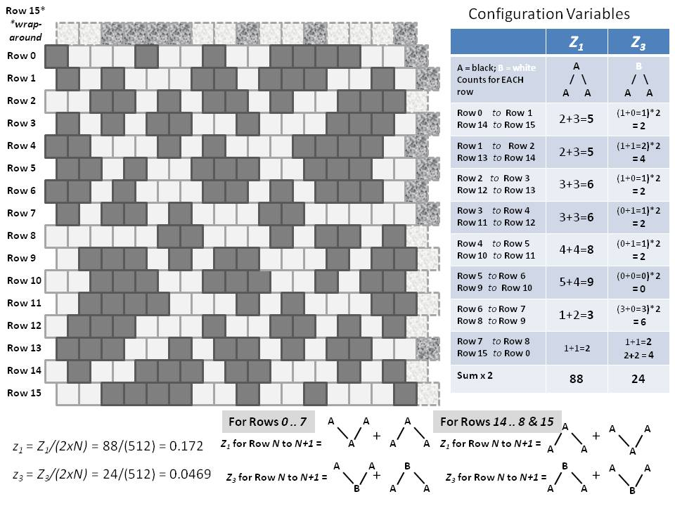
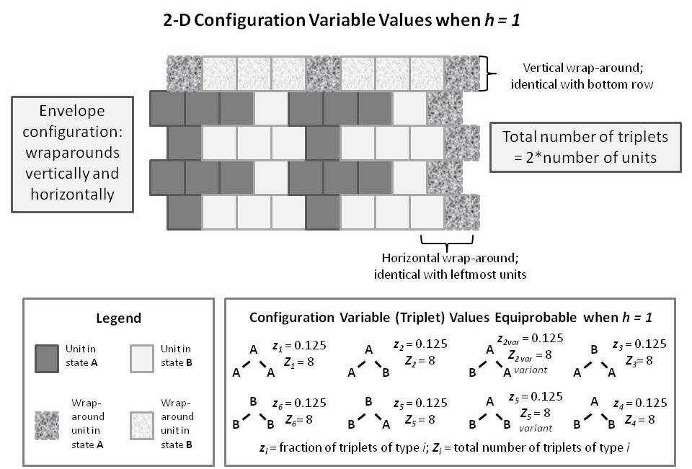
Illustrative Unit Array for the 256 (16 x 16) 2-D CVM System
Illustrative 32-unit system, with full wrap-arounds (vertical & horizontal)

Slide 7
Documentation Overview
The Configuration Variables
Code Functionality
Crucial Variables
Program Structure
Verification and Validation
Illustrative Results

Slide 8
Code Functionality
There are two primary versions of this code, with very much the same functions and procedures. (Some functions, particular to the analtyic computation version, are still resident as vestigial code in the probabilistic version.)
Analytic computations - for specified, known-equilibrium values of configuration variables and enthalpy parameters, and
Probabilistic computations - generating a unitArray to meet certain probability specifications, then altering it to achieve free energy minimization for specific h-values.
This documentation focuses on the probabilistic version:
2D-CVM-random-vary-x-and-y-for-FE-min-2017-12-21.py (and later versions of the same)
Functions:
Generate a unitArray (16 x 16, or 256-element) of nodes (0, 1) according to a probabilistic distribution specified by choice of x₁.
For a range of h-values, adjust the unitArray so that it achieves free energy minimization for each (specified range of) h-value. (This is done numTrials for each h, in order to account for probabilistic array generation and motion towards a free energy minimum.) The code returns configuration variables and thermodynamic results.
Prints and plots the results.

Slide 9
Documentation Overview
The Configuration Variables
Code Functionality
Crucial Variables
Program Structure
Verification and Validation
Illustrative Results

Slide 10
Crucial Variables: configVarsList
configVarsList: returned from function computeConfigVariables
configVarsList contains all the configuration variables computed by walking through the unitArray and explicitly counting up all the different configuration occurrences. These are actual count-numbers, NOT fractional values.
X1: The actual number of units in the “on” (A) state; these are shown as ‘1’s in the unitArray print, and are the “black” units when shown in a PPT diagram of the unitArray.
X2: The actual number of units in the “off” (B) state.
Y1: The actual count of A-A pairs, including wrap-arounds. (These are nearest-neighbors.)
Y 2: The actual count of A-B AND B-A pairs, including wrap-arounds.
Y 3: The actual count of B-B pairs, including wrap-arounds.
W1: The actual count of A-A pairs, including wrap-arounds. (Next-nearest-neighbors.)
W2: The actual count of A-B AND B-A pairs, including wrap-arounds.
W3: The actual count of B-B pairs, including wrap-arounds.
Z1: The actual count of A-A-A triplets, including wrap-arounds.
Z2: The actual count of A-A-B AND B-A-A triplets, including wrap-arounds.
Z3: The actual count of A-B-A triplets, including wrap-arounds.
Z4: The actual count of B-A-B triplets, including wrap-arounds.
Z5: The actual count of B-B-A AND A-B-B triplets, including wrap-arounds.
Z6: The actual count of B-B-B triplets, including wrap-arounds.
unitArray: The actual array of 0, 1 units – the code is currently set to work with a 16 x 16 array.

Slide 11
Crucial Variables: newList
newList: returned from function computeConfigAndThermVars
newList contains averages of both a subset of the (fractional and degeneracy-reduced) configuration variables together with a set of thermodynamic variables, for a given h and x1TargetVal. Because the configuration and thermodynamic variables are produced for a probabilistically-generated (and adapted) unitArray, we use numTrials iterations of generating and adapting the unitArray in order to obtain the averaged results.
avgx1: Average of the x₁ (fractional) configuration variable obtained over numTrials iterations.
avgy1: Average of the y₁ (fractional) configuration variable obtained over numTrials iterations.
avgy2: Average of the y₂ (fractional) configuration variable obtained over numTrials iterations.
avgy3: Average of the y₃(fractional) configuration variable obtained over numTrials iterations.
avgz1: Average of the z₁ (fractional) configuration variable obtained over numTrials iterations.
avgz3: Average of the z₃ (fractional) configuration variable obtained over numTrials iterations.
avgNegS: Average of the negative entropy obtained over numTrials iterations.
avgEnthEps0: Average of the total per-unit enthalpy obtained over numTrials iterations.
avgEnthEps1: Average of the total pairwise enthalpy obtained over numTrials
avgFreeEnergy: Average of the total free energy obtained over numTrials
Note: The configuration variables y₂ and w₂ pairs and z₂ and z₅ triplets, obtained in computeConfigAndThermVars, are each divided by 2 to account for the degeneracy factor, so that:

Slide 12
Documentation Overview
The Configuration Variables
Code Functionality
Crucial Variables
Program Structure
Verification and Validation
Illustrative Results

Slide 13
Program Structure: **main**
__main__
Various initialization and parameter setting steps
newList = computeConfigAndThermVars (arraySizeList, h, x1TargetVal, maxXDif, numTrials, jrange, maxRange)

Slide 14
Program Structure: computeConfigAndThermVars
Function computeConfigAndThermVars (arraySizeList, h, x1TargetVal, maxXDif, numTrials, jrange, maxRange)
Called by: **main**
Returns: newList
configVarsList = computeConfigVariables (arraySizeList, unitArray)
sysValsList = computeThermodynamicVars (h, configVarsList)

Slide 15
Program Structure: computeConfigVariables
Function = computeConfigVariables (arraySizeList, unitArray)
Called by: computeConfigAndThermVars
Returns: configVarsList
Essential Function Calls:
configVarsXList = computeConfigXVariables (arraySizeList, unitArray)
configVarsYList = computeConfigYVariables (arraySizeList, unitArray)
configVarsWList = computeConfigWVariables (arraySizeList, unitArray)
configVarsZList = computeConfigZVariables (arraySizeList, unitArray)
The functions to compute (count) the configuration variables comprise the above primary procedures and their associated sub-procedures. They occupy (approximately) lines 280 – 2420 in the code.
computeConfigVariables has been hand-verified via code walkthrough and comparison with hand-computed outputs, see the previous slide on “Illustrative Unit Array for the 256 (16 x 16) 2-D CVM System” as an example.
Note: The computeConfigVariables output is the ACTUAL counts of configurations (including horizontal and vertical wrap-arounds); thus:
They need to be normalized by dividing by N or 2*N, as appropriate, and
The Y₂ and W₂ pairs and Z₂ and Z₅ triplets each further need to be divided by two in order to remove the degeneracy; then we have (where is the degeneracy):

Slide 16
Program Structure: computeThermodynamicVars
Function = computeThermodynamicVars( h, configVarsList):
Called by: computeConfigAndThermVars
Returns: sysValsList
sysValsList = (negS, enthalpy0, enthalpy1, freeEnergy)
Essential Function Calls:
None
The functions to compute the thermodynamic values comprises (TBD) …

Slide 17
Documentation Overview
The Configuration Variables
Code Functionality
Crucial Variables
Program Structure
Verification and Validation
Illustrative Results

Slide 18
Documentation Overview
The Configuration Variables
Code Functionality
Crucial Variables
Program Structure
Verification and Validation
Illustrative Results

