Slide 1


2-D Cluster Variation Method
Analytic Results when Interaction Enthalpy is Zero
with
Alianna J. Maren, Ph.D.
Program Results:
2D-CVM-simple-eq_no-interaction-calc_v2_2018-10-27
October 30, 2018

Slide 2
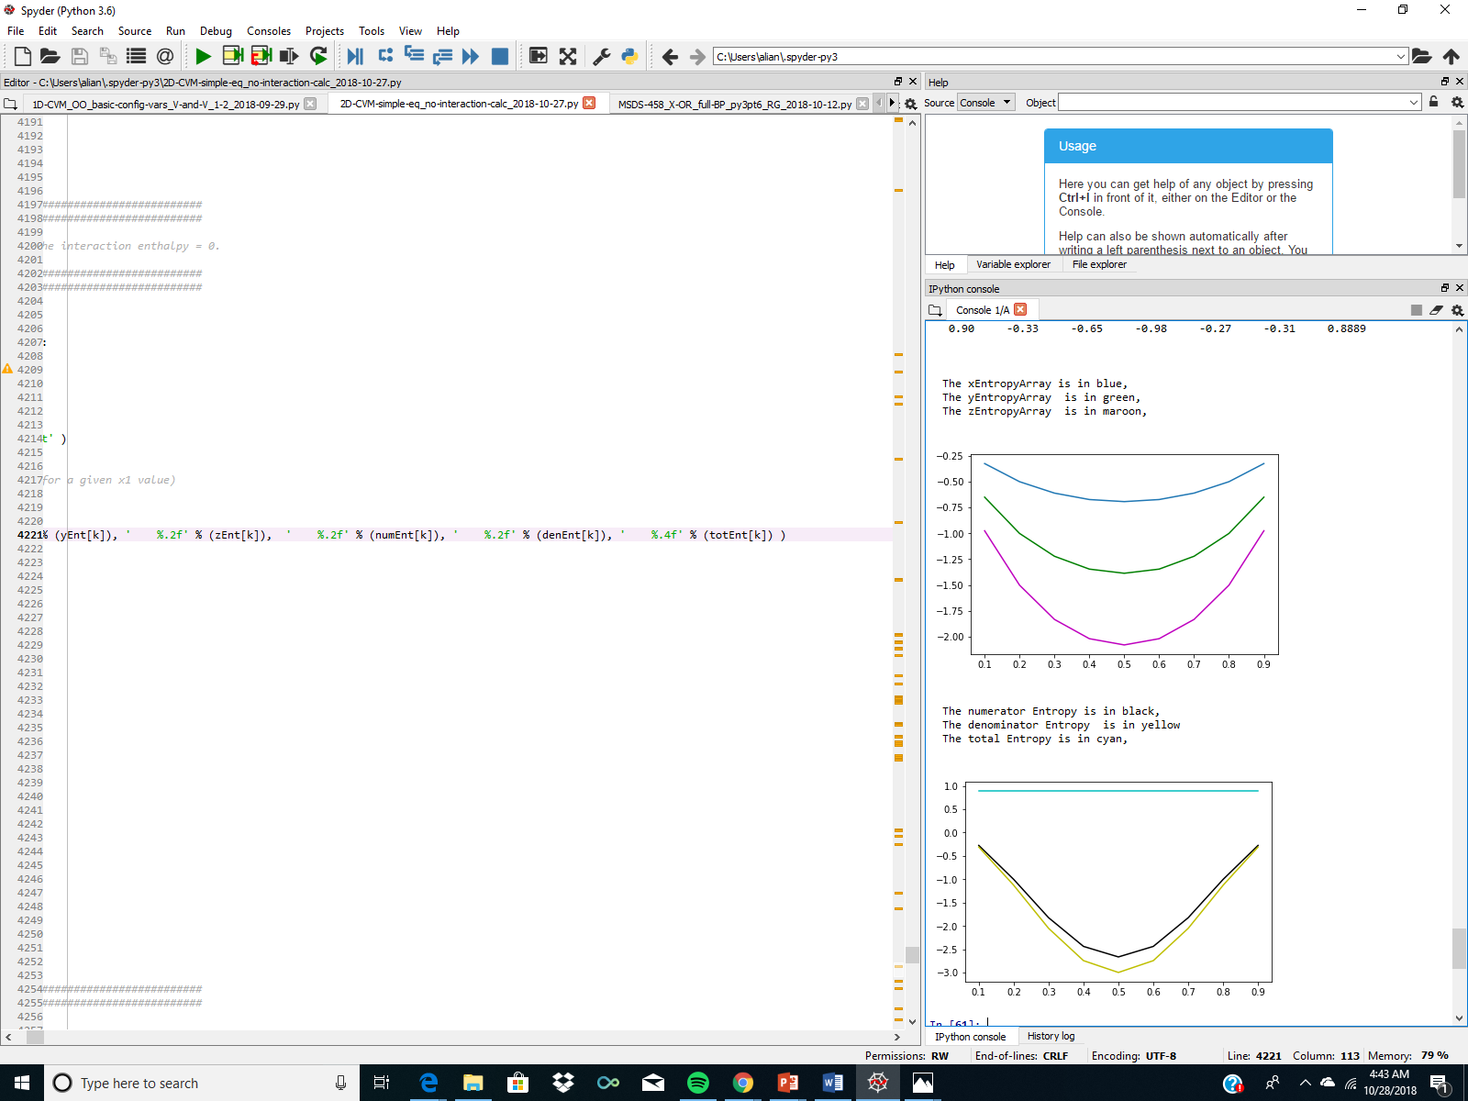
Program Result: Entropies for the x, y, and z Configuration Variables, for the case where Epsilon1 = 0.0

Slide 3



Entropies for the x, y, and z Configuration Variables, for the case where Epsilon1 = 0.0
a
$$\sum{Lf(xi)}$$
(a)
b
$$\sum{βiLf(yi)}$$
(b)
$$\sum{γiLf(zi)}$$
c
(c)
2-D CVM Neg-Entropy for Different Configuration Variables
x₁ (Fraction of units in the “on” state, or state A)

Slide 4
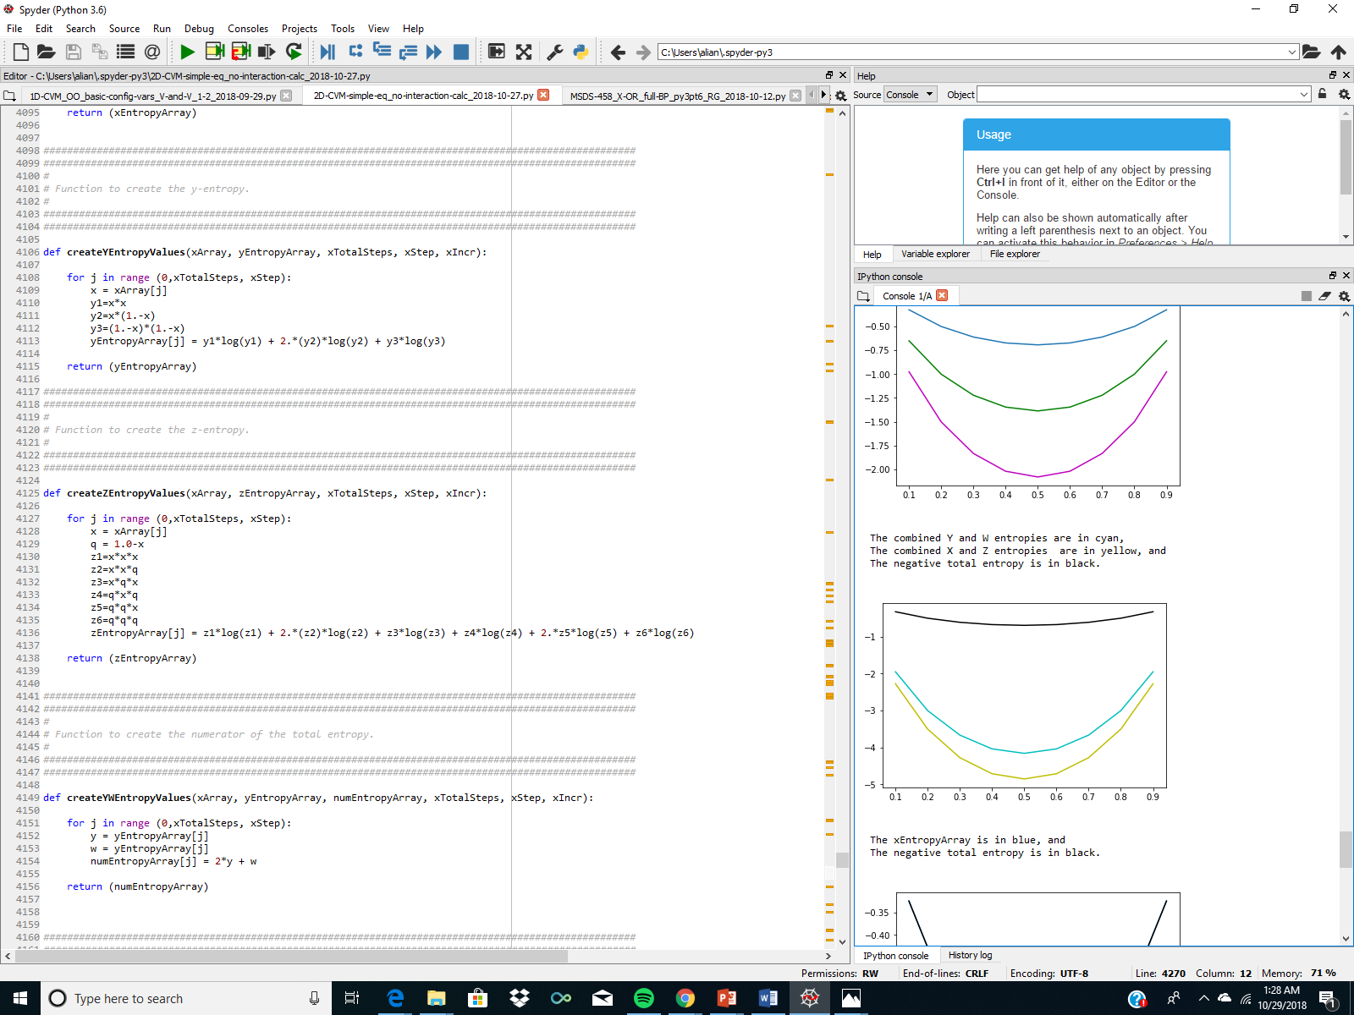
Program Result: Entropies for the Combined x, y, and z Configuration Variables, for the case where Epsilon1 = 0.0

Slide 5
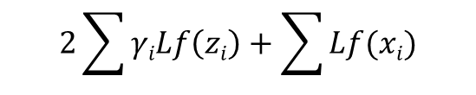
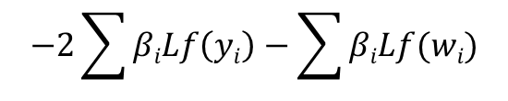
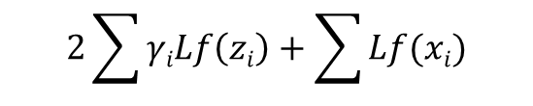
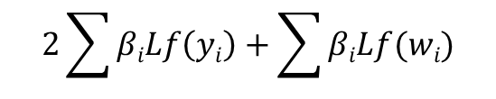
Entropies for the Combined x, y, and z Configuration Variables, for the case where Epsilon1 = 0.0
c
(a)
$$2\sum{βiLf\left(yi\right)}+\sum{βiLf(wi)}$$
(b)
$$2\sum{γiLf\left(zi\right)}+\sum{Lf(xi)}$$
a
(c)
$$2\sum{γiLf\left(zi\right)}+\sum{Lf(xi)}$$
2-D CVM Entropy for Different Combinations of the Configuration Variables
b
$$−2\sum{βiLf\left(yi\right)}−\sum{βiLf(wi)}$$
Note: Curve (c) is for the negative of the total entropy, and is thus the negative of curve (a) – curve (b).
x₁ (Fraction of units in the “on” state, or state A)

Slide 6
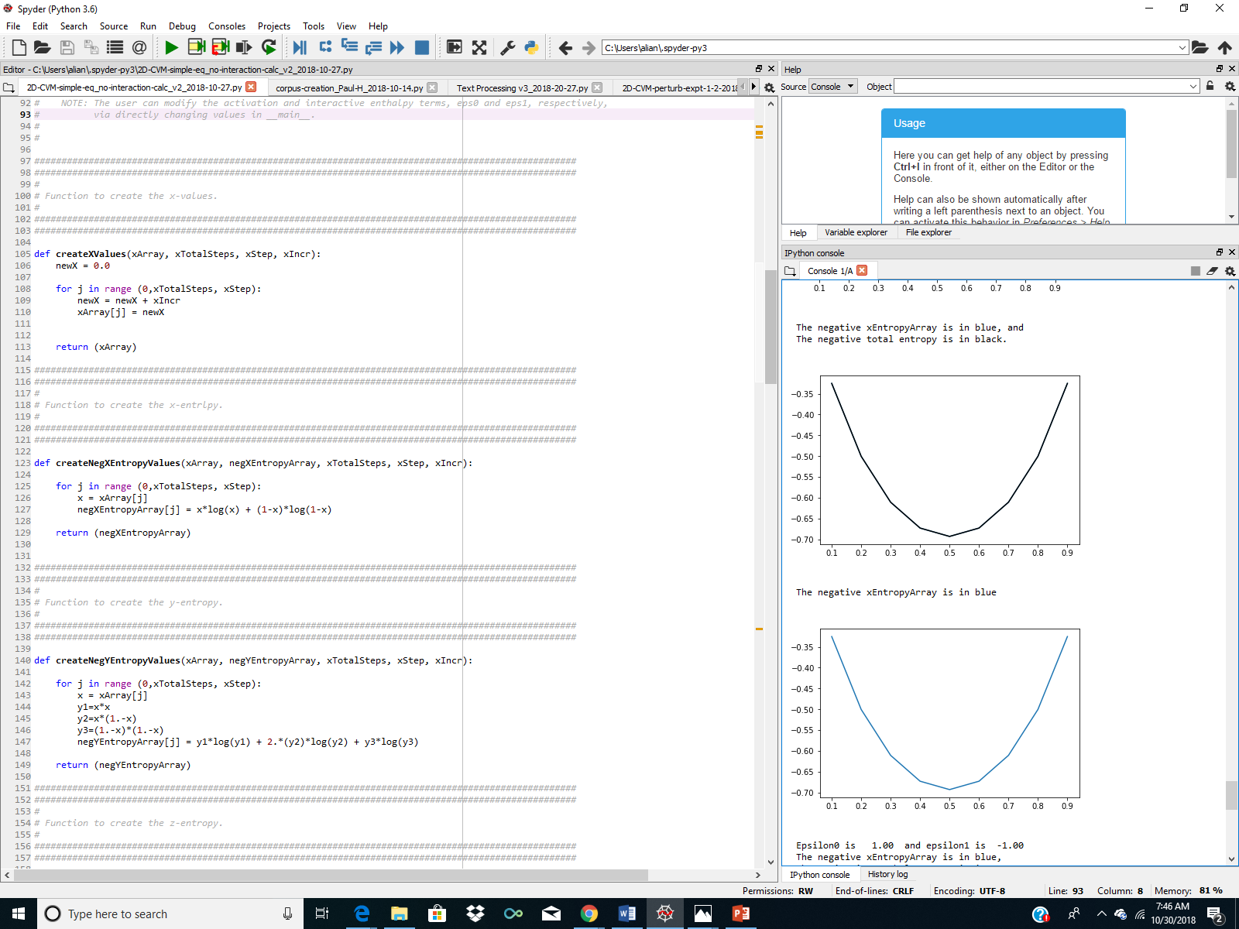
Program Result: x-Entropy and Total Entropy, for the case where Epsilon1 = 0.0

Slide 7
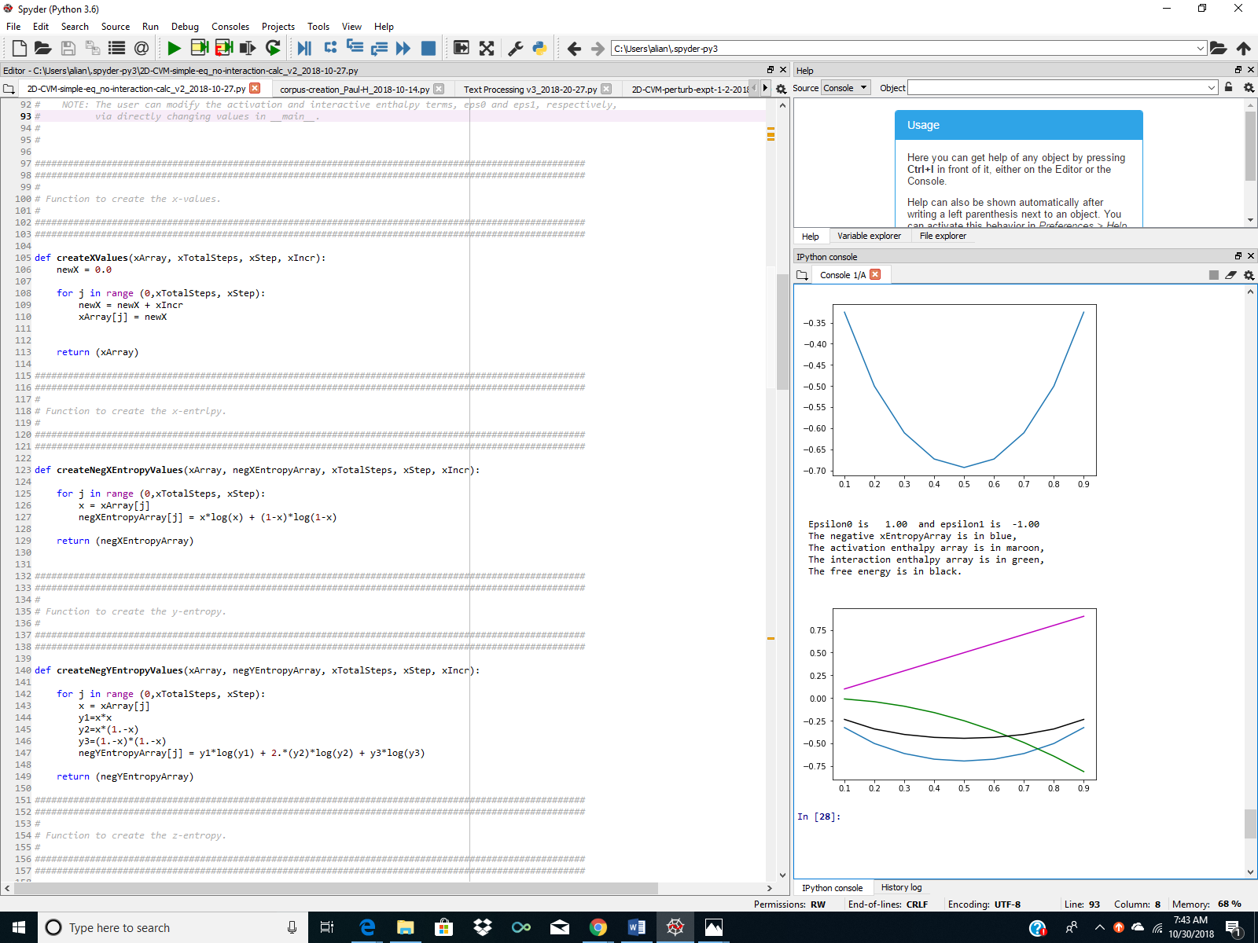
Program Result: Thermodynamic Quantities for a Simple Ising System

Slide 8


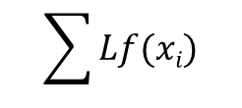


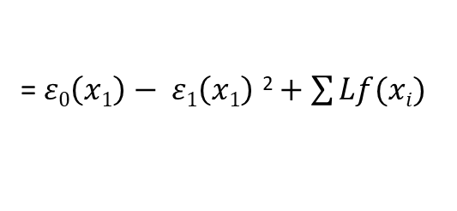

Reduced Thermodynamic Variables for a Simple Ising System
(a)
$$ε0\left(x1\right)$$
Activation Enthalpy
(b)
a
$$− ε1\left(x1\right) \text{2}$$
(c)
$$\sum{Lf(xi)}$$
Thermodynamic Values for a Simple Ising System; No Configuration Variables
Interaction Enthalpy
b
Free Energy
(d)
$$F$$
= $ε0\left(x1\right)− ε1\left(x1\right) \text{2}+\sum{Lf(xi)}$
d
Illustration where:
$$ε0=1$$
c
$$ε1=1$$
Neg-entropy
x₁ (Fraction of units in the “on” state, or state A)

Slide 9
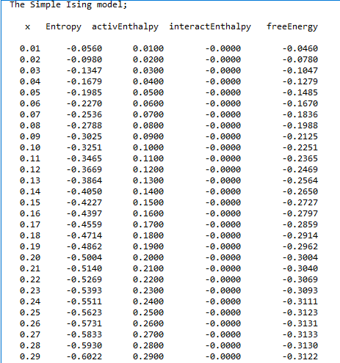
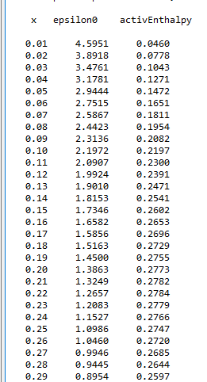
Use the Derivative of the Free Energy Equation to Obtain Epsilon0 (when the interaction enthalpy = 0)
Epsilon0 computed by setting the derivative of the Free Energy to 0.
Epsilon0 =1.0, Epsilon1 = 0.0
Epsilon0 as a function of x1.
Notice x1 value:
x1 = 0.27
Eps0 = 1.0
Free Energy as a function of x1.
Eps0 = 1.0 for the run.
Notice x1 value:
x1 = 0.27
Set Epsilon0 = 1.0 for a run of the free energy as function of x:
Free Energy Minimum
x1 = 0.27
F = -0.313

Slide 10
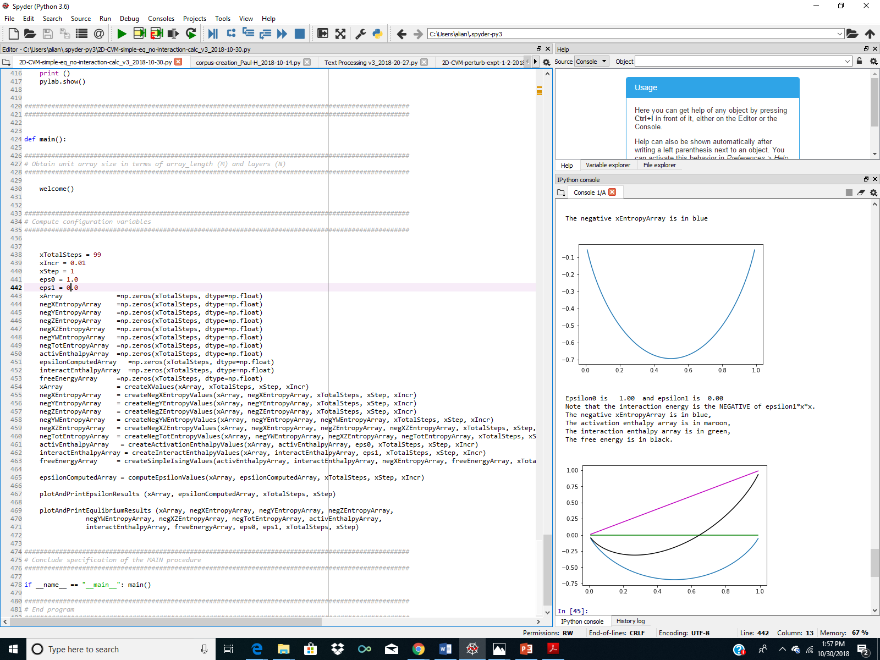




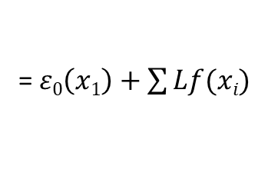
The Free Energy Minimum Occurs Where Expected for a Given Epsilon0 Value
(a)
(b)
(c)
$$\sum{Lf(xi)}$$
$$ε0\left(x1\right)$$
$$− ε1\left(x1\right) \text{2}$$
(d)
$$F$$
= $ε0\left(x1\right)+\sum{Lf(xi)}$
Free Energy Minimum
x1 = 0.27
F = -0.313
a
b
d
c
x1

Slide 11
For More Information:
GitHub Public Repository:
https://github.com/ajmaren/2D-CVM-No-Interaction-Enthalpy-Analytic
Website:
www.aliannajmaren.com
Code Availability:
Code for this presentation is available, use:
2D-CVM-simple-eq_no-interaction-calc_v2_2018-10-27.py
Documentation:
This MS Powerpoint:
2-D_CVM_No-interaction-enthalpy_2018-10-29.pptx
Blog Discussion:
http://www.aliannajmaren.com/2018/10/28/a-strange-odd-little-thing-about-the-cvm-entropy/
Contact Information:
Alianna J. Maren, Ph.D.:
alianna@aliannajmaren.com
alianna.maren@northwestern.edu

