Slide 1


2-D Cluster Variation Method
Analytic Results (Equilibrium)
with
Alianna J. Maren, Ph.D.
Verification and Validation
Revised: November 23, 2018

Slide 2

Alianna J. Maren, Ph.D.
Developed foundational AI courses for Northwestern University’s SPS program – Master of Science in Data Science:
MSDS 458: AI & Deep Learning,
MSDS 453: Natural Language Processing
Four patents:
Biologically-based sensor fusion
Knowledge discovery
Predictive analytics
Evidence-based reasoning
Recent publications:
Brain Sciences
arXiv
Links to all at:
www.aliannajmaren.com

Slide 3
The Cluster Variation Method:
Takes into account local configuration variables
A Single Zigzag Chain
Showing the Configuration Variables x_{i}, y_{i}, w_{i}, and z_{i}
The Set of Configuration Variables
x_{i}: individual nodes
y_{i}: nearest-neighbors,
w_{i}: next-nearest neighbors, and
z_{i}: triplets

Slide 4
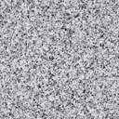

1-D Grid Base Pattern:
Configuration Variable Values when h = 1
The Base Pattern is designed to:
Illustrate the triplet configuration variables: one of each z_{i}
Code and analytics V&V: Useful when comparing code results with hand-computed
Tutorial role: Illustrate how the CVM thinking works
Envelope configuration: wraparound horizontally only
1-D Case:
Total number of triplets = number of units
Horizontal wrap-around; identical with leftmost units
Legend
Configuration Variable (Triplet) Values Equiprobable when h = 1
z₁ = 0.125
Z₁ = 2
z₂ = 0.125
Z₂ = 2
z_{2var} = 0.125
Z_{2 var} = 2
variant
z₃ = 0.125
Z₃= 2
Unit in state A
Unit in state B
A
A
A
B
A
A
A
B
B
A
A
A
Wrap-around unit in state A
Wrap-around unit in state B
B
z₆ = 0.125
Z₆= 2
B
z₅ = 0.125
Z₅ = 2
A
z₅ = 0.125
Z₅ = 2
variant
A
z₄ = 0.125
Z₄ = 2
B
B
B
A
B
B
B
B
z_{i} = fraction of triplets of type i; Z_{i} = total number of triplets of type i

Slide 5
2-D Grid Base Pattern:
Configuration Variable Values when h = 1
Vertical wrap-around; identical with bottom row
Envelope configuration: wraparounds vertically and horizontally
Total number of triplets = 4*number of units
= 4*(4*8) = 128
Horizontal wrap-around; identical with leftmost units
Legend
Configuration Variable (Triplet) Values Equiprobable when h = 1
z₁ = 0.125
Z₁ = 16
z₂ = 0.125
Z₂ = 16
z_{2var} = 0.125
Z_{2 var} = 16
variant
z₃ = 0.125
Z₃= 16
Unit in state A
Unit in state B
A
A
A
B
A
A
A
B
B
A
A
A
Wrap-around unit in state A
Wrap-around unit in state B
B
z₆ = 0.125
Z₆= 16
B
z₅ = 0.125
Z₅ = 16
A
z₅ = 0.125
Z₅ = 16
variant
A
z₄ = 0.125
Z₄ = 16
B
B
B
A
B
B
B
B
z_{i} = fraction of triplets of type i; Z_{i} = total number of triplets of type i

Slide 6
The 2-D CVM Grid Can Serve as a Hidden Layer in a Computational Engine
External States ₂
Markov Blanket: Active Units (a)
A
B
B
B
A
A
A
A
B
A
Internal States
A
B
B
B
A
Representational units
(r)
A
A
A
B
A
Markov Blanket: Sensing Units (s)
External States ₁

Slide 7
Overview:
Visualizing the Configuration Variables
for the Cluster Variation Method (Both 1-D and 2-D)
Visual depiction of how the configuration variables appear in both the 1-D and 2-D CVM grids
Analytic results (equilibrium cases)
Validates code design; corollary document to code verification and validation documentation

Slide 8
Configuration Variables in the 1-D CVM

Slide 9
The 1-D CVM: Comprised of a Single Zigzag Chain
Showing the Configuration Variables x_{i}, y_{i}, w_{i}, and z_{i}
There are four different kinds of local configuration variables:
x_{i} – the fraction of nodes in their specific activation state
y_{i} – nearest-neighbors
w_{i} – next-nearest-neighbors
z_{i} - triplets
Total numbers of each kind:
x_{i} – two types: A or B (“on” or “off,” respectively)
y_{i} – three types: A-A, A-B (also B-A), and B-B (degeneracy = 2 for A-B / B-A
w_{i} – three types: A--A, A--B (also B--A), and B--B (degeneracy = 2 for A--B / B—A – these occur within the same row for the 1-D case
z_{i} – six types of triplets; two have degeneracies of two each – see next slide

Slide 10
1-D CVM with Two Instances of Base Pattern
Base pattern characteristics:
Requires eight nodes; four A (“on”) and four B (“off”)
Yields one instance of each of the different triplets (including the degenerate types)
Envelope configuration: wraparound horizontally only
1-D CVM:
Total number of triplets = number of units
Horizontal wrap-around; identical with leftmost units
Legend
Configuration Variable (Triplet) Values (Equiprobable when h = 1)
z₁ = 0.125
Z₁ = 2
z₂ = 0.125
Z₂ = 2
z_{2var} = 0.125
Z_{2 var} = 2
variant
z₃ = 0.125
Z₃= 2
Unit in state A
Unit in state B
A
A
A
B
A
A
A
B
B
A
A
A
Wrap-around unit in state A
Wrap-around unit in state B
B
z₆ = 0.125
Z₆= 2
B
z₅ = 0.125
Z₅ = 2
A
z₅ = 0.125
Z₅ = 2
variant
A
z₄ = 0.125
Z₄ = 2
B
B
B
A
B
B
B
B
z_{i} = fraction of triplets of type i; Z_{i} = total number of triplets of type i

Slide 11
Square-Grid-Node Representation vs.
Dot-Grid-Node Representation
for the Same Grid
1-D grid with
two repeats of base pattern
Typical grid representation – easy pattern visualization
Horizontal wrap-around; identical with leftmost units
Dot grid representation – easy to view configuration variables (y, w, and z)
Same pattern in dot-grid representation
Same horizontal wrap-around; identical with leftmost units
The wrap-around on the left-hand-side was useful for structured code

Slide 12
Configuration Variables in the 2-D CVM

Slide 13
Two Different Visualizations of the Same 2-D CVM Grid
(Showing only ONE of the wrap-arounds on top and right)
Block grid:
Used in most papers & slidedecks
Easiest for visualizing local shapes & patterns
Dot grid:
Used only to show how the different configuration variables are set up
Note: BOTH grid patterns show both horizontal and vertical wrap-arounds; at the top and right-side edges; dark and light mottled grey

Slide 14
The y_{i} Configuration Variables in a 2-D CVM Grid
Four y_{i} nearest-neighbor variables per node are diagonally UP or DOWN with regard to the center node
To compensate for double-counting, we divide by 2. Y = Total number of y_{i} config variables = 2N
(where N = number of nodes in grid)
Col 0
Col 1
Col 2
Col 3
Col 4
Four y_{i} nearest-neighbor variables:
Row 0
One on each diagonal
Separation distance = 1 unit
Degeneracy factor of 2 to account for counting A-B and B-A nearest neighbors differently
Row 1
y_{i}:
Row 2
Row 3
Row 4

Slide 15
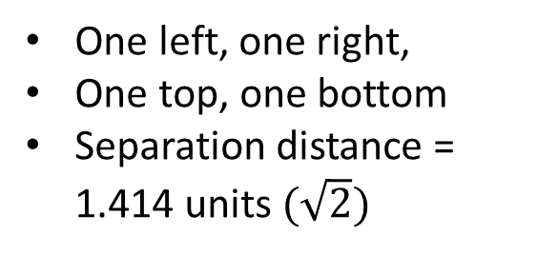
The w_{i} Configuration Variables in a 2-D CVM Grid
Four w_{i} nearest-neighbor variables per node are the two horizontal and two vertical neighbors
To compensate for double-counting, we divide by 2. W = Total number of w_{i} config variables = 2N
(where N = number of nodes in grid)
Col 0
Col 1
Col 2
Col 3
Col 4
Row 0
Four w_{i} next-nearest-neighbor variables:
Row 1
One left, one right,
One top, one bottom
Separation distance = 1.414 units $(\sqrt{2})$
w_{i}:
Row 2
Row 3
Row 4

Slide 16
The Eight z_{i} Configuration Variables per Node in a 2-D CVM Grid
To compensate for double-counting, we divide by 2. Z = Total number of z_{i} config variables = 4N
(where N = number of nodes in grid)
Four horizontal z_{i} configurations
Within two rows and three columns each:
Four z_{i} triplet variables within the rows immediately above and below the central node
Four vertical z_{i} configurations
Within two columns and three rows each:
Four z_{i} triplet variables extend to two rows above and two rows below the central node (two for each direction)

Slide 17
These are NOT z_{i} Configurations
NOT allowable z_{i} configurations:
The z_{i} triplet variables must be in a “bent-angle” configuration, not a straight line.

Slide 18
Illustration of Computing Configuration Variables for a Base Pattern
Base Pattern: 4*8 = 32 nodes
2*32 = 64 total Y configurations
2*32 = 64 total W configurations
4*32 = 128 total Z configurations
Same Base Pattern with horizontal and vertical wrap-arounds:
Two wrap-around rows on top
Two wrap-around columns on right-hand side

Slide 19
2-D Grid: HORIZONTAL Triplet Configuration Variable Values when h = 1
Upwards-facing vertical Z1 triplet
Vertical wrap-around; identical with bottom two rows
Total number of triplets = 4*number of units = 4*32 = 128; equal numbers of each kind of triplet for the base pattern means 128/8 = 16 of each kind of triplet; 8 vertical and 8 horizontal triplet configurations
Downwards-facing vertical Z1 triplet
Envelope configuration: wraparounds vertically and horizontally
Horizontal wrap-around; identical with two leftmost units
Legend
Horizontal Triplet Configuration Variable Values Equiprobable when h = 1
z₁ = 0.125
Z_{1, Hor} = 8
z₂ = 0.125
Z_{2, Hor} = 8
z_{2var} = 0.125
Z_{2, Hor var} = 8
variant
z₃ = 0.125
Z_{3, Hor}= 8
Unit in state A
Unit in state B
A
A
A
B
A
A
A
B
B
A
A
A
Wrap-around unit in state A
Wrap-around unit in state B
B
z₆ = 0.125
Z_{6, Hor}= 8
B
z₅ = 0.125
Z_{5, Hor} = 8
A
z₅ = 0.125
Z_{5, Hor} = 8
variant
A
z₄ = 0.125
Z_{4, Hor} = 8
B
B
B
A
B
B
B
B
z_{i} = fraction of triplets of type i; Z_{i} = total number of triplets of type i

Slide 20
Left-facing vertical Z1 triplet
2-D VERTICAL Configuration Variable Values when h = 1
Vertical wrap-around; identical with bottom two rows
Right-facing vertical Z1 triplet
Total number of vertical Z1 triplets = 8 for this 32-node base pattern (8 horizontal Z1 triplets shown in previous slide)
Envelope configuration: wraparounds vertically and horizontally
Horizontal wrap-around; identical with two leftmost units
Legend
Vertical Triplet Configuration Variable Values Equiprobable when h = 1
A
z₁ = 0.125
Z_{1, Vert} = 8
z₂ = 0.125
Z_{2, Vert} = 8
z_{2var} = 0.125
Z_{2, Vert var} = 8
variant
z₃ = 0.125
Z_{3, Vert}= 8
Unit in state A
Unit in state B
A
A
A
B
A
A
B
B
A
A
A
Wrap-around unit in state A
Wrap-around unit in state B
B
z₆ = 0.125
Z_{6, Vert}= 8
B
z₅ = 0.125
Z_{5, Vert} = 8
A
z₅ = 0.125
Z_{5, Vert} = 8
variant
A
z₄ = 0.125
Z_{4, Vert} = 8
B
B
B
A
B
B
B
B
z_{i} = fraction of triplets of type i; Z_{i} = total number of triplets of type i

Slide 21
Illustration of Grid Patterns in the 2-D CVM
Note: Approximate; Counts only Horizontal Triplets

Slide 22
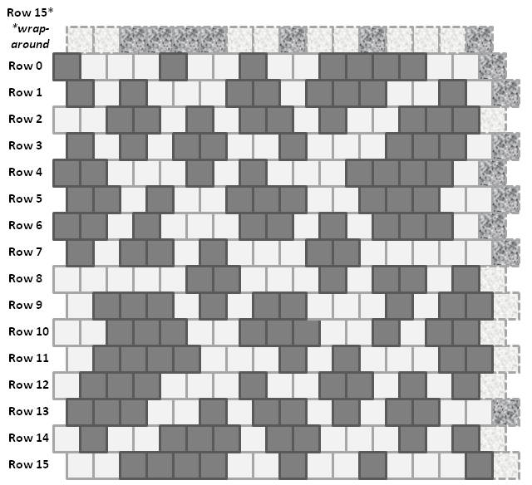
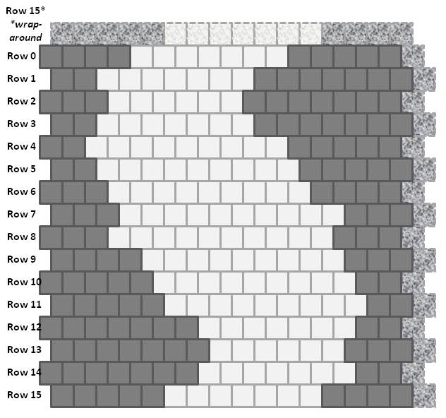
Two Different Configurations for a 2-D CVM Grid
Equiprobable unit distribution (x₁ = x₂ = 0.5)
Each grid contains 256 units (16 x 16)
(a)
Scale-free-like topography
(b)
Extreme rich club-like topography

Slide 23
Row 15*
*wrap-around
A Rich Club-Like Composition:
= 128 “A” (all connected)
and 128 “B” (connected)
Row 0
Configuration Variables
Row 1
Horizontal Triplets | Z₁ | Z₃
A = black; B = white Counts for EACH row | A / \ A A | B / \ A A
Row 0 to Row 1 Row 14 to Row 15 | (7+7=14) *2 = 28 | (1+1=2)*2 = 4
Row 1 to Row 2 Row 13 to Row 14 | (8+9=17) *2 = 34 | (0+0=0)*2 = 0
Row 2 to Row 3 Row 12 to Row 13 | (9+8=17) *2 = 34 | (0+0=0)*2 = 0
Row 3 to Row 4 Row 11 to Row 12 | (7+6=13) *2 = 26 | (0+1=1)*2 = 2
Row 4 to Row 5 Row 10 to Row 11 | (6+6=12) *2 = 24 | (0+0=0)*2 = 0
Row 5 to Row 6 Row 9 to Row 10 | (6+6=12) *2 = 24 | (0+0=0)*2 = 0
Row 6 to Row 7 Row 8 to Row 9 | (5+5=10) *2 = 20 | (0+1=1)*2 = 2
Row 7 to Row 8 Row 15 to Row 0 | 5+5=10 7+7 = 14 | 0+0=0 1+1 = 2
Sum x 2 | 214 | 10
Row 2
Row 3
Row 4
Row 5
Row 6
Row 7
Row 8
Row 9
Row 10
Row 11
Row 12
Row 13
Row 14
Row 15
Illustration based on counting the horizontal triplets only:
z₁ = Z₁/(2xN) = 214/(512) = 0.4180
z₃ = Z₃/(2xN) = 10/(512) = 0.0195

Slide 24
Row 15*
*wrap-around
A Scale-Free-Like Composition
Configuration Variables
Horizontal Triplets | Z₁ | Z₃
A = black; B = white Counts for EACH row | A / \ A A | B / \ A A
Row 0 to Row 1 Row 14 to Row 15 | 2+3=5 | (1+0=1)*2 = 2
Row 1 to Row 2 Row 13 to Row 14 | 2+3=5 | (1+1=2)*2 = 4
Row 2 to Row 3 Row 12 to Row 13 | 3+3=6 | (1+0=1)*2 = 2
Row 3 to Row 4 Row 11 to Row 12 | 3+3=6 | (0+1=1)*2 = 2
Row 4 to Row 5 Row 10 to Row 11 | 4+4=8 | (0+1=1)*2 = 2
Row 5 to Row 6 Row 9 to Row 10 | 5+4=9 | (0+0=0)*2 = 0
Row 6 to Row 7 Row 8 to Row 9 | 1+2=3 | (3+0=3)*2 = 6
Row 7 to Row 8 Row 15 to Row 0 | 1+1=2 | 1+1=2 2+2 = 4
Sum x 2 | 88 | 22
Row 0
Row 1
Row 2
Row 3
Row 4
Row 5
Row 6
Row 7
Row 8
Row 9
Row 10
Row 11
Row 12
Row 13
Row 14
Row 15
For Rows 0 .. 7
A
A
A
For Rows 14 .. 8 & 15
A
A
A
+
+
z₁ = Z₁/(2xN) = 88/(512) = 0.172
Z₁ for Row N to N+1 =
A
A
A
Z₁ for Row N to N+1 =
A
A
A
z₃ = Z₃/(2xN) = 22/(512) = 0.0430
A
A
B
B
A
A
Z₃ for Row N to N+1 =
+
Z₃ for Row N to N+1 =
+
B
A
A
A
A
B

Slide 25
Details of Counting Horizontal Triplets for the Two Different Grid Configurations
Rich Club-Like Topography
Scale-Free-Like Topography
Horizontal Triplets | Z₁ | Z₃
A = black; B = white Counts for EACH row | A / \ A A | B / \ A A
Row 0 to Row 1 Row 14 to Row 15 | (7+7=14) *2 = 28 | (1+1=2)*2 = 4
Row 1 to Row 2 Row 13 to Row 14 | (8+9=17) *2 = 34 | (0+0=0)*2 = 0
Row 2 to Row 3 Row 12 to Row 13 | (9+8=17) *2 = 34 | (0+0=0)*2 = 0
Row 3 to Row 4 Row 11 to Row 12 | (7+6=13) *2 = 26 | (0+1=1)*2 = 2
Row 4 to Row 5 Row 10 to Row 11 | (6+6=12) *2 = 24 | (0+0=0)*2 = 0
Row 5 to Row 6 Row 9 to Row 10 | (6+6=12) *2 = 24 | (0+0=0)*2 = 0
Row 6 to Row 7 Row 8 to Row 9 | (5+5=10) *2 = 20 | (0+1=1)*2 = 2
Row 7 to Row 8 Row 15 to Row 0 | 5+5=10 7+7 = 14 | 0+0=0 1+1 = 2
Sum x 2 | 214 | 10
Horizontal Triplets | Z₁ | Z₃
A = black; B = white Counts for EACH row | A / \ A A | B / \ A A
Row 0 to Row 1 Row 14 to Row 15 | 2+3=5 *2 = 10 | (1+0=1)*2 = 2
Row 1 to Row 2 Row 13 to Row 14 | 2+3=5 *2 = 10 | (1+1=2)*2 = 4
Row 2 to Row 3 Row 12 to Row 13 | 3+3=6 *2 = 12 | (1+0=1)*2 = 2
Row 3 to Row 4 Row 11 to Row 12 | 3+3=6 *2 = 12 | (0+1=1)*2 = 2
Row 4 to Row 5 Row 10 to Row 11 | 4+4=8 *2 = 16 | (0+1=1)*2 = 2
Row 5 to Row 6 Row 9 to Row 10 | 5+4=9 *2 = 18 | (0+0=0)*2 = 0
Row 6 to Row 7 Row 8 to Row 9 | 1+2=3 *2 = 6 | (3+0=3)*2 = 6
Row 7 to Row 8 Row 15 to Row 0 | 1+1=2 *2 = 4 | 1+1=2 2+2 = 4
Sum x 2 | 88 | 22

Slide 26
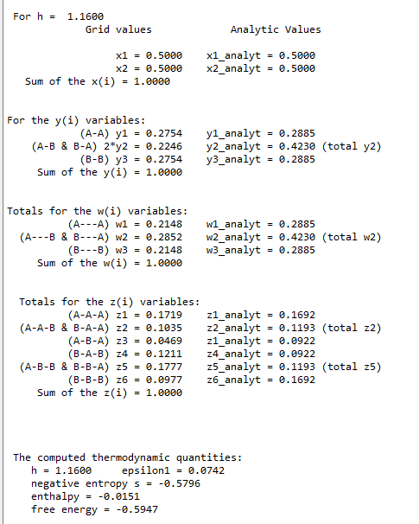
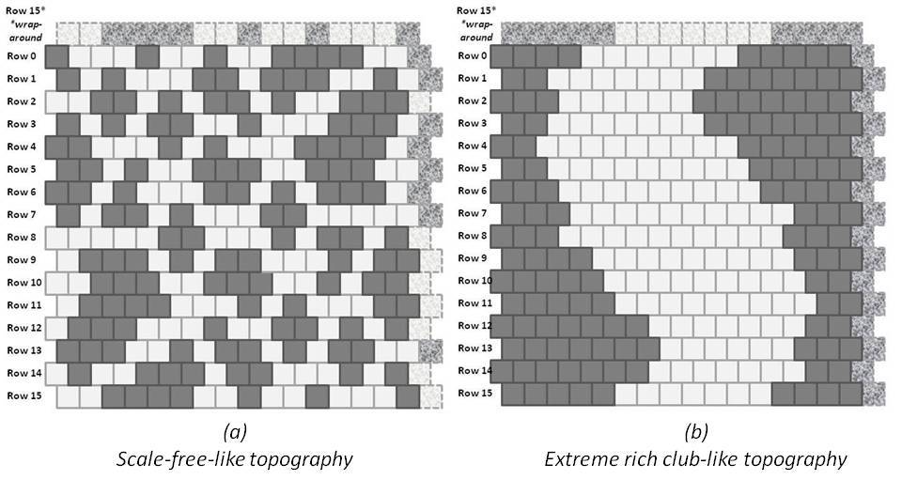
A Scale-Free-Like Composition: Code Validation
z₁ = Z₁/(2xN) = 88/(512) = 0.172
z₃ = Z₃/(2xN) = 24/(512) = 0.0430
Hand-counted z₁ and z₃ values:
Code validation step
Approximate h-value: 1.16
NOTE: Hand-crafted pattern has unequal values for z₁ & z₆, etc., so the h-value can only be approximate; the pattern is not an equilibrium one.
Program: 2D-CVM_defined-patterns_analytic-solution_2017-12-08_rev_2018-11-22.py
Run Date: 11/23/2018 Private GitHub: 2-D-CVM-Random-Pattern-Configurations

Slide 27
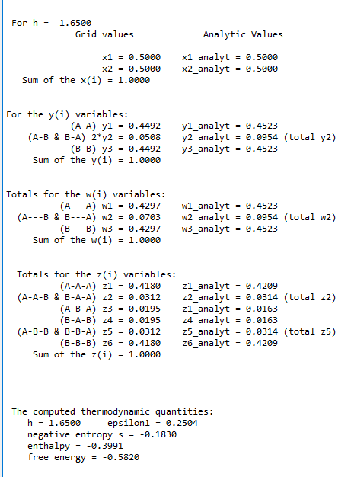
An Extreme Rich Club-Like Composition: Code Validation
z₁ = Z₁/(2xN) = 214/(512) = 0.4180
z₃ = Z₃/(2xN) = 10/(512) = 0.0195
Hand-counted z₁ and z₃ values:
Code validation step
Approximate h-value: 1.65
NOTE: Hand-crafted pattern has equal values for z₁ & z₆, etc., so the h-value corresponds to the hand-counts. However: the analytic solution diverges as h gets larger.
Program: 2D-CVM_defined-patterns_analytic-solution_2017-12-08_rev_2018-11-22.py
Run Date: 11/23/2018 Private GitHub: 2-D-CVM-Random-Pattern-Configurations

Slide 28
Two Extremely Different Topographies Give the Range of Useful h-values
(a)
Scale-free-like topography
(b)
Extreme rich club-like topography
Approximate h-value: 1.16
Approximate h-value: 1.65

Slide 29
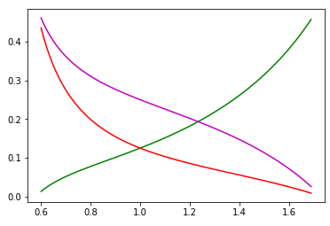


We Can Obtain Analytic Results for Certain Cases
Analytic Values for Configuration Variables y₂, z₁, and z₃
Case where activation enthalpy : x₁ = x₂ = 0.5
$${ ε}_{0}=0$$
B
A
A
y₂
Z₃:
Z₁:
y₂:
B
B
A
A
A
A
A
z₁
Configuration variable
z₃
y₂
z₁
h = 1 (ε₁ = 0)
For h = 1:
z₃
y₂ = 0.250
z₁ = 0.125
z₃ = 0.125
h: interaction enthalpy parameter;
$${ h=exp(2ε}_{1})$$

Slide 30

Analytic Values for Configuration Variables y₂, z₁, and z₃
Scale-Free-Like
Extreme Rich Club-Like and Scale-Free-Like Patterns
B
A
A
For h = 1.16:
Z₃:
Z₁:
y₂:
B
B
A
A
A
A
y₂ = 0.212
A
z₁ = 0.169
Configuration variable
y₂
Scale-Free-Like
z₃ = 0.092
h = 1.16
(ε₁ = 0.074)
z₃
Rich Club-Like
Rich Club-Like
h = 1.65
(ε₁ = 0.250)
z₁
For h = 1.65:
y₂ = 0.047
z₁ = 0.418
Approximate Useful Range for h
z₃ = 0.020
h: interaction enthalpy parameter;
$${ h=exp(2ε}_{1})$$

Slide 31

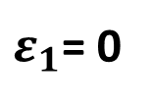

Analytic Values for Active Nodes x₁
Interaction enthalpy is zero:
${ ε}_{1}$= 0
By taking the derivative of the free energy function, we can find the equilibrium value for x₁ at different activation enthalpies
$${ ε}_{0}$$
0.5
x₁ vs (Activation Enthalpy Parameter)
0.4
x₁
0.3
0.2
0.1
0.0
0.0
1.0
0.2
3.0
4.0
5.0
(Activation Enthalpy Parameter)
$${ ε}_{0}$$

Slide 32








Our Goal is to Fill in the Phase Space Values
$${ ε}_{0}$$
$${ ε}_{1}$$
Configuration Variables are Functions of and
Values Found at Equilibrium
$${ ε}_{0}$$
$${ ε}_{1}$$
x₁ vs (Activation Enthalpy Parameter) and (Interaction Enthalpy Parameter)
$${ ε}_{0}$$
(Activation Enthalpy Parameter)
x₁
0.0
1.0
2.0
3.0
4.0
5.0
0.0
0.500
0.269
0.119
0.047
0.018
0.007
Scale-Free-Like
0.1
0.500
Rich Club-Like
Goal is to fill in this grid with values for x₁, y₂, z₁, and z₃
0.2
0.500
(Interaction Enthalpy Parameter)
For h = 1.16:
0.3
0.500
${ ε}_{1}$= 0.074
y₂ = 0.212
For h = 1.65:
0.4
0.500
z₁ = 0.169
${ ε}_{1}$= 0.250
$${ ε}_{1}$$
y₂ = 0.047
z₃ = 0.092
0.5
0.500
z₁ = 0.418
z₃ = 0.020

Slide 33


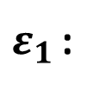
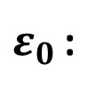


Our Goal is to Fill in the Phase Space Values
Pragmatically, we only need a portion of the grid
$${ ε}_{0}$$
$${ ε}_{1}$$
x₁ vs (Activation Enthalpy Parameter) and (Interaction Enthalpy Parameter)
$${ ε}_{0}$$
(Activation Enthalpy Parameter)
x₁
0.0
1.0
2.0
3.0
4.0
5.0
0.0
0.500
0.269
0.119
0.047
0.018
0.007
Scale-Free-Like
Useful portion
0.1
0.500
Useful portion of the grid is bounded by:
0.2
0.500
Rich Club-Like
(Interaction Enthalpy Parameter)
${ ε}_{0 }$< 3.0
For h = 1.16:
$ε_{1}$< 0.25
0.3
0.500
${ ε}_{1}$= 0.074
If the activation enthalpy is too large, then x₁ becomes too small, and we risk not having sufficient numbers of the z₁ triplets.
0.4
0.500
For h = 1.65:
${ ε}_{0 }$:
$${ ε}_{1}$$
${ ε}_{1}$= 0.250
0.5
0.500
If the interaction enthalpy is too large, then we’ve already pushed the system to a single, maximally-sized cluster of each type, and there is no benefit to increasing the interaction enthalpy.
${ ε}_{1 }$:
Two extreme topography types

Slide 34
Next Steps
Fill in the grid values by obtaining configuration variable sets where the free energy is minimized for given pairs of non-zero enthalpy parameters.
Non-trivial, as the parameters interact with the configuration variables producing the free energy minimum. Computational solutions will be needed.
$${ ε}_{0}$$
(Activation Enthalpy Parameter)
x₁
0.0
1.0
2.0
3.0
4.0
5.0
0.0
0.500
0.269
0.119
0.047
0.018
0.007
0.1
0.500
Fill in this portion of the grid
0.2
0.500
(Interaction Enthalpy Parameter)
0.3
0.500
0.4
0.500
$${ ε}_{1}$$
0.5
0.500

Slide 35
For More Information:
GitHub Public Repository:
https://github.com/ajmaren/2D-Cluster-Variation-Method
Code for some of this work is still on a private repository
Website:
www.aliannajmaren.com
Code Availability:
Code will be made available on the public GitHub repository after initial development, documentation, V&V, and experiments are completed.
Look on arXiv for various papers documenting theoretical and experimental results. See the “Patents and Publications” page on www.aliannajmaren.com for full access to the latest papers. See the “Blog” page for discussions on theory, code, and experimental results.
Contact Information:
Alianna J. Maren, Ph.D.:
alianna@aliannajmaren.com
alianna.maren@northwestern.edu

