Slide 1
2-D CVM Code: Experimental Results Perturbations Applied to a 2D CVM January, 2018
A.J. Maren, Ph.D.
Northwestern University, School of Professional Studies (SPS) Master of Science in Data Science Program
alianna@aliannajmaren.com
Alianna.maren@northwestern.edu
For Blog Discussions, Publications, and More:
www.aliannajmaren.com

Slide 2
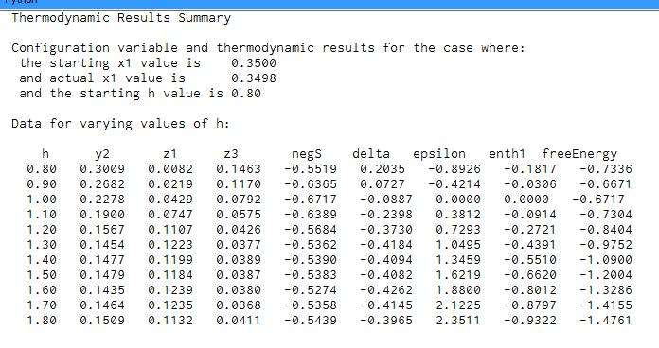
Experimental Results
x= 0.35, h = 0.8 – 1.8, and perturbation = 0.1

Slide 3
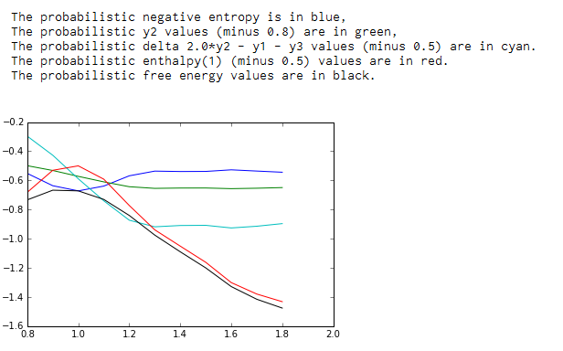
Experimental Results
x1= 0.35, h = 0.8 to 1.8

Slide 4
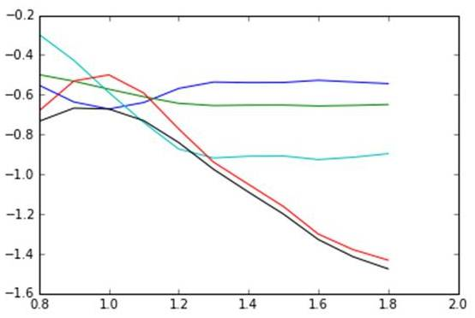
Configuration Variables and Thermodynamic Results
x1= 0.35, h = 0.8 to 1.8
delta =
2y₂ – y₁ – y₃ – 0.5
y₂ – 0.8
enthalpy – 0.5
entropy
free energy
y₂, delta, and enthalpy all have scalars subtracted to bring them into the same visual field as entropy and free energy.
h-value

Slide 5
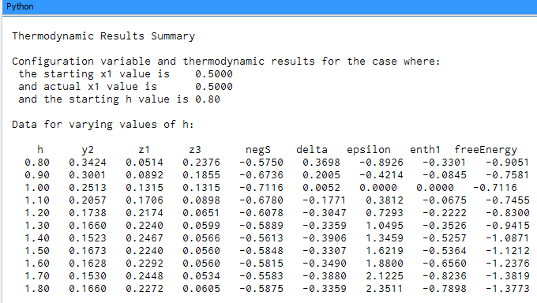
Experimental Results
x= 0.50, h = 0.8 – 1.8, and perturbation = 0.1

Slide 6
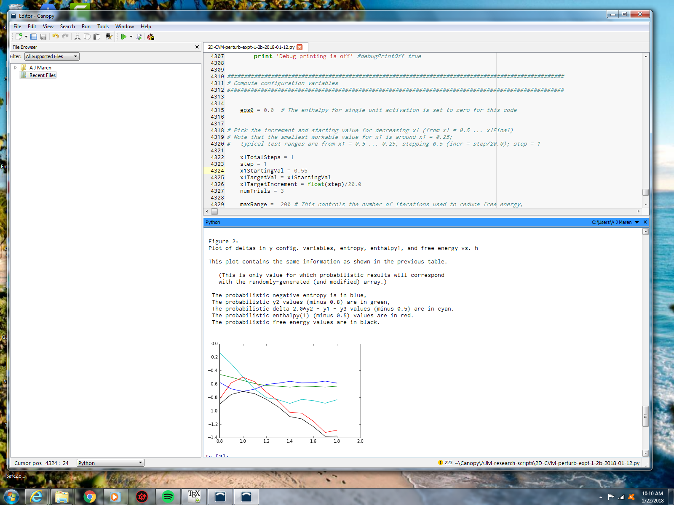
Experimental Results
x1= 0.50, h = 0.8 to 1.8

Slide 7
Configuration Variables and Thermodynamic Results
x1= 0.50, h = 0.8 to 1.8
delta =
2y₂ – y₁ – y₃ – 0.5
y₂ – 0.8
enthalpy – 0.5
entropy
free energy
y₂, delta, and enthalpy all have scalars subtracted to bring them into the same visual field as entropy and free energy.
h-value

Slide 8
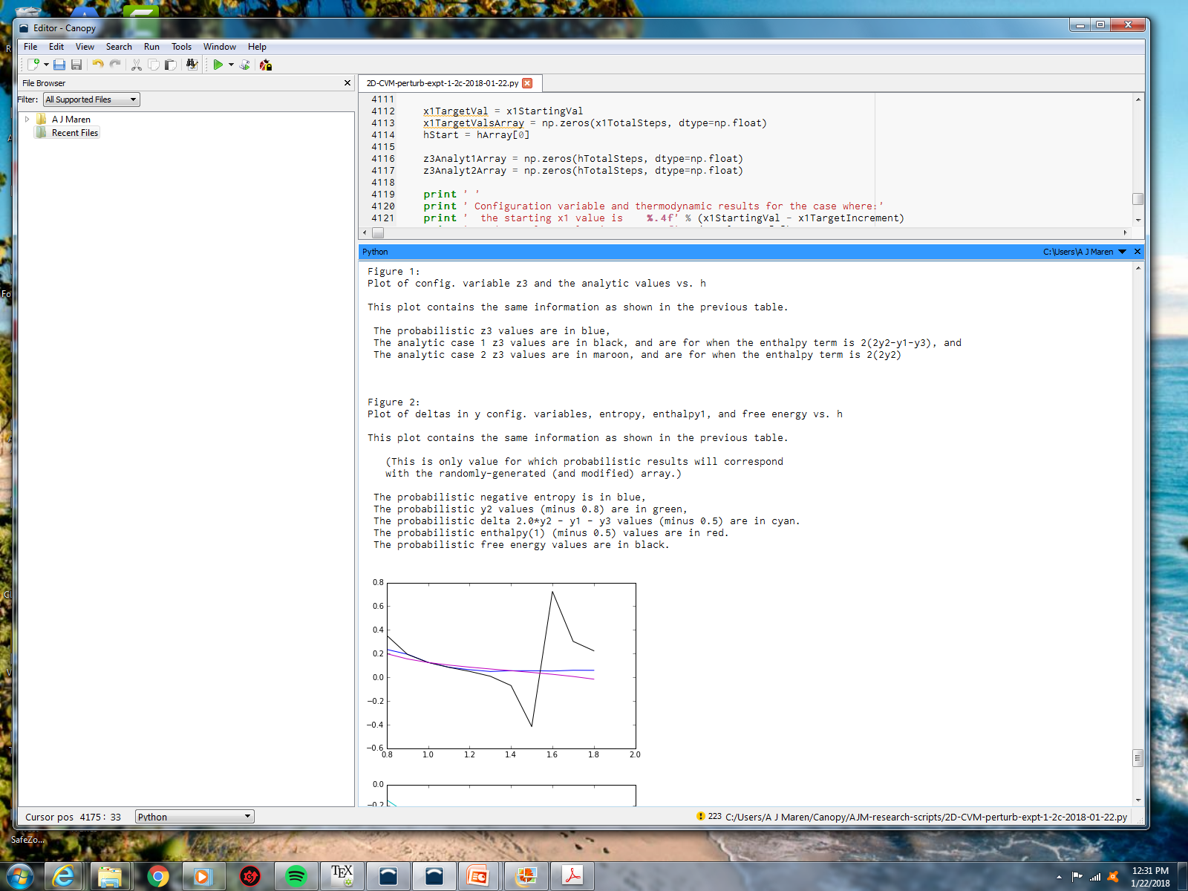
Configuration Variables and Analytic Results
x1= 0.50, h = 0.8 to 1.8

Slide 9
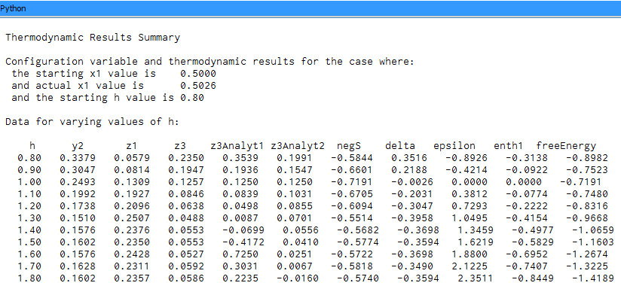
Configuration Variables and Analytic Results
x1= 0.50, h = 0.8 to 1.8

