Slide 1


2-D Cluster Variation Method:
Before and After Free Energy Minimization:
A Study in Topography Re-Shaping
with
Alianna J. Maren, Ph.D.
Results from Pattern 6: Large-Scale Scale-Free-Like (Adapted to Larger Clusters)
Experiments Conducted January, 2019
Slides Constructed March 19-21, 2019

Slide 2

Alianna J. Maren, Ph.D.
Developed foundational AI courses for Northwestern University’s SPS program – Master of Science in Data Science:
MSDS 458: AI & Deep Learning,
MSDS 453: Natural Language Processing
Four patents:
Biologically-based sensor fusion
Knowledge discovery
Predictive analytics
Evidence-based reasoning
Recent publications:
Brain Sciences
arXiv
Links to all at:
www.aliannajmaren.com

Slide 3
Where We Left Off (in the Previous Slidedeck)
GitHub: ajmaren/2D-Cluster-Variation-Method
2D-CVM_Expts-vary-eps0-and-eps1_2018-12-29.pptx
This Slidedeck: Experimental Results
Free Energy Minimization using the 2-D CVM Method
Applied to Pattern 6 – a large, scale-free-like pattern
Python Program:
2D-CVM_def-pttrns_var-Bayes_v1pt1_lg-grid_2019-01-19.py
As of March 21, 2019, this program is not yet publicly available.
It WON’T be available until the author has published at least an arXiv paper on this work.
When it IS available, the word and the link (to the GitHub repository) will be posted on:
www.aliannajmaren.com
You can sign up at this website to receive an email blast that will let you know when the program will be offered to all.

Slide 4
Parameter Specifications for This Work:
Epsilon0 = 0, meaning that the activation enthalpy for active nodes (A nodes) is zero, which means that
The number of “on” (A, or dark) nodes is the same as the number of “off” (B, or white) nodes.
The initial Pattern 6 was manually constructed, to approximate a “scale free-like” pattern.
As this work shows, Pattern 6 is NOT an equilibrium pattern.
Pattern 6 was subjected to free energy minimization, using the 2-D Cluster Variation Method (CVM).
The interaction enthalpy, epsilon1, was selected so that the corresponding h-value is given as:
h=1.165
If epsilon1 = 0, then the corresponding h-value would be h = 1.0.
This is still a relatively low h-value.
For More Background:
See the last two slides in this deck.
See the blogs: www.aliannajmaren.com

Slide 5


Pattern 6:
A Large (32x32) Scale Free-Like Pattern
(b)
(a)
Pattern 6 (a) is created by juxtaposing four sets of the original smaller-scale pattern shown in (b).
Both patterns are scale free-like, in that they have relatively few large clusters, and an (approximately) geometrically-scaled number of successively smaller clusters.

Slide 6
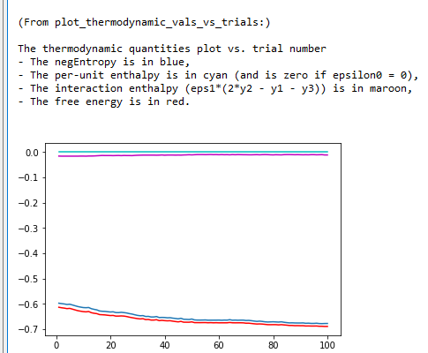
Program Results: Evolution of Free Energy Minimum
The free energy minimum is largely achieved after 40 – 60 time steps.
The experimental run was conducted over 100 time steps.

Slide 7
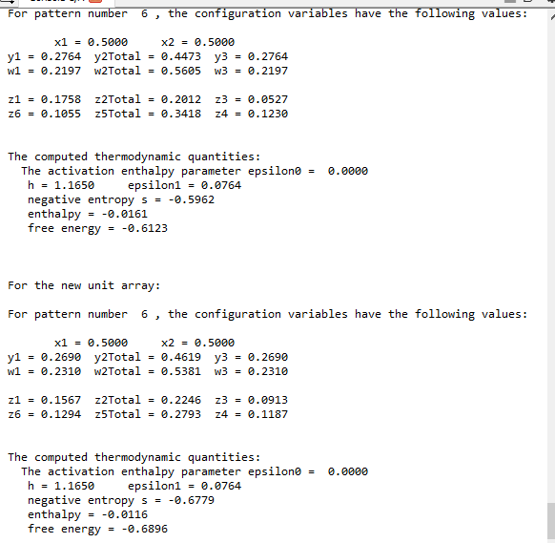
Configuration Variables and Thermodynamic Quantities
After Free Energy Minimum has been Achieved
h is set to 1.165 (see the equilibrium plot, next slide, for the original observed values for the configuration variables).

Slide 8
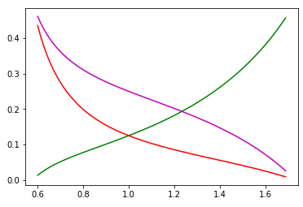


After Free Energy Minimization: Computational Results when h = 1.165
Pattern 6 – Large Scale-Free (4 Simple Repeats of Small-Scale Grid)
Computational Values for Configuration Variables y₂, z₁, and z₃
Case where activation enthalpy : x₁ = x₂ = 0.5
$${ ε}_{0}=0$$
B
A
A
y₂
Z₃:
Z₁:
y₂:
B
B
A
A
A
A
A
z₁
y₂
z₁
z₃
Configuration variable
h = 1.165 (for expts)
z₃
For h = 1.165:
y₂ = 0.231
z₁ = 0.157
z₃ = 0.091
h: interaction enthalpy parameter;
$${ h=exp(2ε}_{1})$$

Slide 9
Original Observed Values for the Configuration Variables in Pattern 6 (Psi)
(Large Scale-Free-Like System)
Just for fun, we set h= 1.165 for the free energy minimization process.
Configuration Variable | Original (Observed) | Anticipated (Approx.) | Actual (After Free Energy Minimization)
y₂ | 0.224 | 0.224 | 0.231
z₁ | 0.176 | 0.155 | 0.157
z₃ | 0.053 | 0.1 | 0.091
These results indicate that:
The resultant system is much closer to a free energy minimum (and observing the results of node-flipping, we won’t get much better with continued node-flips),
The z₃ value is still a bit low (0.091, where equilibrium would be closer to 0.1), however – we now have more A-B-A triplets, and
The original “islands of A’s” are a bit more broken up; more inclusions of B within the A-masses (as indicated by increase in A-B-A triplets); the overall topography has changed.

Slide 10
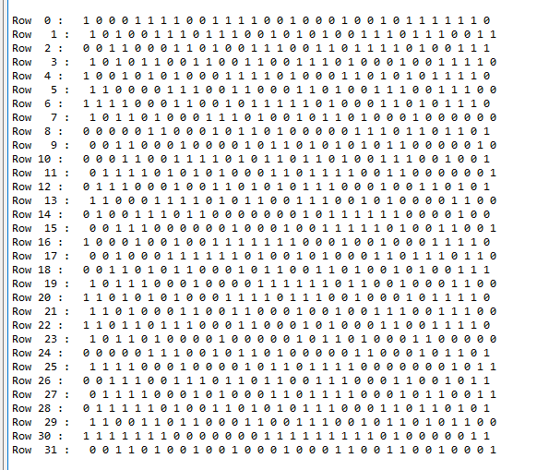
The New, Free Energy-Minimized Pattern 6
New – Evolution of Pattern 6
(Showing Flipped Nodes)
Illustrative Number of Nodes Flipped to Achieve Free Energy Minimum
(from Pattern #6)
Complete set of nodes that were flipped as the system was brought to free energy equilibrium; 127 out of 1024 nodes, or 12.5% of the total.
Row | Flips
0 | 4
1 | 3
2 | 2
3 | 5
4 | 5
5 | 2
6 | 5
7 | 3
8 | 2
9 | 6
10 | 6
11 | 4
12 | 0
13 | 4
14 | 5
15 | 4
Total | 60
Row | Flips
16 | 4
17 | 3
18 | 4
19 | 6
20 | 4
21 | 3
22 | 7
23 | 1
24 | 1
25 | 7
26 | 2
27 | 1
28 | 3
29 | 2
30 | 13
31 | 6
Total | 67

Slide 11
A Prettier Version of the Free Energy-Minimized Pattern 6
(b)
(a)
The (a) resultant free energy-minimized pattern
(starting from Pattern 6; (b) a quarter of the initial Pattern 6.
The h-value for the free energy minimization was set to h=1.165.

Slide 12
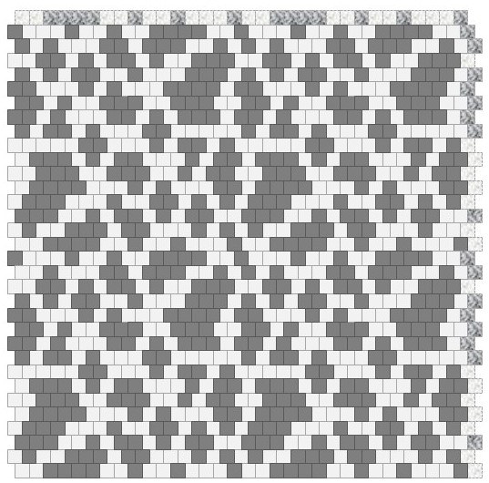
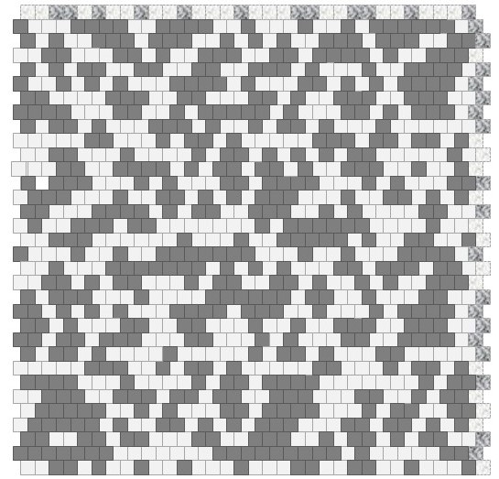
Side-by-Side: Pattern 6 – Before and After
Before and After Free Energy Minimization
Using the 2-D Cluster Variation Method
(a)
(b)
Pattern 6: (a) a large-scale (32x32, 1024 node) scale-free-like pattern; before free energy minimization, and (b) after free energy minimization, using the 2-D Cluster Variation Method (2D CVM)

Slide 13
Noteworthy Things about the Free Energy-Minimized Pattern: (1) Inland Lakes and Rivers
The larger landmasses acquire either “inland lakes” or “river headwaters,” where the “rivers” lead to the surrounding “seas” of “off” (B) units.

Slide 14
Noteworthy Things about the Free Energy-Minimized Pattern: (2) “Daddy Longlegs” Connectors
Through a combination of “hollowing out” the bigger land masses and extending out lengthy peninsulas, some previously-isolated islands and landmasses are now connected with “daddy longlegs”-thin connecting strands.

Slide 15
Noteworthy Things about the Free Energy-Minimized Pattern: (3) Choppier Coastlines
With h=1.165 (still a relatively low h-value), the free energy minimization also gave us a choppier coastline for the A islands and landmasses.

Slide 16
Interpreting the Results (1)
(Starting with a Large Scale-Free-Like System)
We had set h= 1.165 for the free energy minimization process.
Configuration Variable | Original (Observed) | Anticipated (Approx.) for h=1.165 | Actual (After FE Min.) | Compare with anticipated for h = 1.00
y₂ | 0.224 | 0.224 | 0.231 | 0.250
z₁ | 0.176 | 0.155 | 0.157 | 0.125
z₃ | 0.053 | 0.1 | 0.091 | 0.125
When we set h = 1.165 (where h = 1.0 indicates no nearest-neighbor interaction), we preferentially increase like-near-like neighbors, and decrease like-near-unlike. (E.g., more A-A combinations, fewer A-B.)
Nearest-neighbor unlike pairs (y₂) are fewer than would be expected if the interaction enthalpy was set to 0 (h = 1.1.65 instead of h = 1.0, which is when the interaction enthalpy epsilon1 = 0). (The y₂ also did not reach the anticipated value for h=1.165; this is likely due to the “random-pick” strategy for node flipping to achieve free energy minimization.
A-A-A triplets are close to what is expected, and larger than what we’d have if h = 1.0.
A-B-A triplets are markedly increased, versus the original pattern, and are closer to (but not quite the same as) what would be analytically expected.

Slide 17
Interpreting the Results (2)
(Starting with a Large Scale-Free-Like System)
We had set h= 1.165 for the free energy minimization process.
Configuration Variable | Original (Observed) | Anticipated (Approx.) for h=1.165 | Actual (After FE Min.) | Compare with anticipated for h = 1.00
z₃ | 0.053 | 0.1 | 0.091 | 0.125
z₃ is the measure of A-B-A triplets.
The original (manually-constructed) Pattern 6 had a very low value for z₃.
This showed up as relatively smooth boundaries on the islands and land masses.
It also indicates that (especially if there were fewer nodes in A, as compared to B) the islands and landmasses would be well-separated.
There would be few, if any, situations where there would be a river or narrow “strait” of B separating masses of A.
The original Pattern 6 was very much NOT at equilibrium, because the original (observed) value for z₃ was so low. (Abnormally low, considering the values for y₂ and z₁.)

Slide 18
Interpreting the Results (3)
(Starting with a Large Scale-Free-Like System)
We had set h= 1.165 for the free energy minimization process.
Configuration Variable | Original (Observed) | Anticipated (Approx.) for h=1.165 | Actual (After FE Min.) | Compare with anticipated for h = 1.00
z₃ | 0.053 | 0.1 | 0.091 | 0.125
z₃ is the measure of A-B-A triplets.
During free energy minimization, our value for z₃ got much closer to the equilibrium-expected value (when h = 1.165).
A bigger z₃ meant more A-B-A triplets, and that meant:
Inserting little pockets of B into islands and land masses of A.
Creating little peninsulas of A that tracked along the coast of islands and landmasses (A separated from A by a single node of B.)

Slide 19
Some examples of the newly-increased z₃ (A-B-A) triplets
We increased z₃ by: (1) creating “islands” and “rivers” of B within A, (2) creating peninsular “connection” bridges – especially if they tracked alongside an A landmass, and (3) making the coastlines more irregular –little incursions of B into an otherwise smooth A coastline.

Slide 20
A Short Summary
Note that this summary is particular to the case where:
The h-value (h = 1.165) is still relatively small; we’re increasing the likelihood of like-near-like pairs (A-A), but not pushing it too hard, and
The initial configuration was very much NOT at equilibrium; it would NOT BE an equilibrium pattern for ANY h-value. (It was manually-designed, not generated according to rules specifying random unit values according to any set of heuristics.)
Given those little caveats, we have:
A system where topography matters.
This means that we have:
A system where only two parameters drive the resulting topography; epsilon0 and epsilon1 (which creates our h-value) drive all sorts of useful topographic features, and in this case epsilon0 was set to zero (meaning equal numbers of A and B nodes); so we weren’t even touching what happens when the numbers A and B differ),
Each time we run the free energy minimization process, we’d have different specific nodes be either A or B – but the resulting patterns would be characteristically the same.

Slide 21
One Final Word
Given any system, with any distribution of configuration variables, we can:
Work backwards to identify the h-values – that is, find the most-likely interaction enthalpy between nodes.
We can also:
Determine if the system is at equilibrium or not, and identify roughly how far away it is from equilibrium,
By changing our (interpreted) h-value, cause the system to take on a different topology, reflecting a different value for nearest-neighbor interactions.
Through free energy minimization, using the 2-D Cluster Variation Method, we can shape and reshape a system’s topology.
And, we can characterize the topology by using one, or at most two, parameters. (The h-value, or epsilon1, and also epsilon0.)

Slide 22
And a FINAL Final Word
The usefulness / relevance of this to artificial intelligence is still unknown.
However, all previous AI / NN / Deep Learning methods have been topology-free. (Except for convolutional NNs, which are not a part of this discussion.)
We’re now looking at a brand-new thing.
We can consider:
Potential impact of introducing a new process into the hidden layer of a NN, which would conduct FE minimization within the hidden layer,
Investigating impact of changing h-values (and possibly also epsilon0) into the activations of hidden layer nodes, and
Many other complex and subtle processes.
Potentially:
Free energy minimization within the hidden layer provides a means for a new representation (“r”) of external system ( “Psi”*) activities and behaviors.
*See anything by Karl Friston for the “Psi” notation.
And no, it doesn’t mean ESP.

Slide 23
Code Sources and Documentation
Programs Used:
Various

Slide 24
For More Information:
GitHub Public Repository:
https://github.com/ajmaren/2D-Cluster-Variation-Method (slidedecks, no code)
Prior slidedeck: 2D-CVM_Expts-vary-eps0-and-eps1_2018-12-29.pptx
Divergence in analytic results: 2D-CVM_Expts-vary-eps0-and-eps1_2018-12-27
Code for some of this work is still on a private repository
Website:
www.aliannajmaren.com
Code Availability:
Code will be made available on the public GitHub repository after initial development, documentation, V&V, and experiments are completed.
Look on arXiv for various papers documenting theoretical and experimental results. See the “Patents and Publications” page on www.aliannajmaren.com for full access to the latest papers. See the “Blog” page for discussions on theory, code, and experimental results.
Contact Information:
Alianna J. Maren, Ph.D.:
alianna@aliannajmaren.com
alianna.maren@northwestern.edu

