Slide 1
Concrete Strength Prediction using Linear Regression
TEAM & ROLES
Ajmeera Sharath
2026MCB1507 · Documentation Lead
Kabir Jhamb
2026AIB1045 · Execution Lead
Amit Patel
AI101 Mini-Project | Team No. XX
2026EEB1319 · PPT Lead
School of AI & Data Engineering, IIT Ropar
Bhargav Sugat Shende
2026EEB1335 · Video Lead
Repo: github.com/ajmeerasharath/concrete_strength_prediction_linear_regression_
Notes:
Introduce the team and roles. Mention that all four members wrote code and committed from their own GitHub accounts.

Slide 2
Predicting concrete strength from the mix
What: predict compressive strength (MPa) from 8 inputs: cement, slag, fly ash, water, superplasticizer, coarse and fine aggregate, and age.
Why: lab strength tests take weeks of curing and cost material. A model gives a quick estimate before casting.
1,030
9
0
rows
columns
missing
Source: Kaggle, Concrete Compressive Strength dataset (UCI). 8 features + 1 target; 25 duplicate rows noted.
Notes:
Cement has the strongest positive link with strength (r = 0.50). Water is negative (r = -0.29): more water, weaker concrete. Dataset: 1,030 rows, 8 inputs, 1 target, no missing values.

Slide 3
Approach: a four-module pipeline
1
2
3
4
5
Data
Analysis
Preprocess
Training
Evaluation
concrete_data.csv
analysis.py
preprocessing.py
training.py
evaluation.py
1,030 × 9
Stats, correlation, heatmap
Median imputer, 80/20 split
LinearRegression fit on 824 rows
R², MAE, RMSE, residuals
Model: Multiple Linear Regression
Libraries
Strength = b0 + b1·x1 + … + b8·x8, fitted by ordinary least squares (scikit-learn). Random split: 824 train / 206 test, seed 42.
pandas · NumPy · scikit-learn · Matplotlib · seaborn (Python)
Notes:
Walk through the pipeline left to right. The orange box is the training stage: LinearRegression().fit on 824 training rows, then predictions on both train and test sets, which evaluation.py scores.

Slide 4
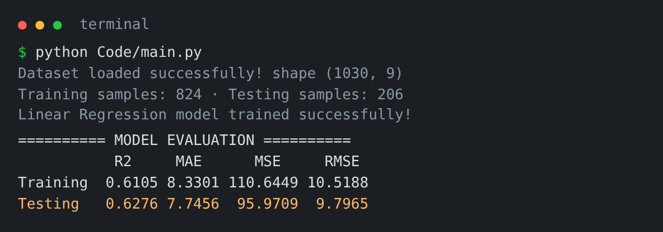
Results: test R² of 0.63, typical error about 7.7 MPa
0.63
7.75
9.80
test R²
MAE (MPa)
RMSE (MPa)
Train R² 0.61 vs test R² 0.63: no sign of overfitting. Predictions rise with actual strength but scatter widely, especially above 60 MPa.
Notes:
Key numbers on unseen data: R2 0.6276, MAE 7.75 MPa, RMSE 9.80 MPa. Training R2 is 0.6105, so the model is not overfitting. Points near the diagonal are accurate predictions; the spread shows a straight line cannot capture everything.

Slide 5
Learnings: what worked, what didn't, who did what
What worked
What didn't
Who did what
Modular pipeline: one module per member, runs end to end from main.py
Train and test R² are close, so it generalises
Coefficients match chemistry: more cement raises strength, more water lowers it
R² 0.63 leaves 37% of variation unexplained
Strength vs age is curved; a straight line misses it
Next: log(age), polynomial terms or Random Forest
Sharath: README and structure
Kabir: setup and fresh-clone test
Amit: training module and slides
Bhargav: demo video
All four wrote and committed code
AI-use disclosure ChatGPT: planning, README, debugging help. Claude: drafted training.py and these slides. We ran and reviewed all code; no AI generated the dataset or results.
Notes:
Be honest about the limits: R2 0.63 means linear regression is a baseline. Each member should be able to explain any part of the code. Read the AI-use disclosure.

