Slide 1
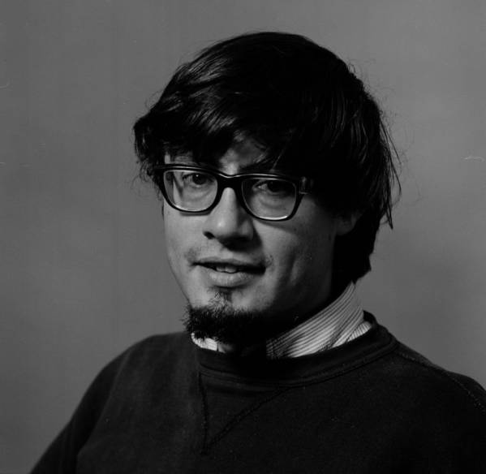
Professor Myrl Chalmers Hendershott
A Symposium in His Honor
By his Ph.D. Students

Slide 2
Hendershott Ph.D. Students
David W. Behringer, 1972
Greg Holloway, 1976
Richard L. Salmon, 1976
Gerard G. Stock, 1976
Julian P. McCreary, Jr., 1977
Michael E. Parke, 1978
Paola M. Rizzoli, 1978
Michael J. McPhaden, 1980
Bruce A. Wielicki, 1980
David C. Chapman, 1981
Kathryn A. Kelly, 1983
Michael L. van Woert, 1984
Vittorio G. Barale, 1986
Arthur J. Miller, 1986
Timothy J. Boyd, 1989
Cynthia A. Paden, 1990
Guillermo Auad, 1994
James A. Lerczak, 2000

Slide 3
Hendershott Ph.D. Students
David W. Behringer, 1972
Greg Holloway, 1976
Richard L. Salmon, 1976
Gerard G. Stock, 1976
Julian P. McCreary, Jr., 1977
Michael E. Parke, 1978
Paola M. Rizzoli, 1978
Michael J. McPhaden, 1980
Bruce A. Wielicki, 1980
David C. Chapman, 1981
Kathryn A. Kelly, 1983
Michael L. van Woert, 1984
Vittorio G. Barale, 1986
Arthur J. Miller, 1986
Timothy J. Boyd, 1989
Cynthia A. Paden, 1990
Guillermo Auad, 1994
James A. Lerczak, 2000

