Slide 1
From sardines, Salmon, and bottom-trapped waves, to soccer, girlfriends and global warming: The Hendershott viscosity.
Guillermo Auad
CRD - SIO
Bonus feature: Matlab counter-attacks
(Rated R).

Slide 2
The Hendershott Viscosity:
(a sticky effect… positive defined)

Slide 3


1989: I meet Myrl in Ensenada – discussed mean flow stability (wrt my MsSc. Thesis)
1990: I visit Myrl in his office – he encourages me to apply to the Scripps PhD program
1990: I start at Scripps…. My advisor? ==> Rick Salmon!
1991: Myrl becomes my advisor after my 1st year at Scripps.
1992-1995: work on observational coastal oceanography: S. Barbara Channel Project
1995: On Nov 3rd 1995 I defend my thesis – we stayed at T-29 drinking until 2am!
1996: Brother Art becomes my post-doc advisor.
1998: I become the soccer advisor (coach) of Art's son, Matteo
1998: Art's son and my son (Matteo & Pedro) become soccer teammates.
1999: .......still publishing with Myrl (and Art)
2000: still exchanging jokes by email with Myrl ☺ ☺ ☺ →
2003: for 3 years I dated the daughter of one of Art's best friends :)
2005: Matteo and Pedro snowboard together too!
and.....................
2006: Yesterday I had dinner with Myrl and I met most of my siblings.

Slide 4
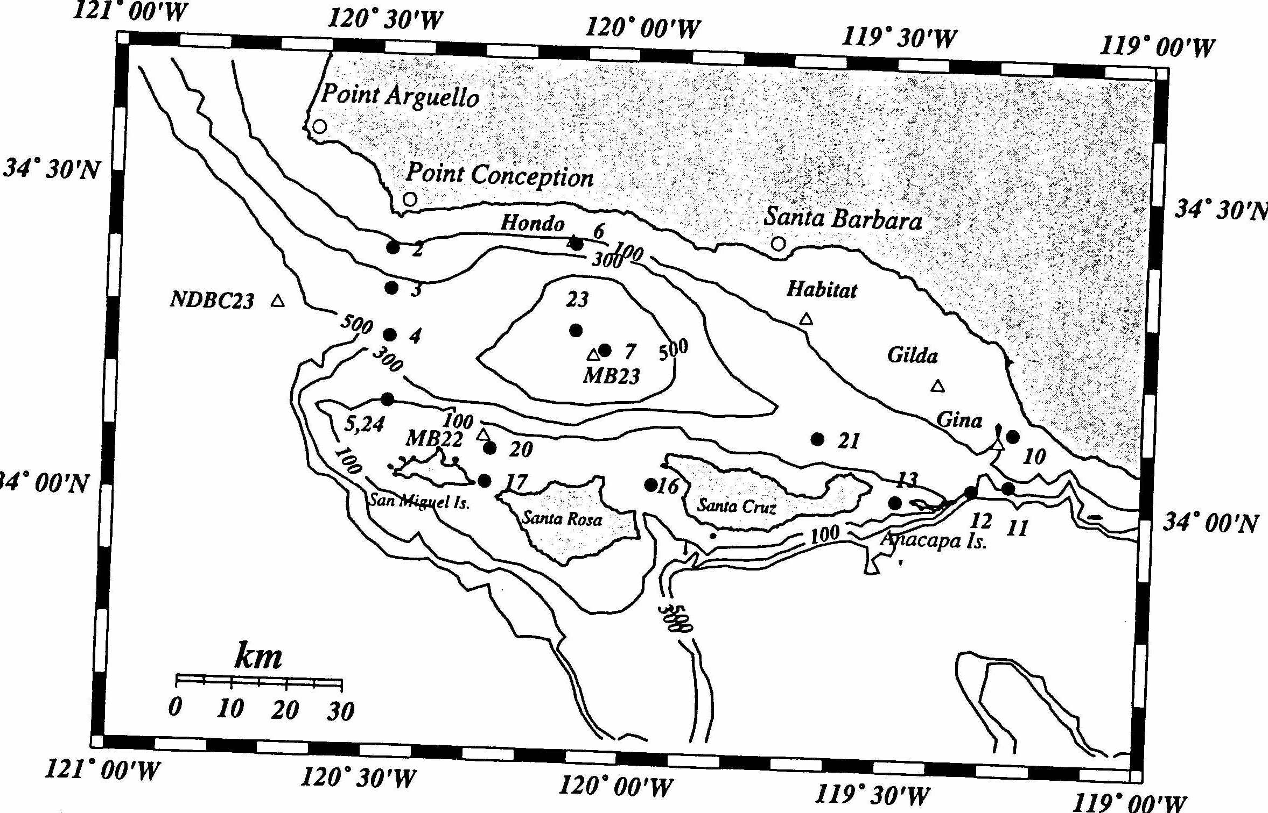
Santa Barbara Channel geometry and instrument location
The SBC paradox! Nearby instruments at same depth: poorly correlated – far away instruments at different depths: well correlated

Slide 5
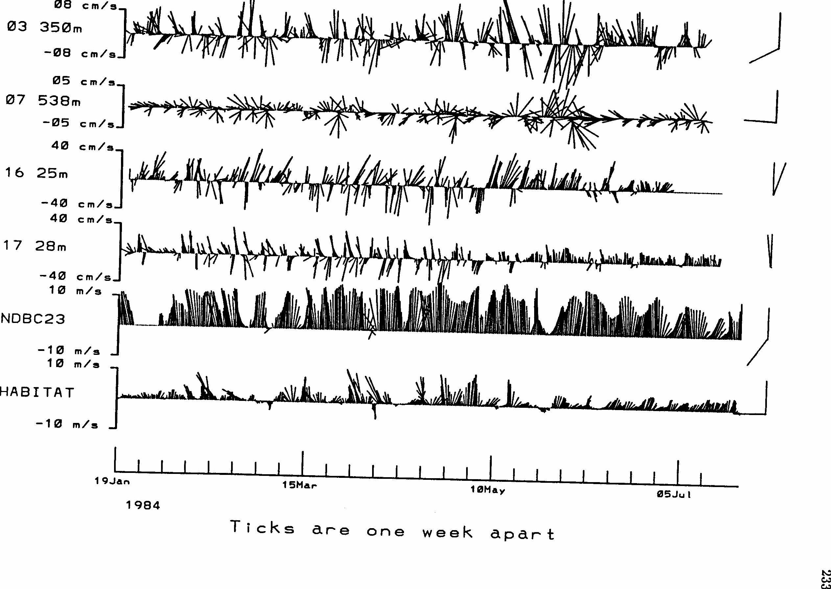
Bottom-trapped Rossby waves: at western entrance on northern slope

Slide 6
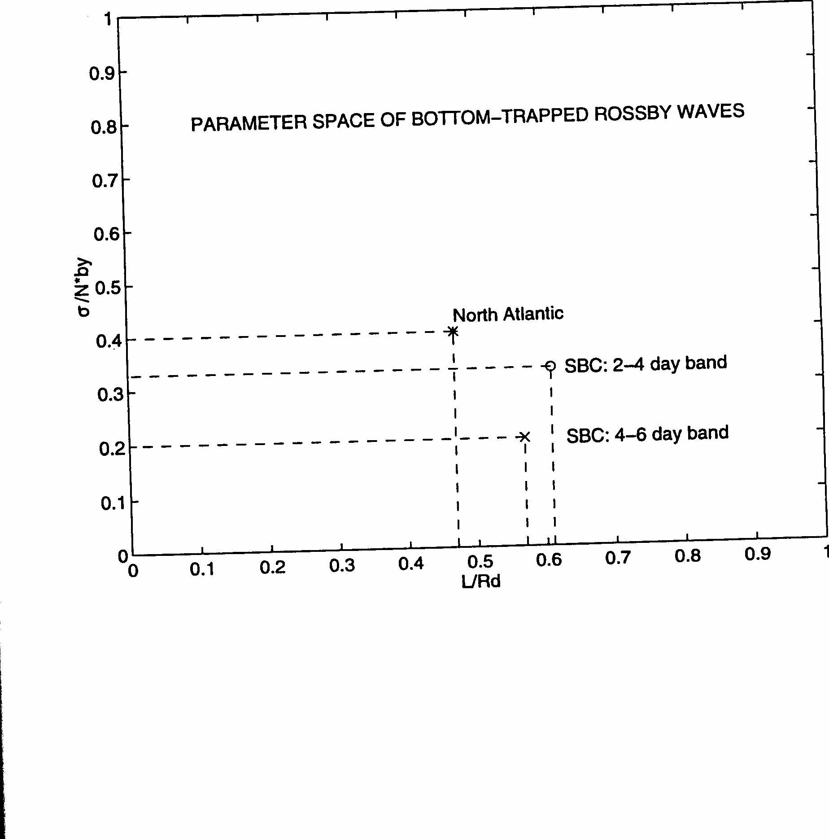
SBC's Bottom Trapped Waves vs. North Atlantic's Bottom Trapped Waves:
(just neighbors in their parametric space!)

Slide 7
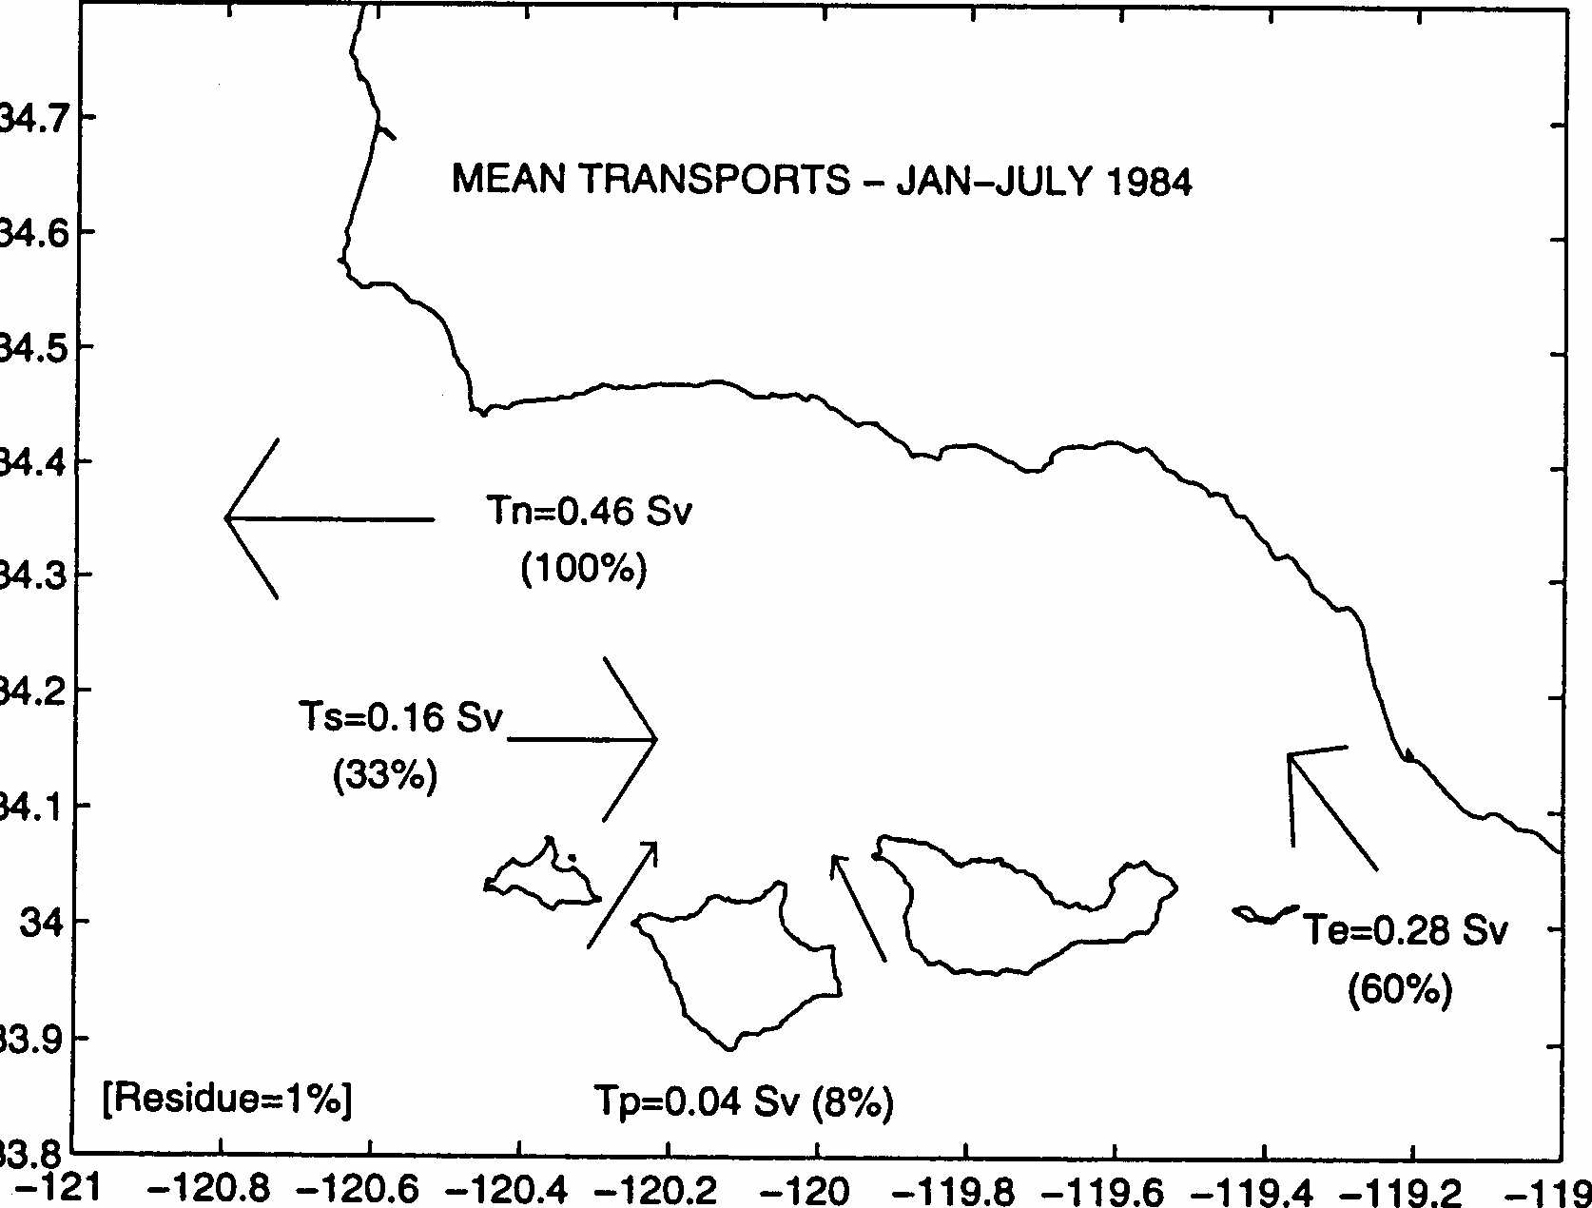
Estimated mass and heat transports from moored instruments with new statistical approach:

Slide 8
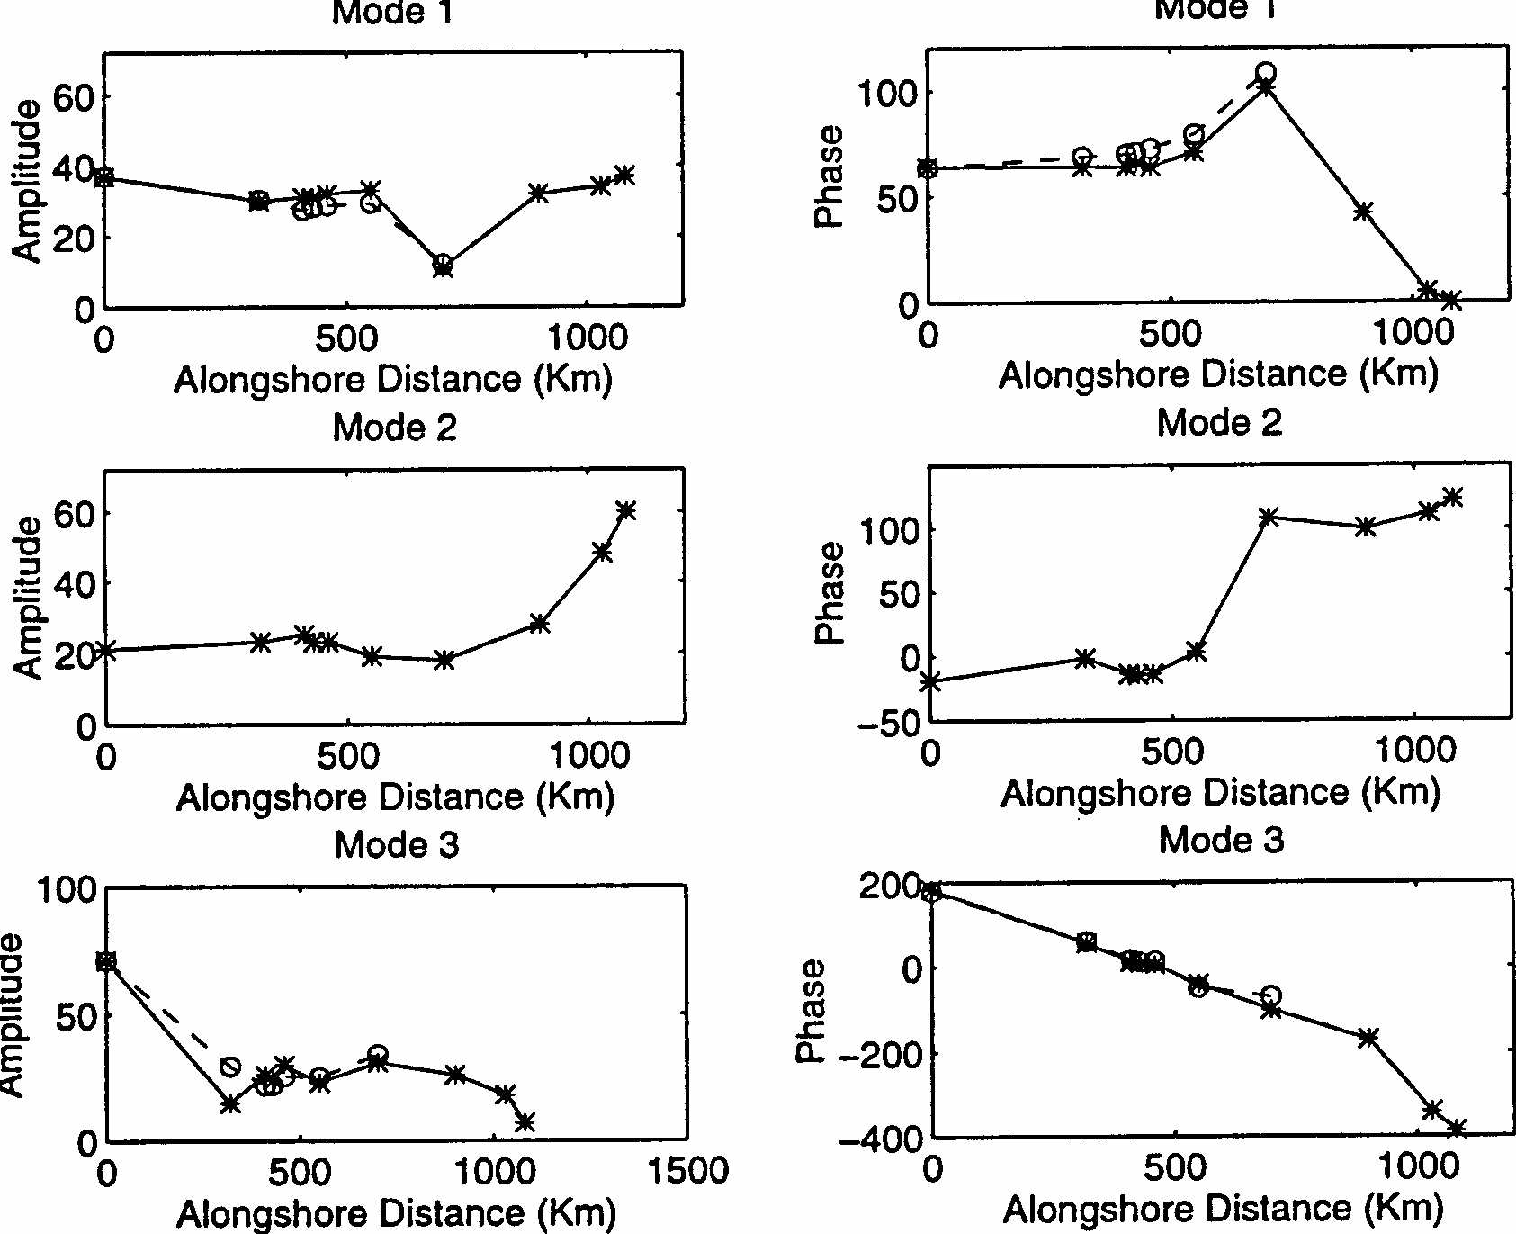
Adjusted Sea Level Analysis: 8-18day band
Large scale mode
upw
mode
CTWs

Slide 9

Since then, I went from observational coastal oceanography to the numerical modelling of large scale circulation and climate change, e.g.,:
global warming's impact on sardine recruitment and productivity off California
climate change in the Gulf of Alaska.
response of water masses in the North Pacific and Antarctica to climate change.
sources of global warming during El Niño............
and Myrl's always-positive influence has been there all along...
THANK YOU MYRL !!

Slide 10
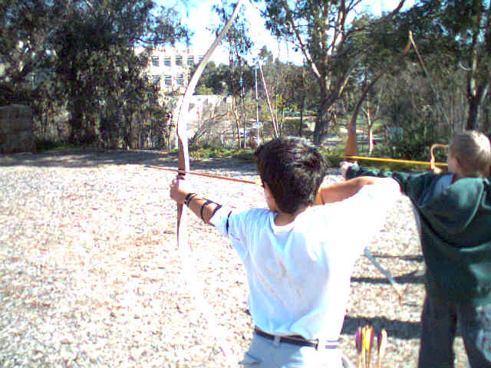
Matteo,
Art’s son
Pedro,
Guiyo’s son
Early 2004

Slide 11

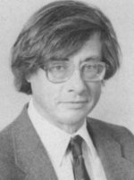
Steadyyy…
Don’t move
Grandpa!!
Matteo,
Art’s son
Pedro,
Guiyo’s son
Early 2004

Slide 12

BONUS FEATURE
MATLAB HITS ON MYRL
Disclaimer

Slide 13
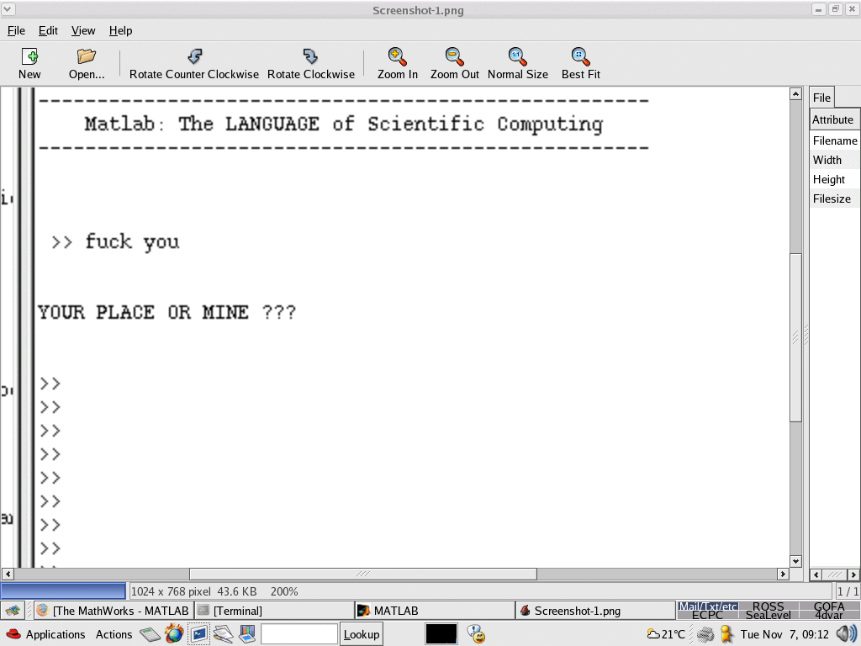
Myrl typed
Matlab replied (version 1.0 probably)

Slide 14
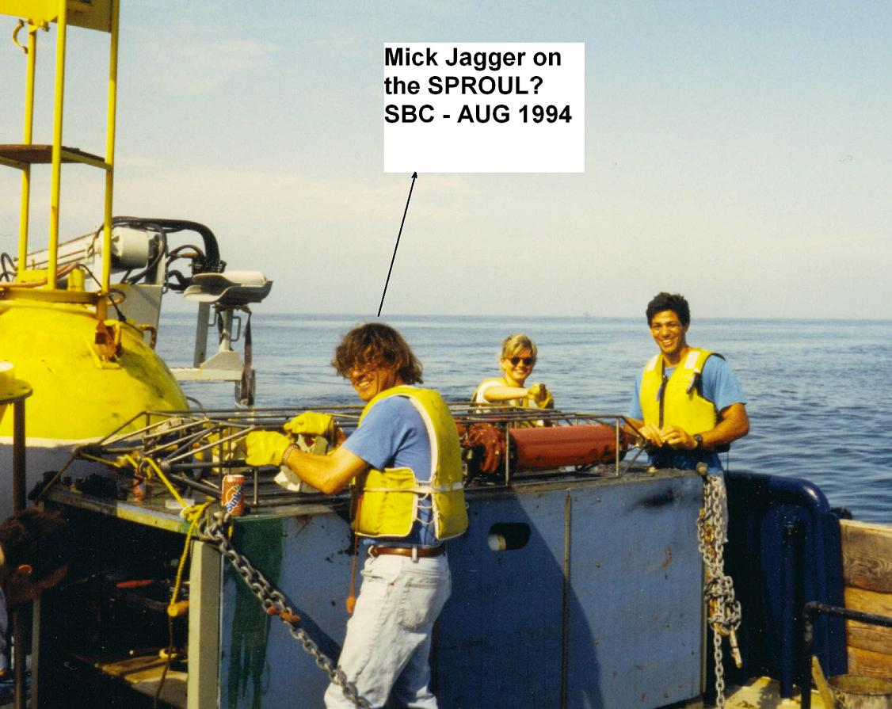

Slide 15
