Slide 1
Factory Design Pattern
Kelsey Smith, Kevin Gilbert, Andrew Miller, Hans Vomend

Slide 2
Intent
Defines an interface for creating an object. However, subclasses make the decision which class to instantiate.
Define a “virtual” deconstructor.
The new operator is considered not beneficial.

Slide 3
Problem
A framework has to standardized the architectural model for a variety of applications
It still has to allow for individual applications to define their own objects and provide for their instantiation.

Slide 4
Discussion - General
Factory method is to creating objects as Template Method is to implementing an algorithm – template method allow subclasses redefine certain steps of an algorithm without changing the algorithms structures.
A superclass declares all standard and generic behavior by using pure virtual placeholders for the creation steps. Then, it delegates the creation details to subclasses that are provided by the client.

Slide 5
Discussion - Customizable
In Factory Method, design is more customizable and slightly more complicated than other design patters.
In other design patterns, a new design requires a new classes, whereas in Factory Method only a new operation is required.

Slide 6
Discussion – Standard Method
Factory Method is the standard way to create objects.
Not if the class that is instantiated never changes
Not if instantiation takes place in an operation that subclasses can easily override – such as an initialization operation.

Slide 7
Discussion – Abstract Method
Abstract Method provide an interface for creating families or dependent objects without specifying their concrete classes.
Factory Method is similar to Abstract Method but without the emphasis on families.
Thus, implementation of Factory Method overlaps with Abstract Method.

Slide 8
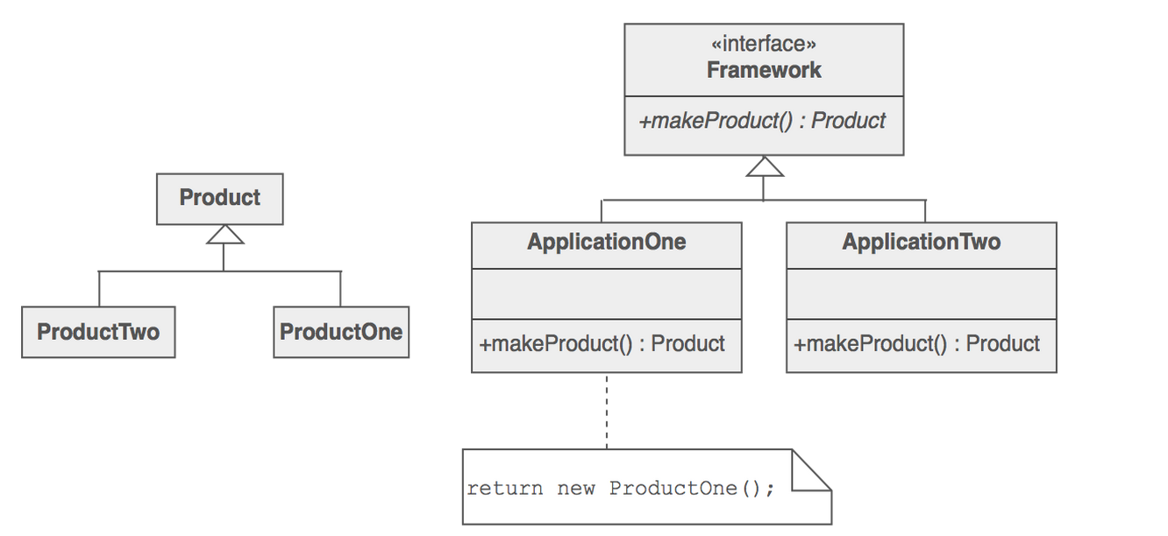
Implementation

Slide 9
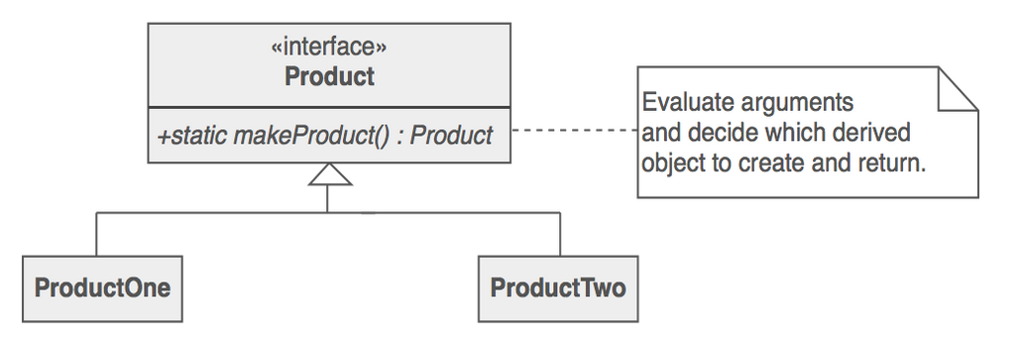
Implementation–Static Method
A static method of a class that returns an object of that class’ type is becoming increasingly popular.
Unlike a constructor:
Actual object returned may be an instance of a subclass
Existing object may be reused instead of new objects created
Factory methods can have different and more descriptive names

Slide 10
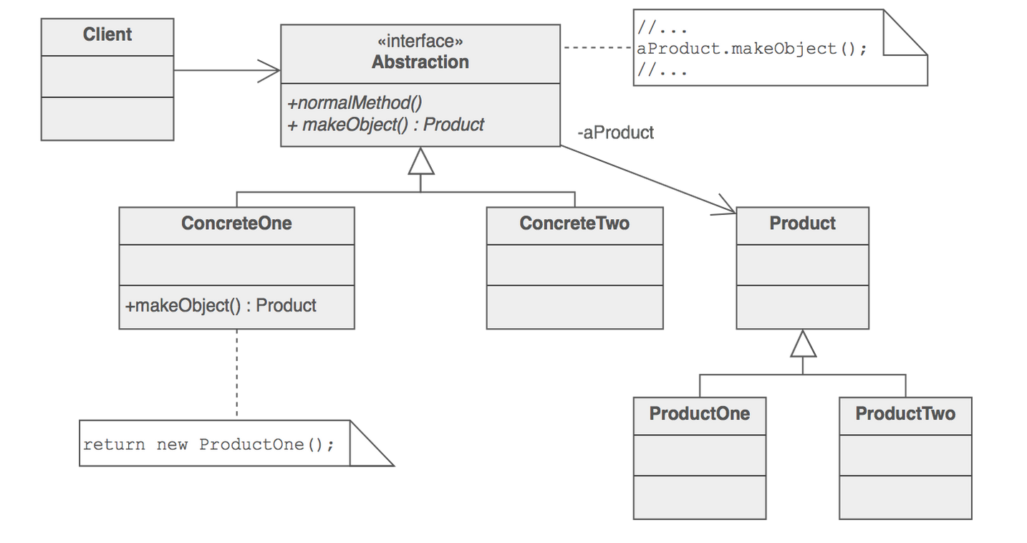
Implementation - Polymorphism
Client is separated completely from the implementation description of the derived classes. Thus, polymorphic creation is now an option.

Slide 11
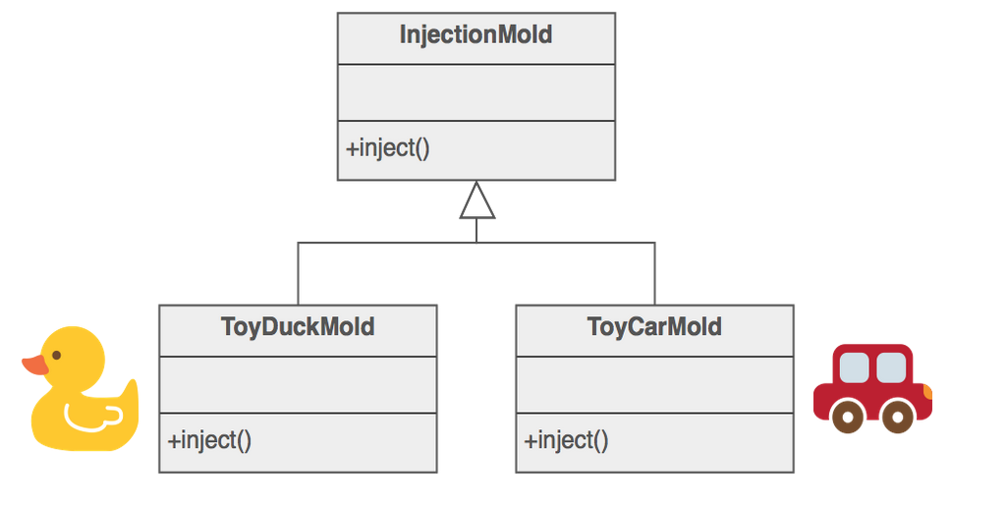
Example
The Factory Method defines an interface for creating objects, but grants the subclasses the ability to choose which class to instantiate from.
Injection molding portraits this pattern :

Slide 12
Check List
If an inheritance hierarchy that exercises polymorphism is included, one should consider to define a static factory method in the base class – to grant polymorphic creation.
All constructors should be private or protected
Designing the arguments of the factory method one should decided which arguments are sufficient to choose the correct derived class to instantiate
An “object pool” should be designed to allow objects to be reused instead of creating them

Slide 13
Rule of Thumb
Abstract Factory are implemented using Factory Methods but can also implemented using Prototypes
Factory method creates through inheritance whereas Prototyping creates through delegation
Factory Methods are usually called in Template Methods
Commonly, designs begin with Factory Method and evolve to Abstract Factory, Prototype, or Builder when designers realize more flexibility is required
Some Factory Method advocates state that all constructors should be protected or private to encapsulate whether an object is created or reused
The new keyword is considered harmful since the new keyword always creates an object and fails to encapsulate object creation

Slide 14
References
http://sourcemaking.com/design_patterns/factory_method
http://sourcemaking.com/design_patterns/abstract_factory
http://sourcemaking.com/design_patterns/template_method

