Slide 1
Genetic Algorithms
CIS-487 Directed Research in CIS
Department of Computer Sciences, Mathematics, and Engineering​
Shepherd University​
P.O. Box 3210​
Shepherdstown, WV 25443
Andrew Miller, Kelsey Smith, Hans Vomend

Slide 2
What is Genetic Algorithm
Subfield of AI and Evolutionary Algorithms
Mimics the process natural selection to provide solutions to optimization problems
Techniques inspired by natural evolution, such as inheritance, mutation, selection, and crossover.

Slide 3
The Process
Beginning population is randomly generated individuals
The process is iterative where each iteration is a generation
The fitness of every individual in the population is tested
The more fit individuals are selected and mutated or modified and used in the next generation
The algorithm quits if a sufficient fitness is found or enough generations have passed

Slide 4
Requirements of GA
A genetic model of the solution domain
A fitness method/function to evaluate the solution domain

Slide 5
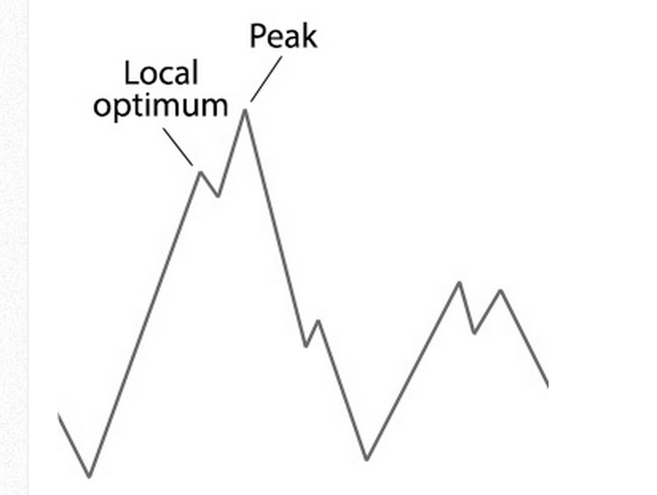
Limitations of GA
Local optimum – Blindfold example
Can escape if shallow enough
Unreasonable to find a global optimum
Most often a close approximate of the optimal solution should be expected

Slide 6
Binary Genetic algorithm
Population – Manages all individuals of a population
Individual – Manages an individual
Algorithm – Manages our evolution algorithms such as crossover and mutation
FitnessCalc – Allows us set a candidate solution and calculate and individual’s fitness

Slide 7
Initialization
Create an the first generation population.
Usually, this population is generated randomly.
Most of the time it can be any desired size, from only a few individuals to thousands.

Slide 8
Evaluation
Each member of the population is evaluated
A 'fitness' for that individual is evaluated
The fitness value is calculated by how well it fits with our desired requirements.
These requirements could be simple, 'faster algorithms are better', or more complex, 'stronger materials are better but they shouldn't be too heavy'.

Slide 9
Selection
The idea is to constantly improve the fitness of the individual
In the selection process, bad designs are removed and only the best individuals are kept in the population.
There are various selection methods; The idea is that the better individuals are selected for the next generation.

Slide 10
Crossover
In the process of crossover, we design new individuals by combining aspects of our selected individuals.
We can think of this as imitating the process of sex in nature. The hope is that by combining certain traits from two or more individuals we will create an even 'fitter' offspring which will inherit the best traits from each of it's parents.

Slide 11
Mutation
Randomness has to be added into our populations' genetics otherwise every combination of solutions we can create would be in our initial population.
Mutation typically works by making very small changes at random to an individuals genome.

Slide 12
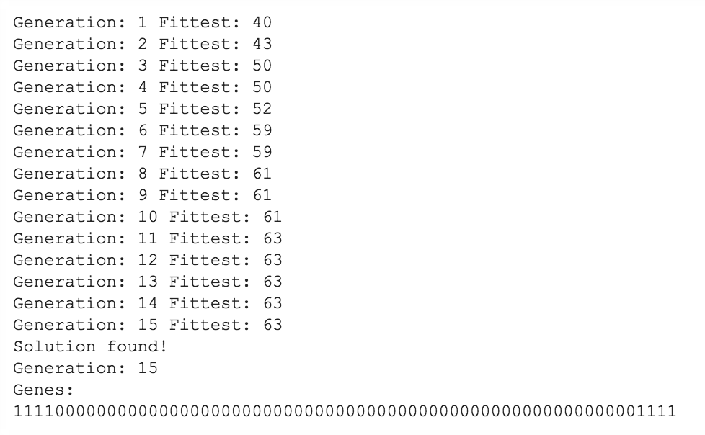
Repeat!
Now we have our next generation the idea is to we tart again from step two until we reach a desired fitness or solution close enough.

Slide 13
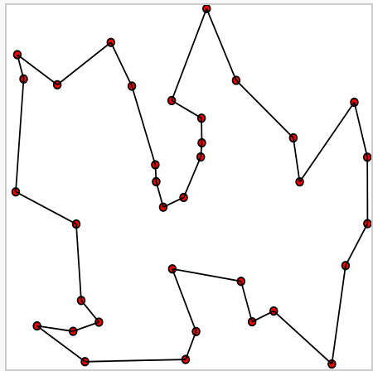
Traveling Sales man problem
Given a list of cities and the distances between each pair of cities, what is the shortest possible route that visits each city exactly once and returns to the original city?

Slide 14
Info on tsp
First formulated in 1930
One of the most studied problems in optimization
Used as a benchmark for many optimization methods
Belongs to the class of NP-complete problems
Possible that the worst-case running time for any algorithm increases exponentially with the number of cities

Slide 15
Planning of tsp ga
City – Encodes the tour city
TourManager – Holds all of our destination cities for our tour
Tour – Encodes the tour
Population – Holds a population of candidate tours
GA – Evolve our population of solutions

Slide 16
Refrence
http://www.theprojectspot.com/tutorial-post/creating-a-genetic-algorithm-for-beginners/3
http://en.wikipedia.org/wiki/Genetic_algorithm
http://en.wikipedia.org/wiki/Travelling_salesman_problem

