Slide 1
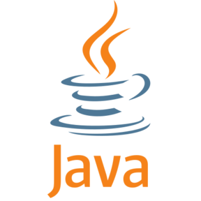
Java

Slide 2
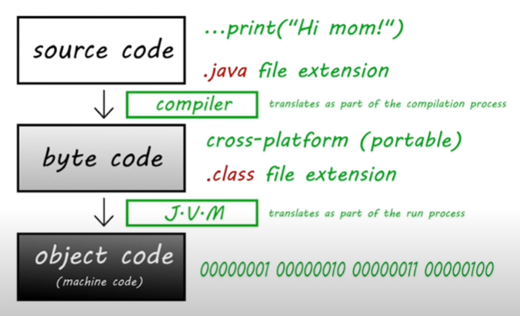
Why java
Top 3 most popular language
Extremely flexible (businesses, web apps, android apps, games)
Easy to find job as a developer

Slide 3
JDK- Java Development Kit (developer tools)
→ JRE- Java Runtime Environment (libraries & toolkits)
→ JVM - Java Virtual Machine (runs java program)
IDE - Integrated Development Environment (software that helps us to write software )
Eg: Eclipse, IntelliJ IDEA
Install jdk
https://www.oracle.com/java/technologies/downloads/#jdk18-windows

Slide 4
Variable: placeholder for a value that behaves as the value it contains
data type size primitive/reference value
boolean 1 bit primitive true or false
byte 1 byte primitive -128 to 127
short 2 bytes primitive -32,768 to 32,767
int 4 bytes primitive -2 billion to 2 billion
long 8 bytes primitive -9 quintillion to 9 quintillion
float 4 bytes primitive fractional number up to 6-7 digits
ex. 3.141592f
double 8 bytes primitive fractional number up to 15 digits
ex. 3.141592653589793
char 2 bytes primitive single character/letter/ASCII value
ex. 'f'
String varies reference a sequence of character
ex. "Hello world!”
primitive data type vs reference data type
• 8 types (boolean, byte,etc.) • unlimited (user defined)
• stores data • stores an address
• can only hold 1 value • could hold more than 1 value
• less memory • more memory
• fast • slower

