Slide 1
IDEAS-TIH · ISI Kolkata
FASAL 2.0 Initiative
Intent Classifier
for the NPCYF AI CoPilot
Muhammed Ajmal M C
M.Sc. Data Science | Aligarh Muslim University
Guide: Kunal Gupta | IDEAS-TIH, ISI Kolkata
Internship Period: 21 Jan 2026 – 31 Mar 2026
National Platform for Crop Yield Forecasting · DA&FW, Govt. of India

Slide 2
The Organisation
DA&FW
IDEAS-TIH · ISI Kolkata
Dept. of Agriculture & Farmers' Welfare
IDEAS — Institute of Data Engineering, Analytics and Science Foundation — is the Technology Innovation Hub (TIH) at the Indian Statistical Institute (ISI), Kolkata.
Established under the National Mission on Interdisciplinary Cyber-Physical Systems by the Department of Science & Technology (DST), IDEAS-TIH combines ISI's deep statistical expertise with cutting-edge AI and data science capabilities.
NPCYF was built here for the Department of Agriculture and Farmers' Welfare under the FASAL 2.0 initiative.
Nodal ministry commissioning NPCYF for national crop forecasting
DST / NMICPS
National Mission on Cyber-Physical Systems
Funds and governs the TIH programme under which IDEAS-TIH operates
ISI Kolkata
Indian Statistical Institute
Host institution — one of India's premier research institutes for statistics and data science
Muhammed Ajmal M C · AMU · Spring Internship 2026

Slide 3
NPCYF — The Platform
1
Data Ingestion
What is NPCYF?
The National Platform for Crop Yield Forecasting (NPCYF) is an AI-powered web platform for forecasting crop yields across India.
It handles the entire pipeline from raw data ingestion to final yield predictions, serving policy makers, researchers, and agricultural planners.
Built under FASAL 2.0 by IDEAS-TIH at ISI Kolkata.
2
Feature Engineering
3
Model Building
4
Forecasting
5
Admin Management
6
AI CoPilot ★
Muhammed Ajmal M C · AMU · Spring Internship 2026

Slide 4
My Work — The Problem I Solved
The NPCYF AI CoPilot receives user questions in plain English. It needs to know what kind of question it is before it can respond correctly — that's the intent classification problem.
general_query
database_query
platform_query
Example queries:
Example queries:
Example queries:
"What is machine learning?"
"List all crops in the database"
"How do I reset my password?"
"Who invented the telephone?"
"How many rows in yield table?"
"What is the Quick Glance section?"
"What is crop yield?"
"Show crop_id = 5"
"What is a training feature set?"
Muhammed Ajmal M C · AMU · Spring Internship 2026

Slide 5
The Dataset I Collected
3,847
3
80/20
~97%
Total Queries
Intent Classes
Train / Test
Accuracy
Intent Class | Excel Sheet | Sample Question | Count
general_query | General Queries | What is the boiling point of water? | 1,200
database_query | Database Queries | List all crops ordered by creation date | 1,203
platform_query | Platform Queries | How do I navigate to Model Building? | 1,444
Muhammed Ajmal M C · AMU · Spring Internship 2026

Slide 6
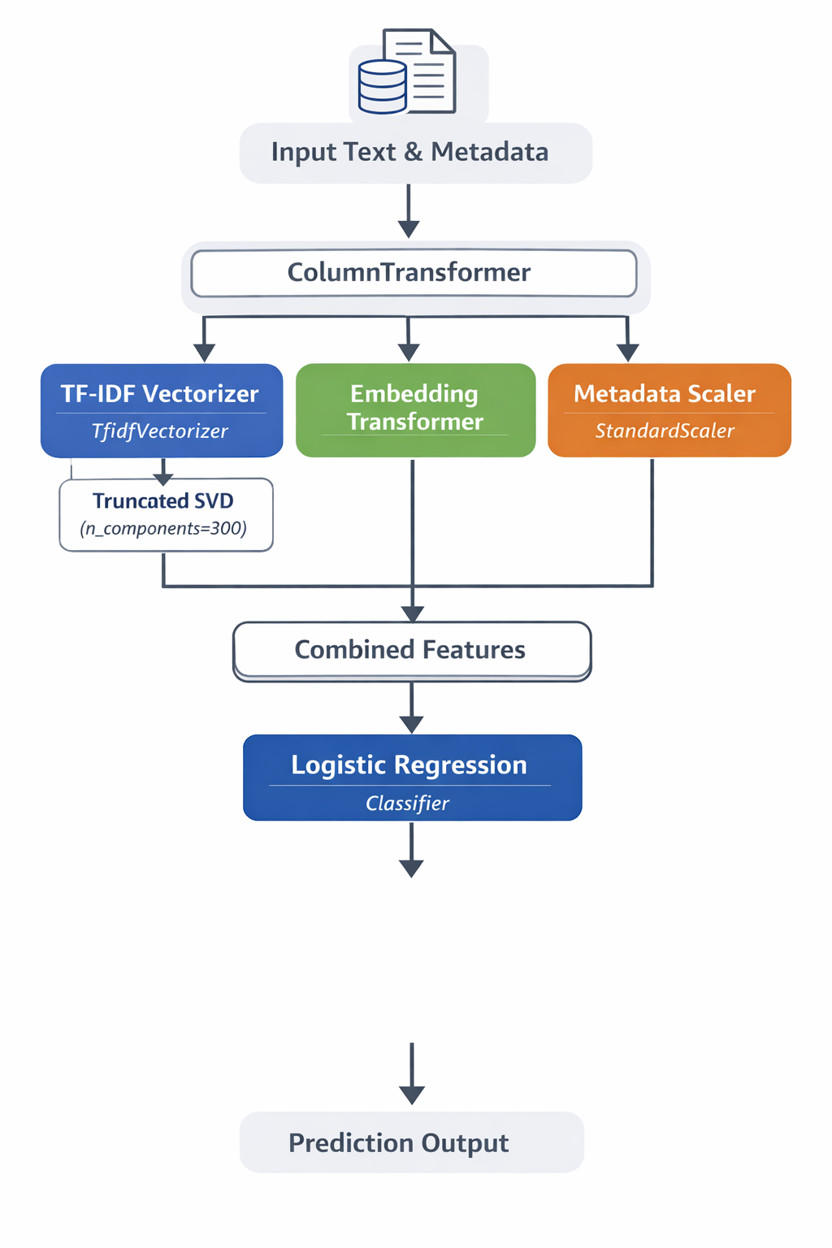
P
pipeline flowchart
Muhammed Ajmal M C · AMU · Spring Internship 2026

Slide 7
How the Model Works — Pipeline
User
Query Text
TF-IDF + SVD
Embeddings
Metadata
TfidfVectorizer
max_features=5,000
SentenceTransformer
all-MiniLM-L6-v2
char_length, word_count
avg_word_length
TruncatedSVD
300 components
384-dim semantic
vectors
uppercase_ratio
digit_ratio
ColumnTransformer — 3 branches run in parallel on the same query
Logistic Regression
→ Predicted Intent
Muhammed Ajmal M C · AMU · Spring Internship 2026

Slide 8
Design Decisions — Why I Did It This Way
Why TF-IDF?
Why Embeddings?
Why Metadata?
Captures domain vocabulary like 'crop_id', 'ARIMA'. SVD removes noise and keeps key patterns.
Short queries like 'What is NPCYF?' have little TF-IDF signal but carry strong semantic meaning.
DB queries tend to be longer with more numbers. char_length and digit_ratio pick up these structural cues.
Why Logistic Regression?
Why ColumnTransformer?
Why Pickle?
Three well-separated classes in high-dimensional space. Fast, interpretable, and achieves 97% accuracy.
Text and numbers need different preprocessing. CT applies the right pipeline to each column type at once.
Saves the full pipeline as one file. Load it anywhere — no rebuilding or retraining needed.
Muhammed Ajmal M C · AMU · Spring Internship 2026

Slide 9
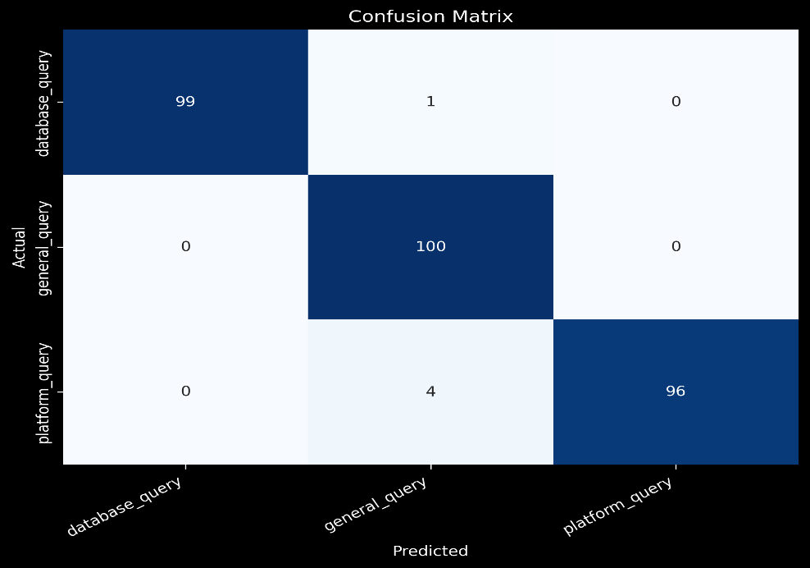
Results
~98.3%
Confusion Matrix
Overall
Accuracy
Class | Correct | Total | Acc.
database_query | 99 | 100 | 99%
general_query | 100 | 100 | 100%
platform_query | 96 | 100 | 96%
Muhammed Ajmal M C · AMU · Spring Internship 2026

Slide 10
Deployment — Making It Work in Real Time
Saving the model
Prediction flow
The entire pipeline — ColumnTransformer (all 3 feature branches) plus Logistic Regression — is saved as a single .pkl file.
This means one file gives you complete preprocessing + prediction. No rebuilding, no retraining.
1
Load model
pickle.load('intent_classifier.pkl')
2
Receive query
User types question into NPCYF CoPilot
3
Build DataFrame
text + char_length, word_count, ratios
import pickle
# Save
with open('intent_classifier.pkl','wb') as f:
pickle.dump(full_pipeline, f)
# Load
model = pickle.load(open('intent_classifier.pkl','rb'))
4
model.predict(df)
Full pipeline preprocesses + classifies
5
Return intent label
0→database 1→general 2→platform
Muhammed Ajmal M C · AMU · Spring Internship 2026

Slide 11
What I Learned & Achieved
Platform
Contributed to NPCYF — a national AI platform for crop forecasting under FASAL 2.0 at ISI Kolkata
Built
Designed a full NLP pipeline combining TF-IDF, sentence embeddings, and text metadata from scratch
Dataset
Collected and cleaned 3,839 domain-specific NPCYF queries across 3 balanced intent classes
Achieved
~98.3% classification accuracy — general_query at 100%, database and platform at 96% each
Deployed
Model saved as a single .pkl file for real-time query routing in the NPCYF AI CoPilot
Muhammed Ajmal M C · M.Sc. Data Science, AMU · Guide: Kunal Gupta · IDEAS-TIH, ISI Kolkata

