Slide 1
Viva
Cash Flow Modeling Examples
A scaffolding presentation for the Viva language project
Introducing four representative examples
Private project • Alexandre Scherer

Slide 2
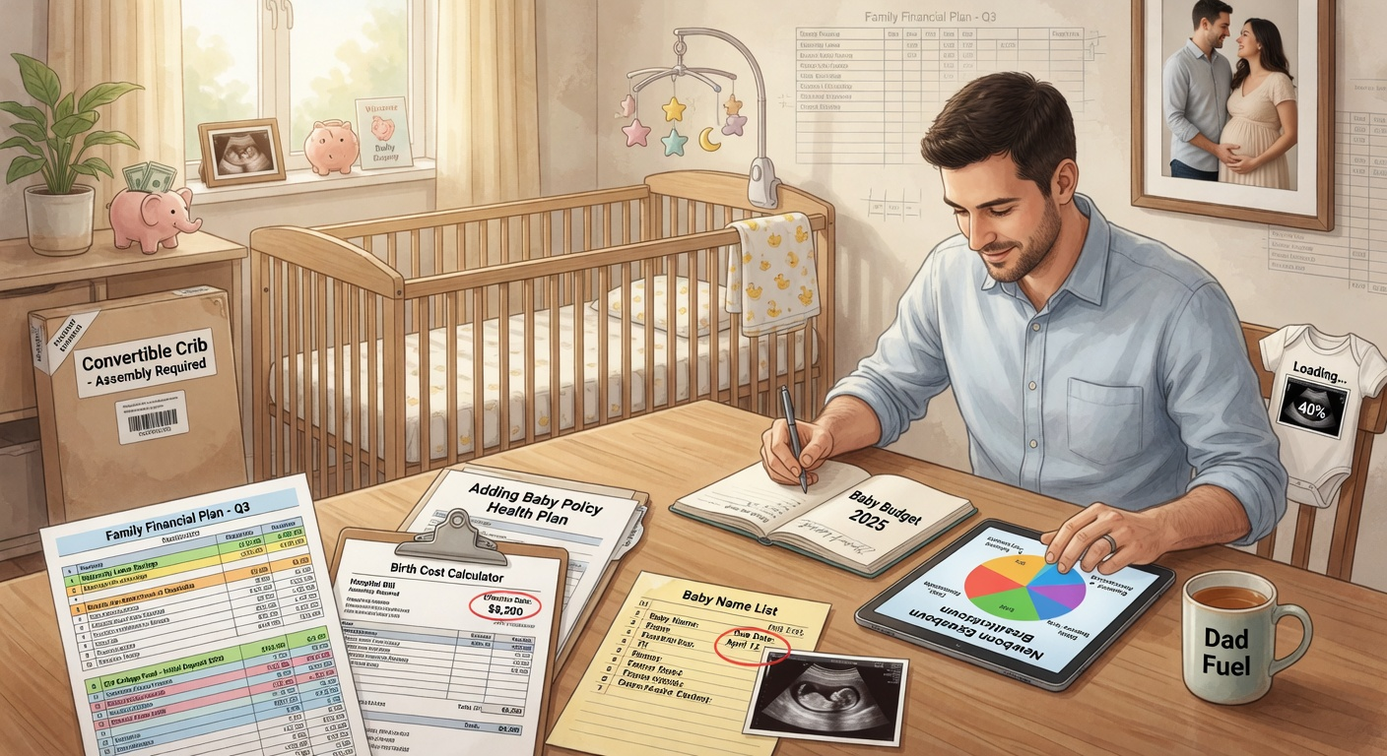
Paul's Life Planning
Core Example from Genesis
A young man planning for potential child birth, ongoing savings, and life insurance protection. Demonstrates basic life declarations, probabilistic events, and triggered flows.
life: Paul, man, born 4/5/2005
event: child_birth, in the next 10 years, uniform annual probability 80%
flow: child_expense, -20k, upon child_birth, for 20 years
flow: saving, 1k per month
flow: insurance, 1m, upon Paul.death
1 / 4

Slide 3

Retirement Planning
Long-term Financial Security
Models a person's career income, retirement savings contributions (401k + Roth IRA), and post-retirement income streams including Social Security and phased withdrawals, plus late-life healthcare costs.
life: Alex, person, born 1/1/1980
flow: salary, 150k per year, until retirement
flow: 401k_contribution, -20k per year, until retirement
event: retirement, at age 65
flow: social_security, 25k per year, upon retirement
flow: 401k_withdrawal, 60k per year, upon retirement, for 30 years
2 / 4

Slide 4

Family & Education
Multi-Generational Planning
A family of three planning for childbirth, K-12 education, college tuition, housing, childcare, and life insurance across multiple lives. Shows complex event timing and multi-life interactions.
life: Jordan, person, born 6/15/1990
life: Spouse, person, born 3/22/1992
life: Child, person, born 9/1/2028
event: child_birth, in 2028, probability 100%
event: child_college, at age 18 for Child
flow: childcare, -25k per year, upon child_birth, for 5 years
flow: college_tuition, -50k per year, upon child_college, for 4 years
3 / 4

Slide 5
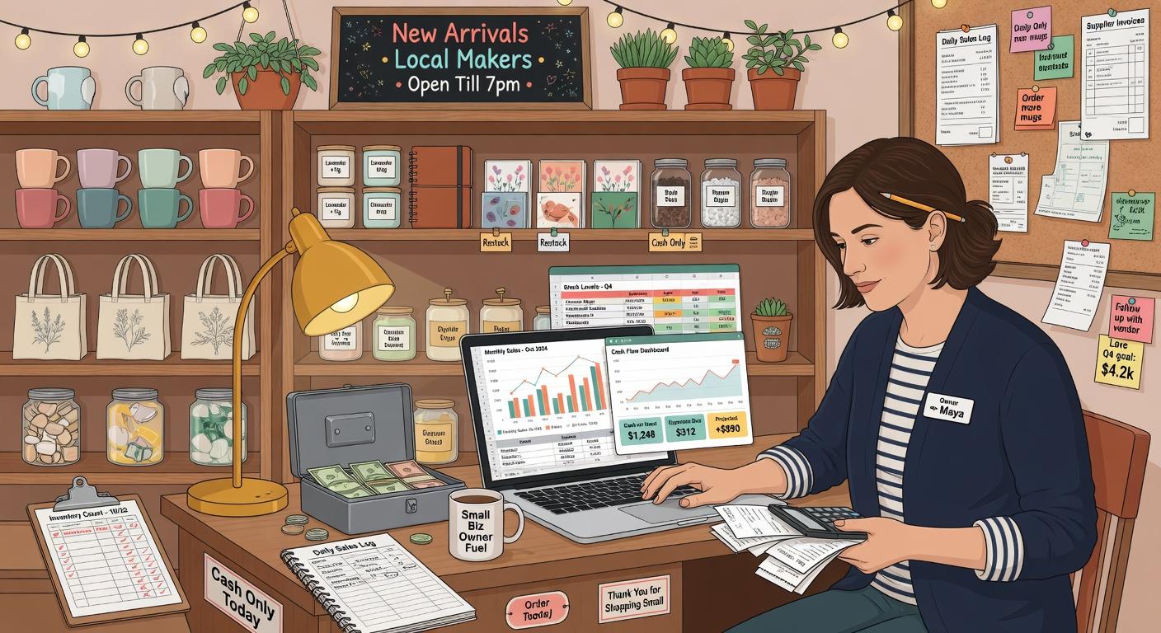
Small Business Cash Flow
Entrepreneurial Finance
Models a small business startup: revenue streams, operating expenses, loans, taxes, owner compensation, equipment purchases, and low-probability risk events (e.g. insurance payout on fire).
life: Owner, person, born 2/10/1975
event: business_start, year 2025
event: expansion, in 3 years after start, probability 60%
flow: product_sales, 500k per year, upon business_start
flow: salaries, -250k per year, upon business_start
flow: startup_loan, 200k, upon business_start
flow: loan_repayment, -25k per year, for 10 years
4 / 4

