Slide 1

Bitcoin Inspector
Jean-Marc SOUMET

Slide 2
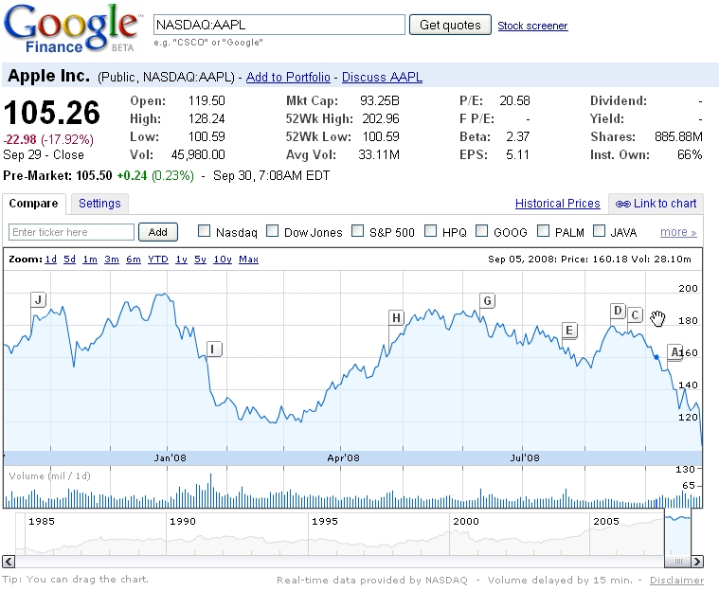

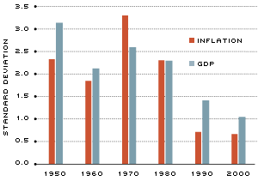
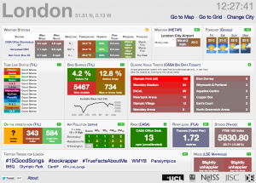
Querying the Bitcoin network
?
?
?
?
?
?
?
?
How to visualize live Bitcoin activity?

Slide 3
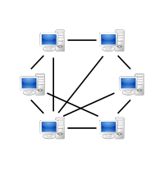
Bitcoin Data
Historical data
> 300k blocks (new Bitcoins)
> 48M transactions
Real-time data
Average 2 transactions / second
Available via peer-to-peer Bitcoin network
BTCUSD exchange transactions data (1 GB)
25 GB (2009-2014)

Slide 4
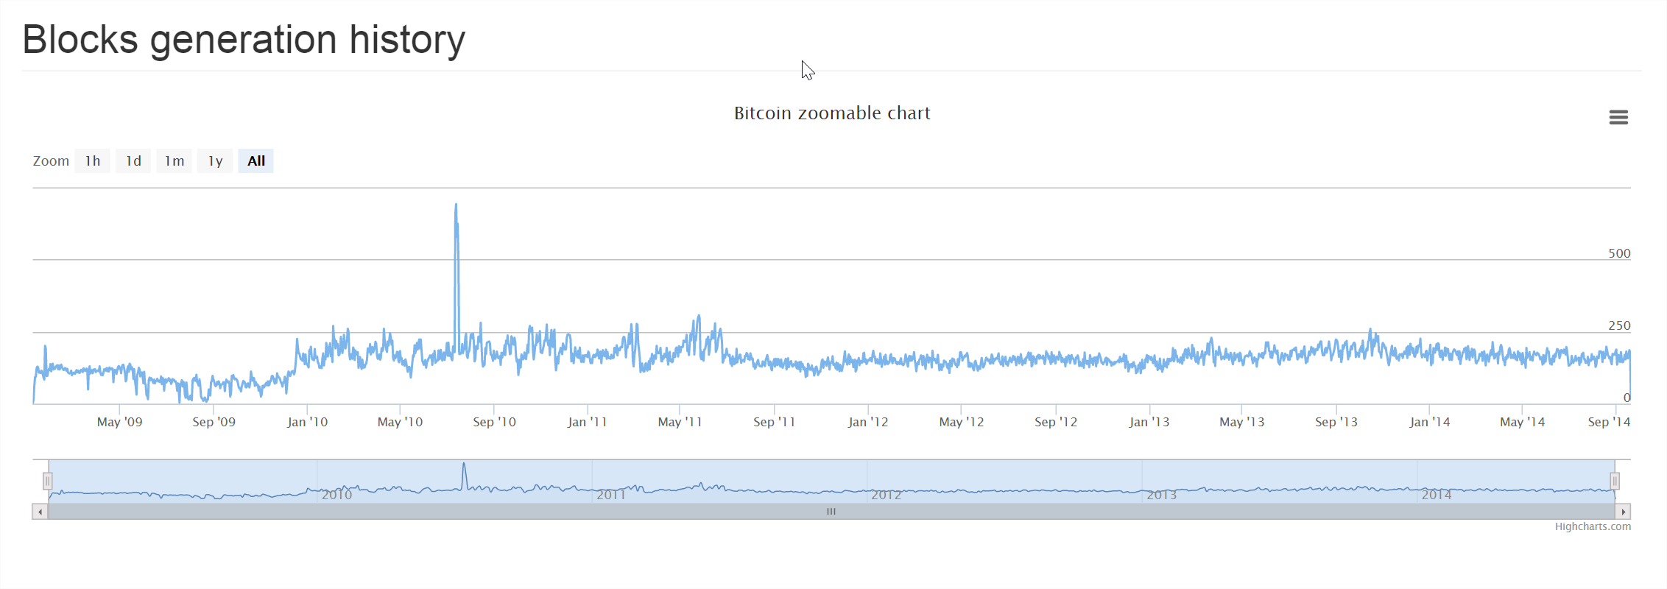
Demo
API Demo http://bitcoin-inspector.com

Slide 5
Listening to the Bitcoin network
JSON RPC API
bitcoind Listener
Collector Jobs (Python)
Historical data
Bitcoin Network
Live transaction data

Slide 6
JSON to protobuf
{
"hash" : "000000005d2616ca6e0c0234a259077ba7555d34938a2330d0848e71b720ce28",
"confirmations" : 310565,
"size" : 216,
"height" : 12141,
"version" : 1,
"merkleroot" : "a76dcd59fcf014ddfca2f7bcad680fe01225677e698ef87d5add137a58e34f00",
"tx" : [
"a76dcd59fcf014ddfca2f7bcad680fe01225677e698ef87d5add137a58e34f00"
],
"time" : 1240633759,
"nonce" : 478734356,
"bits" : "1d00ffff",
"difficulty" : 1.00000000,
"chainwork" : "00000000000000000000000000000000000000000000000000002f6e2f6e2f6e",
"previousblockhash" : "00000000824761513433920303af8ec04ce167e5393840a821ee90c31f63c006",
"nextblockhash" : "0000000004432502f35cb207f7182551e31aacd70f4ed5b56b6d9146b14e0a23"
}

Slide 7
JSON to protobuf
{
"hash" : "000000005d2616ca6e0c0234a259077ba7555d34938a2330d0848e71b720ce28",
"confirmations" : 310565,
"size" : 216,
"height" : 12141,
"version" : 1,
"merkleroot" : "a76dcd59fcf014ddfca2f7bcad680fe01225677e698ef87d5add137a58e34f00",
"tx" : [
"a76dcd59fcf014ddfca2f7bcad680fe01225677e698ef87d5add137a58e34f00"
],
"time" : 1240633759,
"nonce" : 478734356,
"bits" : "1d00ffff",
"difficulty" : 1.00000000,
"chainwork" : "00000000000000000000000000000000000000000000000000002f6e2f6e2f6e",
"previousblockhash" : "00000000824761513433920303af8ec04ce167e5393840a821ee90c31f63c006",
"nextblockhash" : "0000000004432502f35cb207f7182551e31aacd70f4ed5b56b6d9146b14e0a23"
}

Slide 8







Data Pipeline
MapReduce
Bitcoind Listener
Historical
KAFKA
HDFS Consumer
HDFS
MySQL
Realtime
Flask + Apache
HBASE
BTC/USD Exchange data
(csv)
WebCrawl
STORM

Slide 9
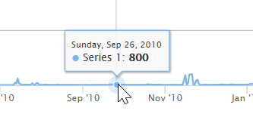
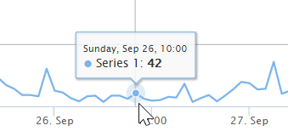
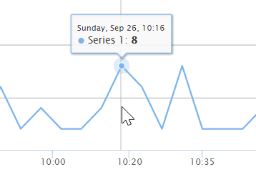
Dynamic granularity
Daily aggregate
(transactions_daily_1285459200, 800)
Hourly aggregate
(transactions_hourly_1285495200, 42)
Minute aggregate
(transactions_minutely_1285495980, 8)

Slide 10
MapReduce
Calculate Wallet balance
Calculate transaction occurrence by day/by month/by minute
Calculate new Bitcoins created
Timestamp

Slide 11
MapReduce
Calculate Wallet balance
Calculate transaction occurrence by day/by month/by minute
Calculate new Bitcoins created
Day timestamp
Timestamp
Month timestamp
Minute timestamp

Slide 12
MapReduce
Calculate Wallet balance
Calculate transaction occurrence by day/by month/by minute
Calculate new Bitcoins created
Calculate Aggregates
Day timestamp
Day Sums
Timestamp
Month timestamp
Month Sums
Minute timestamp
Minute Sums

Slide 13
MapReduce
Calculate Wallet balance
Calculate transaction occurrence by day/by month/by minute
Calculate new Bitcoins created
Calculate Aggregates
Day timestamp
Day Sums
Flask / Apache
Timestamp
Month timestamp
Month Sums
Minute timestamp
Minute Sums

Slide 14




Jean-Marc Soumet
France ➔ U.S. in 2004
Previous employment:
Adobe
National Semiconductor / Texas Instruments
CS degree (EPITA, Paris)
MBA (Santa Clara University) 2014
Sports (Soccer, Hockey, Snowboard, …)
Contact: jeanmarc.soumet@gmail.com
GitHub: http://github.com/ajmssc

Slide 15
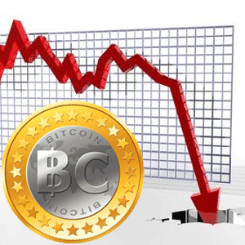
Queries supported
Full transaction history for specific Bitcoin address
Total USD transaction volume over time
Side-by-side comparison with other financial indices
Drug dealer detection, highly connected wallets
Other wallet information (wealthiest accounts)
Processing fees

Slide 16
Project Idea
What transactions are happening right now?
Who has the most Bitcoins in their wallet?
Is Bitcoin correlated with other financial instruments?
Goals
Enable rapid querying of latest Bitcoin data
Enable real-time visualization and analytics via API

