Slide 1
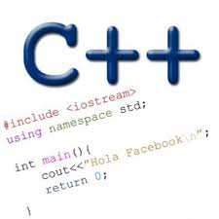

Dynamic memory allocation linked lists
Problem Solving with Computers-I
https://ucsb-cs16-wi17.github.io/

Slide 2



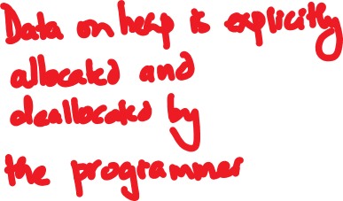






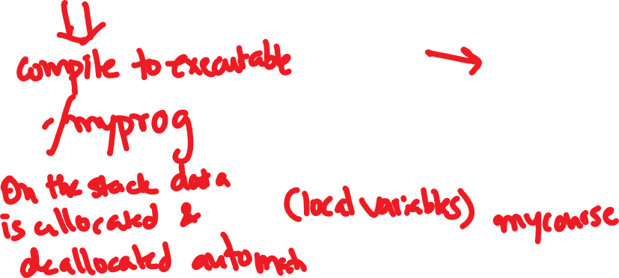


Program layout in memory at runtime
A generic model for memory
Low address
Text
int globalData=20;
int foo() {
int mycourse = 16;
cout<<“Welcome to CS”<<mycourse;
}
0
1
2
3
4
5
6
7
8
9
10
Global and static data
Dynamic memory
High address

Slide 3

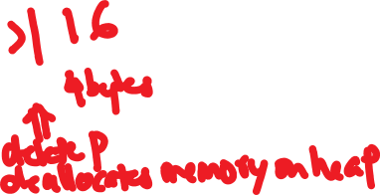


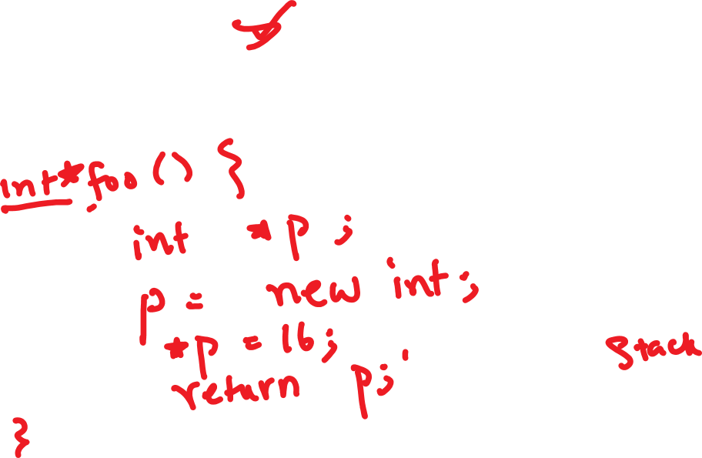

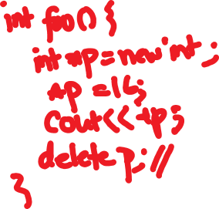
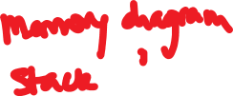

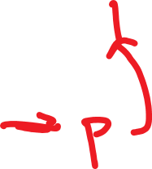







Creating data on the heap: new and delete
int foo() {
int mycourse = 16;
cout<<“Welcome to CS”<<mycourse;
}
Low address
Text
Global and static data
Dynamic memory
High address

Slide 4
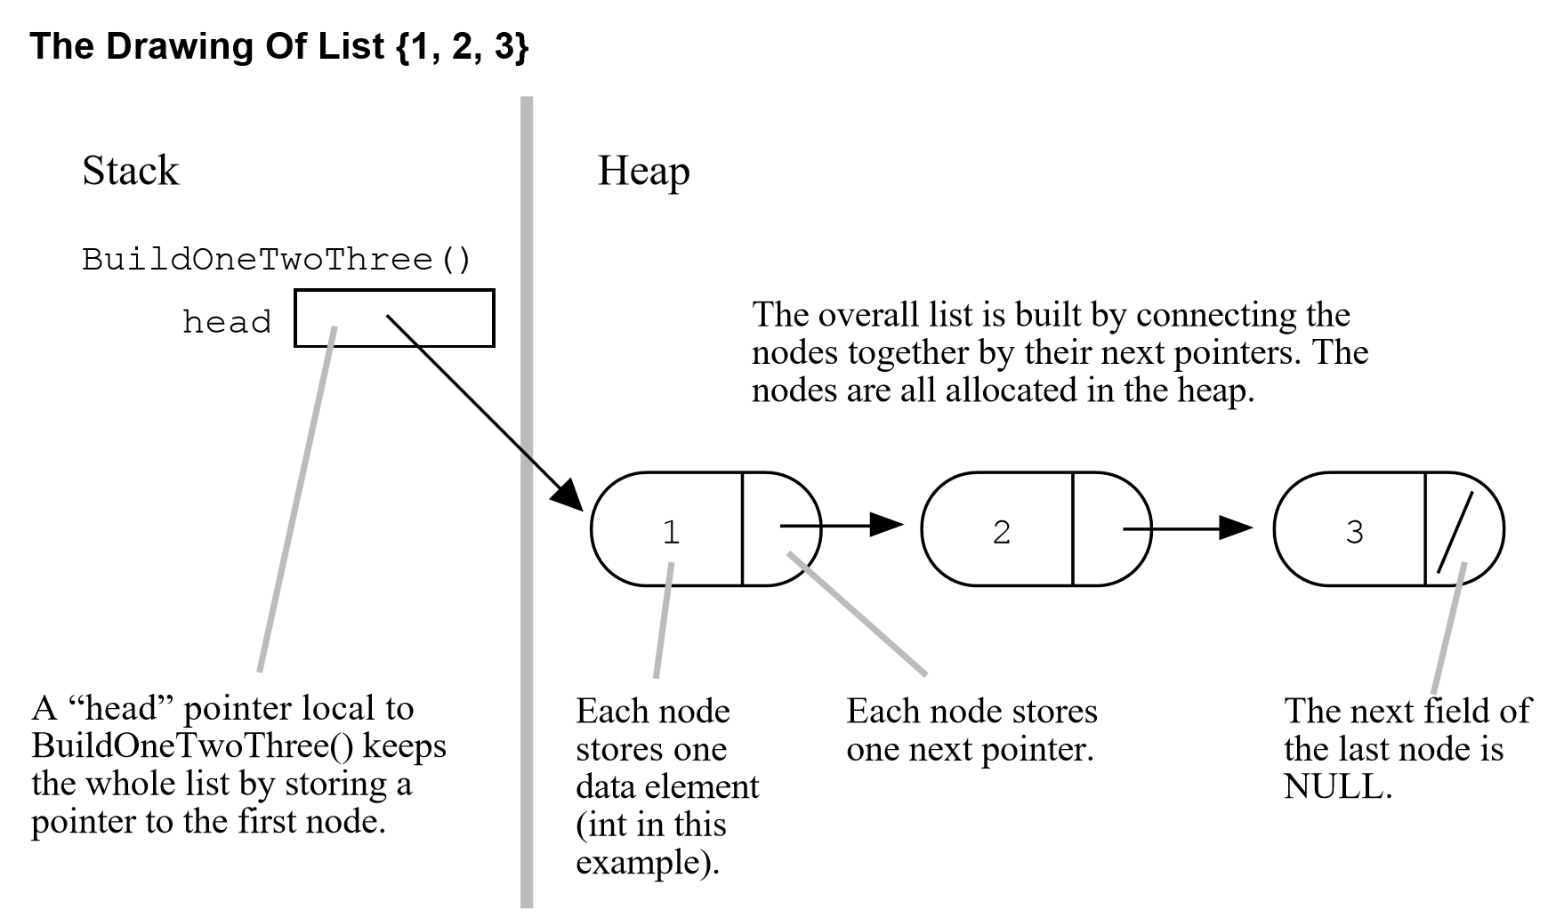
Linked Lists
1
2
3
Array List
Linked List

Slide 5
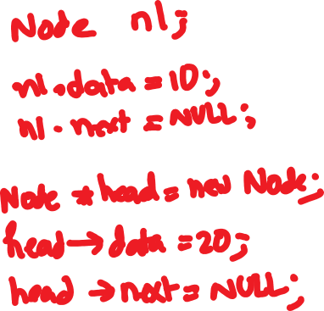






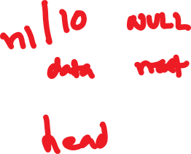


Creating nodes (Stack vs. Heap)
struct Node {
int data;
Node *next; };

Slide 6






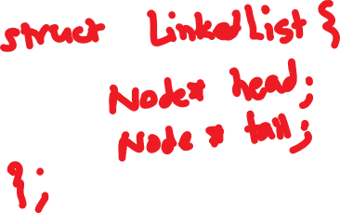
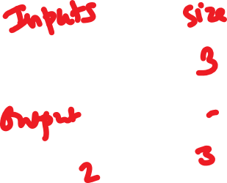








Building a list from an array
a
1
2
3
LinkedList * arrayToLinkedList(int a[], int size) ;

Slide 7







Building a list from an array
LinkedList * arrayToLinkedList(int *a, int size) {
LinkedList *list = new LinkedList;
list->head = list->tail = NULL;
return list;
}
0x400
What is the return value of the function?
(See diagram on the right)
0x200
0x400

Slide 8









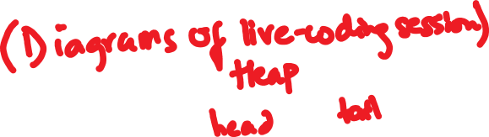
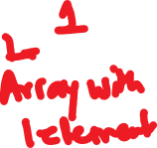




LinkedList * arrayToLinkedList(int *a, int size){
LinkedList *list = new LinkedList;
list->head = list->tail = NULL;
for(int i=0; i< size; i++){
Node* p = new Node;
p->data = a[i];
p->next = NULL;
list->head = p;
list->tail = p;
}
return list;
}

Slide 9


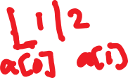







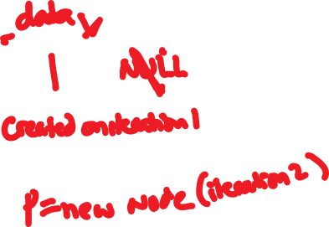



















LinkedList * arrayToLinkedList(int *a, int size) {
LinkedList *list = new LinkedList;
list->head = list->tail = NULL;
for(int i=0; i< size; i++){
Node* p = new Node;
p->data = a[i];
p->next = NULL;
if(i==0){
list->head = p;
}else{
list->tail->next = p;
}
list->tail = p;
}
return list;
}

Slide 10







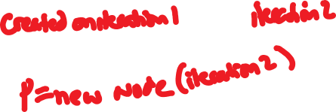

LinkedList * arrayToLinkedList(int *a, int size) ;
int arr[2] ={1, 2};
LinkedList *mylist;
mylist = arrayToLinkedList(arr,2);
mylist

Slide 11
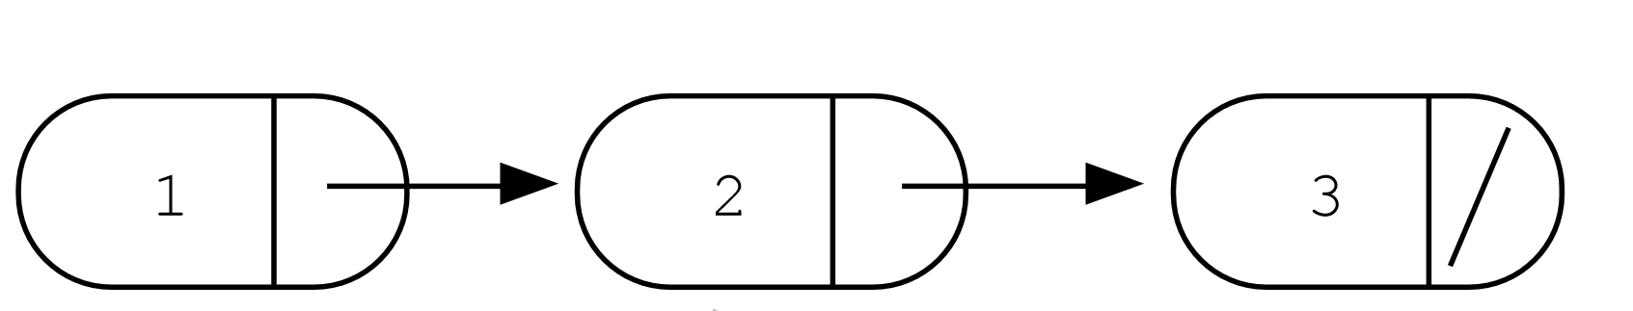




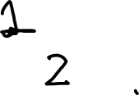
Accessing elements of a list
struct Node {
int data;
Node *next; };
head
Assume the linked list has already been created, what do the following expressions evaluate to?
head->data
head->next->data
head->next->next->data
head->next->next->next->data
1
2
3
NULL
Run time error

Slide 12
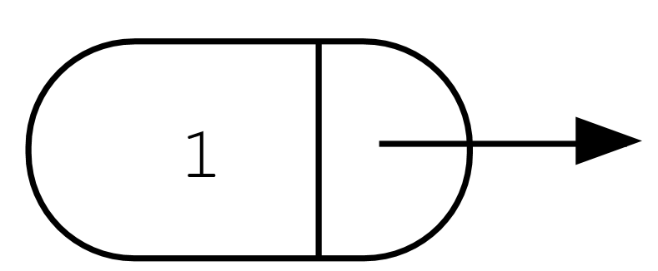
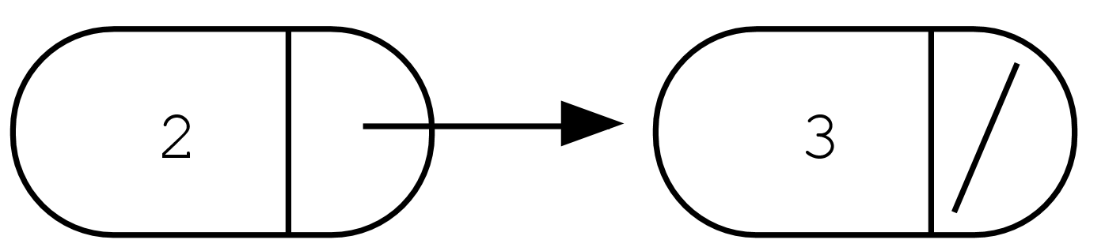
Iterating through the list
int lengthOfList(LinkedList * list) {
/* Find the number of elements in the list */
}
list
head
tail
Notes:
A

Slide 13
Deleting the list
int freeLinkedList(LinkedList * list) {
/* Free all the memory that was created on the heap*/
}
list
head
tail
Notes:
A

Slide 14
Complex declarations in C/C++
How do we decipher declarations of this sort?
int **arr[];
Read
* as “pointer to” (always on the left of identifier)
[] as “array of” (always to the right of identifier)
( ) as “function returning” (always to the right …)
For more info see:
http://ieng9.ucsd.edu/~cs30x/rt_lt.rule.html

Slide 15
Complex declarations in C/C++
Illegal combinations include:
[]() - cannot have an array of functions
()() - cannot have a function that returns a function
()[] - cannot have a function that returns an array
Right-Left Rule
int **arr [];
Step 1: Find the identifier
Step 2: Look at the symbols to the right of the identifier. Continue right until you run out of symbols *OR* hit a *right* parenthesis ")"
Step 3: Look at the symbol to the left of the identifier. If it is not one of the symbols ‘*’, ‘(), ‘[]’ just say it. Otherwise, translate it into English using the table in the previous slide. Keep going left until you run out of symbols *OR* hit a *left* parenthesis "(".
Repeat steps 2 and 3 until you've formed your declaration.

Slide 16
Complex declarations in C/C++
int i;
int *i;
int a[10];
int f( );
int **p;
int (*p)[];
int (*fp) ( );
int *p[];
int af[]( );
int *f();
int fa()[];
int ff()();
int (**ppa)[];
int (*apa[ ])[ ] ;

Slide 17
Next time
Dynamic arrays
Pointer arithmetic
Dynamic memory pitfall

