Slide 1
Sprint Report 4 &
Project Review

Slide 2
Transition from Tamagachi-like to Edutainment Game
The project was originally requested as a Tamagachi-like game with some education aspects.
After interviews with sponsors, it was discovered that the application would require much more education aspects.
The game transferred from a Tamagachi-like to an Educational Game with some Tamagachi aspects.
The user is expected to have some amount of knowledge of how to be an Athletic Trainer. This requires the designers to have knowledge of athletic training.
The game was designed to be an educational help for those learning to become an Athletic Trainer.

Slide 3
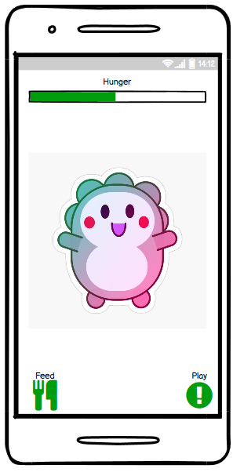
Original Request: Tamagachi-Like
Image right: What a normal tamagachi-like looks like.
Feed the tamagachi every now and then.
Play with the tamagachi every now and then.
Maybe some evolution aspect.
In this case, add some injury aspect where the user would have to treat their tamagachi when they get hurt.
Relatively easy to make: design some games, feeding aspect, cute avatars.

Slide 4
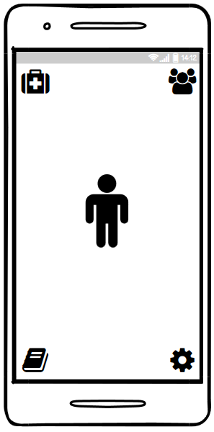
Current Project: Edutainment for Athletic Trainers
Multiple customizable avatar athletes
Minigames based on the HOPRS method: a method that athletic trainers learn to determine if and how an athlete is injured.
HOPRS is a complex five part method with different ways of determining information. These scenarios must be designed by an expert.
The game should still be fun and intriguing.
Requires a more complex database to keep track of all the different kinds of information: player info, athlete info, scenario data, superuser/designer data.

Slide 5
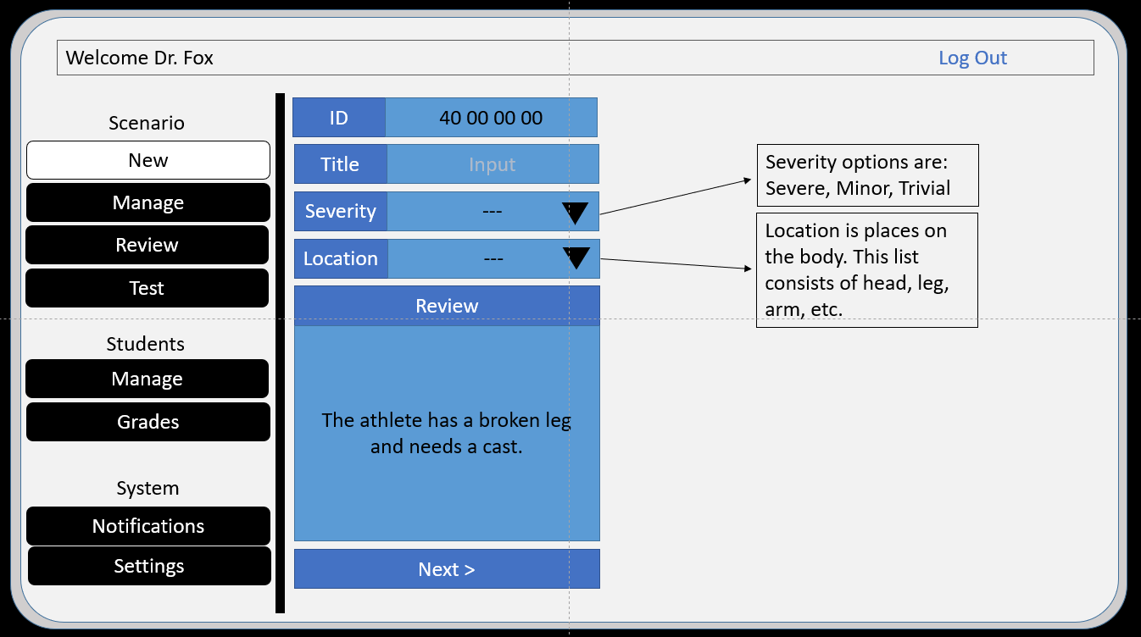
Current Project: Designer Side of Application
Because the scenarios require expert knowledge to design, it is important to design an easy UI for the experts to use to make scenarios.
The professors using this application also need an easy way to read these scenarios and modify them if necessary.
Sponsors are experts allowing us to find out what they need in a design.
Design has to be done that requires no programming from the experts.

Slide 6
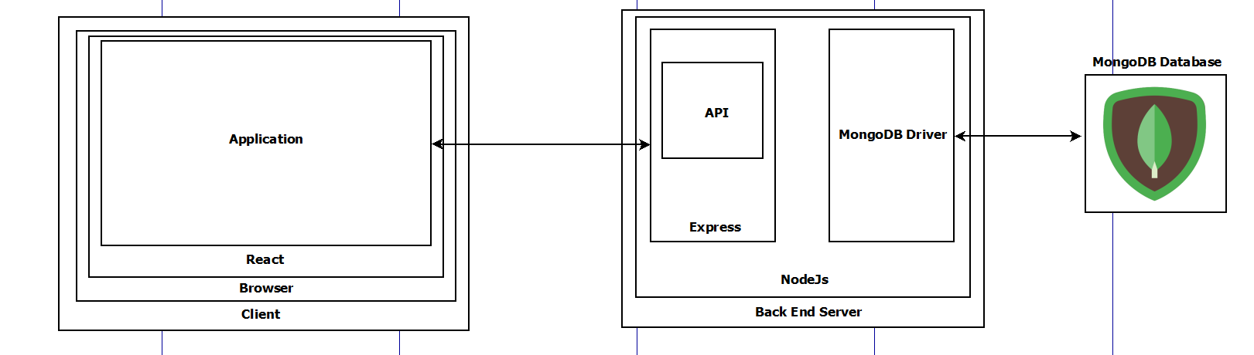
Software Architecture Overview

Slide 7
Any Questions

Slide 8
Dillon’s Progress since last Sprint:
Currently working on the athlete customization and animation.
Scalable Vector Graphic design using vectors through React.
Learning to design with Adobe Illustrator and animate with SVGator.
Why SVGs and not images:
SVG look good on a webpage as they do not lose fidelity.
Fun fact: You can watch the animated show Mucha Lucha in 4k because it was made using vectors through Flash instead of traditional art even though the show is 15 years old.
SVG is easy to customize because it can take in data structures.
SVGs allows a programmer to create animations without animation knowledge. (Design knowledge)
SVGs must be designed to take in data from a database and act accordingly.

Slide 9
Tyler’s Intended and Actual Progress
Broadcast/Force Injury Feature – Done
Allows Super Users/Professors to force set injuries onto uninjured athletes in the app.
(Front End) Allow Super users to submit desired injury type they’d like to broadcast
(Back End) Use POST/GET requests to look for uninjured athletes under each student ID and apply a random injury based on the criteria given.
Organize Information in Tables – Done
Tables will dynamically fill with relevant information from the DB
Begin request functions for player front end – Moved to next sprint
Most of the Sprint time was spent troubleshooting above features. My intended progress for next sprint will prioritize this issue.

Slide 10
AJ’s Progress since last Sprint
Added navigation button functionality on the user front-end
This required a refactor of the user front-end code
Implemented lazy-load code splitting
This was required to separate the user/superuser front-end
Superuser is on localhost:3000
User is on localhost:3000/student
Implemented Google Sign-In for React
Began working on References/Settings page for user front-end

Slide 11
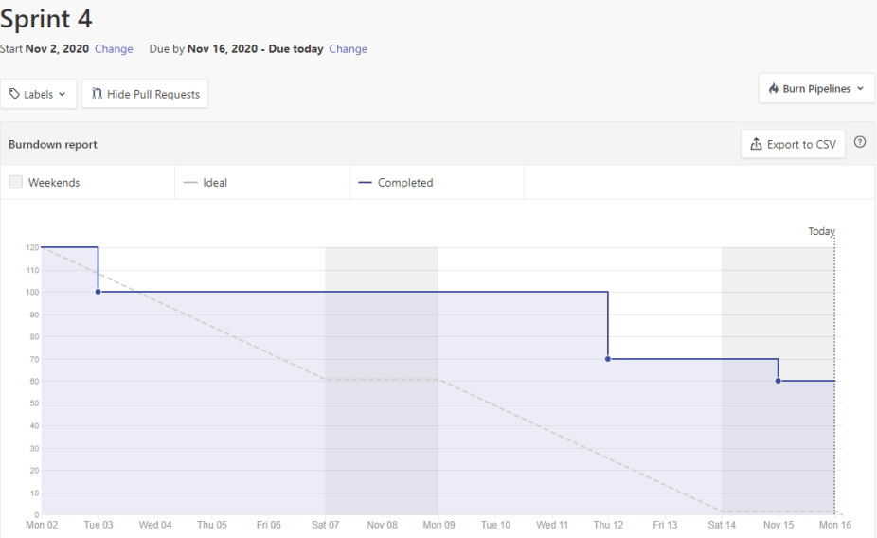

Slide 12
Sprint 5 Projected Progress
Making the player UI more interactable
Adding in custom avatar creation and animations for injury evaluation
Adding in injury evaluation “minigames”
Finishing request/CRUD operations for player functionality.
Double checking player input against correct answers for injury “minigames”
Athlete creation, deletion
Tying Google accounts to players in the database

