Slide 1
GVSU Athletic Training Team
By Dillon Viilo, AJ Natzic, and Tyler

Slide 2
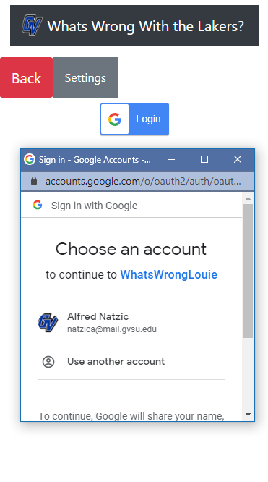
Google Sign In
Google Sign in was implemented.
Because Grand Valley students have a GVSU email account that is connected to google, it made sense to add a Google Sign In
The account will either be attached to student or professor account and will work according to their credentials.

Slide 3
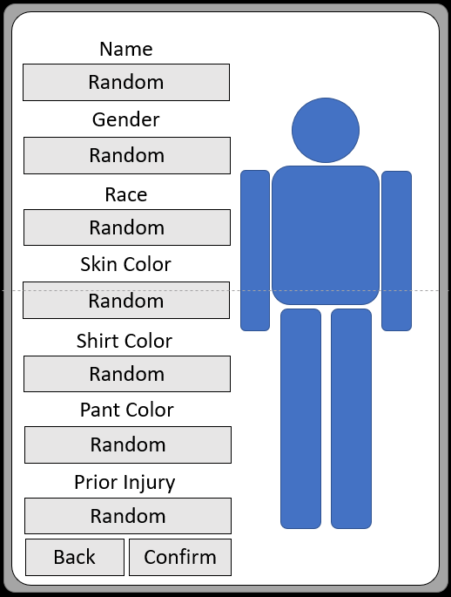
Player: Create Athlete
Players and Students will be able to create their own athletes.
These athletes can be given a name, given a sex, given a race, skin color, clothes and a prior injury.
These athletes will be given injuries that the player will have to treat through mini-games.

Slide 4
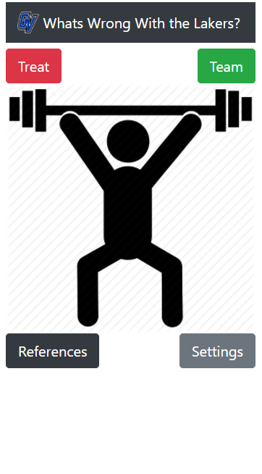
Player: Main Menu
From this screen, the player can choose to treat the current athlete, view the rest of their team, review their references, and change their settings.
Selecting “Treat” will take the player to the mini-game screen where they can treat
Selecting “Team” will take the player to the team screen where they can review all their athletes and if they are injured.
Selecting “Reference” will take them to the reference screen. This screen allows the players to take notes and check them when they need them.
Selecting “Settings” will allow the player to change the settings of the application accordingly.

Slide 5
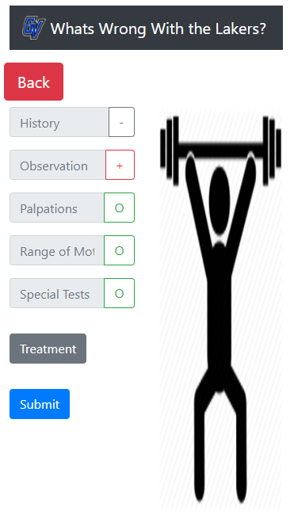
Player: Treatment
This screen shows the players the mini-games they need to perform to treat their athlete.
This screen gives updates upon completion of each game. If the player gets a red plus, that means that the test was positive. This means that something of note was found. If a blue minus was given, then nothing of note was found.
The player needs to complete each mini-game, that represents the HOPRS method. Once they complete each mini-game, they can then perform treatment. After that is completed, the athlete will be considered treated.
From this screen, the player can view their references.

Slide 6
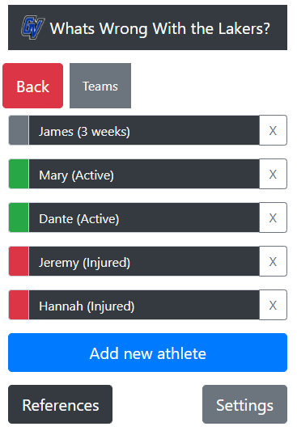
Player: Team
This screen shows the players all their athletes and their current status. These athletes would be customized by the player.
Green status means that the athlete is not injured. Red status means that the athlete is injured and must be treated. Grey means that athlete was injured and treated and it currently in cool down.
Selecting “Add Athlete” will take the player to the create athlete screen.
The Player can sort their athlete by status, name and last injured.

Slide 7
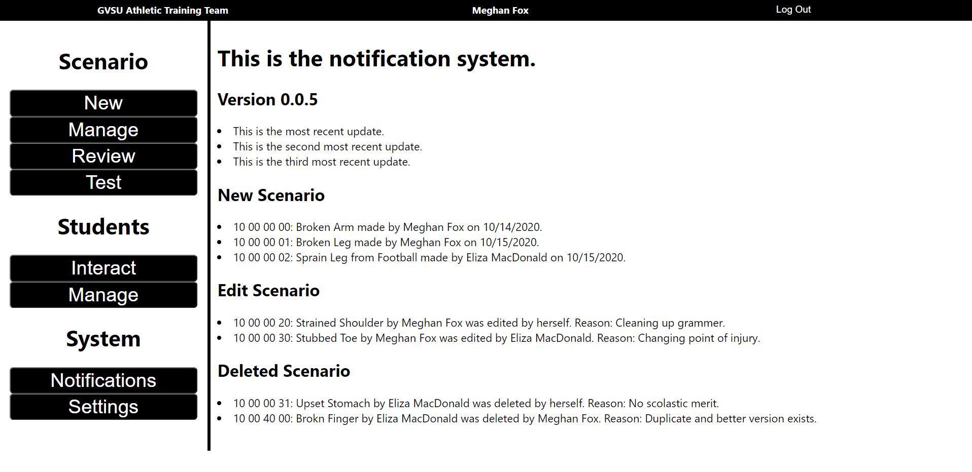
Professor: Notifications
Professors will receive notifications about the application through the notification screen.
Professors will receive updates on new versions of the application, new scenarios that have been created, scenarios that have recently been edited, and scenarios that have been deleted.
The parameters that shows up in the notification screen is determined by the desired settings in the setting screen.

Slide 8
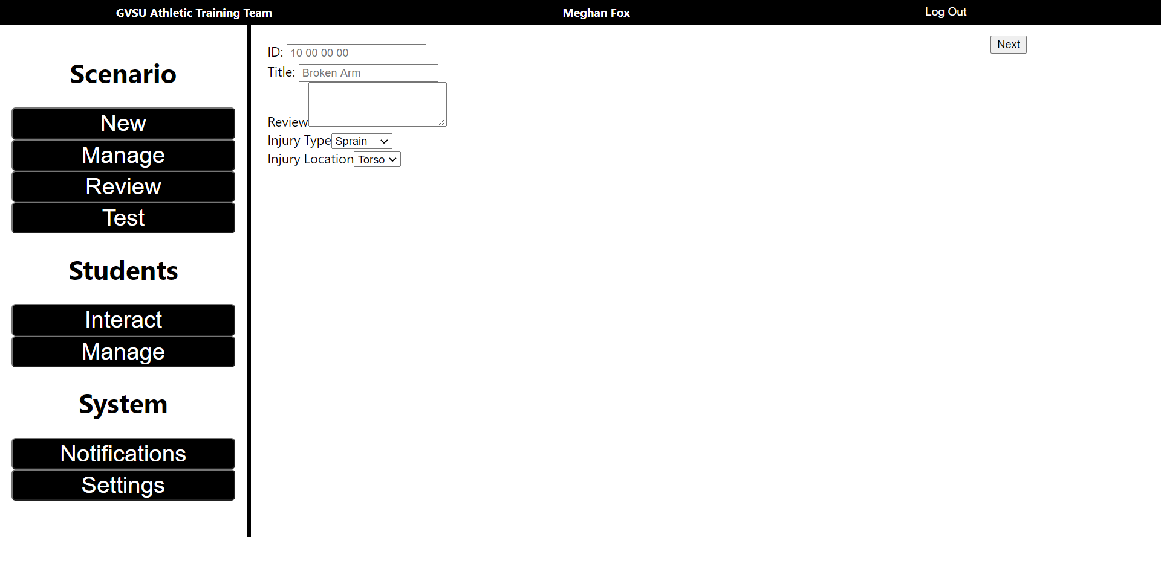
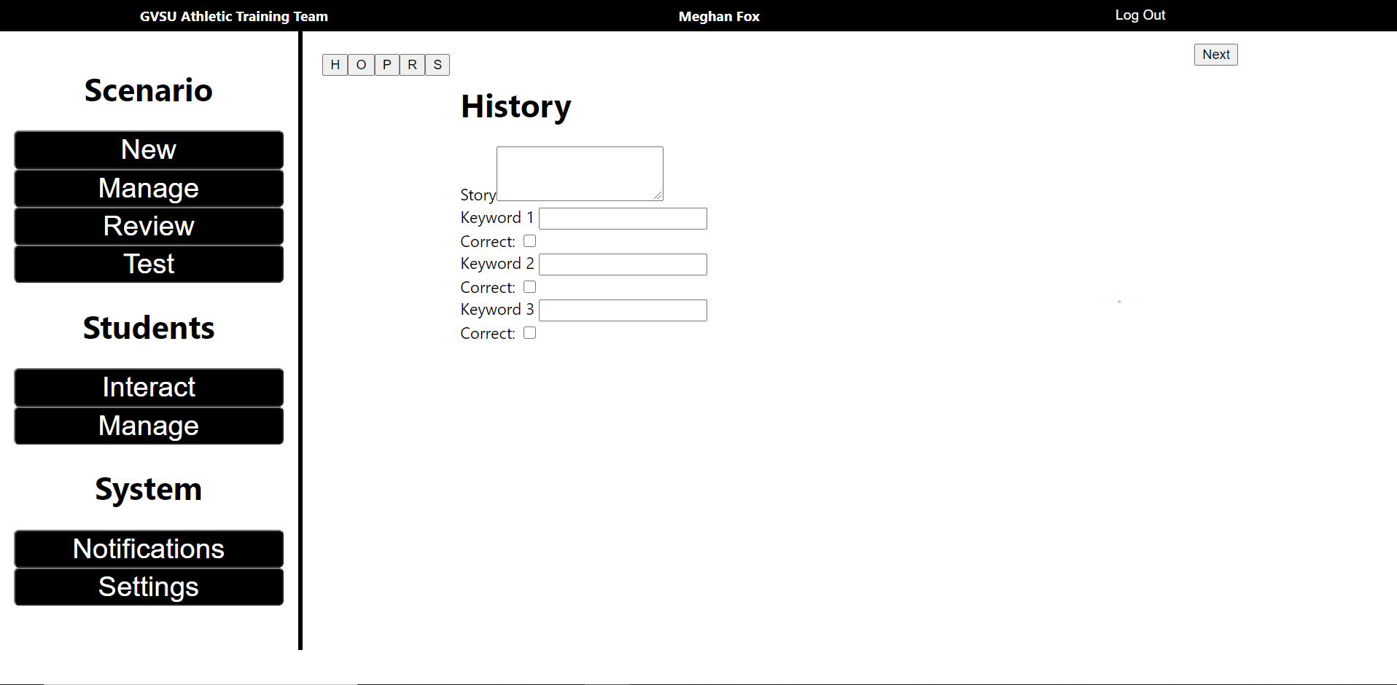
Professor: New Scenario
The professor can create new scenarios through this screen. Once the professor puts in the initial information, they will be able to add information for the scenario.
This collection of screens provides information for the mini-games to use.
Professors can switch between each of the HOPRS methods at will.

Slide 9
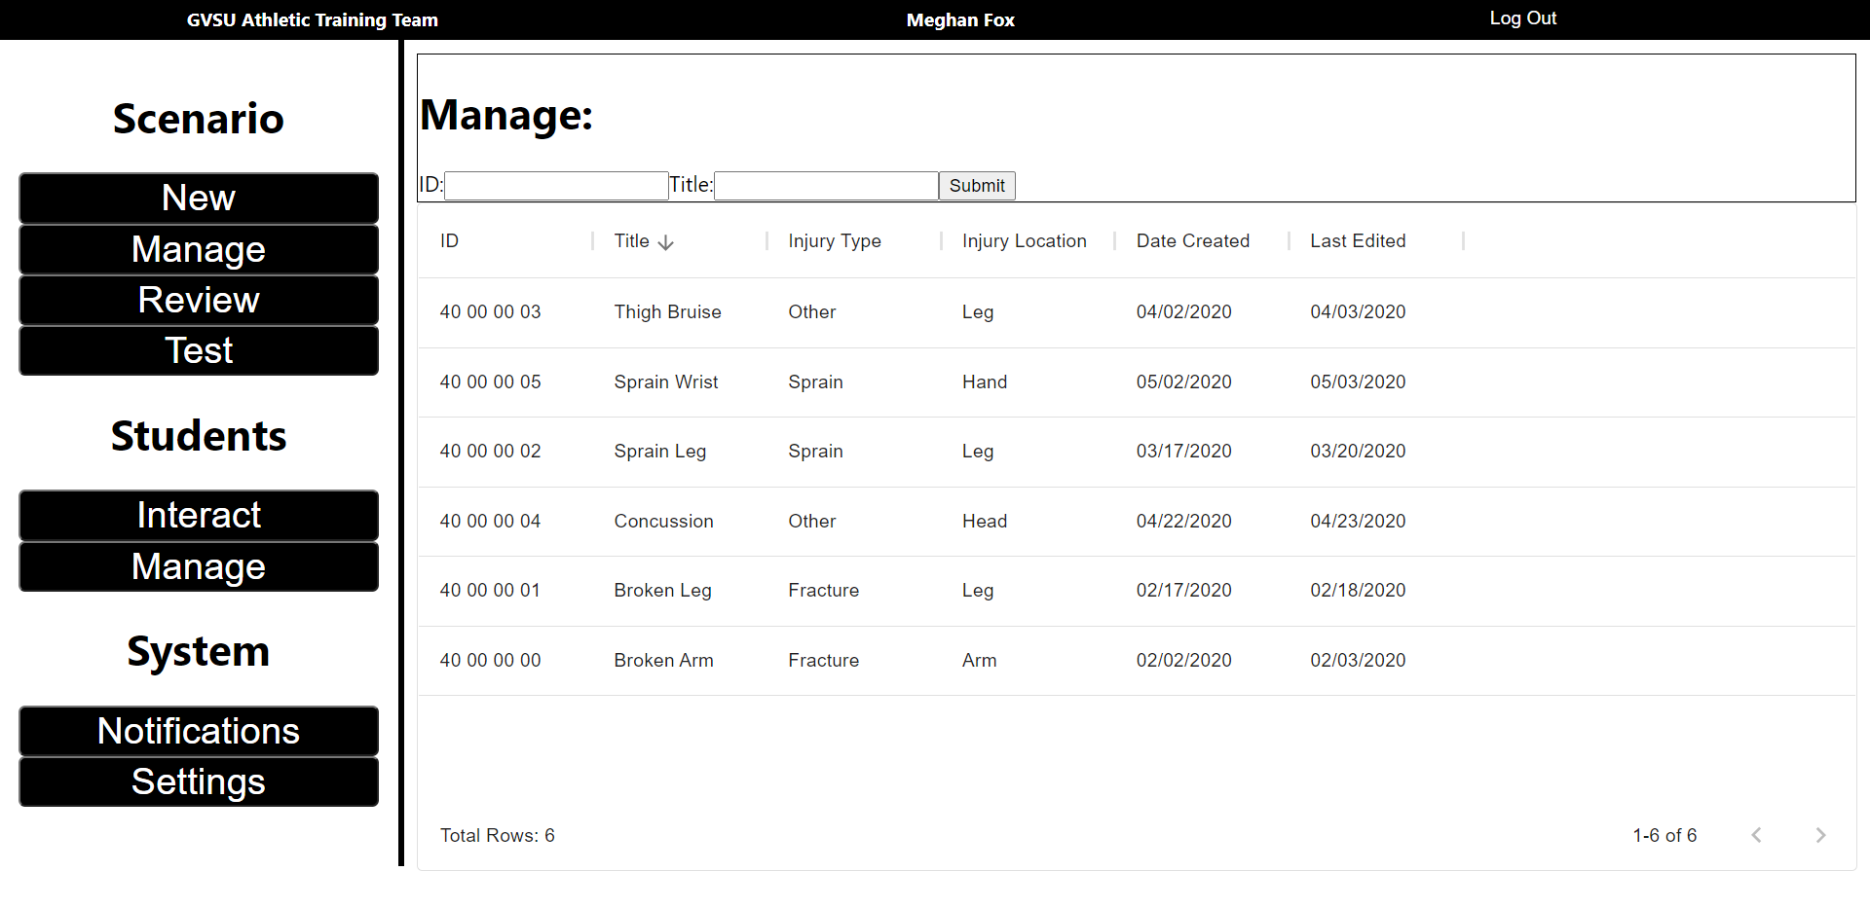

Professor: Manage Scenario
On the manage screen, the professor will be able to manage, edit and delete their scenarios. They will be able to view and sort by ID, title, injury type, injury location, date created, and date edited.
The total amount of scenarios presented reduces scrolling in exchange for paging.

Slide 10
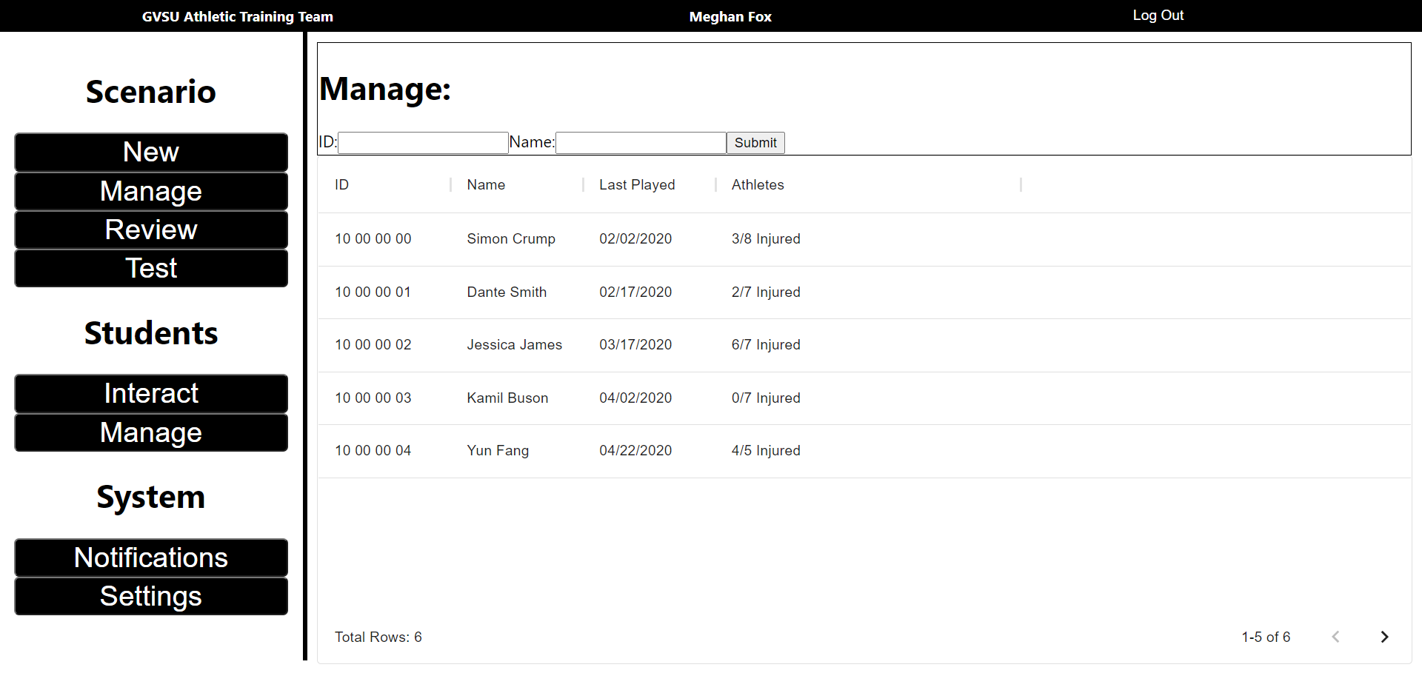
Professor: Broadcast Injury/Scenario
Under the student section on the professor side of the application, the professor can send a particular or random injury to their student’s athletes. This allows for specific testing of specific situations.
The professor can send a specific scenario or send a random injury with given parameters.

Slide 11
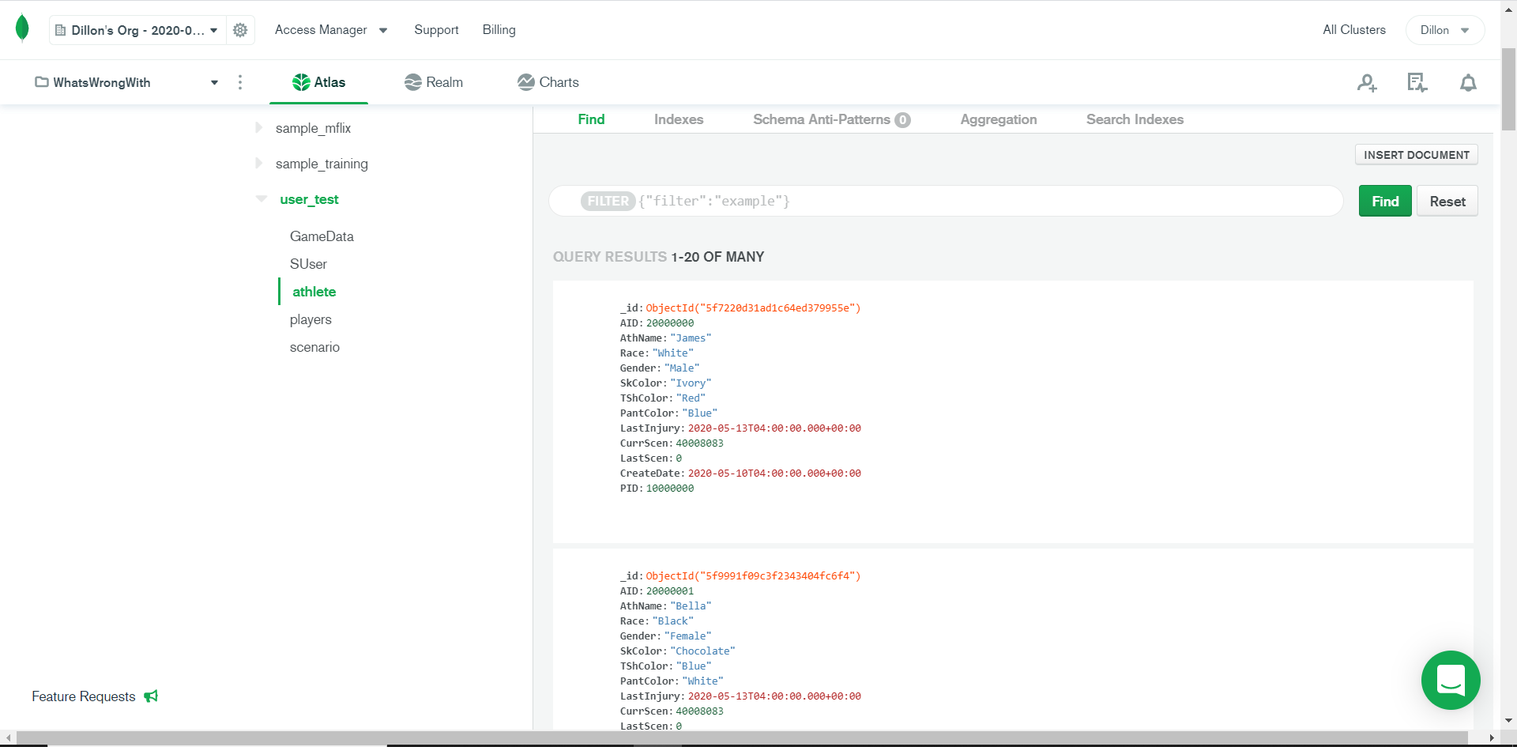
Database
The database was designed to take in information from the professor side and manipulate information to use for the player side mini-games. The database also tracks professor, player and athlete data.
Players are assigned to Professors. Athletes are assigned to Players.

Slide 12
Work in Progress
The following features are still a work in progress:
Minigames
History: Deduce the Proper Keywords
Observation: Find the Affliction
Palpation: Determine and Pain and Point
Range of Motion: Limited Motion
Special Test: Try and Fail
Treatment: Test your Knowledge
Settings
Reference Page
Animations

Slide 13
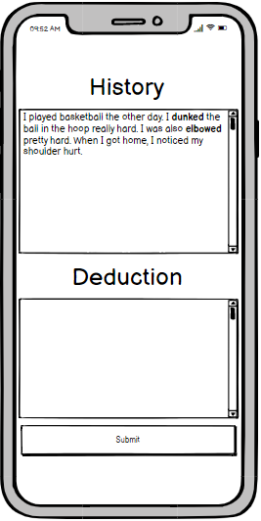
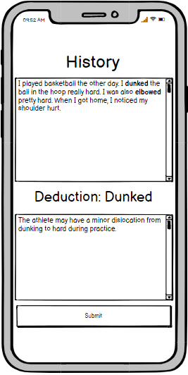
WIP: History Minigame
The player will select a bold word to determine which is the correct deduction from their history.
Because the athlete hurt their shoulder, it is more likely that the slam dunk was the reason they sustained injury.
In this example on the right, “dunked” would be the correct answer and elbowed would be the red herring.

Slide 14
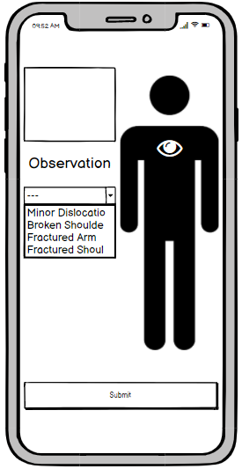
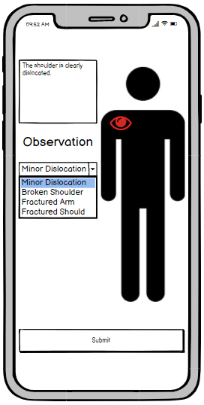
WIP: Observation Minigame
The player will navigate the “eye” cursor over the athlete’s body. Once it turns red, they will receive a description of the observation.
The drop box below “Observation” will have a list of possible deductions that could be correct. In this case, “Minor Dislocation” is the correct answer.

Slide 15
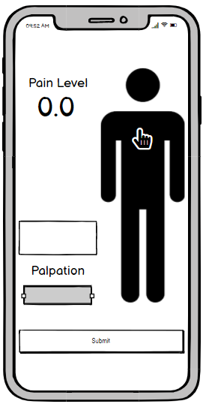
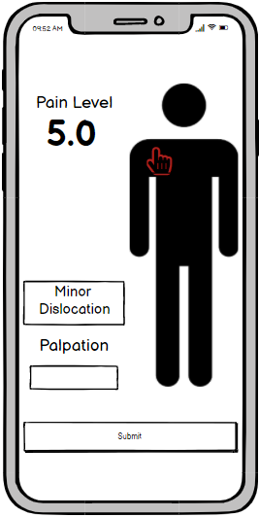
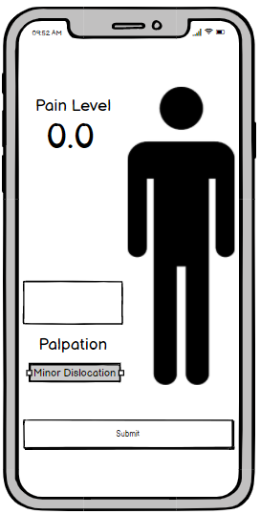
WIP: Palpation Minigame
Like Observation, Palpation will work by moving the touch control over the athlete to simulate touching. This also works similar to a metal detector. The closer you get to the correct point, the higher the pain level will go.
Once the player finds the point, a quick diagnosis will appear in the text box. After the player moves off the athlete, the diagnosis will disappear. They must then memorize and input the diagnosis into the box below.

Slide 16
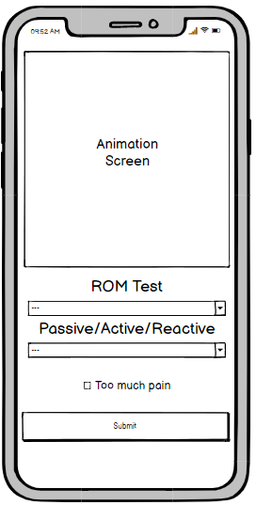
WIP: Range of Motion Minigame
The Range of Motion minigame is the most complicated to create as it relies on multiple animations. These animations would have to be custom made.
The player would go through the different tests until they find the limited movement.
After they find the limited movement, they would submit their findings. However, if the athlete was in too much pain, then the player needs to select ‘Too much pain” and submit.

Slide 17
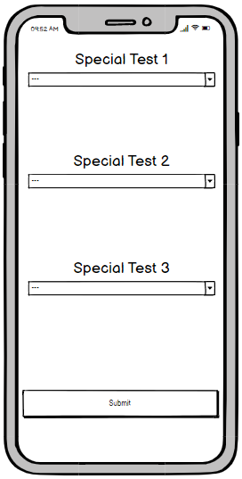
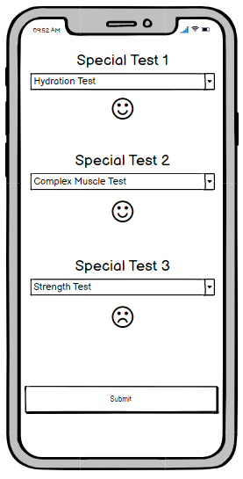
WIP: Special Test Minigame
The player must determine, from a given list, what tests are needed to verify treatment.
If the test is correct, the player will receive a positive indicator, like a smiling face. If the test is incorrect, they will receive a frowning face.
Once the player finds all the correct tests (even if all the special tests are null) they can then proceed.

Slide 18
WIP: Settings
On both sides of the application, settings will determine what the players and professor will see and how they will see the application. These settings will be kept within the database under the user to keep track of their old settings. It is intended that settings will also keep track of usability settings such as color blindness or font size.

Slide 19
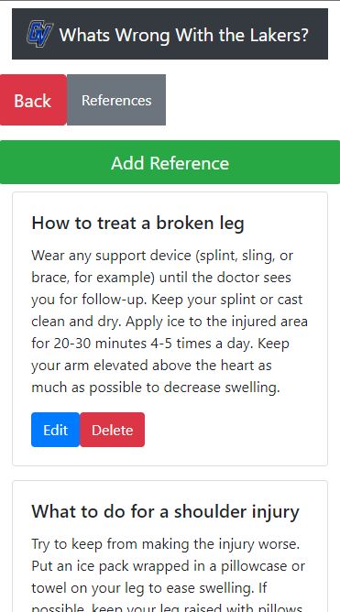
WIP: Reference Page
During gameplay, the player should write down references that they learned in class to assist in healing their athletes.
These references will be kept in the database under the student account.
References can be added, edited, and deleted at will. The player can view these references at any time during gameplay.

Slide 20
WIP: Animations
Now is time for the animation demo.

