Slide 1
Physical Based Modeling and Animation of Fire and Water Surface
Presented at Prof. Joe KeaRney’s animation lecture
Jun Ni, Ph.D. M.E.
Associate Research Scientist, Research Services
Adjunct Assistant Professor
Department of Computer Science
Department of Mechanical Engineering

Slide 2
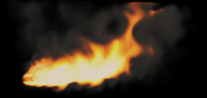
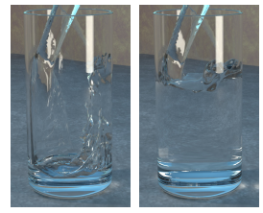
Dr. Ronald Fediw
Department of Computer Science, Stanford University
Conference proceeding at ACM SIGGRAPH 2002

Slide 3
Animation of Fire
Outline
Introduction
Physical Based Model
Level-set Implementation
Rendering of Fire
Animation Results

Slide 4
Introduction
Modeling of natural phenomena such as fire and water remains a challenging problem in computer graphics
Complications of the modeling
  fluid motion with un-stability, transient, non-linear, multi-phases, and multi-component, combustion (chemical reactions), different physical scales, fluid compression, explosions and wave
For example, fluid reaction system
  Combustion processes can be classified into two distinct types of phenomena
    Detonations
    Deflagrations

Slide 5
Introduction to physical phenomena
Deflagrations : low speed events with chemical reactions converting fuel into hot gaseous products, such as fire and flame. They can be modeled as an incompressible and inviscid (less viscous) flow
Detonations: high speed events with chemical reactions converting fuel into hot gaseous productions with very short period of time, such as explosions (shock-wave and compressible effects are important)

Slide 6
Introduction to Modeling
How to model?
  Introduce a dynamic implicit surface to track the reaction zone where the gaseous fuel is converted into the hot gaseous products
  The gaseous fuel and hot gaseous zones are modeled separately by using independent sets of incompressible flow equations.
  Coupling the separate equations by considering the mass and momentum balances along the reaction interface (the surface)

Slide 7
Introduction to Modeling
How to model?
  Rendering the fire as a participating medium with black body radiation using stochastic ray marching algorithm
  Chromatic adaptation of observer to get the reaction colors of the fire

Slide 8
Physical Based Model
Three distinct visual phenomena:
  Blue or bluish-green core: emission lines from intermediate chemical species, such as carbon radical generated during reaction. It is located adjacent to the implicit surface imposed. this color can be used to track the movement of the surface
  Yellowish-orange color: blackbody radiation emitted by the hot gaseous products (carbon soot)
  Fire soot or smoke core: temperature cools to the point where the blackbody radiation is no longer visible

Slide 9
Temperature
blue core
T max
gas fuel
ignition
solid fuel
gas products
gas to solid phase change
time

Slide 10
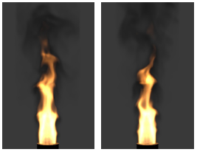
Soot emit blackbody radiation that illuminates smoke
Hot gaseous products
Blue core

Slide 11
Physical Based Model
  Blue or bluish-green core:
    surface area of the blue core is determined by
v_{f}A_{f} = SA_{s}
V_{f} is the speed of fuel injected, A_{f} is the cross section area of cylindrical injection
Reacted gaseous fuel
S
A_{s}
Implicit surface
A_{f}
Un-reacted gaseous fuel
v_{f}

Slide 12

S is small and core is large
S is large and core is small
Blue reaction zone cores with increased speed S (left);
with decreased speed S (right)

Slide 13
Physical Based Model
  Premixed flame and diffusion flame
    fuel and oxidizer are premixed and gas is ready for combustion
    non-premixed (diffusion)
premixed flame
diffusion flame
oxidizer
fuel
fuel
Location of blue reaction zone

Slide 14
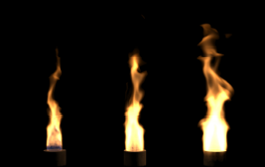
Physical Based Model
  Hot Gaseous Products
    Expansion parameter ρ_{f}/ρ_{h}
ρ_{f}=1.0
ρ_{h}=0.2 0.1 0.02

Slide 15
Physical Based Model
  Mass and momentum conservation require
ρ_{h}(V_{h}-D)=ρ_{f}(V_{f}-D)
ρ_{h} (V_{h}-D)² +p_{h} = r_{f}(V_{f}-D)²+p_{f}
V_{f} and V_{h} are the normal velocities of fuel and hot gaseous
D =V_{f}-S speed of implicit surface direction

Slide 16
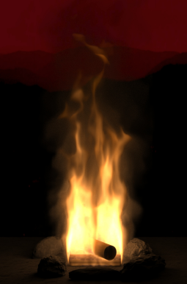
Physical Based Model
  Solid fuel
    Use boundary as reaction front
V_{f}=V_{s}+(ρ_{s} /ρ_{f}-1)S
ρ_{s} and V_{s} are the density
and the normal velocity of solid fuel
Solid fuel

Slide 17
Implementation
Discretization of physical domain into N³ voxels (grids) with uniform spacing
Computational variables implicit surface, temperature, density, and pressure, φ_{i,j,k}, T_{i,j,k}, ρ_{i,j,k}, and p_{i,j,k}
Track reaction zone using level-set methods, φ=+,-, and 0, representing space with fuel, without fuel, and reaction zone
Implicit surface moves with velocity w=u_{f}+s_{n}, so the surface can be governed by
φ_{t}= - w φ

Slide 18
Implementation
Incompressible flow for gaseous fuel and hot gaseous product zone
u_{t}= - (u ) u -
p/ρ +α(T-Tair)z
u=0
(
p/ρ
) =
u*/
t

Slide 19
Implementation
Temperature and density
  T=T_{ignition} for blue zone
  Linear interpolation between T_{ignition} and T_{max} for hot gaseous product zone
  Energy conservation
T-T_{air}
4
T = - (u
) T – C_{t} (
)
T_{max}-T_{air}

Slide 20
Rendering of Fire
Fire: participating medium
  Light energy
  Bright enough to our eyes adapt its color
  Chromatic adaptation
  Approaches
    Simulating the scattering of the light within a fire medium
    Properly integrating the spectral distribution of the power in the fire and account for chromatic adaptation

Slide 21
Rendering of Fire
Light Scattering in a fire medium
  Fire is a blackbody radiator and a participating medium
  Properties of participating are described by
    Scattering and its coefficient
    Absorption and its coefficient
    Extinction coefficient
    Emission
  These coefficients specify the amount of scattering, absorption and extinction per unit-distance for a beam of light moving through the medium

Slide 22
Rendering of Fire
Phase function p(g, ω) is introduced to address the distribution of scatter light, where g(-1,0) (for backward scattering anisotropic medium) g(0) (isotropic medium), and g(0,1) (for forward scattering anisotropic medium)
Light transport in participating medium is described by an integro-differential equation
Emitted radiance
ω L_{λ}(x,w)=f(coefficients, L_{λ}, L_{eλ}, ω)
Incoming direction angle of scattering light
Spectral radiance

Slide 23
Rendering of Fire
Reproducing the color of fire
  Full spectral distribution --- using Planck’s formula for spectral radiance in ray machining
  The spectrum can be converted to RGB before being displaying on a monitor
  Need to computer the chromatic adaptation for fire --- hereby using a transformation Fairchild 1998)

Slide 24
Rendering of Fire
Reproducing the color of fire
  Assumption: eye is adapted to the color of the spectrum for maximum temperature presented in the fire
  Map the spectrum of this white point to LMS cone responsivities (L_{w}, M_{w}, S_{w}) (Fairchild ‘s book “color appearance model”, 1998)
(Xa, Ya, Za)
(Xr, Yr, Zr)
Adapted XYZ tristimulus values
raw XYZ tristimulus values

Slide 25
Animation Result
Domain: 8 meters long with 160 grids (increment h=0.05m)
V_{f}=30m/s A_{f}=0.4m
S=0.1m/s
ρ_{f}=1
ρ_{h}=0.01
Ct=3000K/s
α=0.15 m/(Ks2)

Slide 26
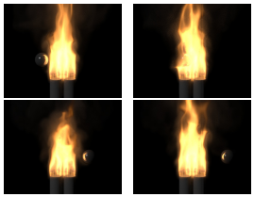
A metal ball passing through and interacts with a gas flame

Slide 27
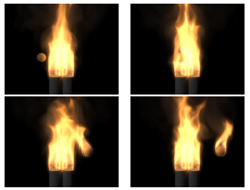
A flammable ball passes through a gas flame and catches on fire
It is time to see several animations!

Slide 28
Animation of Water
Outline
Introduction
Physical Based Simulation Model
Particle -Level-set Method
Rendering of Water
Animation Results

Slide 29
Introduction
Photorealistic simulation of water surface
Treatment of the surface separating the water from air
Two-phase problem
Providing visual impression of water with surface
Key point is to model the surface
Approach: particle level-set method

Slide 30
Introduction
Particle level-set method
  Hybrid surface tracking method using mass-less marker particles combined with a dynamic implicit surface
  An implicit surface imposed to representing water surface during computation.

Slide 31
Introduction
Particle level-set method
  Velocity extrapolation procedure across the water surface into the region occupied by the air.
  Control the behavior of water surface
  Add dampening and/or churning effects

Slide 32
Introduction
Rendering of water
  Relatively easy, since it optical properties are well understood and can be well described.
  Surface tension caused illumination
  There are several algorithms
    Path tracing
    Bidirectional path tracing
    Metropilis light transport
    Photon mapping

Slide 33
Simulation Methods
Liquid volume model (previous model)
Implicit function, φ (<0 water, >0 air, =0 surface) (Foster and Fedkiw, 2001)
φ_{t} + u φ = 0
Particle motion transport equation

Slide 34
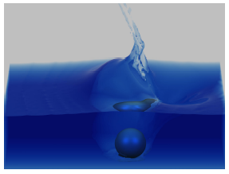
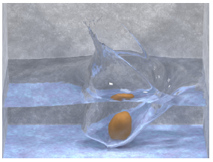
Using previous model
Using modified model

Slide 35
Simulation Methods
Particle Level-set model (modified or particle enhanced level-set model)
Impose two sets (positive and negative particles) on both sides of fluid regions separated by the implicit surface

Slide 36
Simulation Methods
Radius of particle changes dynamics throughout the simulation and is based on level-set function φ.
r_{p} ={
r_{max} if s_{p}φ(x_{p})>r_{max}
s_{p}φ(x_{p})
r_{min}<s_{p}φ(x_{p})<r_{max}
r_{min} if s_{p}φ(x_{p})<r_{min}
Sign function (1 for positive particle and -1 for negative particle)

Slide 37
Simulation Methods
Extrapolation method for air motion
  u_{t} = -N
u
u is velocity in x component
Unit velocity perpendicular to the implicit surface
N

Slide 38
Simulation Methods
equation for fluid motion (N-S)
  u_{t} = -u
1
u+ ν ( u) - p +g
ρ

Slide 39
Simulation Methods
Variables are p , ρ, φ and u
Current surface velocity is smoothly extrapolated across the surface into the air region
Water surface and maker particles are integrated forward in time

Slide 40
Rendering
Physically based Monte Cargo ray tracer capable of handling all types of illumination using photon maps and irradiance caching (Jensen 2001)
Level-set function have two advantages
  Intersecting ray with surface is must efficient, especially for isosurface
  Provide motion of blur in standard distribution ray tracing framework

Slide 41
Two animation results
Pouring water into a glass
Breaking wave
  Theoretical wave solution (Radovitzky and Oritz, 1998) to obtain u(x,y), v(x,y) and η(x,y) (surface height)

Slide 42
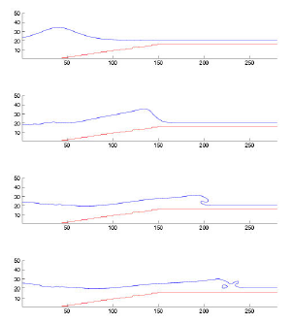

Slide 43
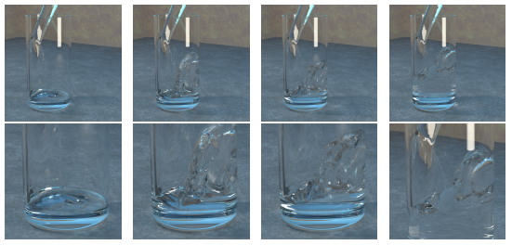
Water being poured into a clear, cylindrical glass (55x55x120 grid cell)

Slide 44
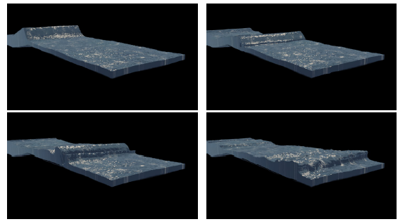
Breaking wave on a submerged shell (540x75x120 grid cell)

