Slide 1
Project Report - FMoT
Kandarp (110050005)
Rohan (110050011)

Slide 2
Aim of our project
Build a working file manager on the terminal
Support for common file manager tasks
Cutting, copying, pasting
Renaming
Deleting
Opening files
Searching for files (pattern-matching supported)

Slide 3
Interacting with FMoT
To run it -> ./fmot
Interface consists of the main window, command window and a few others
Use the arrow keys to navigate
Up/down to move around in the working dir
Left to go to parent dir
Right to enter a directory / open a file
For help with the commands -> press h
When a command is run, the command window changes accordingly

Slide 4
Teamwork Details
Kandarp
FMoT Interface (ncurses)
Menus (self-written), windows, panels
File Management (interface)
Rohan
File Management (system code)
Renaming, moving, deleting, opening files
Searching (database + simple recursive)
Overall contribution -> 50% each

Slide 5
Design Details
Algorithms used
DFS (context: recursive search)
Serialization (context: database building)
Data Structures used
General tree (context: filesystem)
Vector (context: files in working directory)
Libraries / support
dirent (access to underlying filesystem)

Slide 6
Design Details
Libraries / support (contd.)
ncurses (low-level wrapper for controlling the terminal)
Lua 5.2.1 (pattern matching)

Slide 7
Algorithm Design
Problem – make a database of the files on the filesystem
Solution – Store it as a serialized general tree
Explanation
Serialization is the conversion of a data structure in a store-able, recoverable format
In this context, we converted a tree to a general string
Minimizes space taken up by database

Slide 8
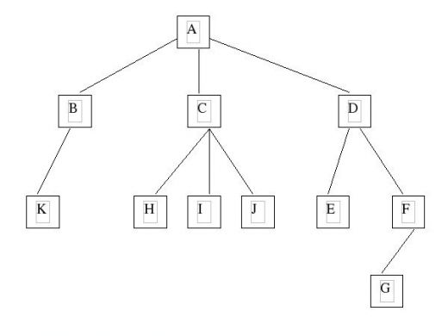
Serialization: tree -> string
When serialized, this tree will become:
A/B/K/\\C/H/\I/\J/\\D/E\F/G\\\\

Slide 9
Serialization explanation
We are storing the tree nodes (in our case filenames) in a single string
Separated by / and \
A/B/ means that B is a child of A
\ means “go up one level”
A/B/\C/ means B is a child of A
But C is not a child of B! It is another child of A
A/B/\C/D/\\E means A has children B C and E, and D is C’s child

Slide 10
Serialization (contd.)
In conclusion:
Build the general tree for the filesystem (‘layered search’)
Serialize the tree
Store the serialized string in a file
Indexed searches will refer to this file (will be updated if necessary)

Slide 11
Algorithm Design (contd.)
Problem – non-indexed recursive search for a filename matching a pattern
Solution – Depth first search starting from the current directory
Each filename is matched against the pattern with a simple Lua script

Slide 12
Class Design
Class Name | Brief Description
customMenu | Contains functions for drawing windows and menus and working with menus (selecting objects, actions to be taken on mouse-click etc.)
database | Contains functions for building a database and recovering the tree from the serialized file and searching through it
tree | General tree class implemented as parents with a pointer to the leftmost child and two to their neighbouring siblings

Slide 13
Source code
Filename | Description | Author
fmot.cpp | Uses the custom menu to present the interface | K
generalTree.hpp | General tree class to represent the filesystem | K
menu&Interface.hpp | Custom menu class | K
fileManagement.hpp | File management functions for the interface | K
fileIndexing.hpp | Database class | K, R

Slide 14
Source code (contd.)
Filename | Description | Author
fileManagementFunctions.hpp | Functions for opening, mmoving, renaming and deleting files | R, K
matchWithLua.hpp | C++ code that calls a Lua script for pattern matching | R
patternSearchScript.Lua | Checks if its arguments pattern-match or not | R
macros | Macros to simplify the code | K

Slide 15
Conclusion
Achieved a working file manager on the terminal
Added support for all the common file management operations

Slide 16
Thank You – Questions?

